Slide 1
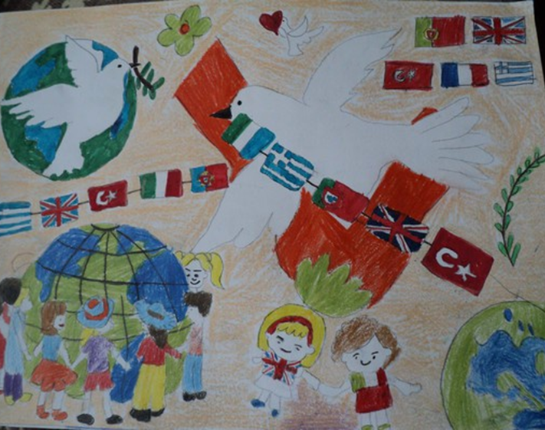
Every Child Matters:
Refugees and Immigrants in Education
3rd Transnational Project Meeting
Tendring Technology College
9th to 13th October 2017

Slide 2
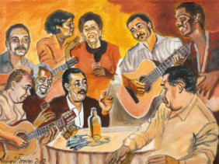
The influence of immigration and refugees on art, music and literature

Slide 3
On the second half of the 1960s, Portugal registered the first arrival of African workers from its colonies who were mainly recruited for construction and manufacturing jobs.
Joining the European Union in 1986 also made Portugal a more attractive destination for non-EU citizens.
The result was a continuous increase in the number of foreign residents, dominated by Africans and, to a lesser extent, Brazilians.

Slide 4
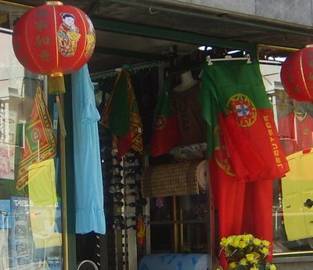
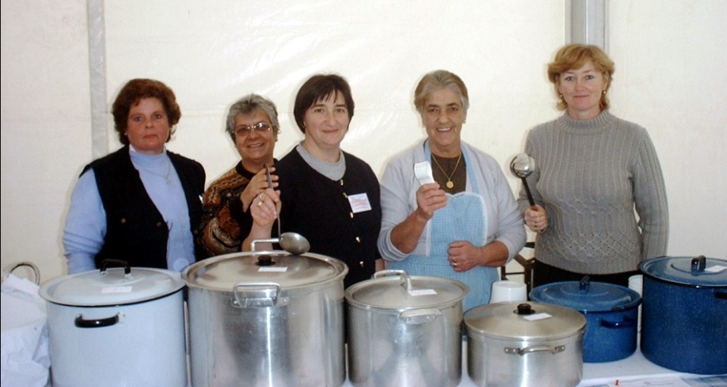
The end of the 1990s was marked by the arrival of thousands of immigrants from Eastern Europe, particularly Ukraine, Russia, Moldavia, and Romania.
A large number of Chinese citizens also chose Portugal as their destination.

Slide 5
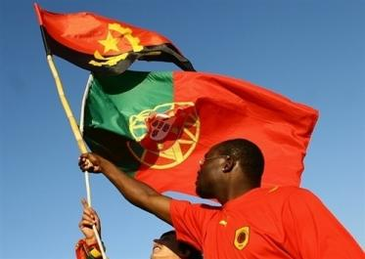
Today Portugal has, through immigration, an important cultural diversity.
However, the most noticed influences in art, music and literature are the ones from immigrants coming from the former Portuguese colonies and from Brazil.

Slide 6
Music from countries like Angola is now very famous in Portugal, specially among young people.
Kizomba and Kuduru were brought to Portugal by immigrants who have mainly settled in Lisbon and surrounding areas.
From there, this type of music and dance invaded the country´s radio stations and clubs.
This music is extremely sensual and it´s danced in pairs or in groups with a specific choreography.

Slide 7
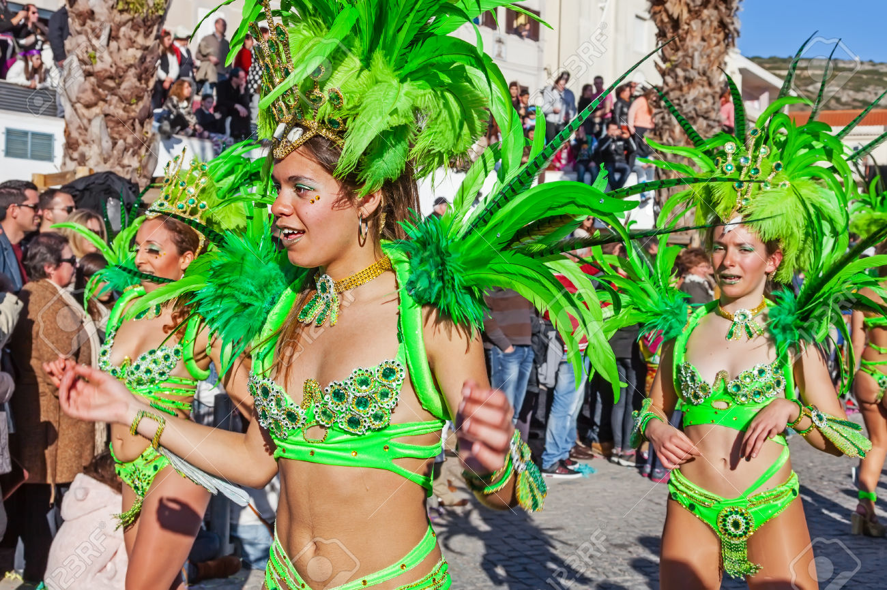
Brazil´s influence is also mostly noticed on music, and Carnival is the time of the year when the warm rhythm of Samba reigns in many Portuguese cities.

Slide 8
Thank you for your attention!

