Slide 1
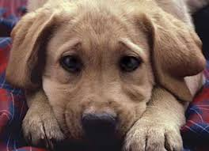
THE DOG.

Slide 2
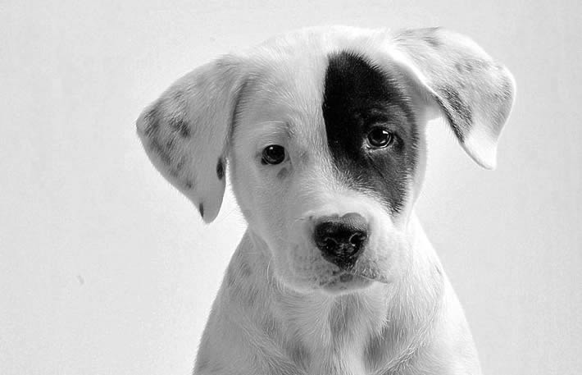
Once upon a time there was a man and his dog that decided to leave Syria to France for a better life.

Slide 3
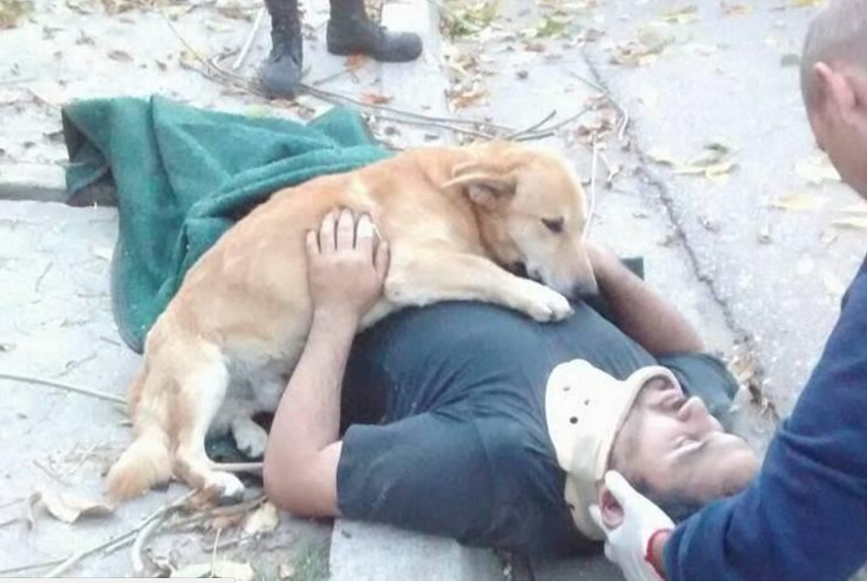
They went to Turkey to catch a boat to Italy and they walked the rest of the way – this took them 3 years!

Slide 4
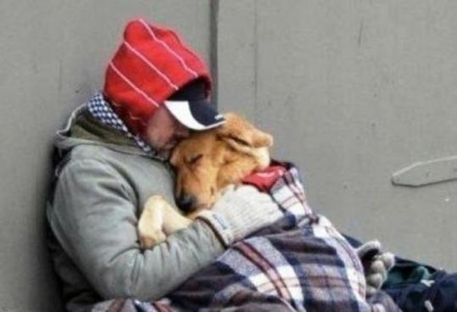
For all of those years the man looked after the dog and the dog looked after the man.

Slide 5
When they got there the dog made sure the man had everything he needed: a house ,a job, food and then he died. The man always remembers his dog!

Slide 6
THE END
Ellie moss
Buse Gok
Irene Miftiou
Gabriela Theologou

