Slide 1
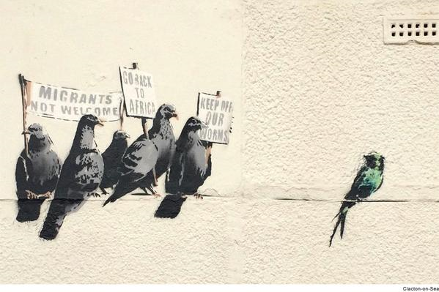
Literature and immigration

Slide 2
The literature of modern Britain reflects the multicultural society of these isles.
For many centuries Britain was subjected to different nations arriving and leaving their influence. Think of the Vikings, the Romans, the Normans and many other cultures that shaped the British society for thousands of years.
People left behind not only their artefacts but their stories too.

Slide 3
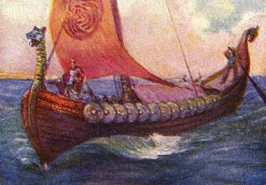
The Anglo-Saxon epic known as Beowulf was written sometime between the 7th century and the early 11th. This tale – set in Scandinavia – depicts a world of heroes, kings and monsters, shedding a unique light on a period of history that we know little about. Nobody really knows who wrote the story, but they had a knowledge of the Vikings.
J.R.R. Tolkien, who was influenced by Beowulf in his creation of his own mythological world, Middle Earth
In Lord of the Rings.
Viking ship

Slide 4
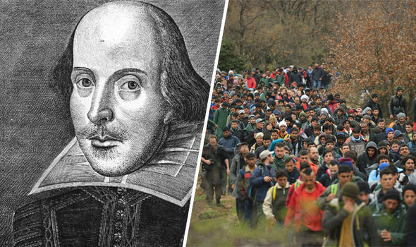
400 years ago Shakespeare wrote a monologue for a play called Thomas More. The character in the play tried to calm down a mob of angry Londoners who tried to attack the local businesses of immigrants who settled in England.
Shakespeare`s play was censored and banned at the time as it wrote about riots in London. Officials feared that the play will cause problems in the streets of London. It was never performed in Shakespeare`s time.

Slide 5
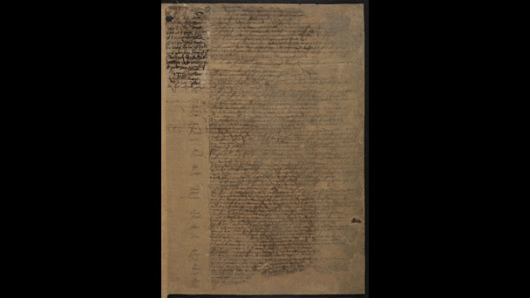
Interestingly the play`s manuscript contains Shakespeare`s own handwriting

Slide 6
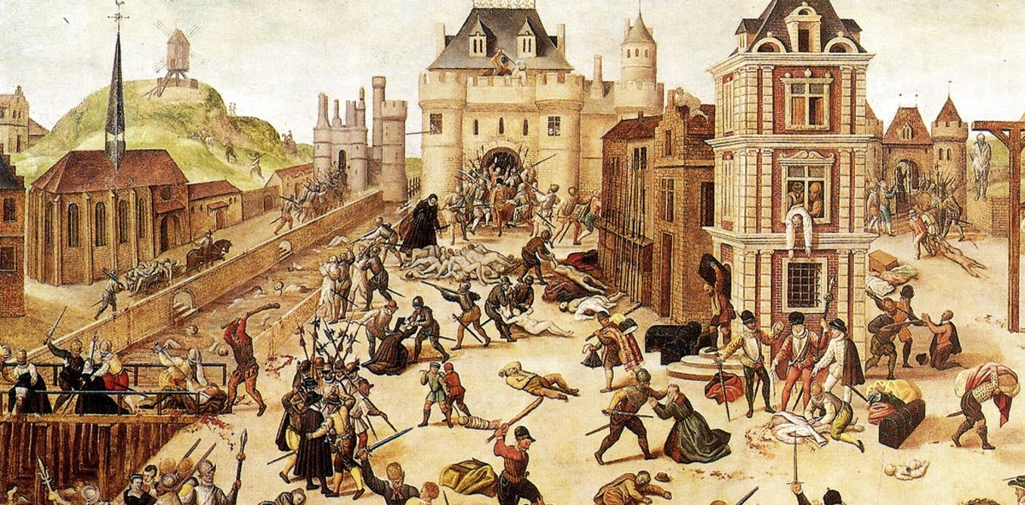
So who did Londoners fear 400 years ago?
The refugees Shakespeare was thinking of were French and Dutch Calvinists, members of Protestant minorities persecuted by contemporary Catholic governments in France and the Southern Countries. Those asylum seekers were known in England as “aliens” or “strangers”.

Slide 7
Thomas More is asked to step in and calm the angry crowds in London. He delivers a speech:
“As but to banish you: whither would you go? What country, by the nature of your error, Should give you harbour? Go you to France or Flanders, To any German province, Spain or Portugal, Nay, anywhere that not adheres to England, Why, you must needs be strangers, would you be pleas’d To find a nation of such barbarous temper That breaking out in hideous violence Would not afford you an abode on earth. ”
Ian McKellen Soliloqui start at 1min

Slide 8
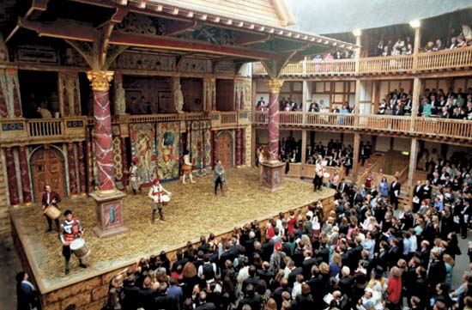
Thomas More asks if the rioters were suddenly banished to a foreign land, they would become ‘wretched strangers’ too, and equally vulnerable to attack.
The theatre audience were to imagine what it would be like to be an asylum-seeker.

Slide 9
20-21st century writers
There are lots of literary figures who emerged from the old colonies of the British Empire.

Slide 10
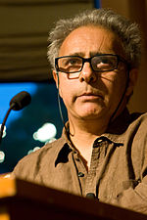
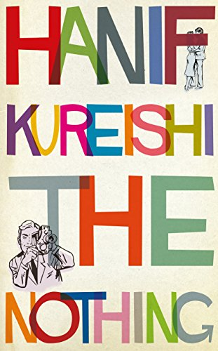
One such famous writer is Hanif Kureishi. Born to a Pakistani father and an English mother in London, he is considered one of the 50 greatest British writers since 1945. He wrote a number of novels, stories and plays, winning lots of awards.

Slide 11
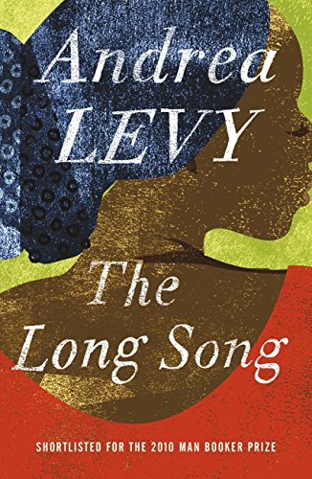
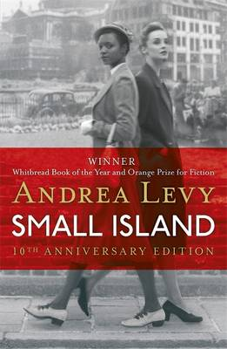
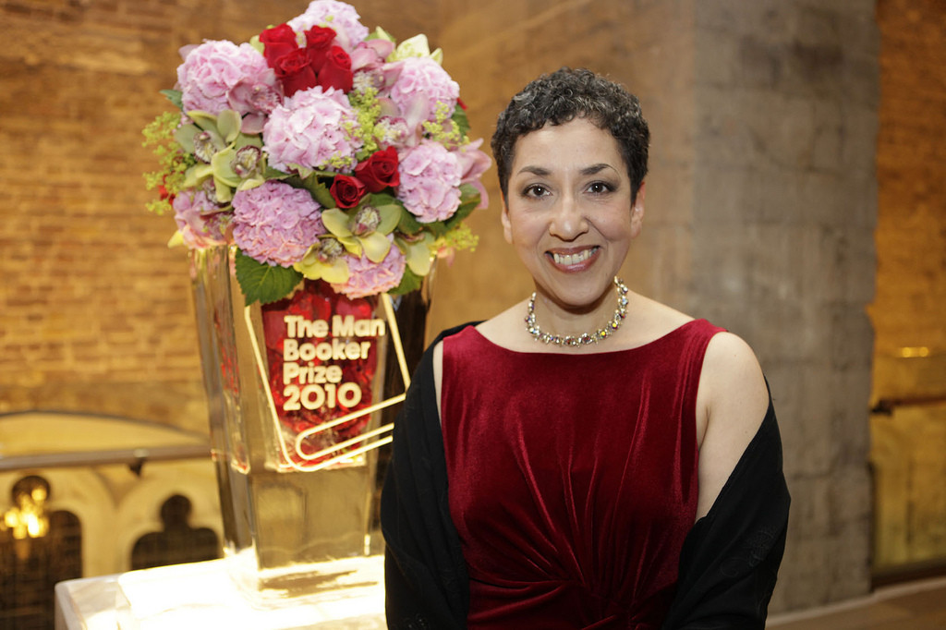
Another such writer is Andrea Levy, a British author born to Jamaican parents with a Jewish Paternal grandfather and Scottish maternal great grandfather. Her stories revolve around the experiences of migrant children growing up in England. This includes her novel Small Island which won the Orange prize for fiction as well as the Whitbread book of the year in 2004.

Slide 12
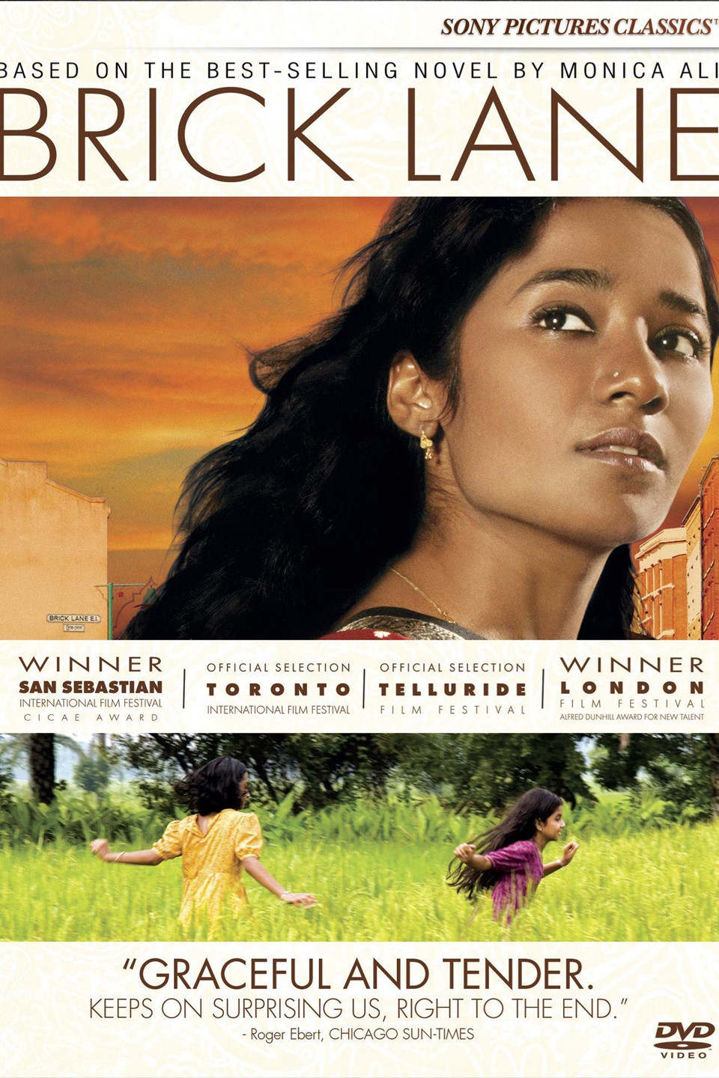
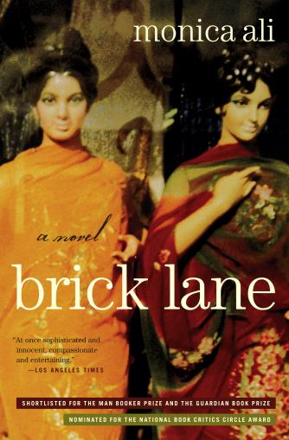
Monica Ali is a British writer of Bangladeshi origin whose debut novel ”Brick Lane” was nominated for the Man Booker Prize in 2003. She graduated at Oxford. Her first novel was so successful that filmmakers adapted it for cinema.
Book to Screen

