Slide 1
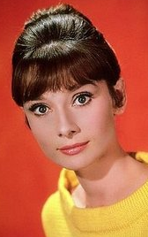
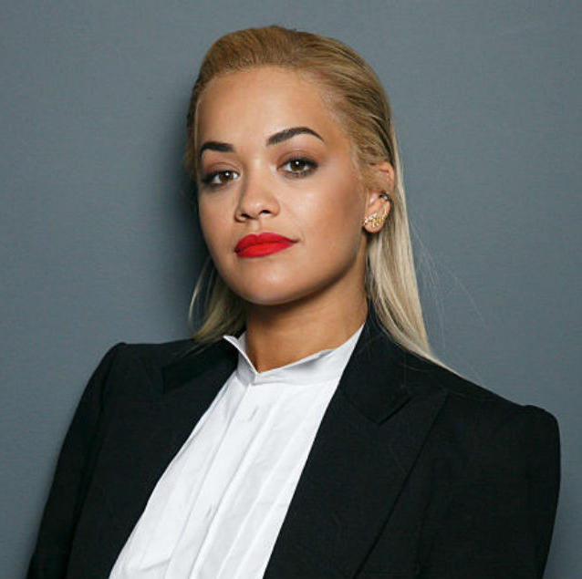
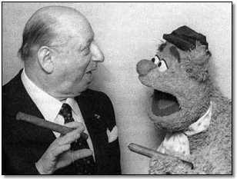
Famous immigrant musician in the UK.

Slide 2
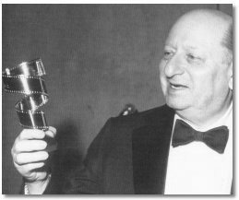
Lew Grade
BORN IN: CRIMEA
BIRTH DATE: 25TH DECEMBER 1906
DATE MOVED TO UK: 1912, AGE 6
PROFFESION: ENTERTAINER

Slide 3
Lovat Winogradsky was born on 25th December 1906 in Tokmak, a small village near the city of Odessa, close to the Black Sea in Crimea. His parents were called Golda and Isaac. They met whilst they were touring Ukraine as singers.
In 1912 Isaac decided that it was safer for the Winogradsky's to immigrate to England rather than stay in Russia, where Jewish families like them were being persecuted at the time. Isaac went ahead of the rest of the family, to prepare for Golda, Lovat and his younger brother, Boris, to follow three months later.
On arrival at Tilbury Docks in the UK, the officials, who would often change the names of immigrants to that of names they found easier to pronounce, decided that Lovat would become Louis and Boris would hence forth be known as Barnet. Oddly enough, the more difficult sounding Winogradsky (the literal translation of which is 'the town where wine is made') remained unchanged.

Slide 4
The Winogradsky's first home was in Brick Lane in the East End of London, an area where many other immigrant families settled on arrival. Although his parents had left Russia with a reasonable amount of money, they had lost a lot of it due to gambling and so had to work a range of jobs to support the family . However, he and Golda found that there was still a demand for their particular brand of entertainment and would often perform on stage at the Mile End Pavilion, where they would sing songs from the 'old home' for the largely immigrant audience.
In 1914, at around the time that World War 1 broke out, the family moved to the Bethnal Green / Shoreditch area and into a block on what was then known as The Boundary Estate. However, in 1917 the family (which now included baby brother Leslie) were evacuated following a German air-raid, and moved to Reigate. Louis was a promising student and by the time he was twelve he found himself in the highest class in the school thanks to his photographic memory -as well as a superb understanding of maths.

Slide 5
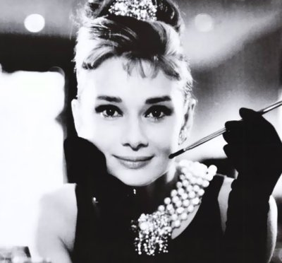
Audrey Hepburn.
Born in: Ixelles, Belgium
Died: 20 January 1993, Tolochenaz, Switzerland
profession: actor and musician
Quotes:
Nothing is impossible, the word itself says 'I'm possible'!

Slide 6
Audrey Hepburn was born on May 4, 1929 in Brussels, Belgium. Her mother, Ella van Heemstra, was Dutch and her father, Joseph Victor Anthony Hepburn-Ruston, was born in Úzice, Bohemia, of English and Austrian descent, and worked in business. After her parents divorced, Audrey went to London with her mother where she went to a private girls school. Later, when her mother moved back to the Netherlands, she attended private schools as well. While she was on holiday with her mother in Arnhem, Netherlands, Hitler's army took over the town. Audrey suffered from depression and malnutrition during the Nazi occupation.

Slide 7
After the liberation, she went to a ballet school in London on a scholarship and later began a modelling career. Then the film producers came calling. In 1948, after being spotted modelling by a producer, she was signed to a bit part in the European film Dutch in Seven Lessons(1948). By the end of the sixties, she divorced from actor Mel Ferrer. Then she decided to retire while she was on top. Later she married Dr. Andrea Dotti. In 1988, Audrey became a special ambassador to the United Nations UNICEF fund helping children in Latin America and Africa, a position she retained until 1993. After this her last film was ”Always” in 1989. Audrey Hepburn died on January 20, 1993 in Tolochnaz, Switzerland, from appendicular cancer. She had made a total of 31 high quality movies in her time.

Slide 8
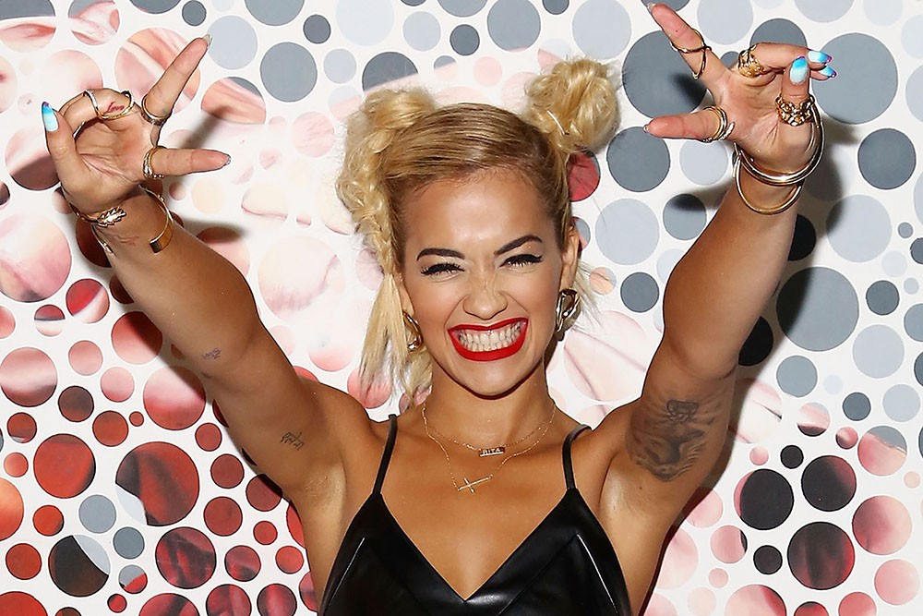
Rita Ora.
Born in: Pristina, Yugoslavia
Birth date:1990
Date moved to uk:1991
profession: singer and musician

Slide 9
Rita Ora is a British singer-songwriter. She was born in 1990 in Pristina, Yugoslavia, which is now known as Kosovo, to Vera (Bajraktari) and Besnik Sahatçiu. She is a granddaughter of director Besim Sahatçiu. When Rita was one, her family moved to the United Kingdom. She grew up in West London and attended St Cuthbert and St Matthias CE Primary School in Earls Court, after she graduated from Sylvia Young Theatre School and then St Charles Catholic Sixth Form College. She began singing from a young age. In 2004, she appeared in her first British film. She auditioned for Eurovision: Your Country Needs You on BBC One to be the British contestant for the 2009 Eurovision Song Contest but later decided to leave the competition after a few episodes as she did not feel ready. In 2007, Ora had her first music release when she appeared on Craig David's track called "Awkward" and then again in 2008 on "Where's Your Love", she also appears in the music video. Ora began singing in bars in and around London, In 2009, Ora was in the video for "Young Forever" and "Over" by Drake. Ora caught the attention of Jay Z and he quietly signed her to Roc Nation, in which she was featured in a commercial for Roc nation.
She still continues her career in music today.

