Slide 2
MIGRATION
Migration is called for people to leave temporarily or permanently from one place to another . It has usually 4 reasons.
CAUSSES OF MIGRATION:
Natural causes
Economic reasons
Social reasons
Political reasons

Slide 3
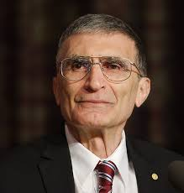
Aziz SANCAR
1946-Mardin,Turkey
2015 Nobel Chemist Award

Slide 4
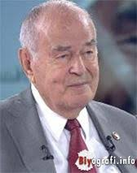
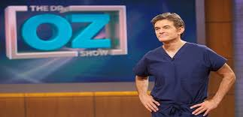
Prof. Mustafa ÖZ Heart Surgeon 1925-Konya,Turkey
Prof. Mehmet ÖZ
Heart Surgeon

Slide 5
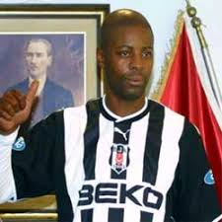
Pascal NOUMA
1972,France
Former professional footballer
in PSG,Marseille,Lille,Caen
DJ, radio programmer, advertorial player

Slide 6
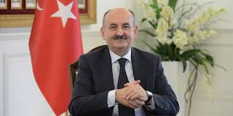
Mehmet MUEZZINOGLU
1955 - Κομοτηνή,Greece
The Minister of Labor and Social Security

Slide 7
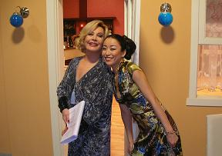
Ayumi TAKANO
1988- Tokyo,Japan
Series player

Slide 8
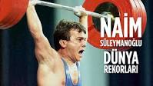
Naim SULEYMANOGLU
1955- Bulgaria
1988,1992,1996 Olympics Weighlifting Gold Medal

Slide 9
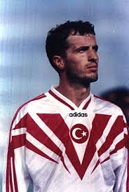
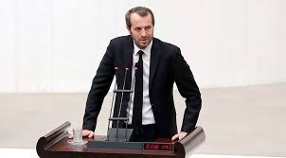
Saffet SANCAKLI
1966-Tutin,Serbia
former professional national team footballer
Now senator in The Parliament

Slide 10
A few examples from the world
Albert Einstein, scientist
Regina Spektor, singer
Marlene Dietrich, actress
M.I.A. , singer
Alek Wek, model
Gloria Estefan, pop singer
Iman, model
Rita Ora, pop singer
Freddie Mercury, singer

