Slide 1
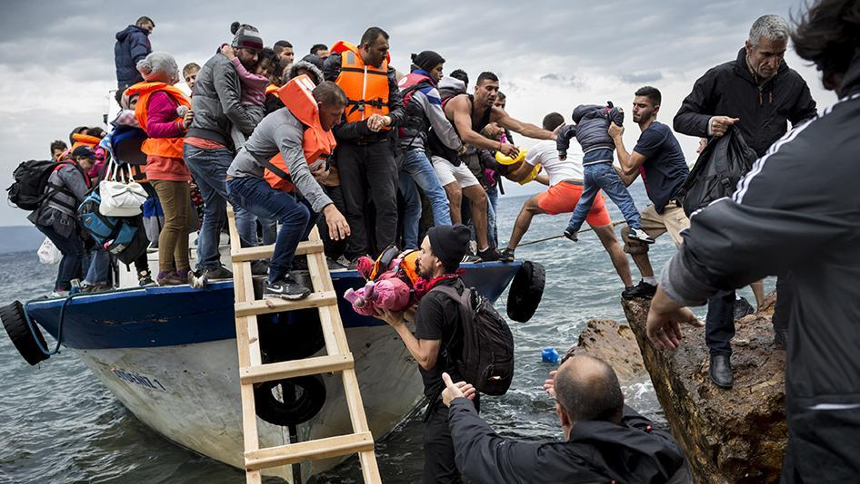
The lost child

Slide 2
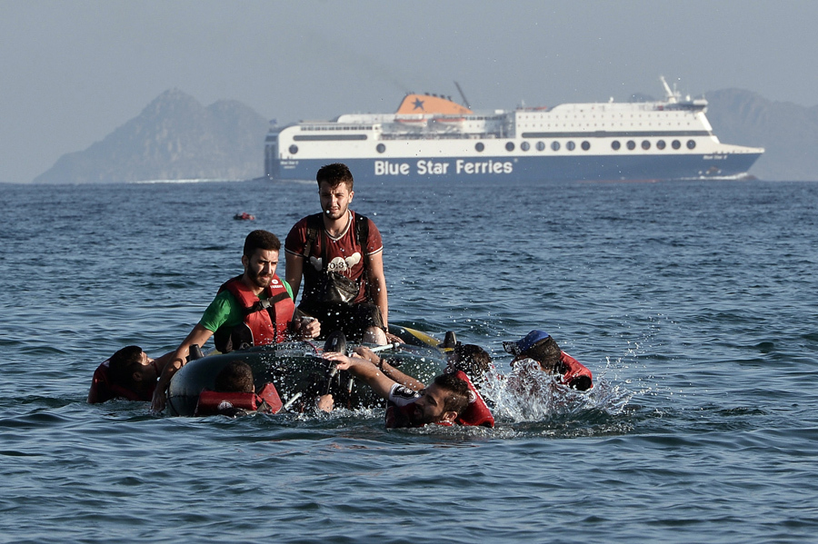
Once upon a time, there was a family that left Syria in search of a better life: free from war. They left in a boat but they soon got into trouble in the sea. The boat, which was carrying too many people, began to sink and they were seperated…

Slide 3
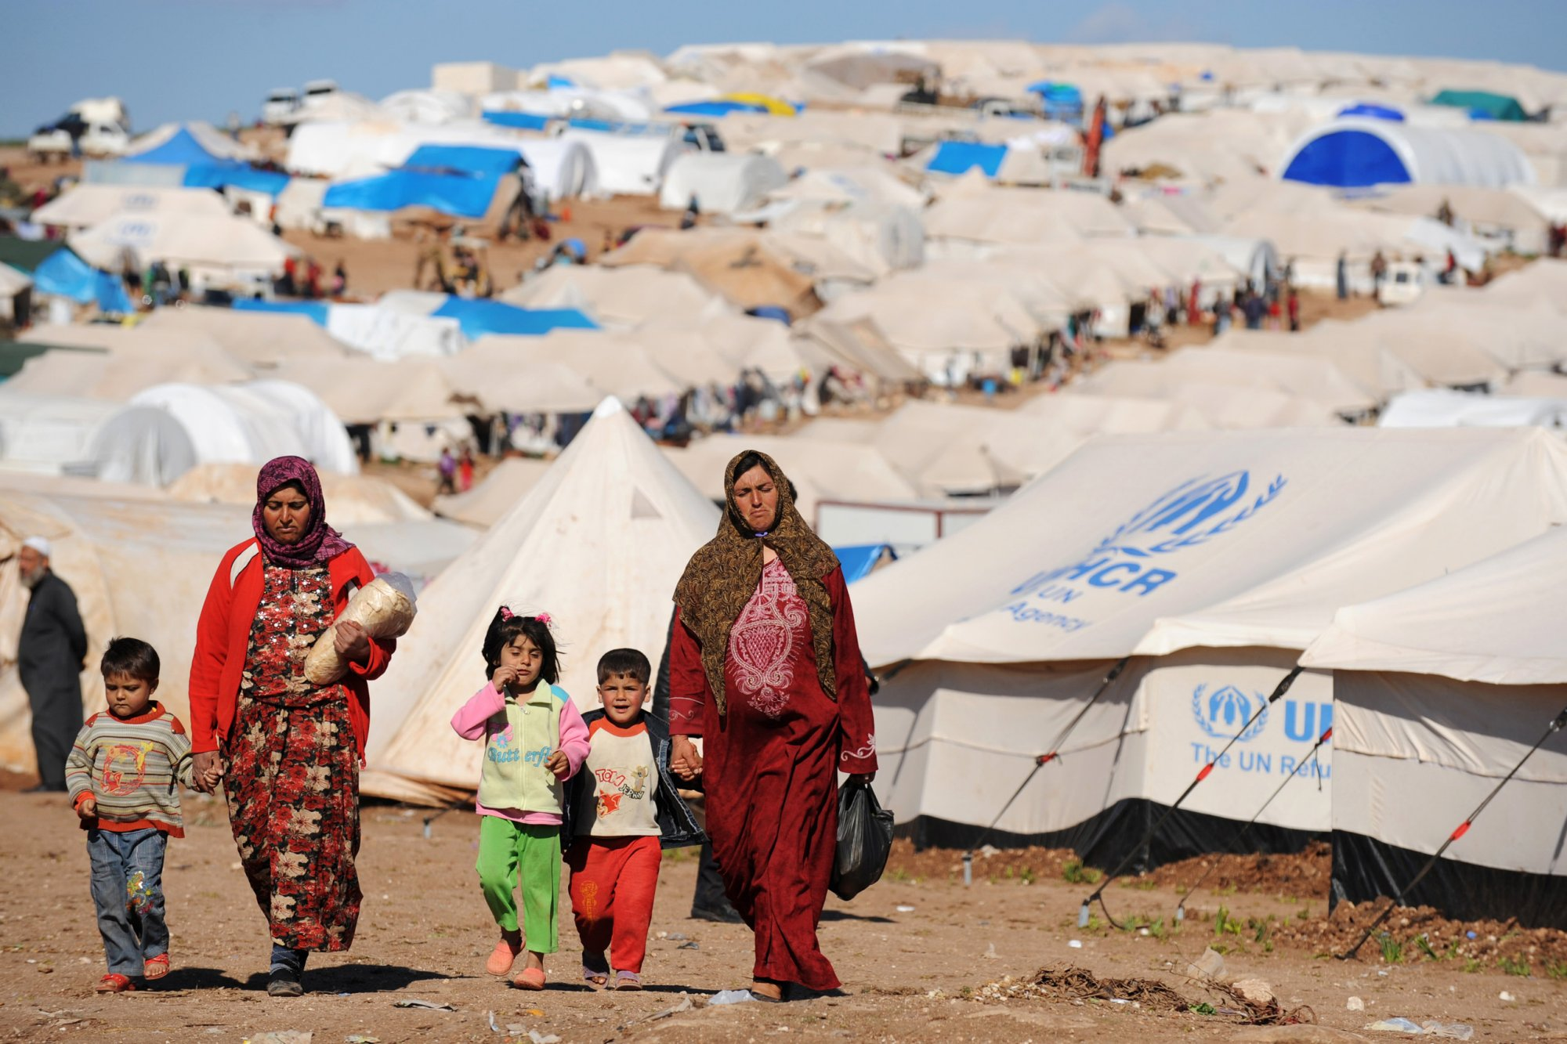
As the boat was pulled a shore, they parents couldn't find their child! The volunteers advised them to go to a camp, so as the hopes of finding their child were lost; they did so.

Slide 4
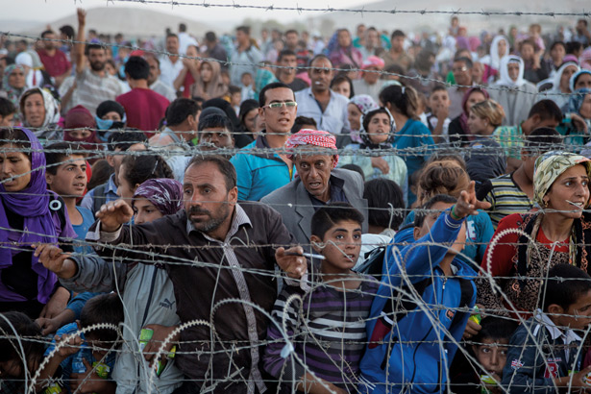
Two weeks passed and the family was still one child missing. They tried to move on in their lives but it was hard.They had tried everything they even put a picture of him the local newspaper but it was no use.

Slide 5
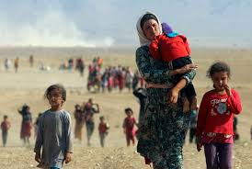
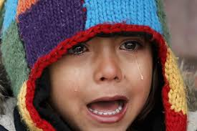
Soon the family left the camp to go to Germany. At the borders they saw a small child clinging on to the fence and, as they grew closer, they realized who it was- they were reunited.

Slide 6
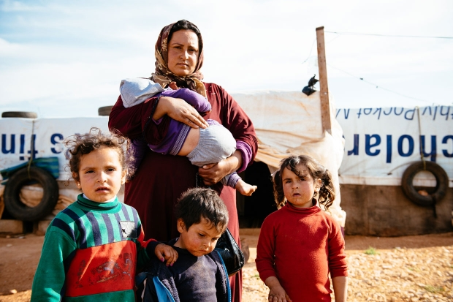
The family continued their journey to Germany altogether…

Slide 7
THE END
Ellie moss
Buse Gok
Irene Miftiou
Gabriela Theologou

