Slide 1
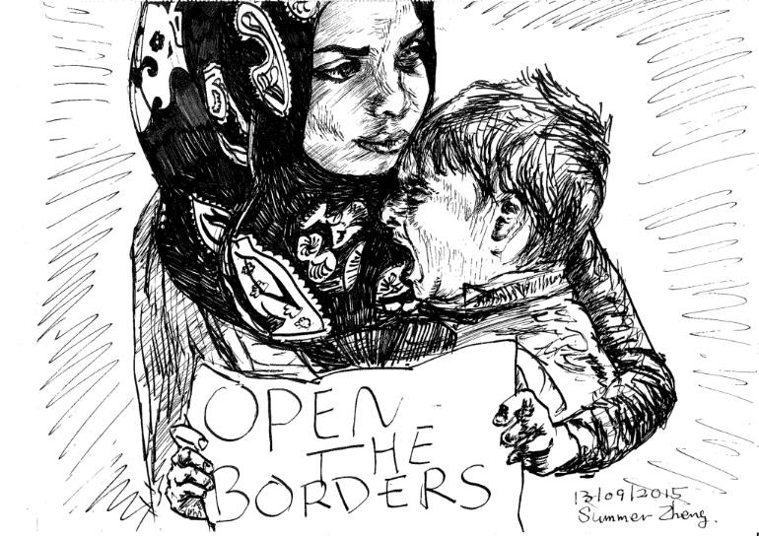
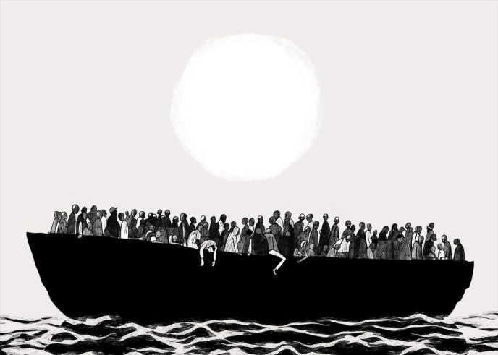
On the Sea
The boat was full of people, it was cold, but I covered him with what I had. Maybe this is the last moment with my son, I know that the weather was about to get worse and the boat could not bear so many people for long. At one point I heard a noise and the ship split in two suddenly.
That's when I started thinking about everything I've lived, from the day of my marriage to the birth of my son, I remember how good it was to keep him in my arms. But it all ended when the first bouts of war were felt.
Suddenly, the boat began to get water from all sides, we heard screams of children crying and people in panic. Not counting the boat turns and we were taken by the huge ocean,… I just wanted to save him, to ensure that he was safe, but I can’t take anymore ...
Giuseppe La Rosa
Joana Santos
Marta Silva

