Slide 1
Mohamed and Hassan’s Journey

Slide 2
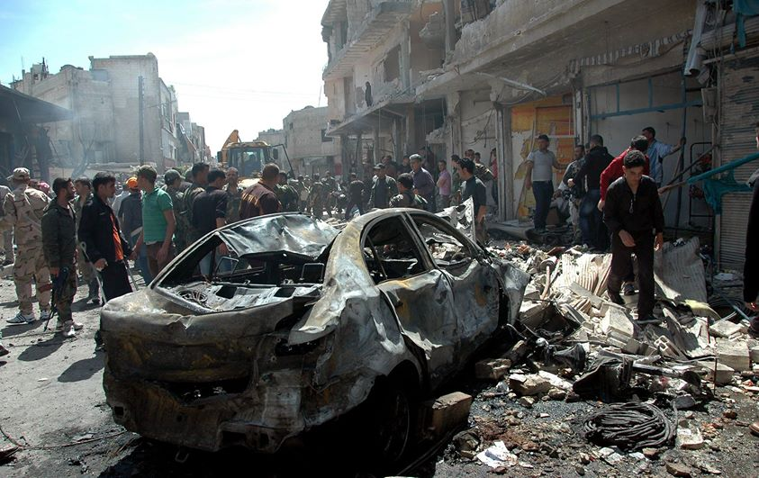
I was separated from my family years ago when the bombs started to be dropped, in Syria. At the time I was six years of age and lived with my mother, two sisters and my elder brother. I remember hearing cries of pain and seeing people crawl from the rubble. I couldn’t hear or see my mother, or my sisters. My brother was sitting on a bench when I spoke to him he did not reply, so I sat by him and we waited whilst men began to pull others from the debris. Eventually we were approached by a man, he sat by me and mumbled, “I’m so sorry but you’re mother and sisters are gone.” We were then left alone in the street surrounded by dead loved ones and torn up families.
There was nothing left, we were forced to leave and find somewhere new to live. Hassan and I overheard others speak of lands far off past the sea, we did not know what to do so the best decision we could think of was to follow them.

Slide 3
The days were long we did not stop, the heat was intense and children and babies always were moaning and crying for food and water, though there was not much, often people fought for the last crumbs of food, and the remaining water. People suffered very much and there were occasional deaths. Usually young children, or the weak and sick. Elders decided to stay behind as they were too old to go with the journey. At night it was very cold the complete opposite to the day time. People would wrap themselves in what they had, hugging each other for warmth.
As the days passed everyone was weak and tired, Hassan had not spoken for the past five days, he was weak, I feared for his life and his survival. Often I had to mime my sentences to him, though he did not ever reply, when I think back I see it all differently, his anger and disappointment. Many had had their money and valuables taken from them; occasionally people were robbed in the night, whilst sleeping.

Slide 4
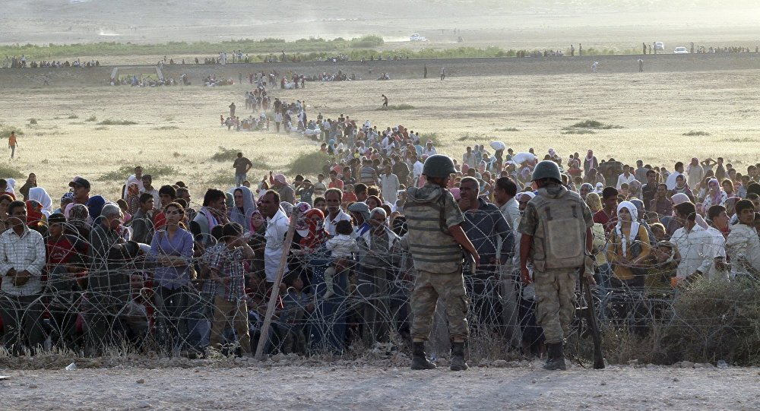
We waited till night, the border was still guarded, so we had to sneak past being as quite as possible. All the younger children were held, their mouths covered by hands to prevent noise. Hassan looked at me the worry and confusion in his eyes makes me cry even to this day as it was to be the last time we would ever see each other.
No one waited as soon as you were over the border everyone rushed, women holding onto their children, men carrying all they had. I couldn’t see Hassan, fear struck me like a blade, cutting through my heart, my pulse raised… I began to cry.

Slide 5
It seemed like hours but only moments later a woman with two young children grabbed my arm and pulled me, I constantly stumbled and tripped I did not know her, and her grip was strong. I didn’t remember falling asleep or going into a building but in the morning we all woke up in a large bare room, full of people and families. I was still with that woman she was sitting next to me with her baby in her arms and her five year old girl came over to me. Her name was Amira, she had long dark hair and was wearing a dark purple burkha. As she approached me I hesitated, then her mother called her over , she looked at me and smiled. I looked away, I did not Know her, I missed my mother, my sisters and Hassan. Some people in simple white tops came in and gave everyone food and water. I ate ravenously. And filled my belly up with water so much that I felt like a balloon. That day people were separated into groups, families stayed together and all the children without parents, including me, were taken to schools and all went to live in an orphanage, until we were taken in by either other Syrians or Turkish people.

