Slide 1
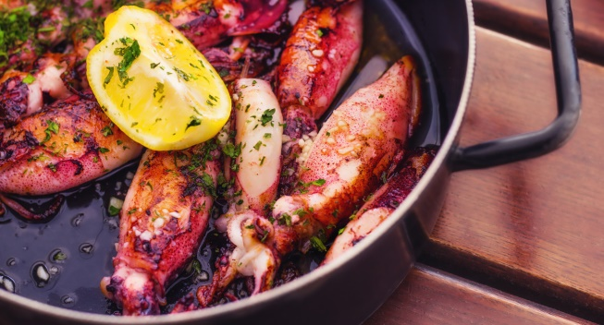
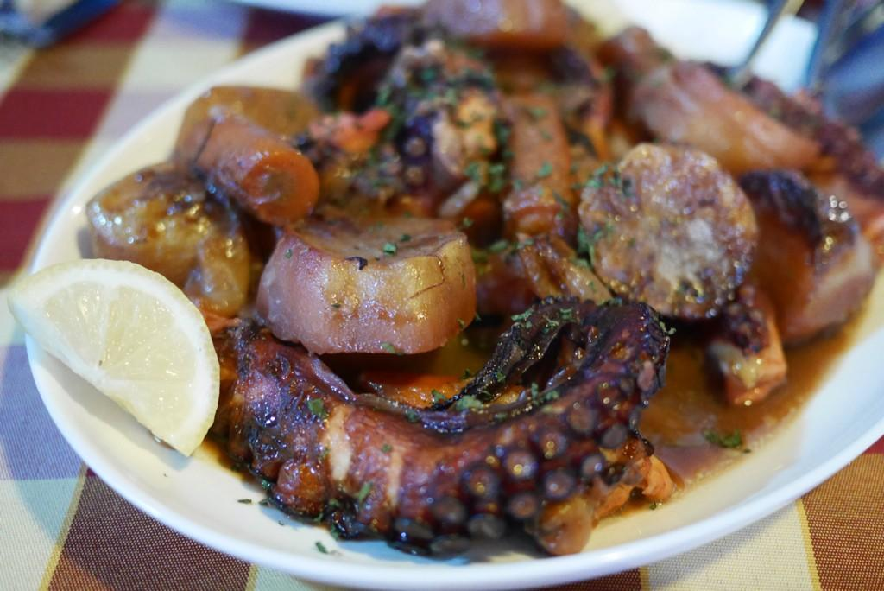
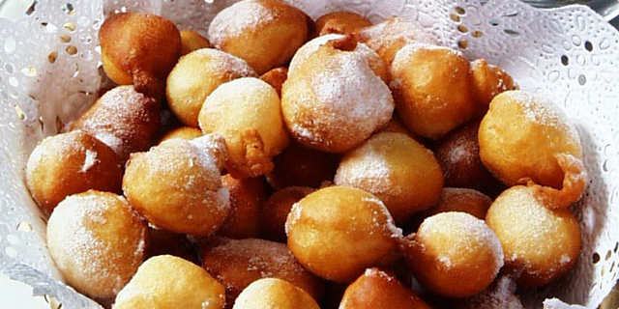
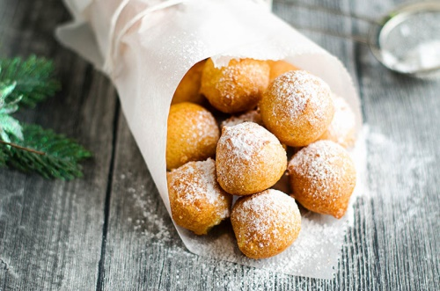
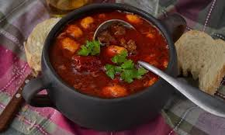
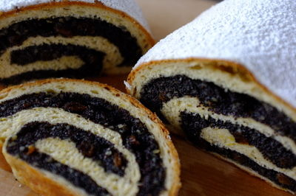
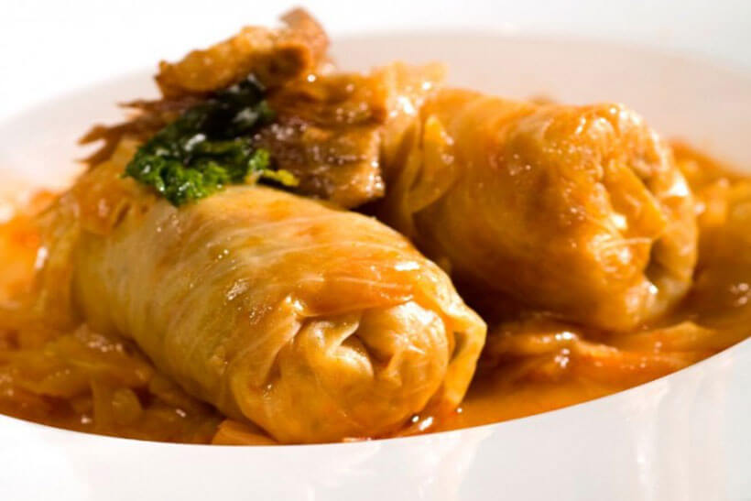
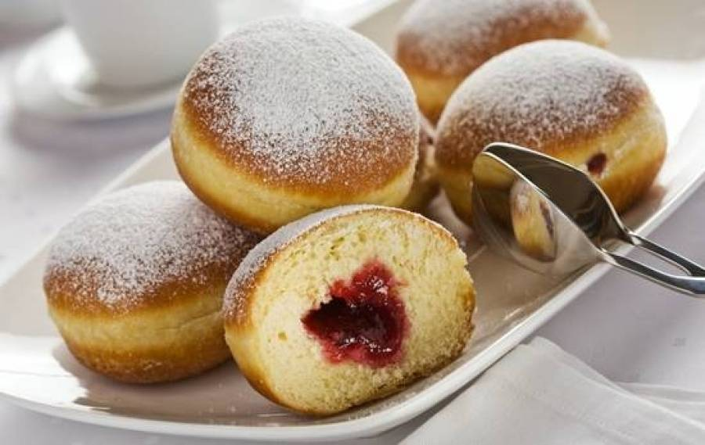
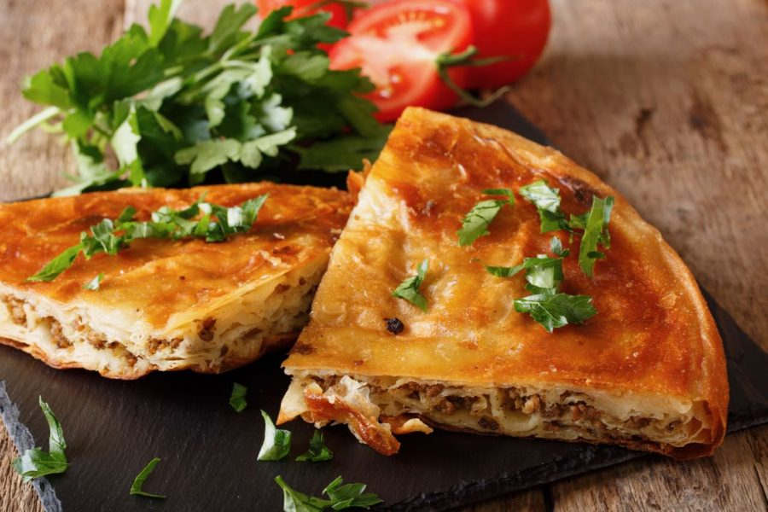
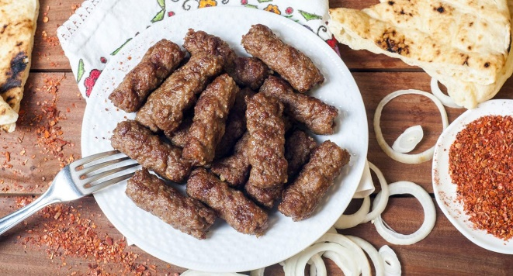
CROATIAN FOOD

Slide 2
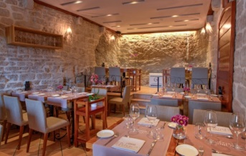
What is traditional Croatian food?
That’s a great question to ask when traveling to a new country and wanting to try the best of the local cuisine.

Slide 3
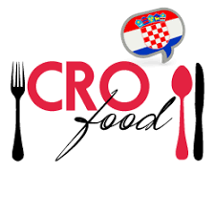
Croatian food has many influences.
Many come from Italy, Turkey, Hungary....
This influence has shaped croatian food over the generations .

Slide 4
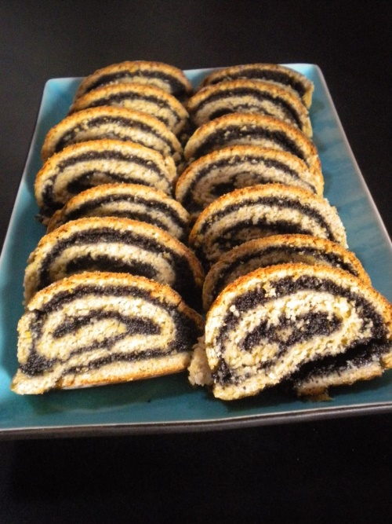
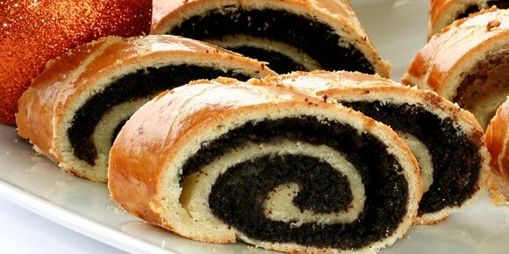
Sweet food typical for croatia
makovnjaca (this is a traditional Croatian dessert, most often it is eaten for Christmas)

Slide 5
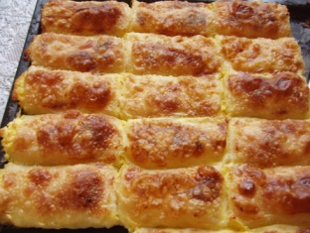
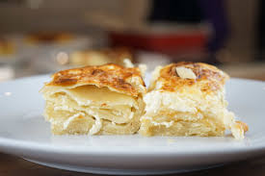
Struklji ( zagorski štruklji, most often Croatian food served in north Croatia )

Slide 6
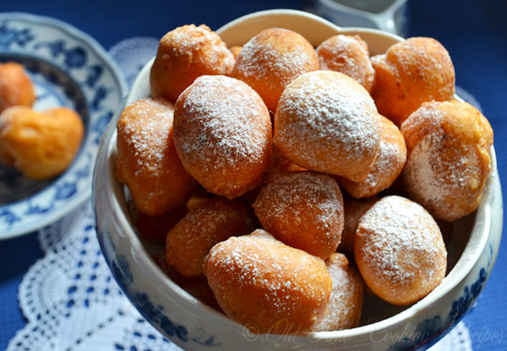
Croatian fritters ( fritule, Croatian desert, they are chruncy on the outside and soft and fluffy inside)

Slide 7
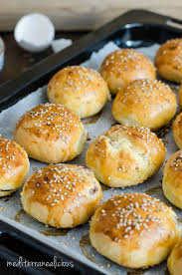
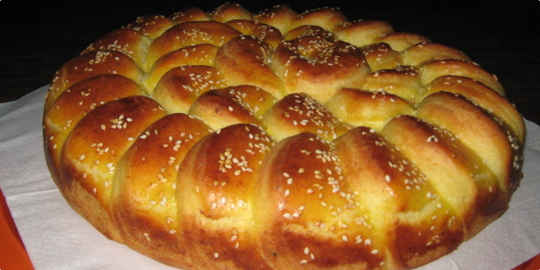
Pogaca ( pogaca is a savoury bread/ pastry eaten in Croatia )

Slide 8
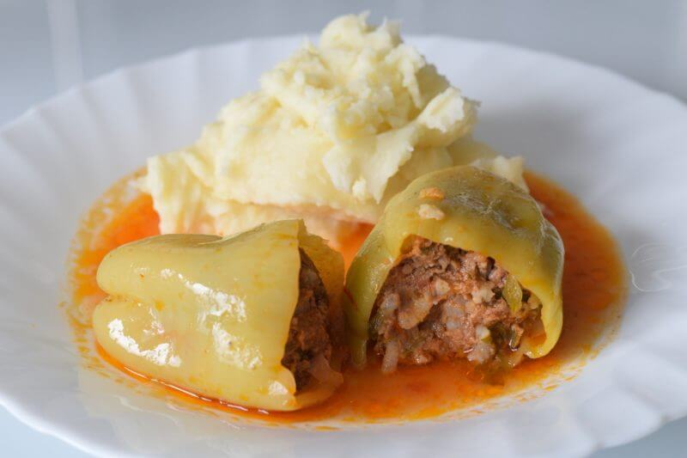
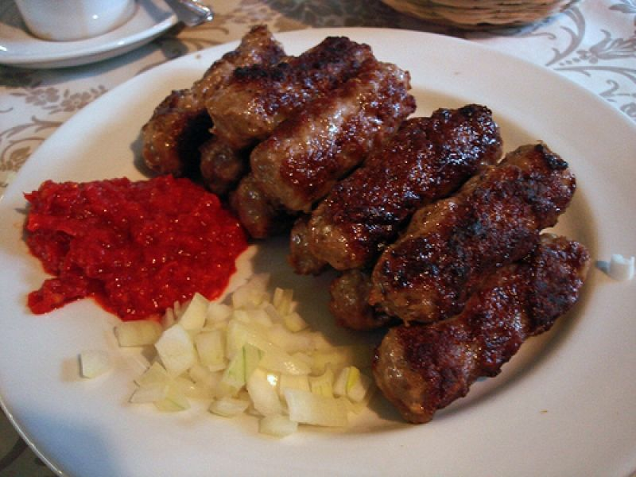
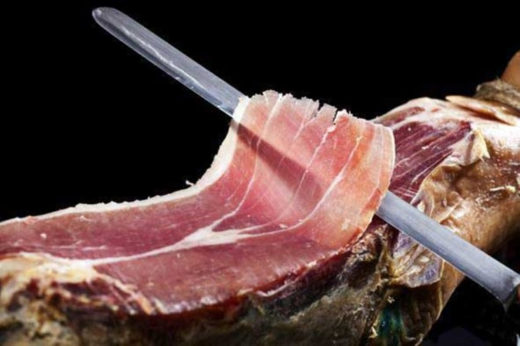
Meat typical for Croatia
sarma( meat wrapped in cabbage)
Čevapi
pršut

Slide 9
Made: Elena Draganić, 7.c

