Slide 1
Energy hunt
Erasmus+ project:
Energytech Journey
Základní škola a Mateřská škola Klíč s.r.o., česká Lípa, Czech Republic
9th March 2022

Slide 2
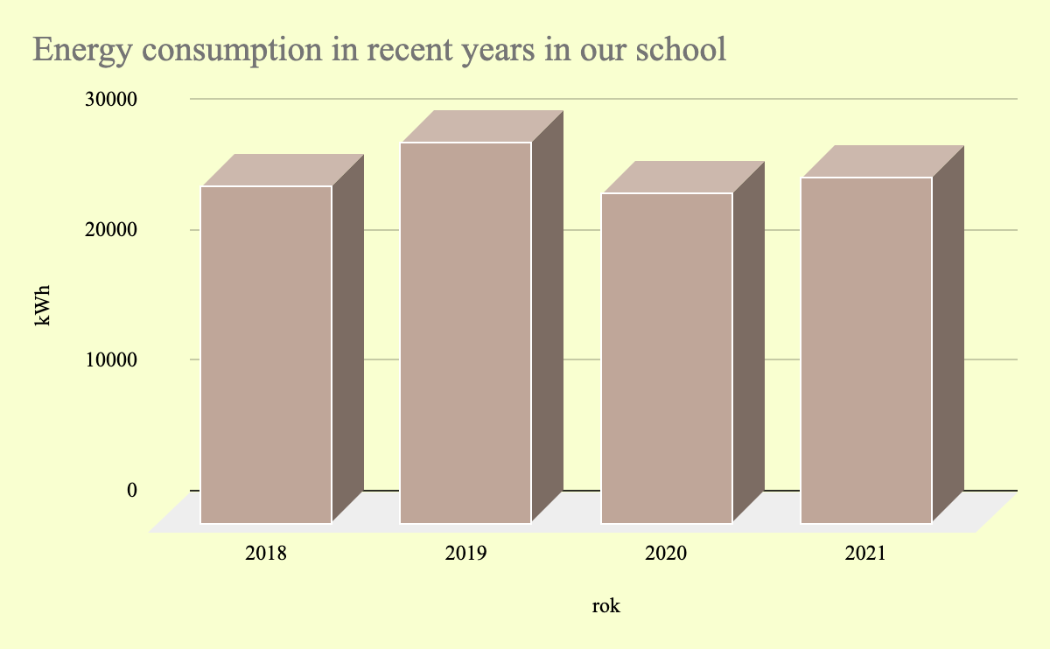
Energy consumption in our school
2020 the lowest - Covid
year | kWh
2018 | 25 849
2019 | 29 230
2020 | 23 266
2021 | 26 439

Slide 3
Light sensors - saving time when the lights are ON
In our school
3 in corridors
2 in locker rooms
Suggestions
where the sensors could be to save energy
4 in toilets
1 in corridor

Slide 4
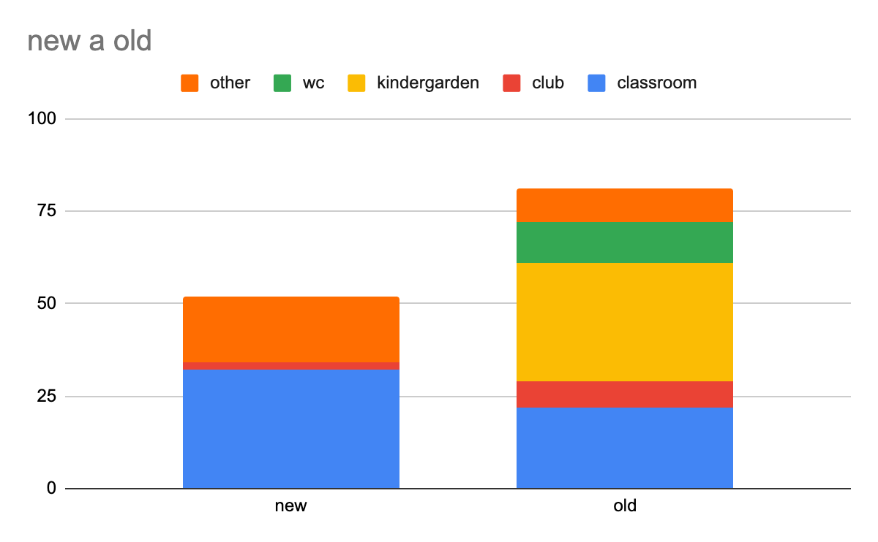
Lights
in the building
new - 38 kWh/year
old - 91 kWh/year
Changing all the lights
saves: 4 293 kWh/year
it is almost 2 months

Slide 5
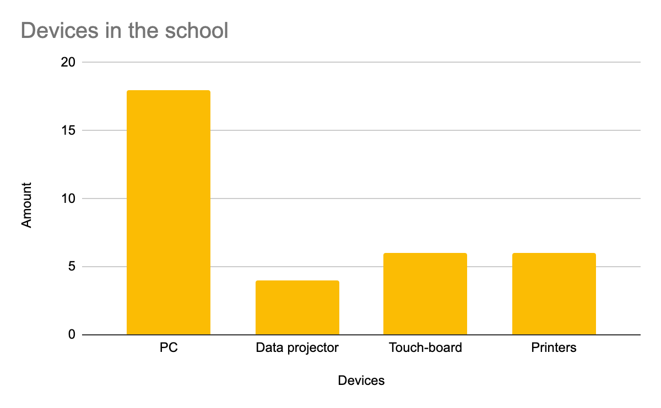
Devices in the classrooms
How to save energy:
turn off when you leave
turn off when you do not use them
when you leave for holidays do NOT leave them on Stand-by

Slide 6
We asked teachers
What can you do to save electric energy in the school?
Turn off the lights in the classroom when they are not needed
Turn off the lights when leaving
Turn off all the devices when you are leaving for home

Slide 7
Research was done by
Nikola
Emma
Ondřej
Ondra
Sam
Honza
Daniela
Oník
pupils from grade 5
with the support of
their teachers:
Petra Plíhalová
Lenka Drobná

