Slide 1
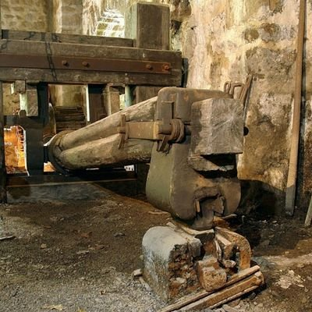
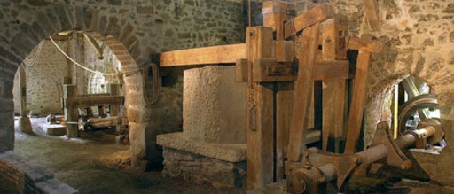
HOW DID SOME FACTORIES WORK WITHOUT ELECTRICITY?
OLD FACTORIES USED NATURAL POWER: WATER, WIND, FIRE…AND SIMPLE MACHINES THAT DIDN´T NEED ELECTRICITY

Slide 2
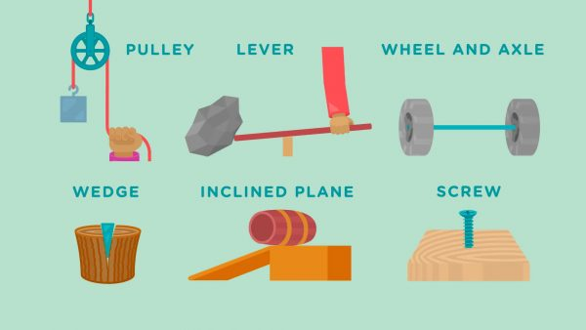
We learned about simple machines. There are 6 types: lever, inclined plane, screw, wedge, pulley, wheel and axel.

Slide 3
Simple machines are the base of many common and useful objects

Slide 6
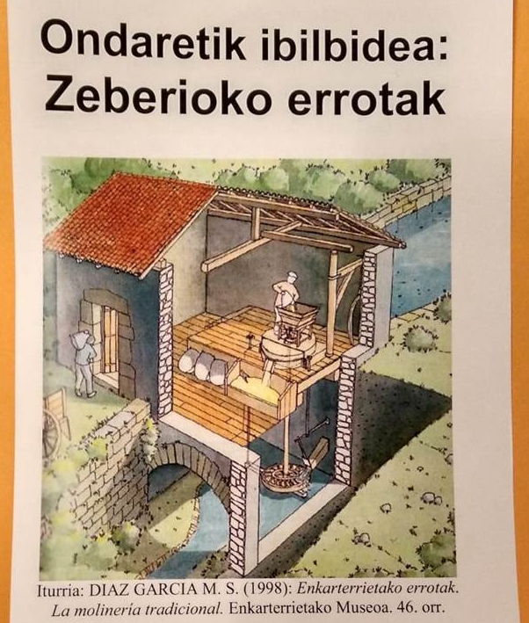
We learned about 2 different factories very common in our area: watermill and iron foundry

Slide 7
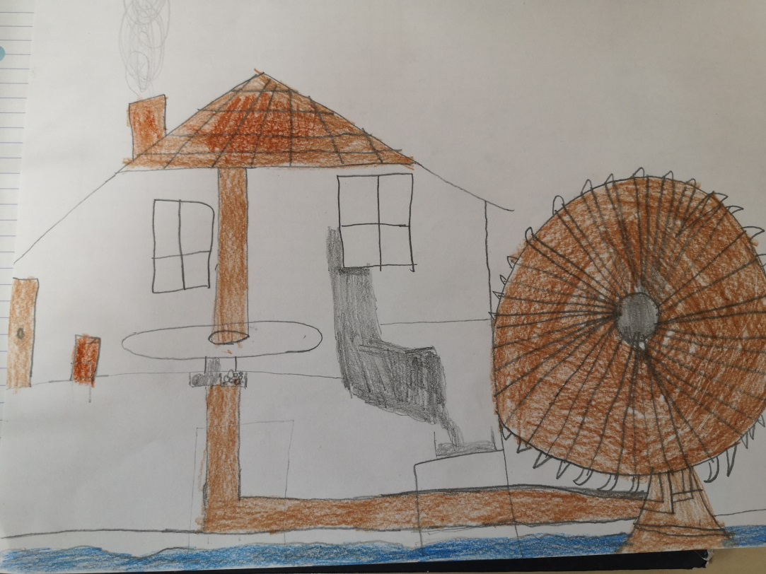
We followed these steps:
WATERMILL
First we drew on a piece of paper how we thought a watermill worked

Slide 8
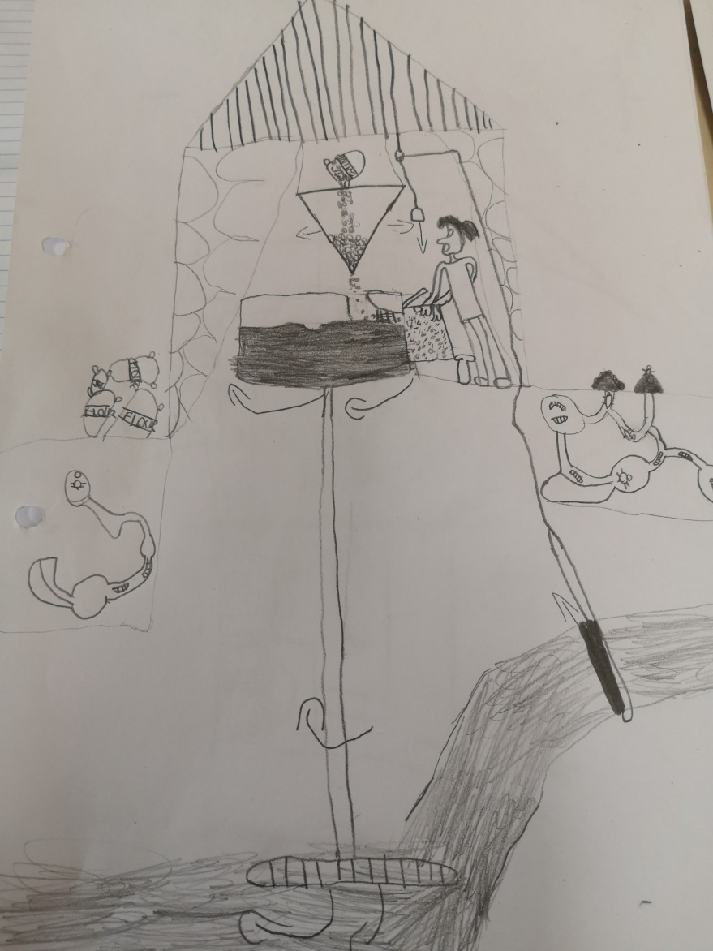
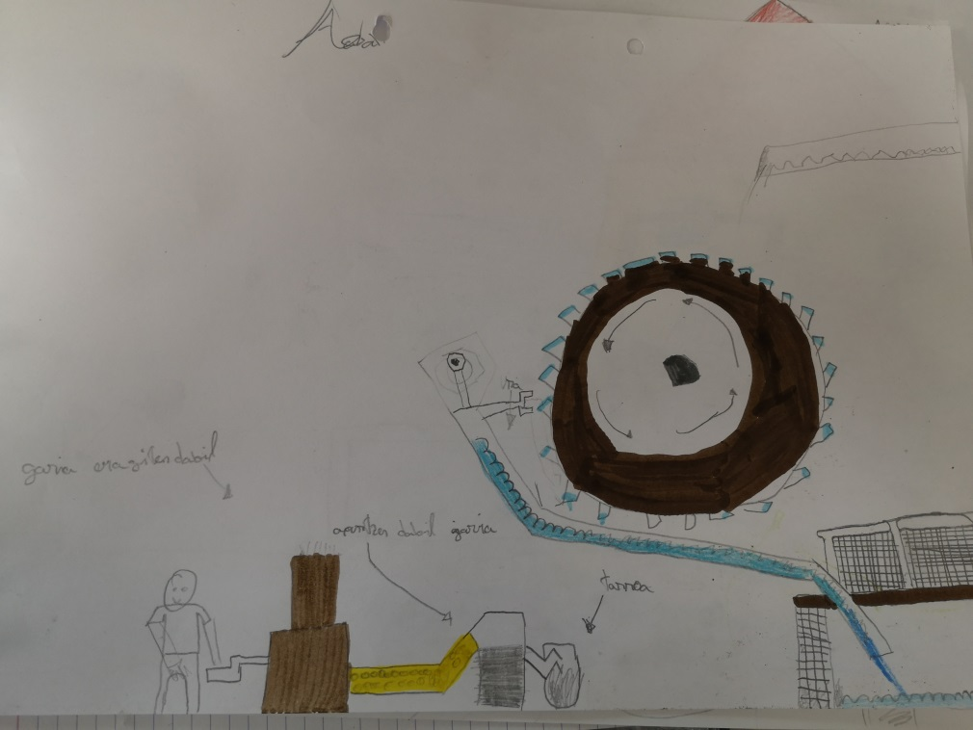
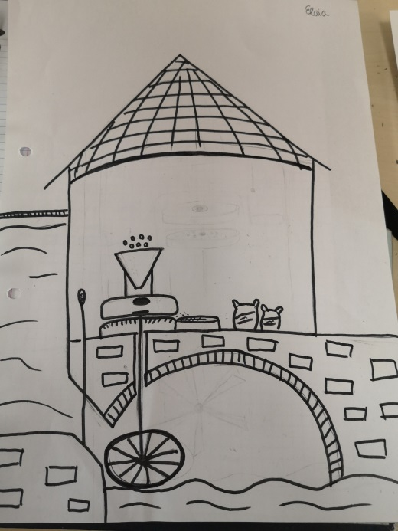
Some examples

Slide 9
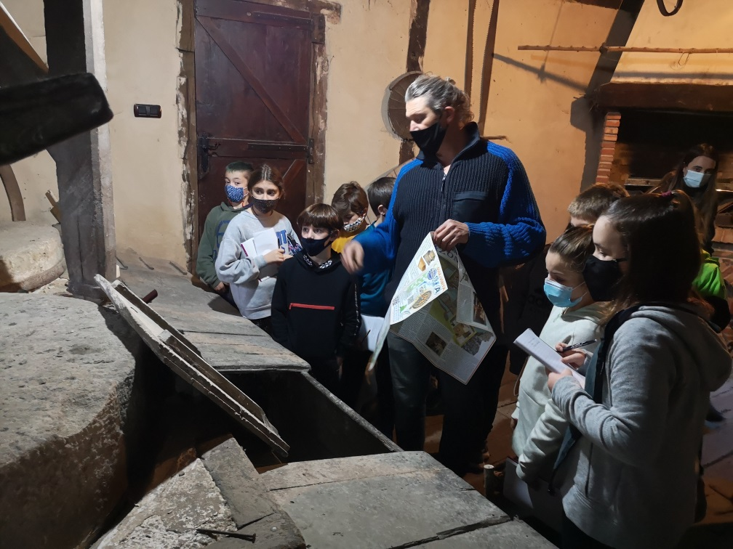
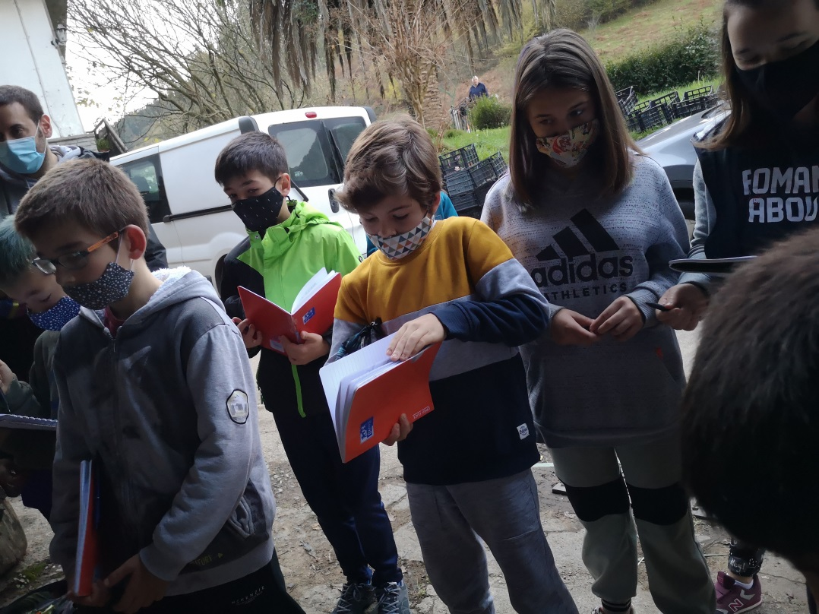
Next we visited a watermill

Slide 10
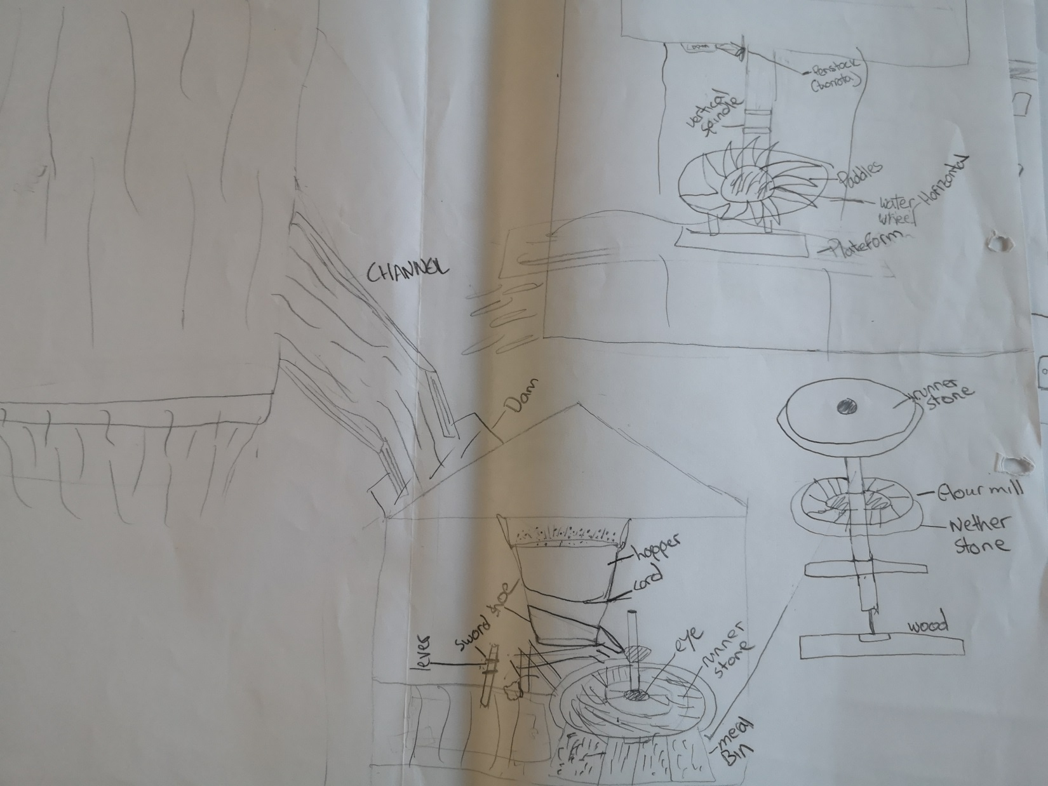
Then we made a diagram of a watermill with all the different parts. We named the parts in english

Slide 11
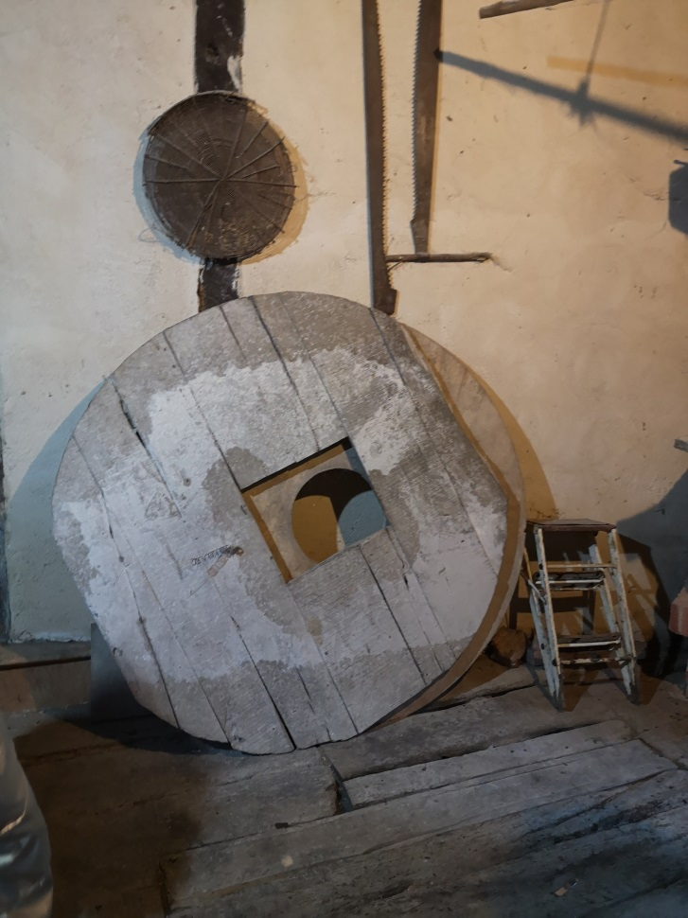
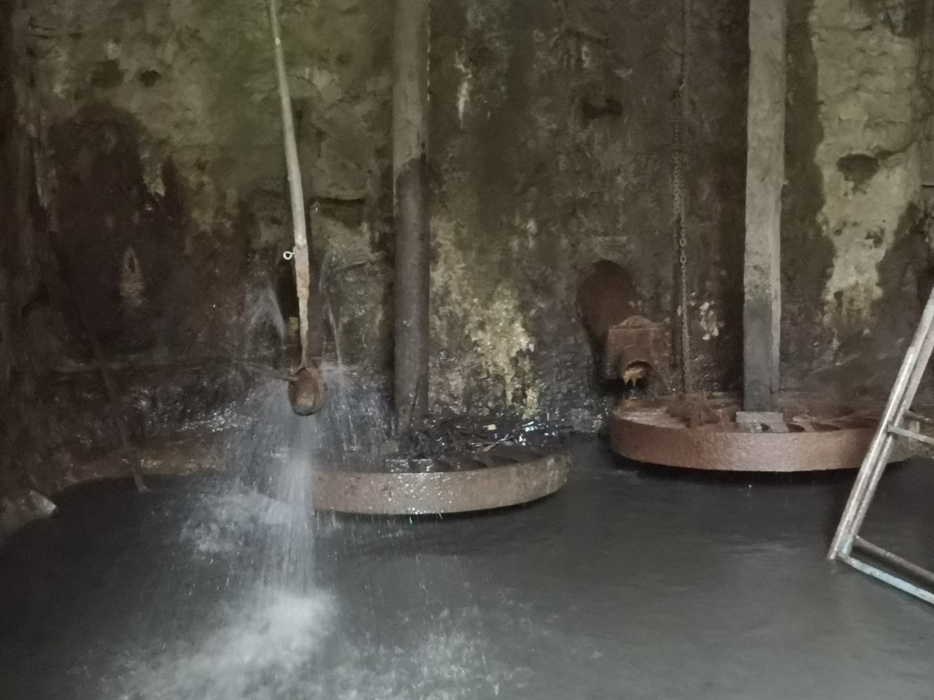
We identified a lot of simple machines: lever, screw, wheel and axel, pulley…

Slide 12
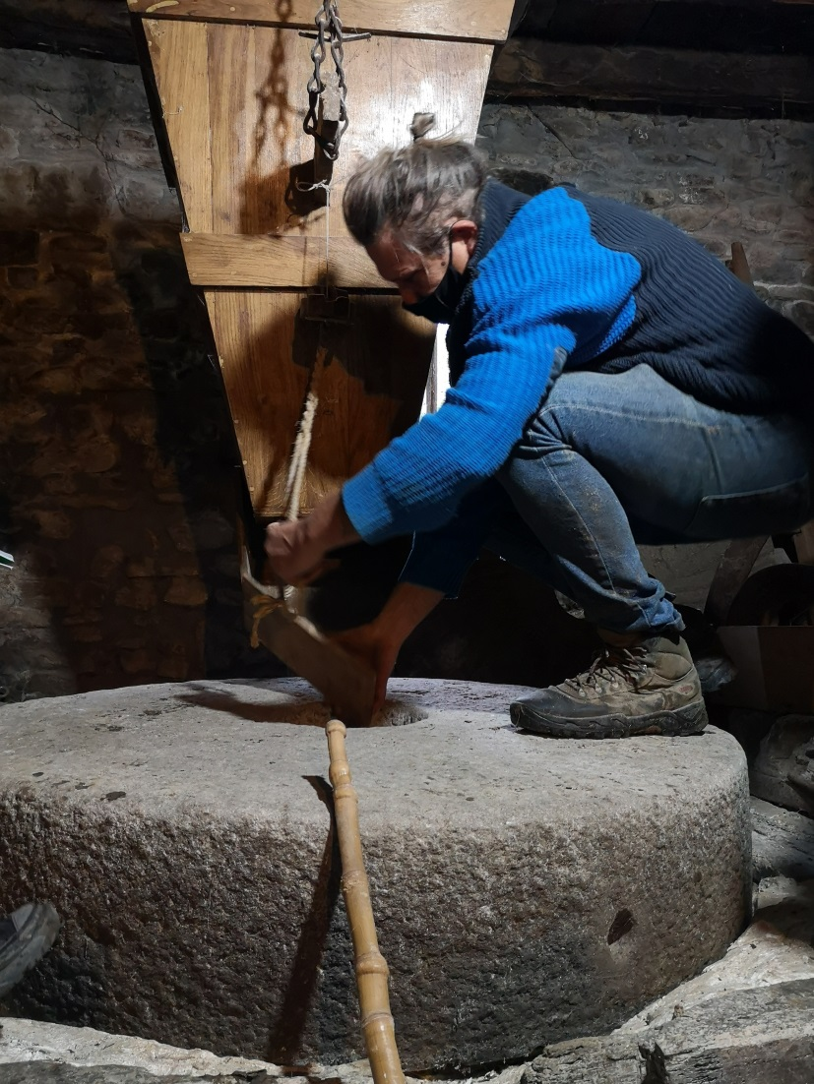
Finally, we wrote a text about how a watermill grinded the grain to produce flour

Slide 13
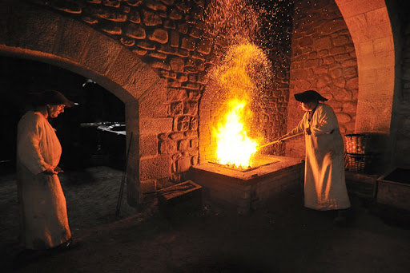
IRON FOUNDRY
We watched a video about a famous old foundry in the Basque Country:Mirandaola
https://youtu.be/VqIsd_cMoxs

Slide 14
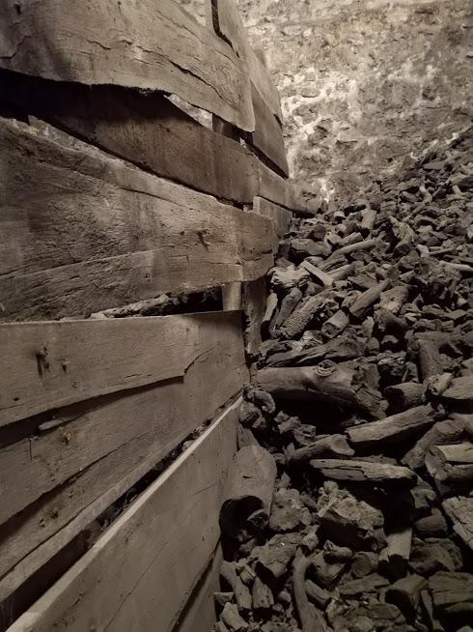
In a foundry, they used: iron mineral, water, and fire to produce iron. There was a lot of iron mineral in our country and there were a lot of woods to get charcoal for the fire. But how did they get the charcoal?.
We wrote a text about how it worked

Slide 15
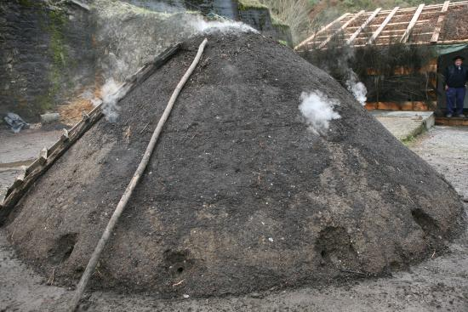
TXONDORRA
They used to make a “ txondorra”.

Slide 16
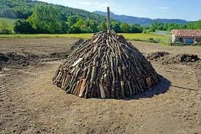
We watched a video about how a “ txondorra” was made and we wrote a text about the video
https://youtu.be/JtwWXf-D1fY

Slide 17
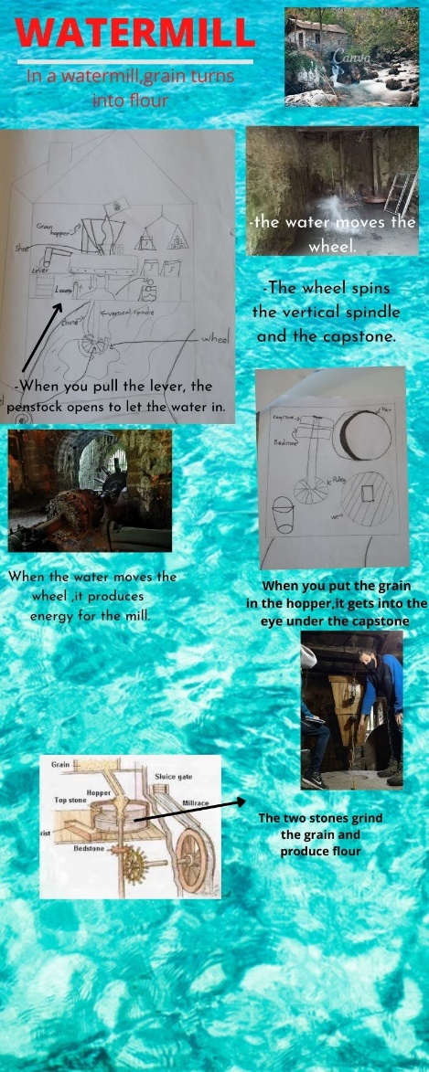
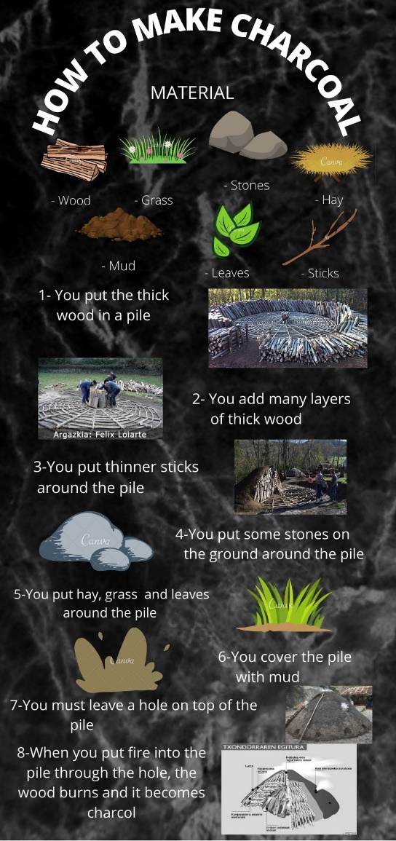
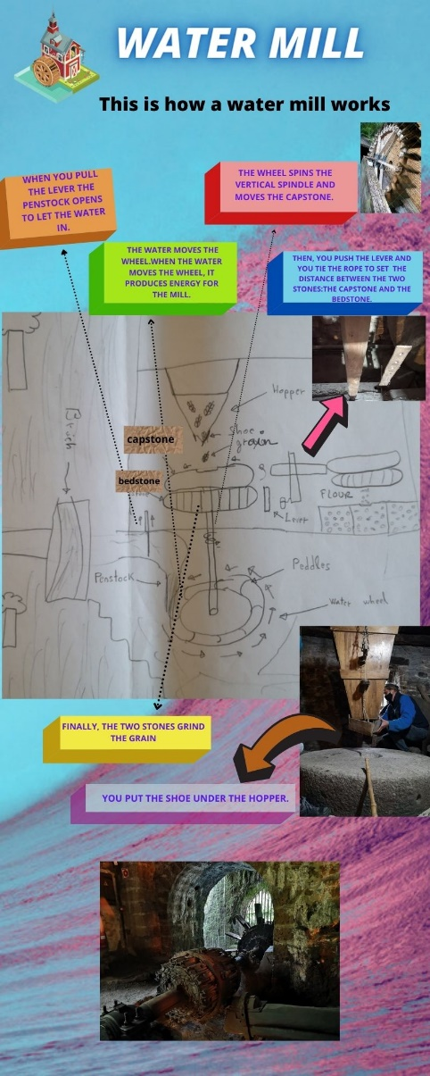
Finally, we created some infographics with the different texts

Slide 18
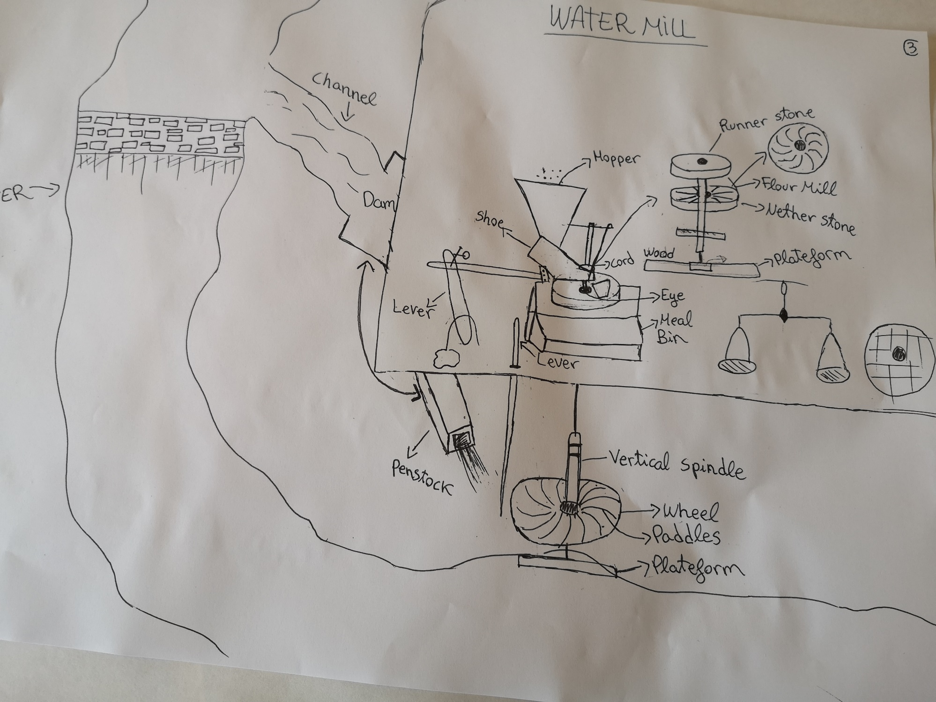

Slide 19
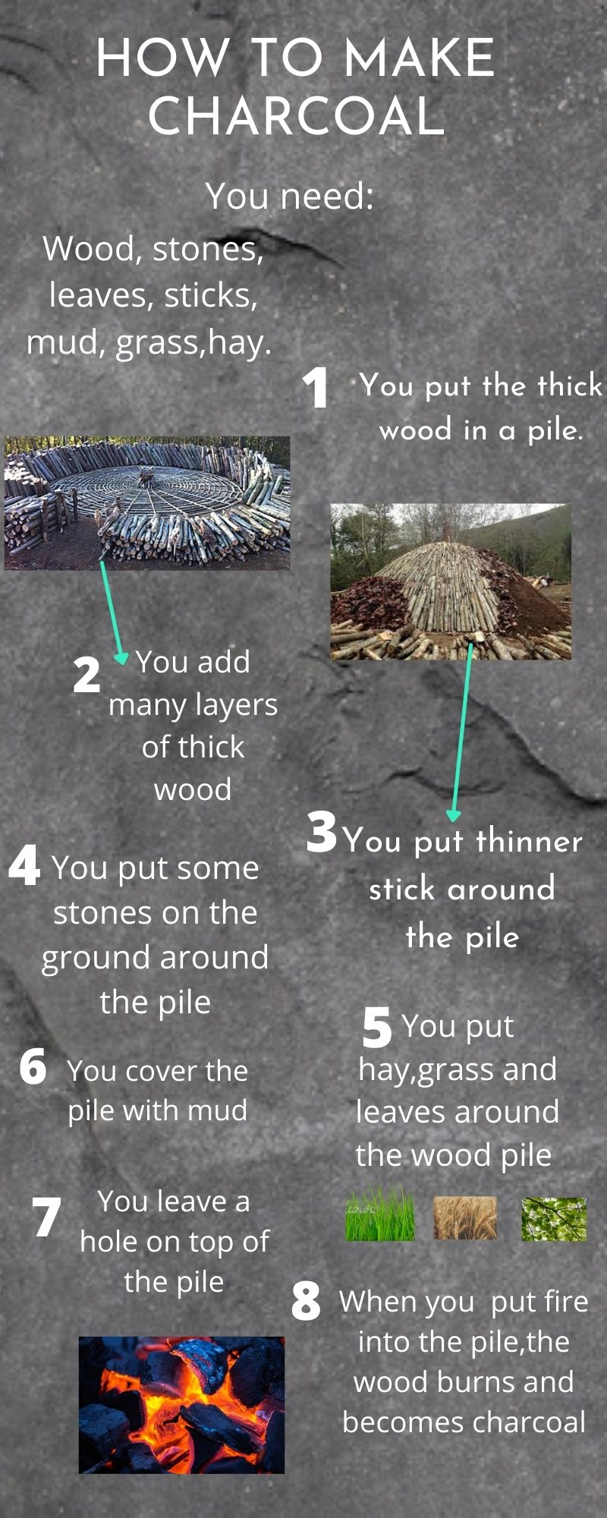

Slide 20
