Slide 1
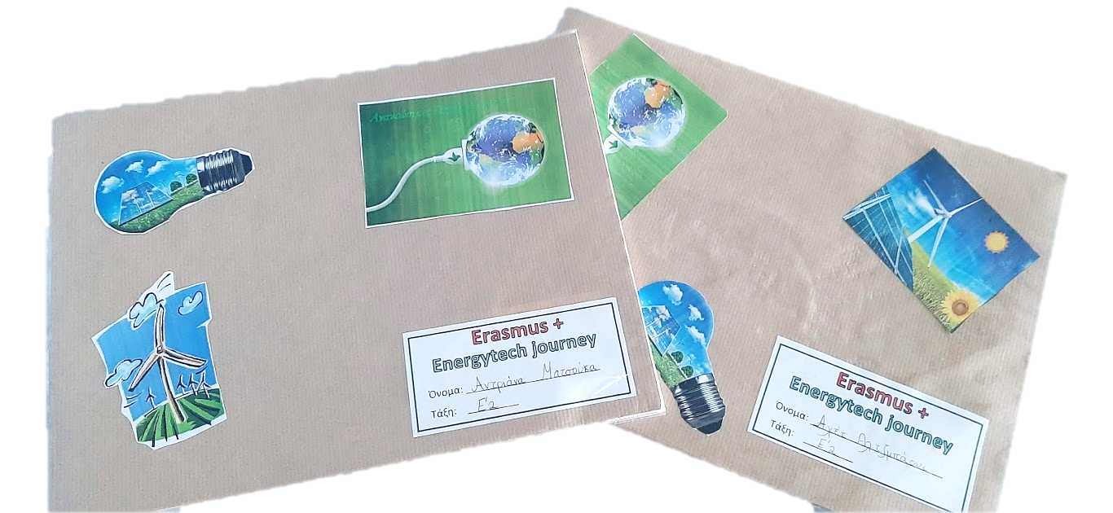
Energytech journey
Erasmus+ 2019-2021

Slide 2
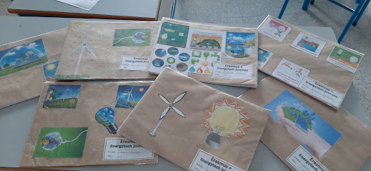
Making our energytech books
First we decided to make a book especially for the Erasmus+ project. Each pupil took a sketching book and decorated its covers with pictures or drawings that are related with energy.
Here are some of our books!

Slide 3
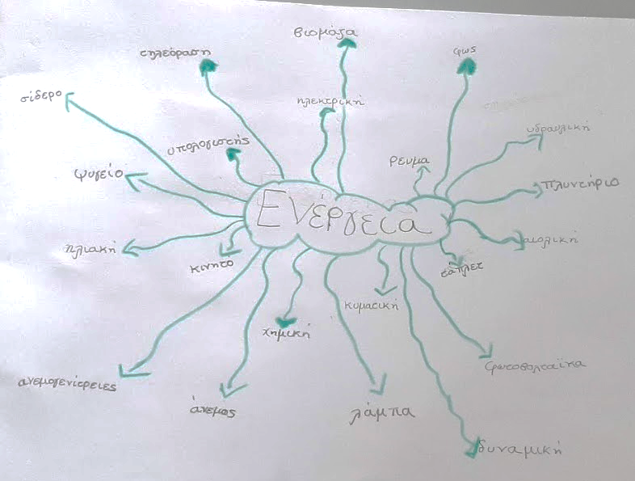
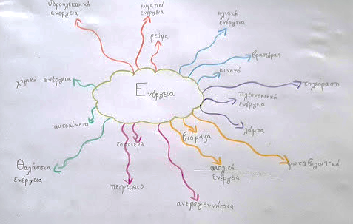
What do we know about energy?
We wanted to see what do we already know about energy, so our teacher asked us to make a brainstorm. Each one of us thought and wrote words that are related with energy.
Here are some of our brainstorms.

Slide 4
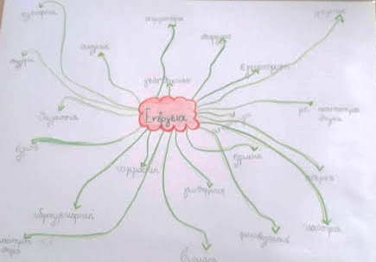
Some of us knew a lot about energy…
and some of us knew only a few…
But we all agreed that we wanted to learn more…

Slide 5
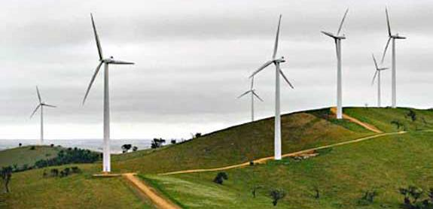
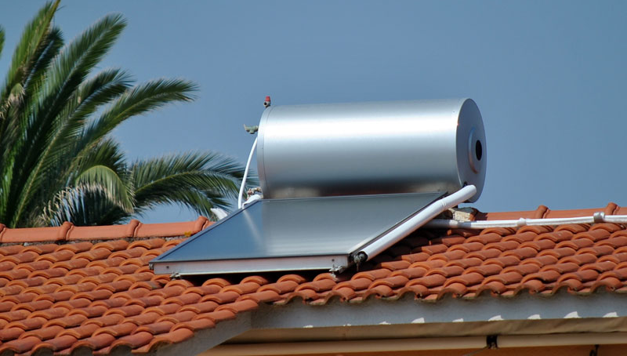
Our conclusions from the brainstorm:
Children mainly mentioned that they Know four energy sources: wind (51%), sun (42%), fuel (32%) and energy of water (30%). They Know sun as energy source because almost every house in Cyprus uses solar water heater. They also Know wind as energy source because they see wind energy parks and solar panels frequently here in Cyprus.

Slide 6
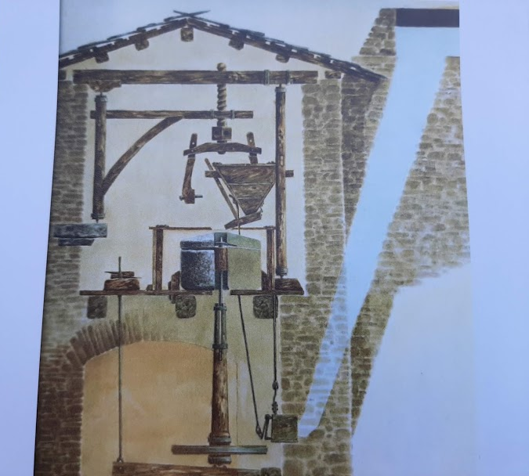
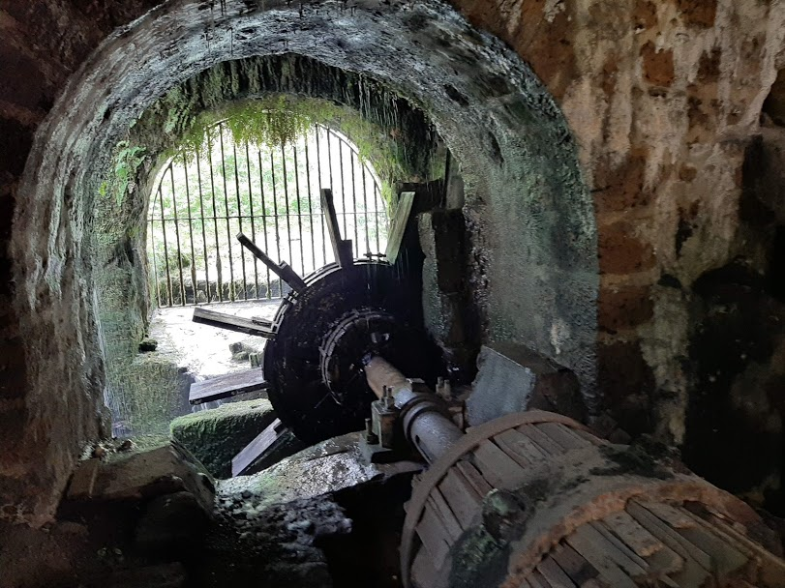
The most common type of energy among the pupils was electricity (59%), hydroelectric energy (61%) and Kinetic energy (30%). Children know electricity because is the most common energy in Cyprus. Pupils mentioned hydroelectric energy because their classmates explained to them a lot of things about this energy through the experience they had from their visit in Zeberio. They also know kinetic energy because they studied this energy in Technology subject.

Slide 7
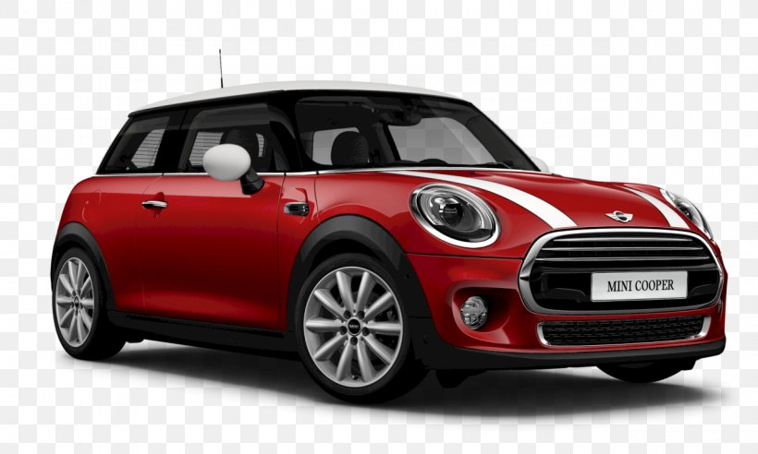
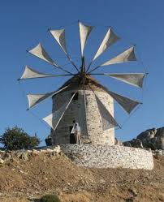
Children know mainly electric appliances (48%) and gasoline powered devices (28%), because they use them a lot in everyday life. They also mentioned wind powered devices (22%) and solar devices (4%). The last two kinds of devices are new in Cyprus. Children learned about wind powered devices because they studied old windmills in Greek lessons.

Slide 8
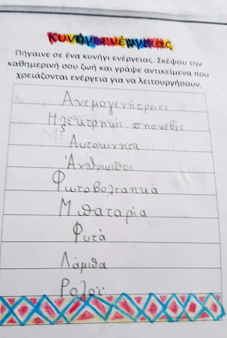
Energy Hunt
Then, we went on an energy hunt. Each one of us thought and wrote 10 things from our daily lives that need energy to work. We were a bit uncertain of what to write at first but we managed eventually!!!

Slide 9
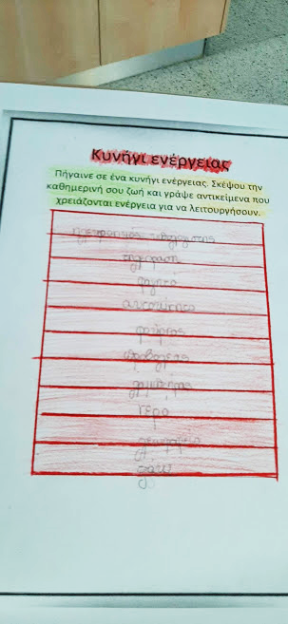
Then we announced what we wrote to the class and concluded that most of us had written the same things more or less.
Most of us wrote : television, laptop, PlayStation, lamp, refrigerator, kitchen oven, washing machine, clock, car, heaters, etc.
But, to be honest, we also made a few mistakes and wrote things that were wrong…
We noticed that most of the things we use in our daily lives use electric energy.

Slide 10
Then we decided to focus on some of the things that we had written and find out more information about each one, like:
Multientrance chart
Is it a necessity?
How is it manufactured?
Which energy does it use?
Where does that energy come from?
Which object did they use before to do the same work?

Slide 11
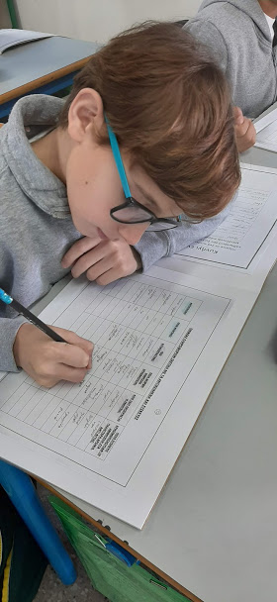
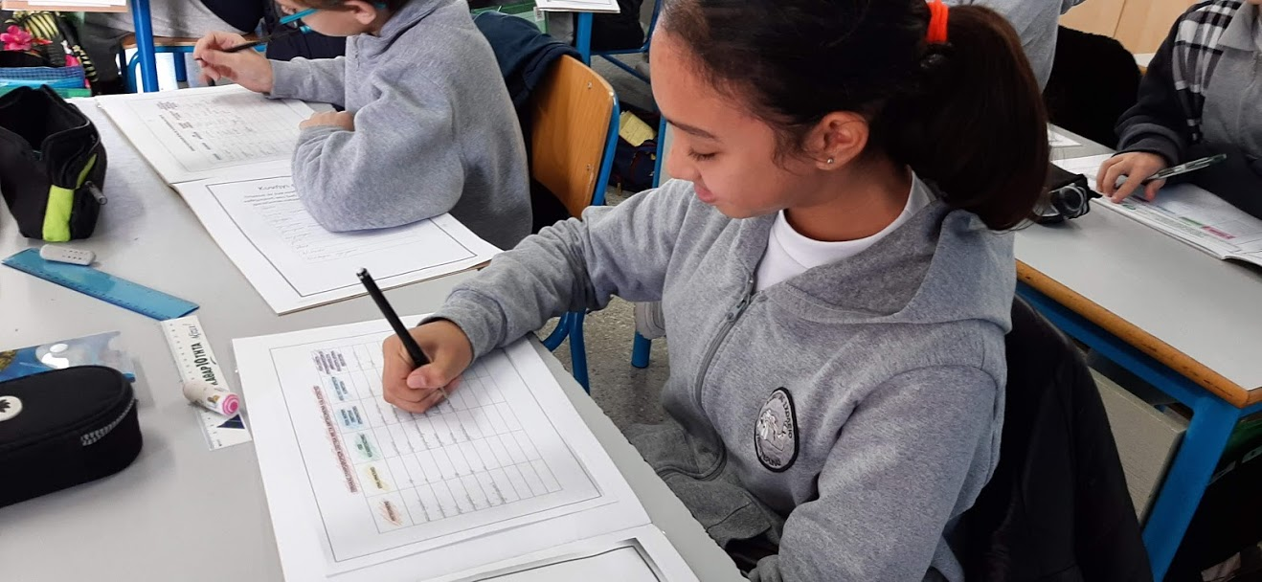
we shared our previous knowledge and discussed with our classmates
To answer those questions :

Slide 12
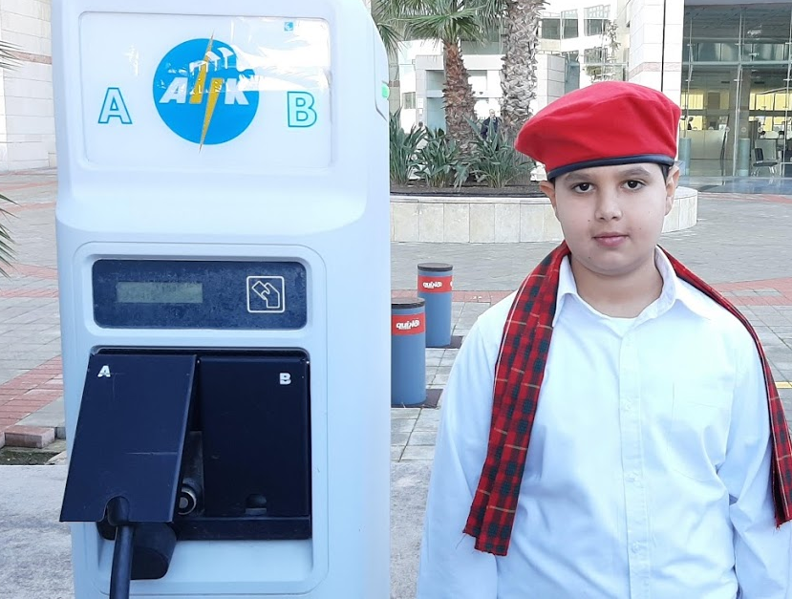
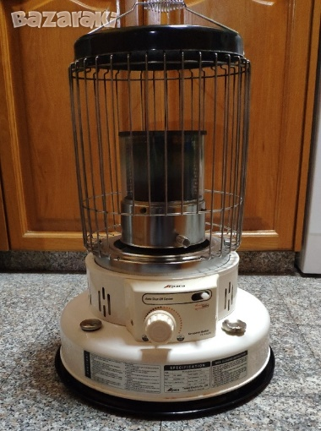
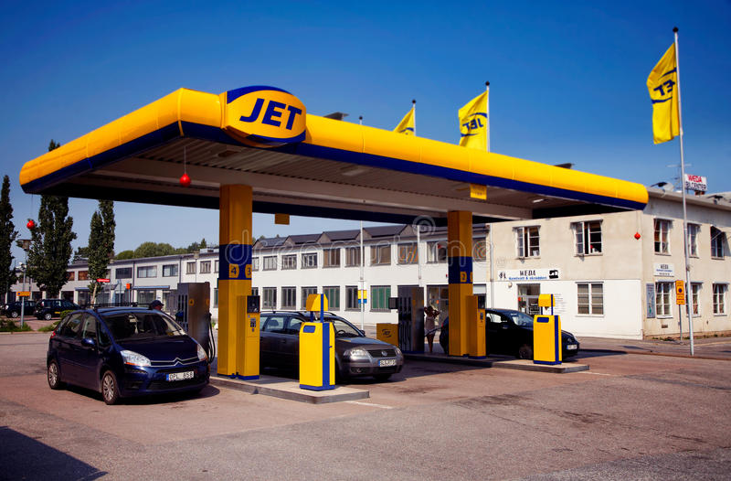
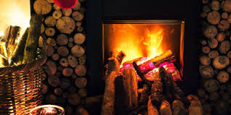
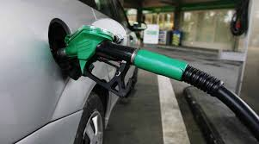
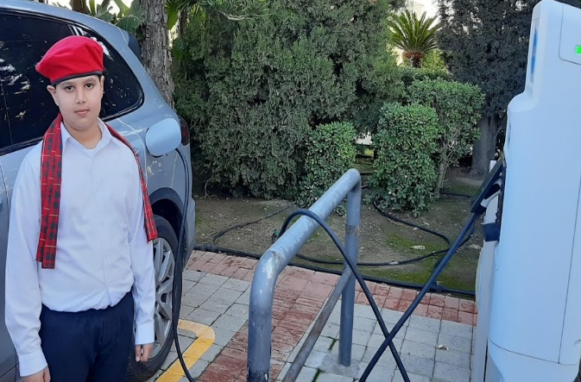
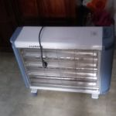
we saw pictures and photos from the internet,
for example a car in the petrol station and in an electric station,
different heaters who use petrol, wood, electricity and gas.

Slide 13
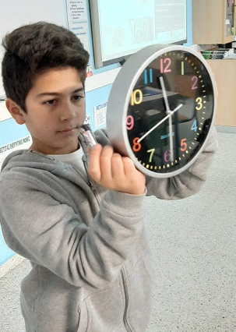
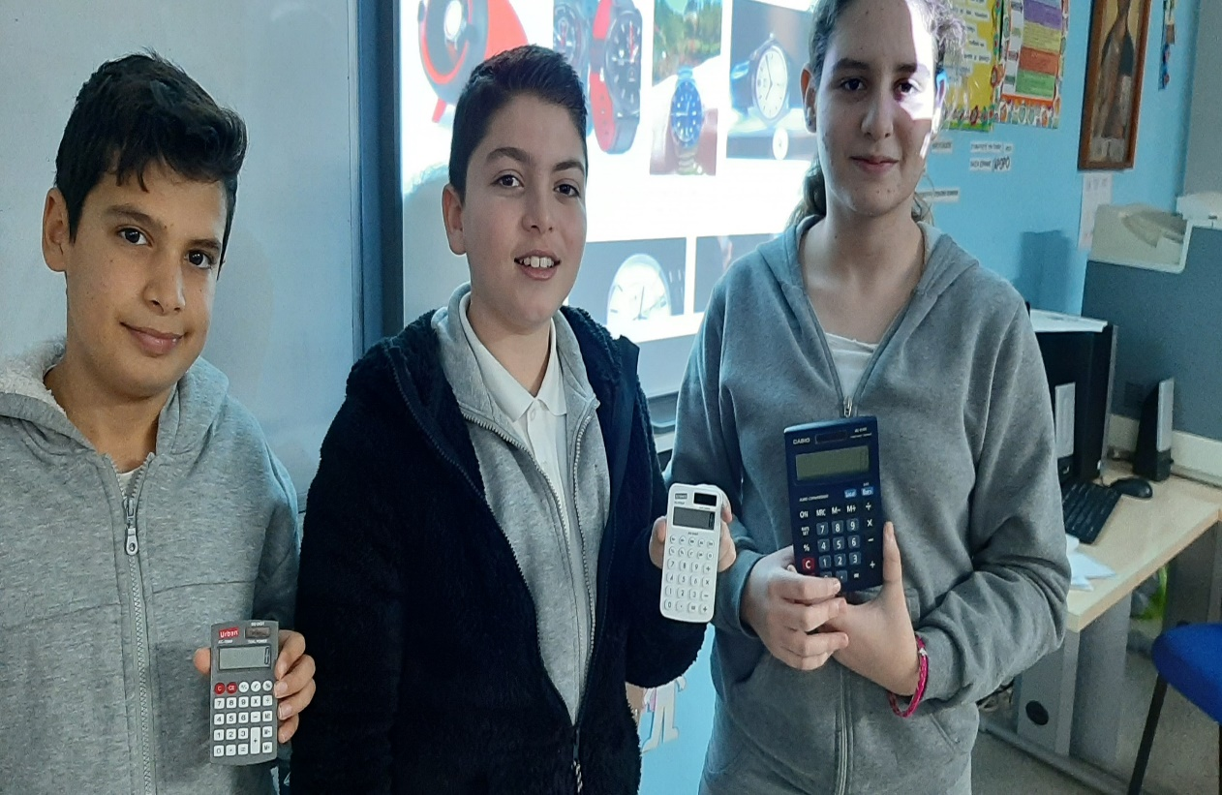
we had real devices in class and saw how they work.
a clock
a solar calculator

Slide 14
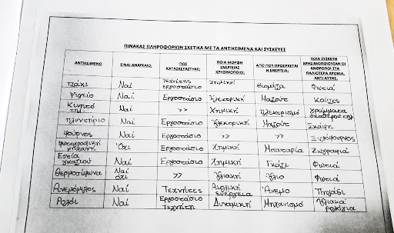
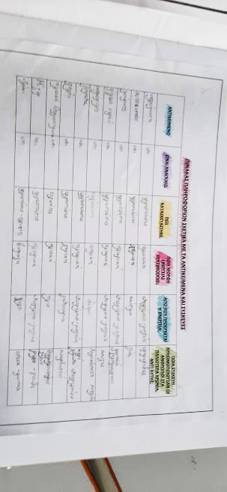
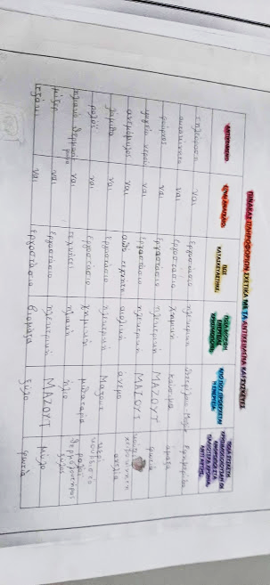
Here are some charts after we had completed them.

Slide 15
These are the things we chose:
OBJECT | IS IT NECESSARY? | HOW IT MANUFACTURED | WHAT KIND OF ENERGY DOES IT USE? | WHERE DOES THAT ENERGY COME FROM? | WHAT DID YOUR GRANDPARENTS USE INSTEAD?
fireplace | yes | factory/ hand worker | chemical | biomass | Fire
fridge | yes | factory | electric | fuel oil | Ice
mobile phone | yes | factory | chemical | battery | Letters
washing machine | yes | factory | electric | fuel oil | Hands, river
oven | yes | factory | electric | fuel oil | Wood oven
camera | yes | factory | chemical | battery | Drawings
gas stove | yes | factory | chemical | gas | Fire
Solar water heater | yes | factory | solar | sun | Fire
windmill | yes | hand worker | wind power | wind | Hands well
Clock lamp | yes | factory/ hand worker | dynamic | mechanism | Solar watch

Slide 16
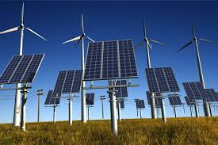
Conclusions
The devices we chose use mostly electric or chemical energy (batteries).This electrical energy comes mostly from the electric power station we have in Cyprus and uses fuel oil (petroleum) to produce it.
However these last years we also have solar parks and wind parks that also produce some amount of electrical energy in Cyprus.

Slide 17
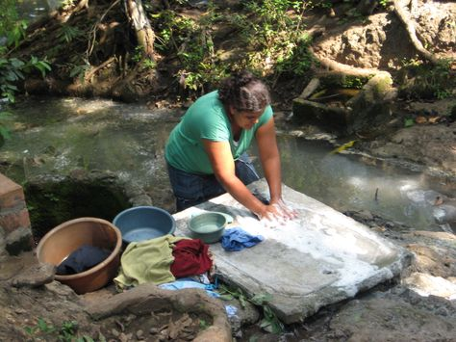
In the past years
Our grandfathers had other tools to use in order to achieve most of the tasks, like wood, fire, water and of course their own hands!

