Slide 1
Energy hunt in our school
Saldus Elementary school

Slide 2
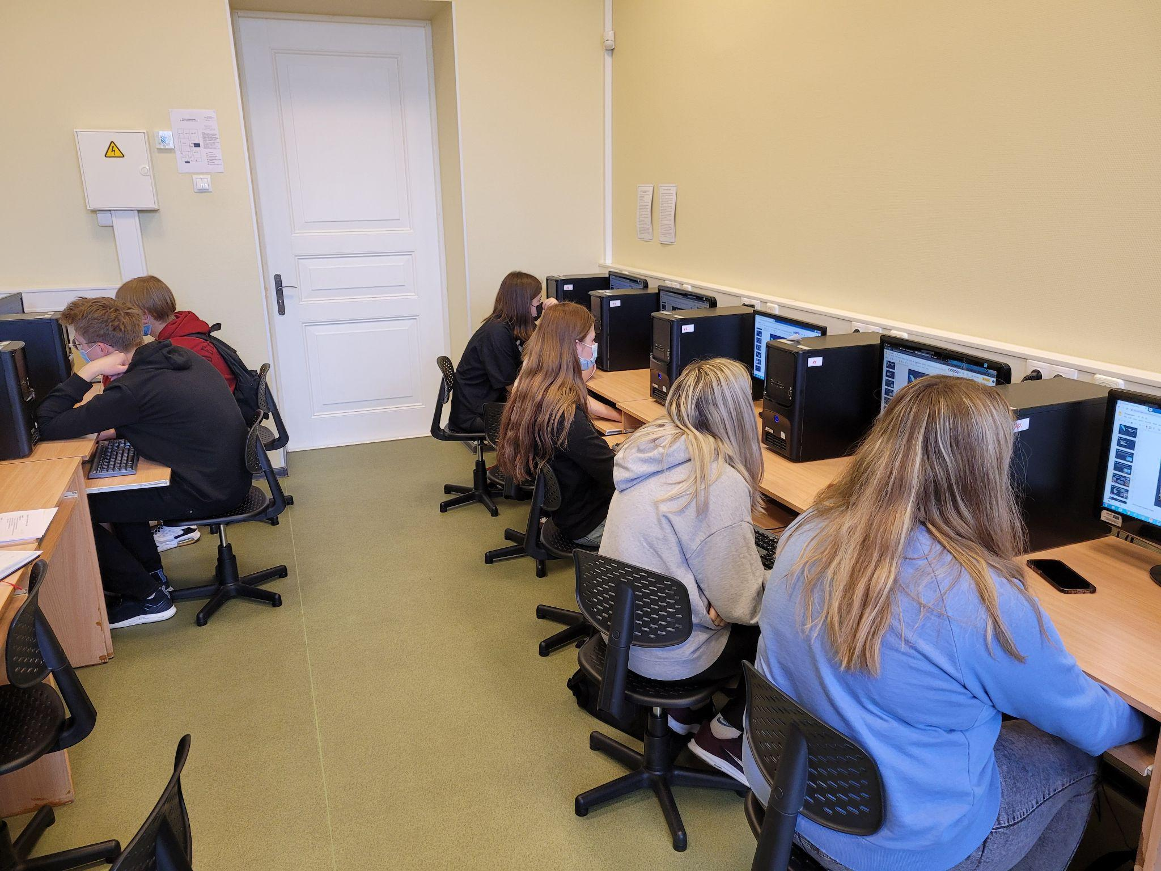
Discussion
Before we made the presentation we had a discussion about:
the possible energy resources
energy in our school
diffrent devices using energy
electricity wasting and saving
how to change our eletricity using habbits
gather data, make pictures, make a presentation.

Slide 3
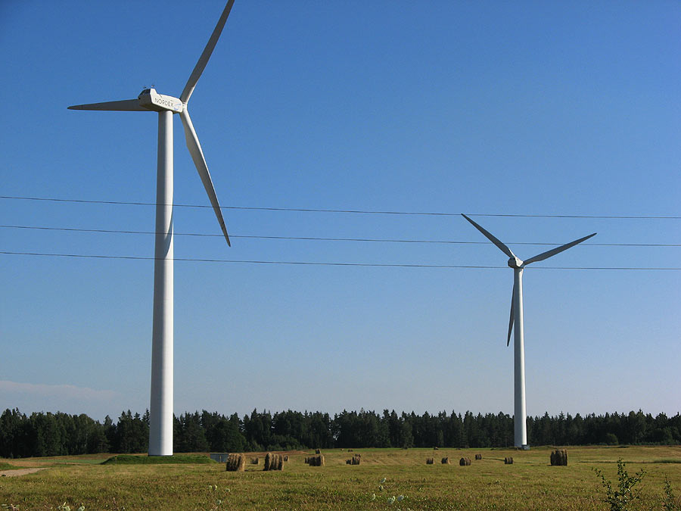
Possible energy sources (wind energy)
The wind energy potential in Latvia is significant, both for onshore and offshore wind. But Latvia is lagging behind its neighbours and others.
The nearsest wind generator from our school in Saldus is about 40 km away.

Slide 4
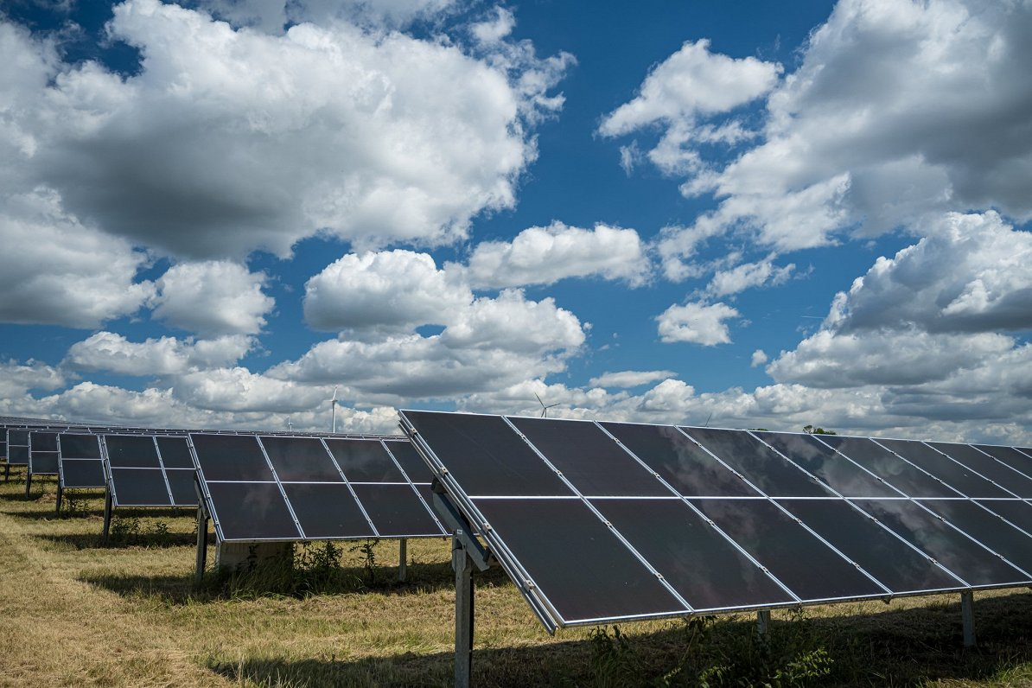
Possible energy sources (solar energy)
Solar technologies convert sunlight into electrical energy. This energy can be used to generate electricity or be stored in batteries or thermal storage. Solar energy is better for the environment but it is not cheaper.
Here in Saldus we don’t use solar energy as much as we would like because it can be expensive.

Slide 5
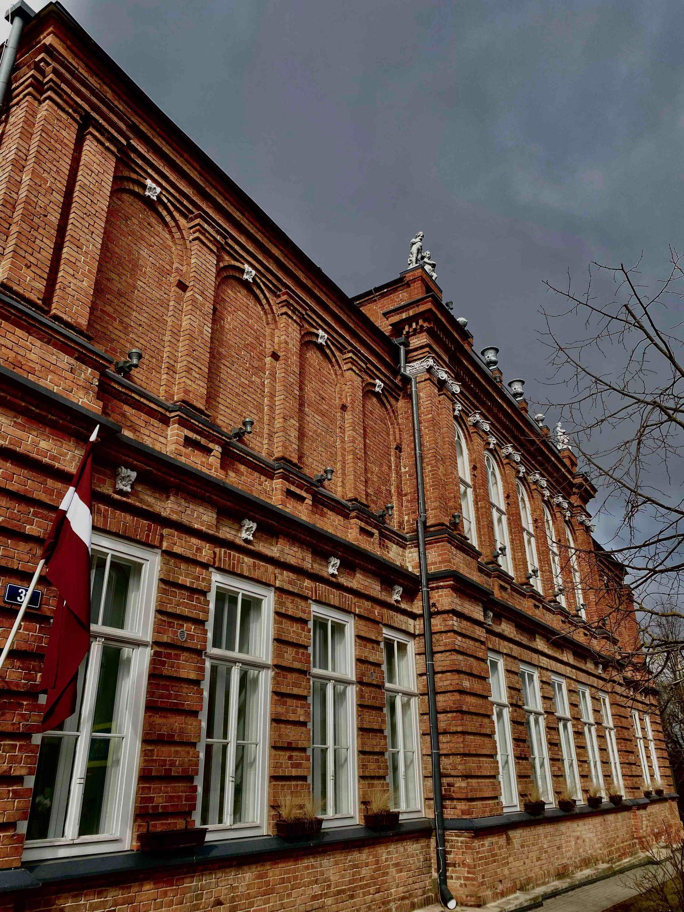
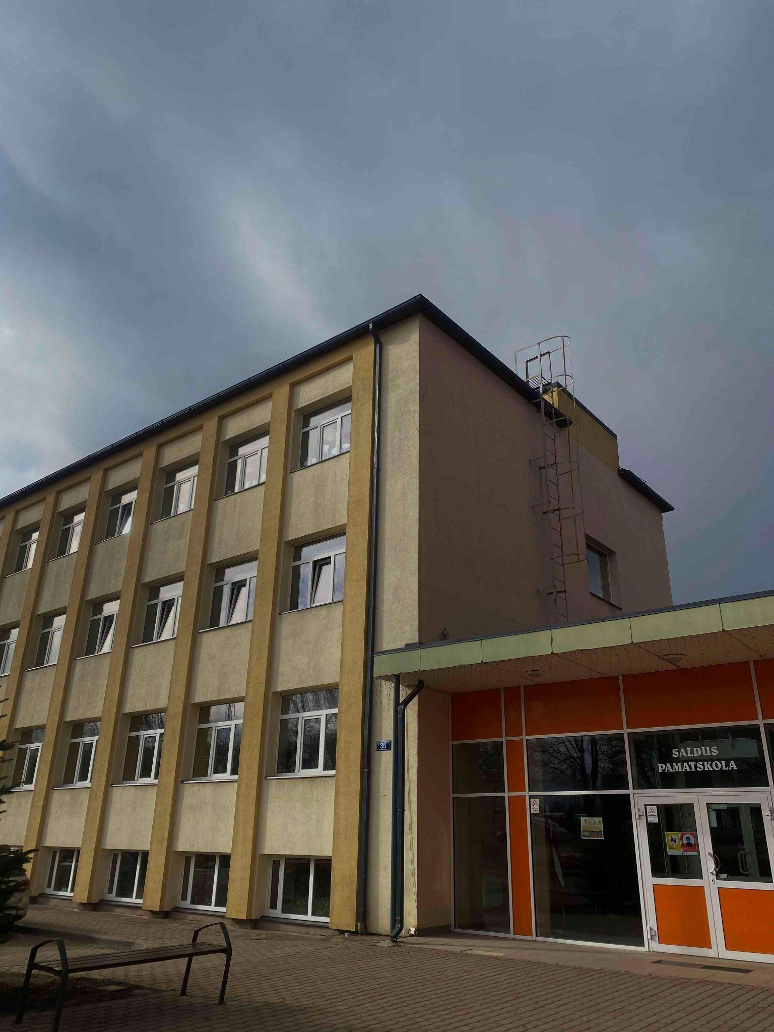
Energy in our school
We think solar batteries would be the best way to get energy, but buying solar batteries and installing them is expensive.
Our school uses electricity and no other form of energy.
Without electricity, our life in school wouldn't be imaginable, because all the devices in our school only work with electricity.
Our school only uses electricity power because there are no wind generators near our school, no solar power, and no hydroelectric power plants.

Slide 6
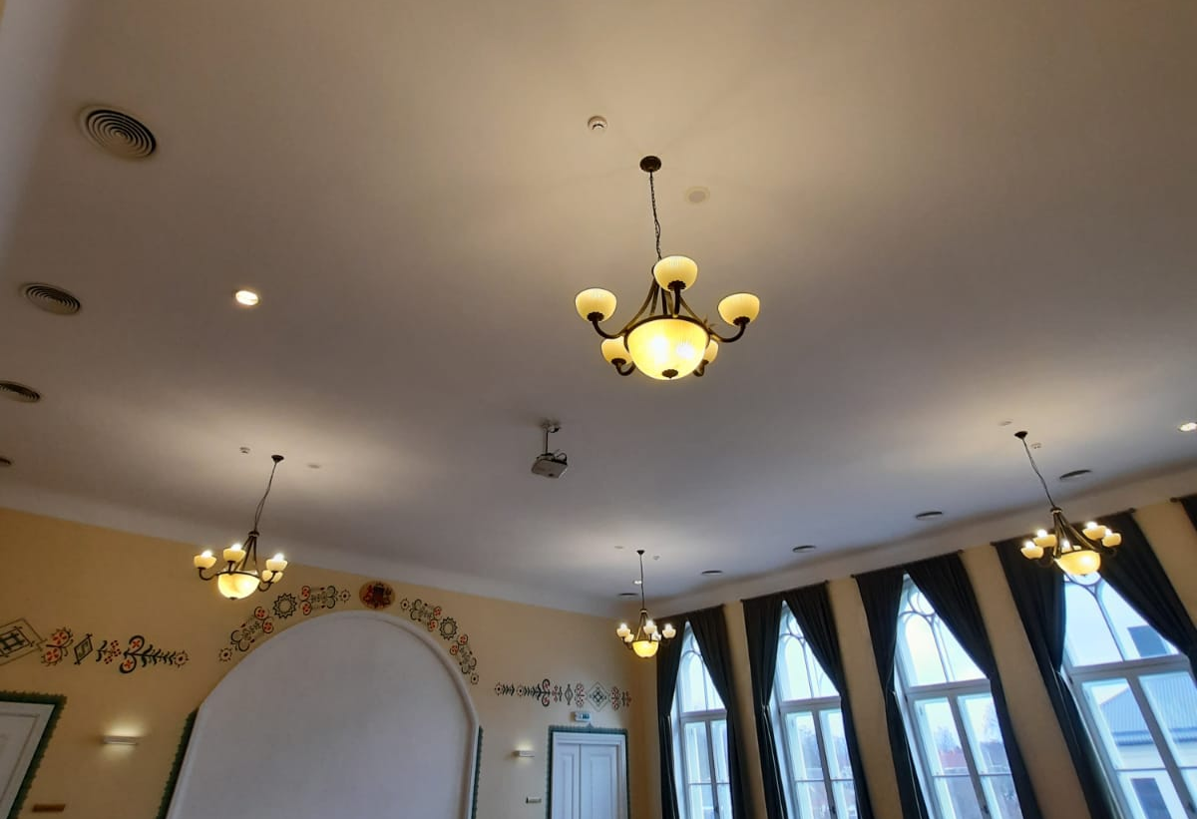
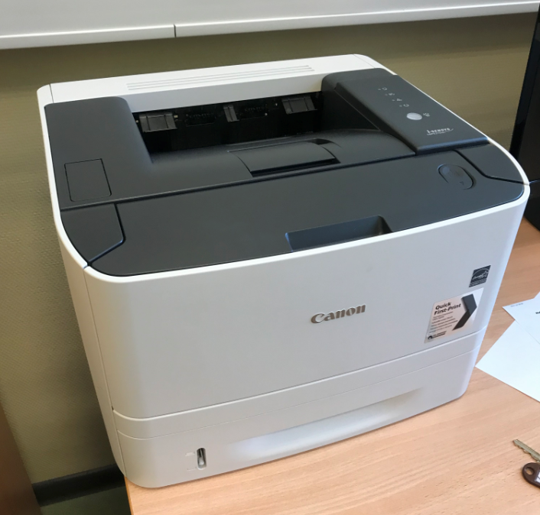
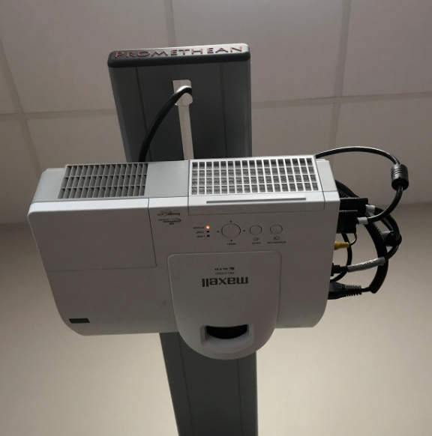
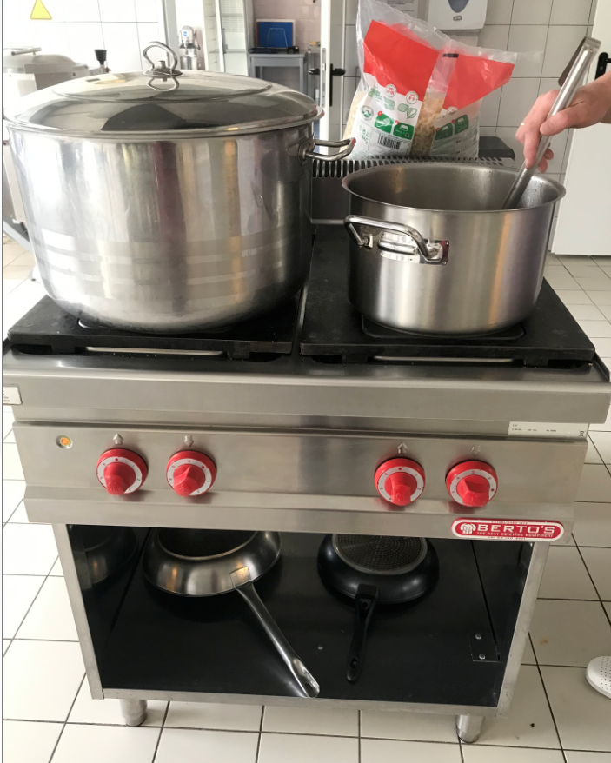
Electro gadgets that use electricity in our school
Our school uses only electricity as energy to power:
lamps,
computers,
printers,
gadgets in the kitchen,
intereactive white boards,
projectors,
wi-fi routers,
gadgets in domestic science class.

Slide 7
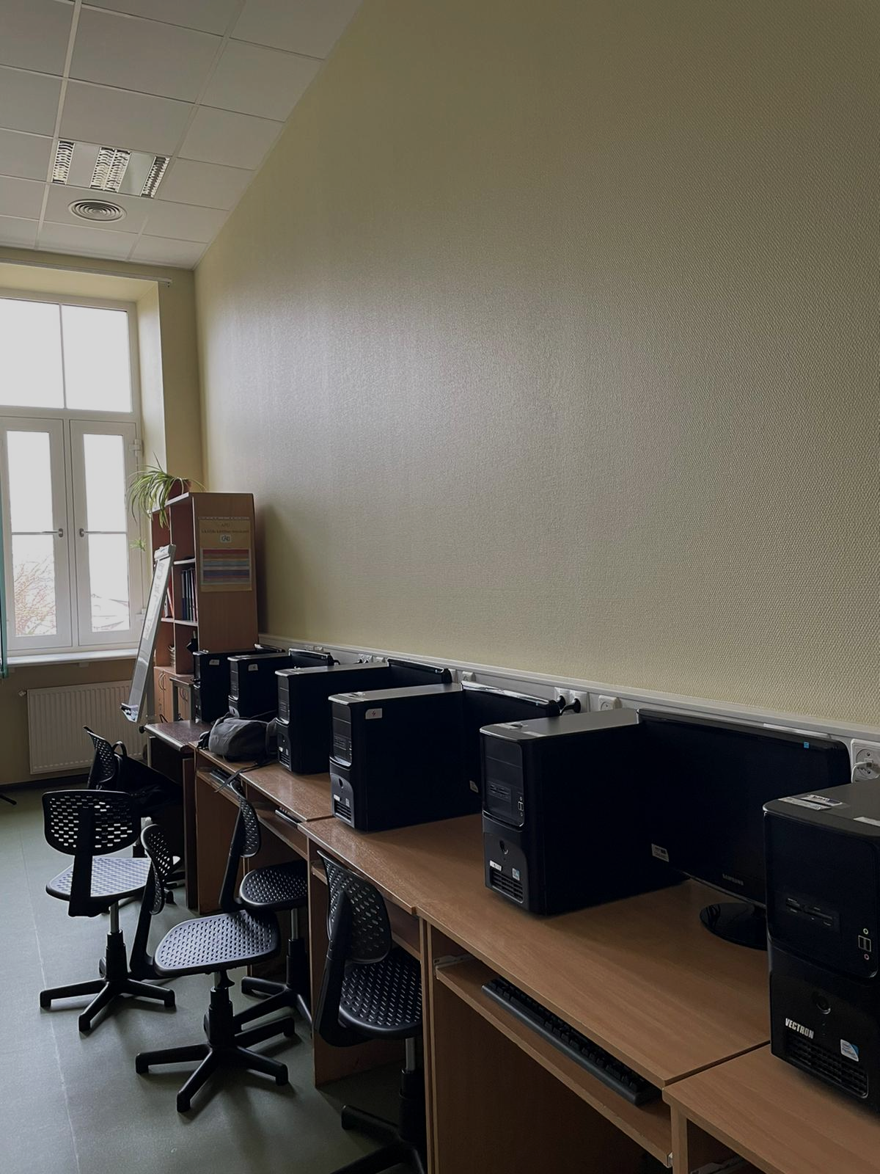
Is it possible to live without electricity?
Looking at the fact that you can't do anything these days without electricity because it plays an important role in our lives.
Without electricity there wouldn't be light in our classrooms, we wouldn't be able to do tasks from the interactive board, we wouldn't be able to use computers, to print worksheets so for us to learn fully, we need electricity.

Slide 8
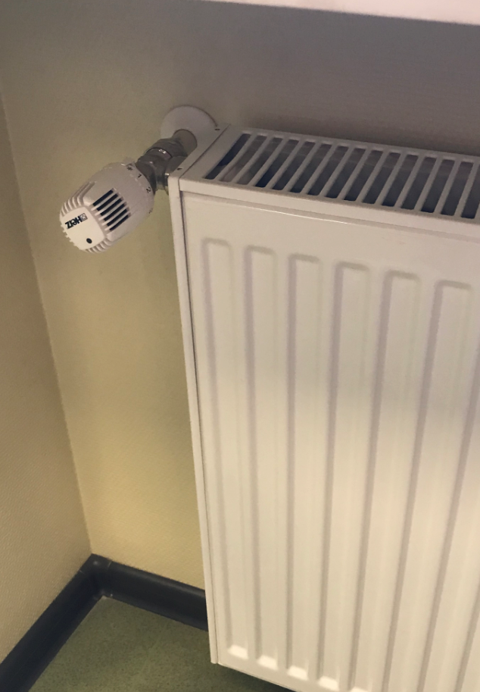
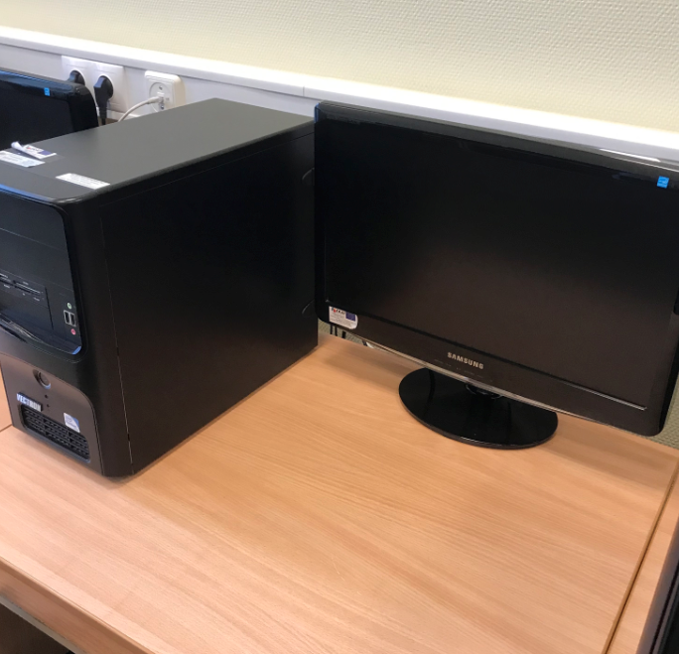
Electricity saving
To save electricity we could:
change our light bulbs to LED,
turn off lights when we don’t need them,
turn off computers and monitors after work,
turn our thermostats a bit lower,
turn off ovens when not used,
unplug wi-fi when the school closes.

Slide 9
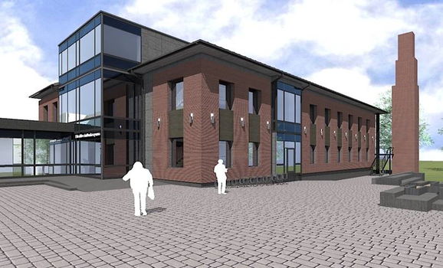
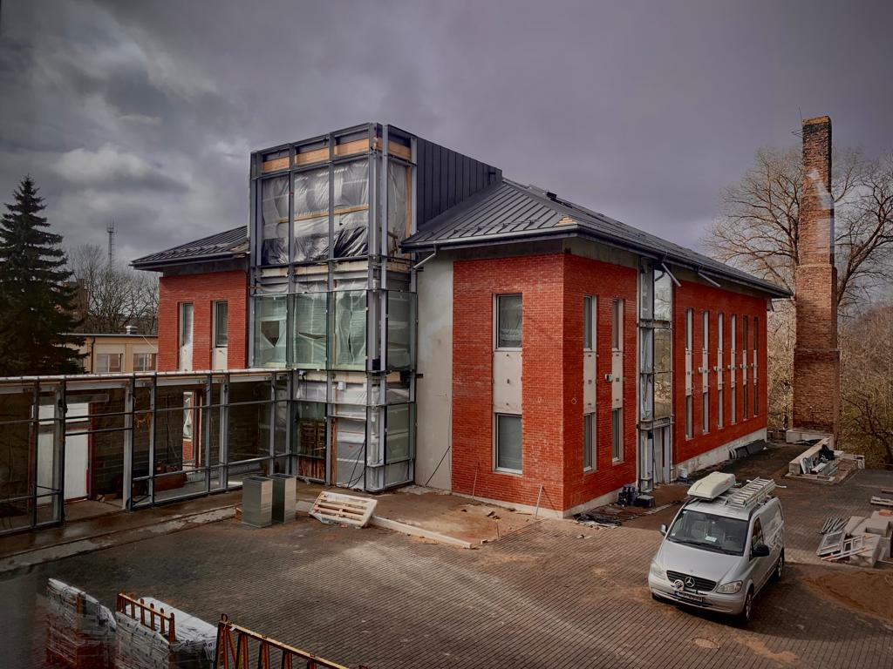
Our new science building
Our school, right now is building a new science building. It’s going to be conected to our school with a coridoor. It will be ready in August.
Our school is going to be powerd by solar and electric energy. We are going to gain solar energy from solar panels, witch are going to be our main electricity source.
Solar energy is going to be more nature friendly, though it isn’t going to be cheaper than electricity.

Slide 10
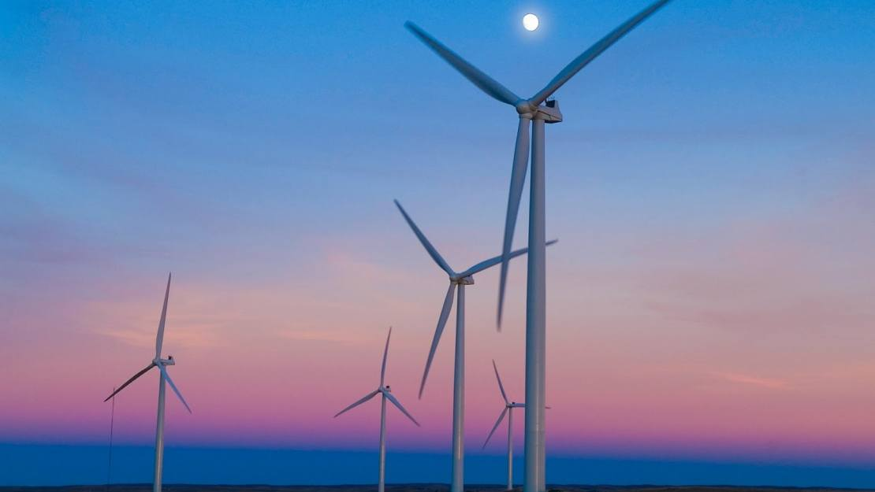
Thank you for your attention!

