Slide 1
Saldus pamatskola Saldus elementary school

Slide 2
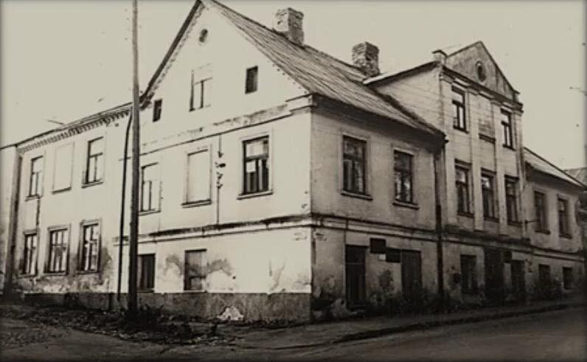
History
Our school was founded in 1904.
At first it was a school just for boys and it had only three grades.
Our school has had 16 headmasters.

Slide 3
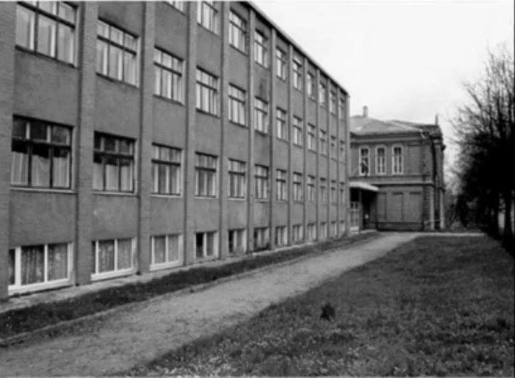
History
In 1970’s another part of the school was built.
In our school it’s called the new part of the school.

Slide 4
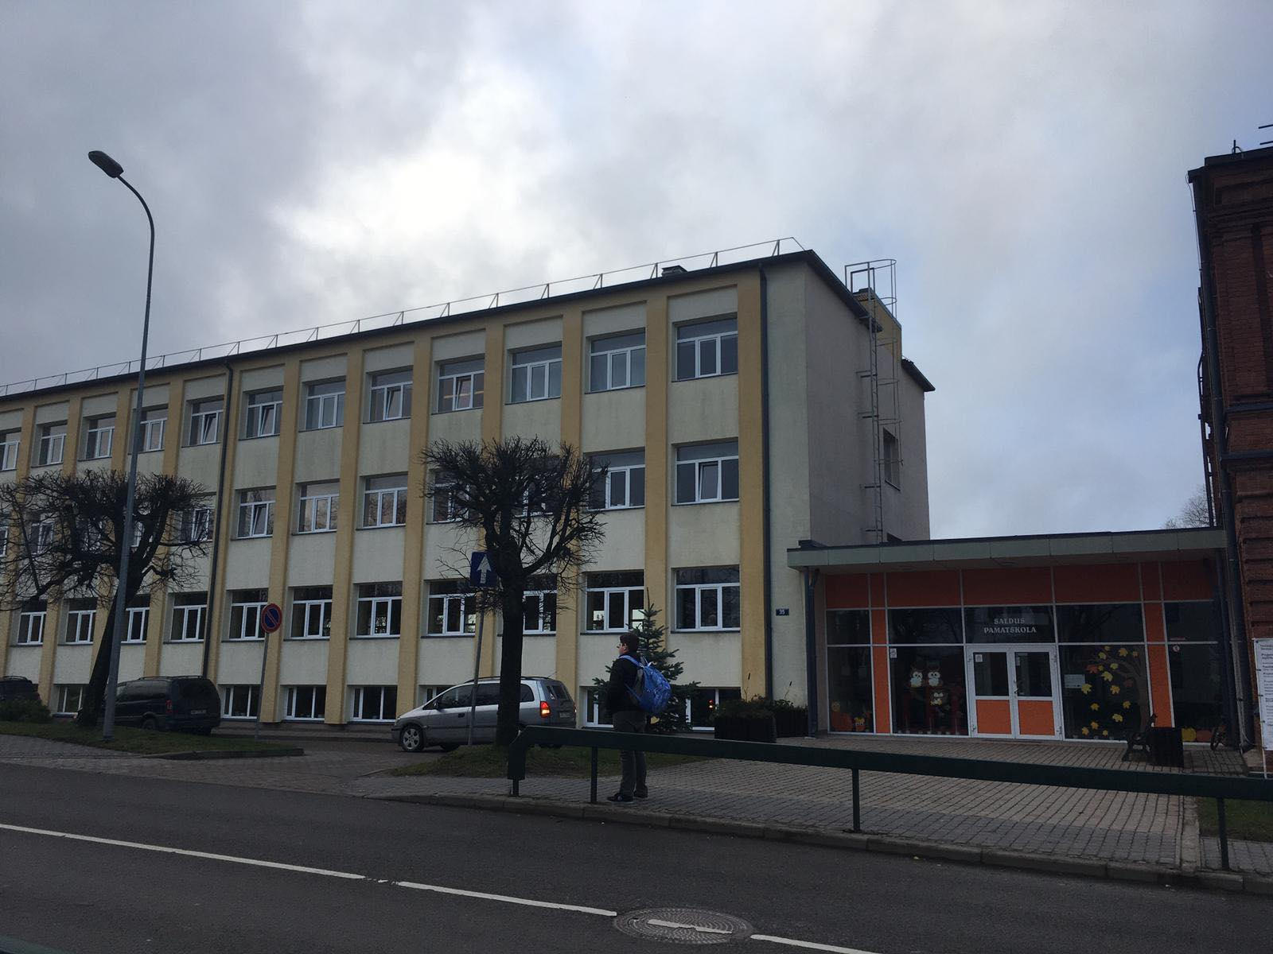
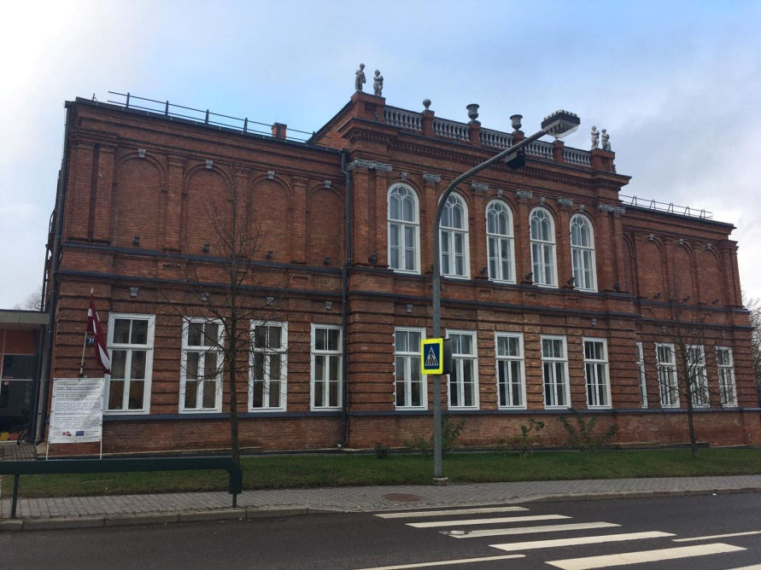
Nowadays
In our school you can learn from 1st grade to 9th grade.
This school year we have 393 students and 18 classes (two of each grade).
Our school has 45 teachers.

Slide 5
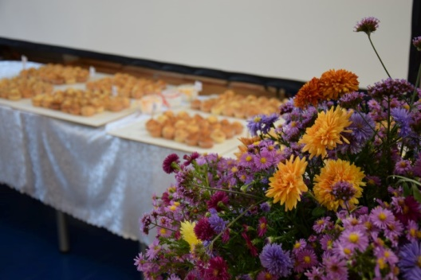
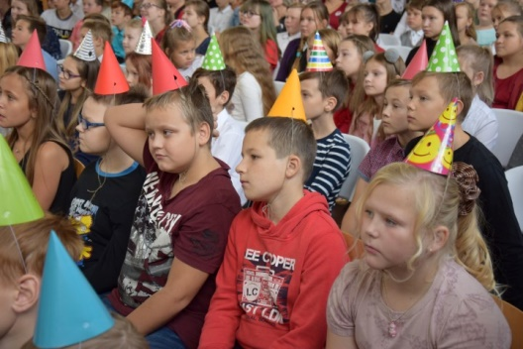
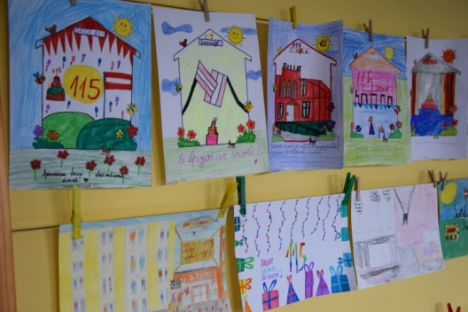
Nowadays
This year our school had a big birthday – 115 years!
We had a celebration, everybody joined in a party!

Slide 6
Schools symbols
This is our schools flag. It was created in 2018.
This is our schools logo. It has two letters – S and P, they are from our schools name.

Slide 7
School uniform
From 1st grade to 4th grade we have a school uniform – a grey vest, a red or blue t-shirt, a grey and red dress or skirt.
From 5th grade to 9th grade we can wear daily clothing – jeans, t-shirts, hoodies, dresses and other.

Slide 8
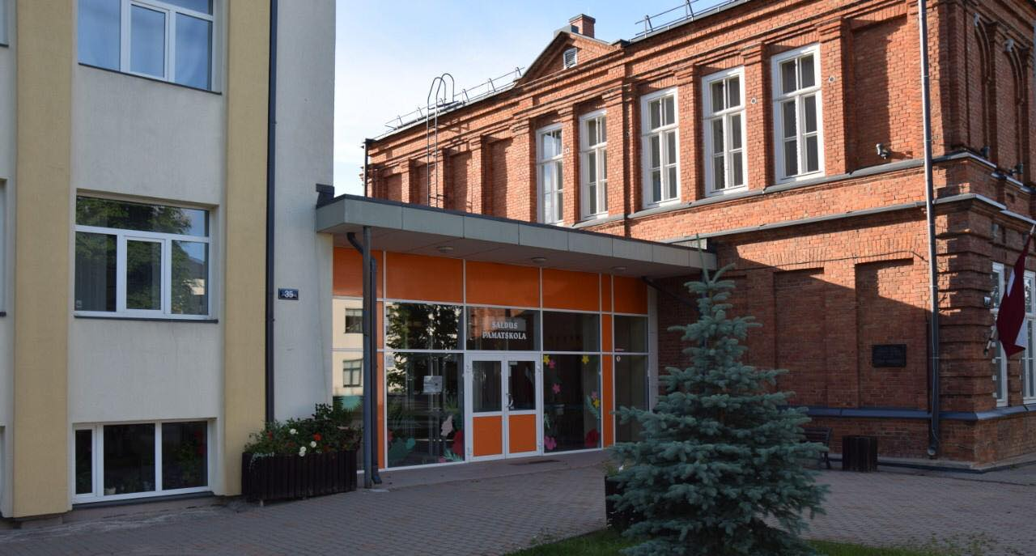
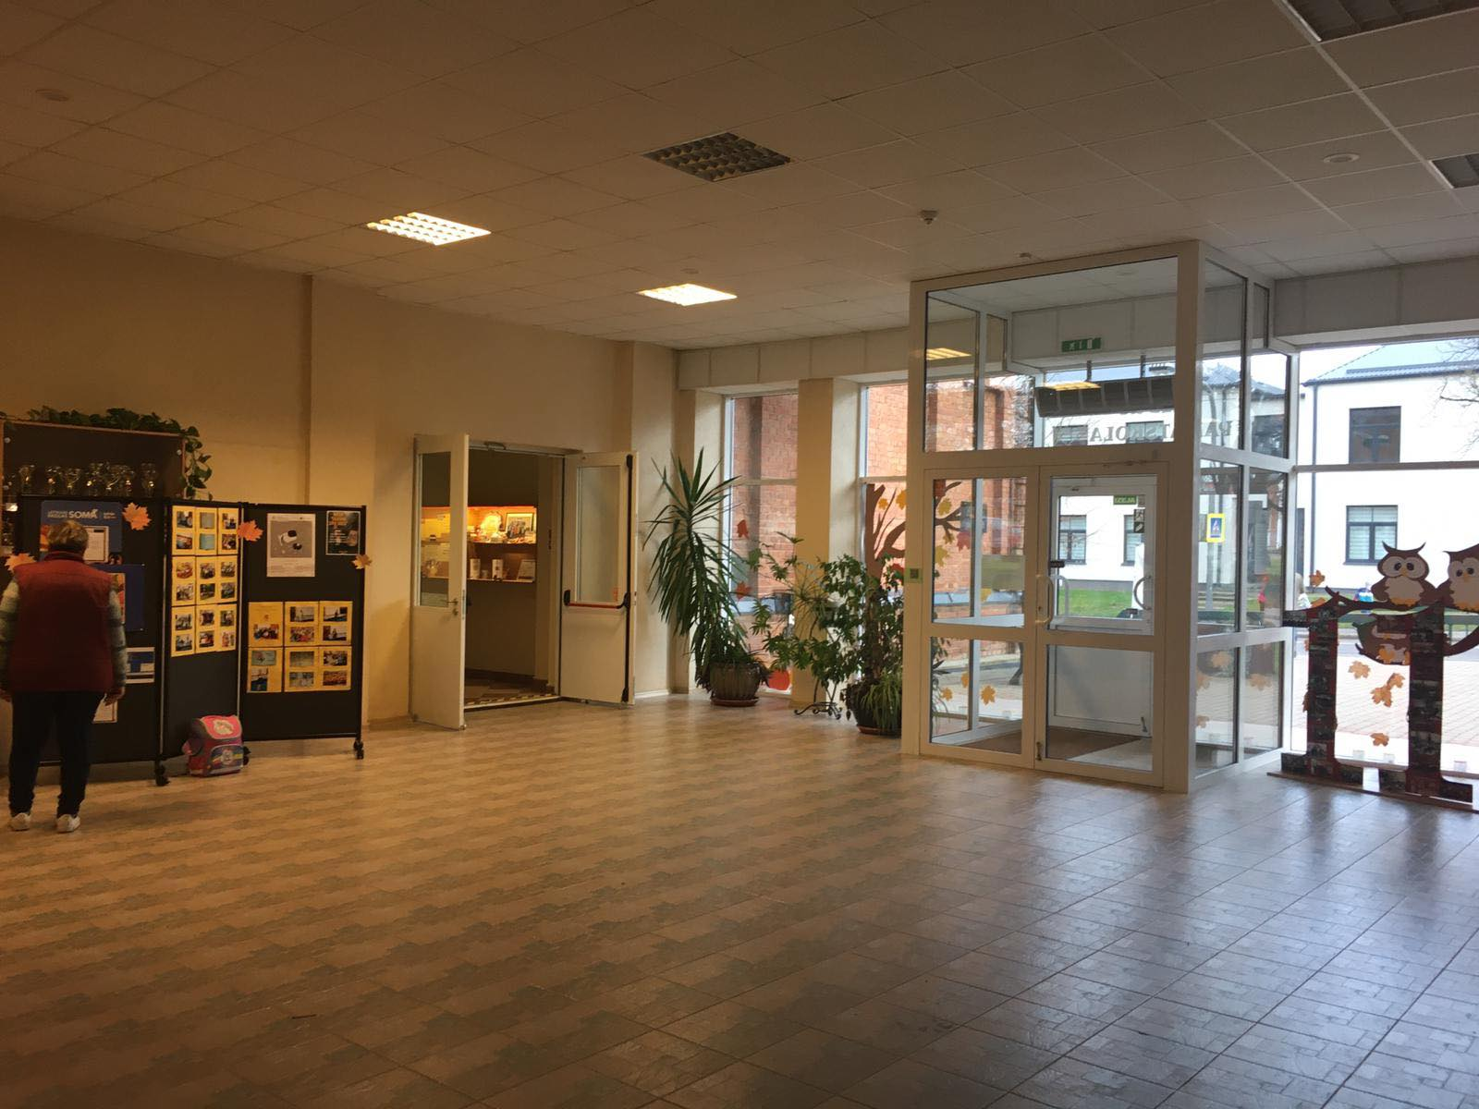
Our school

Slide 9
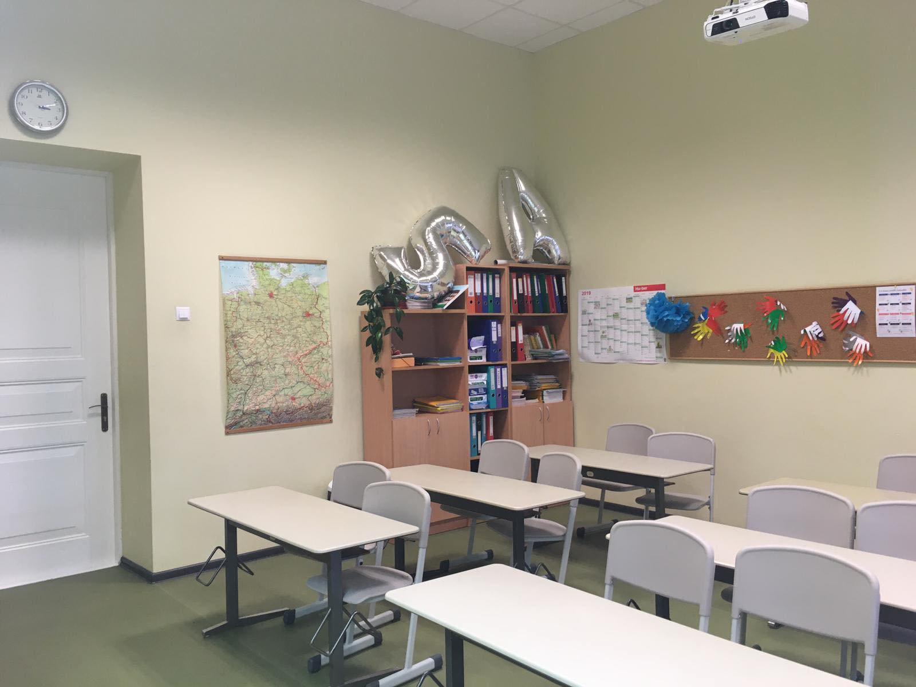
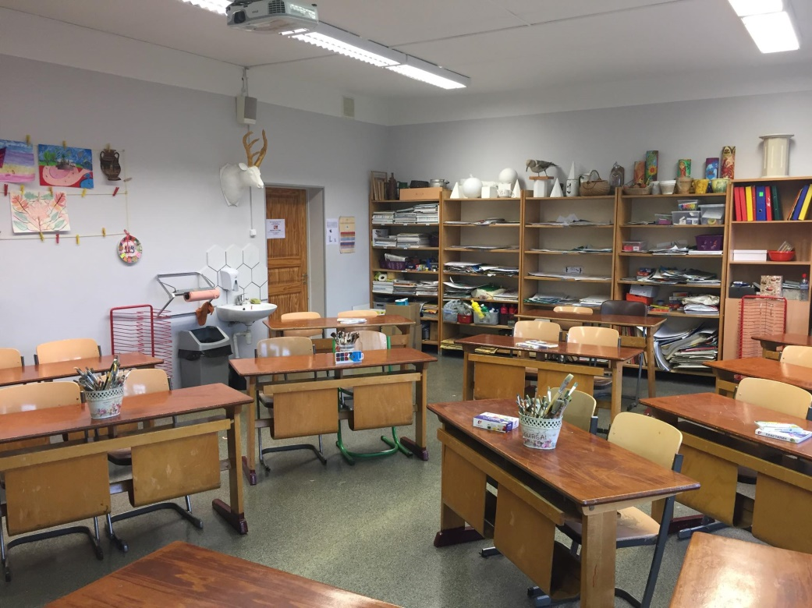
Classrooms
In our school we have four floors and 23 classrooms.

Slide 10
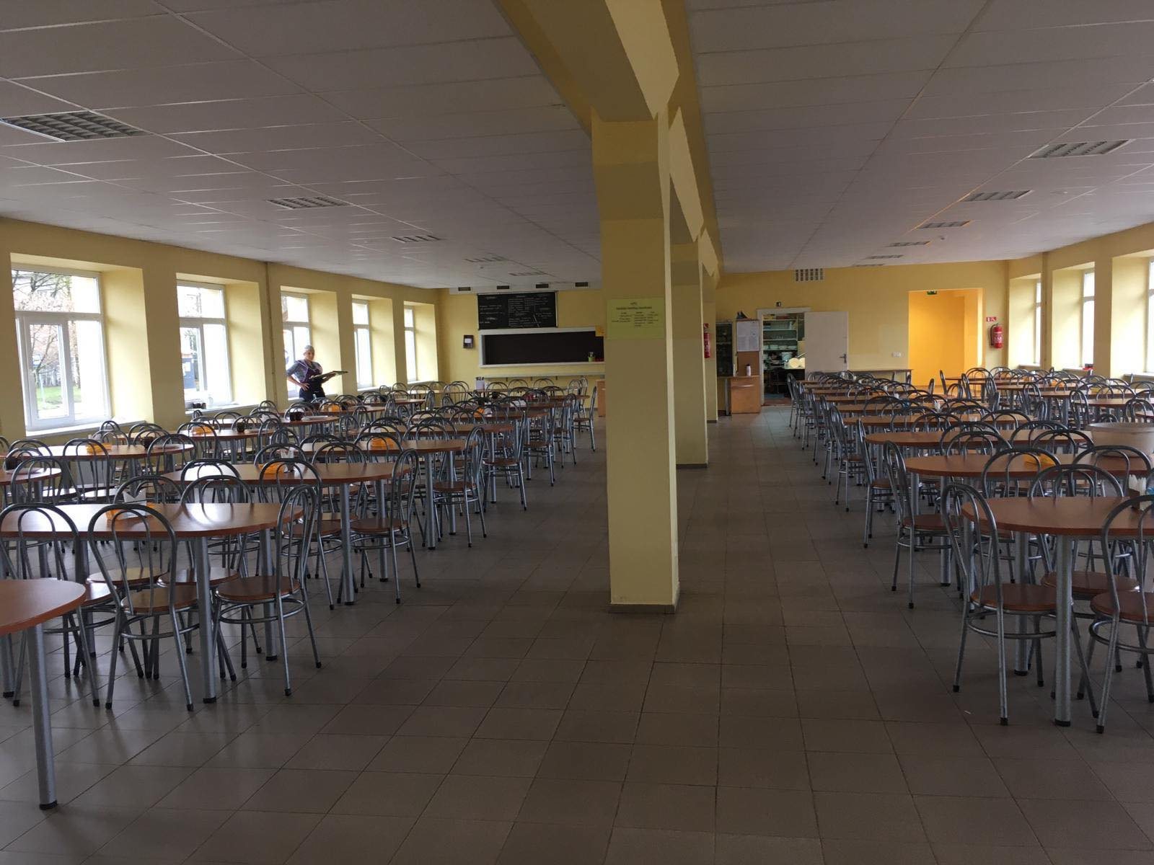
Schools canteen
From 1st grade to 7th grade all students eat together. Each class sits at their own table.
But from 7th grade to 9th grade students can stand in a line to order and pay for their meal.

Slide 11
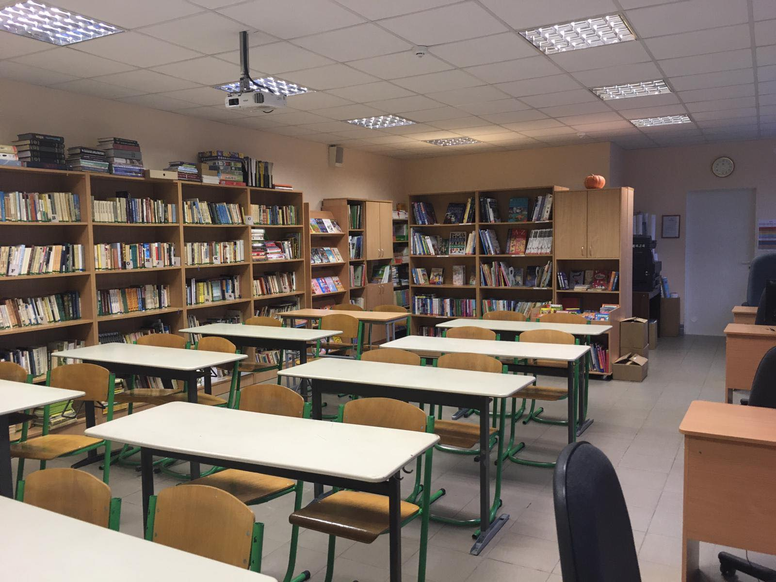
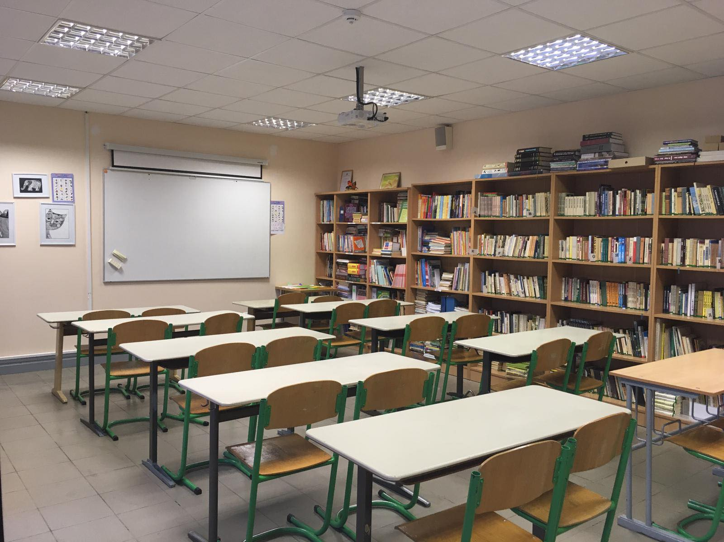
Library
This is our schools library. It is also a classroom where students can have interesting lessons using different books.

Slide 12
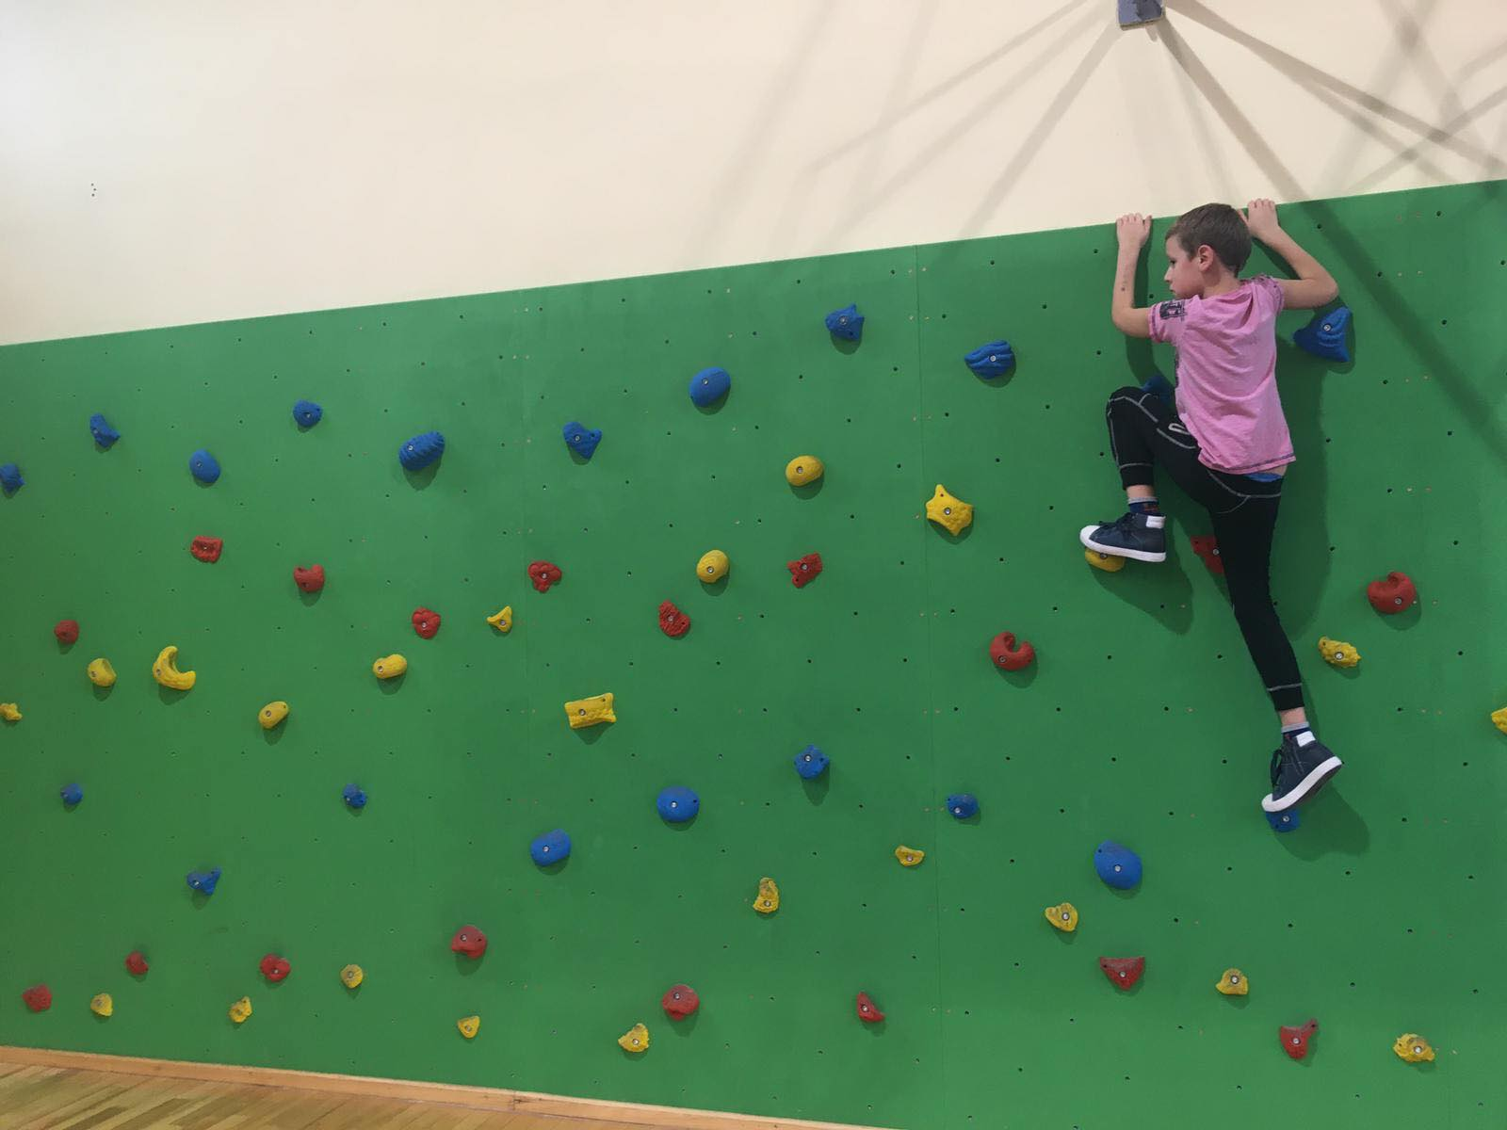
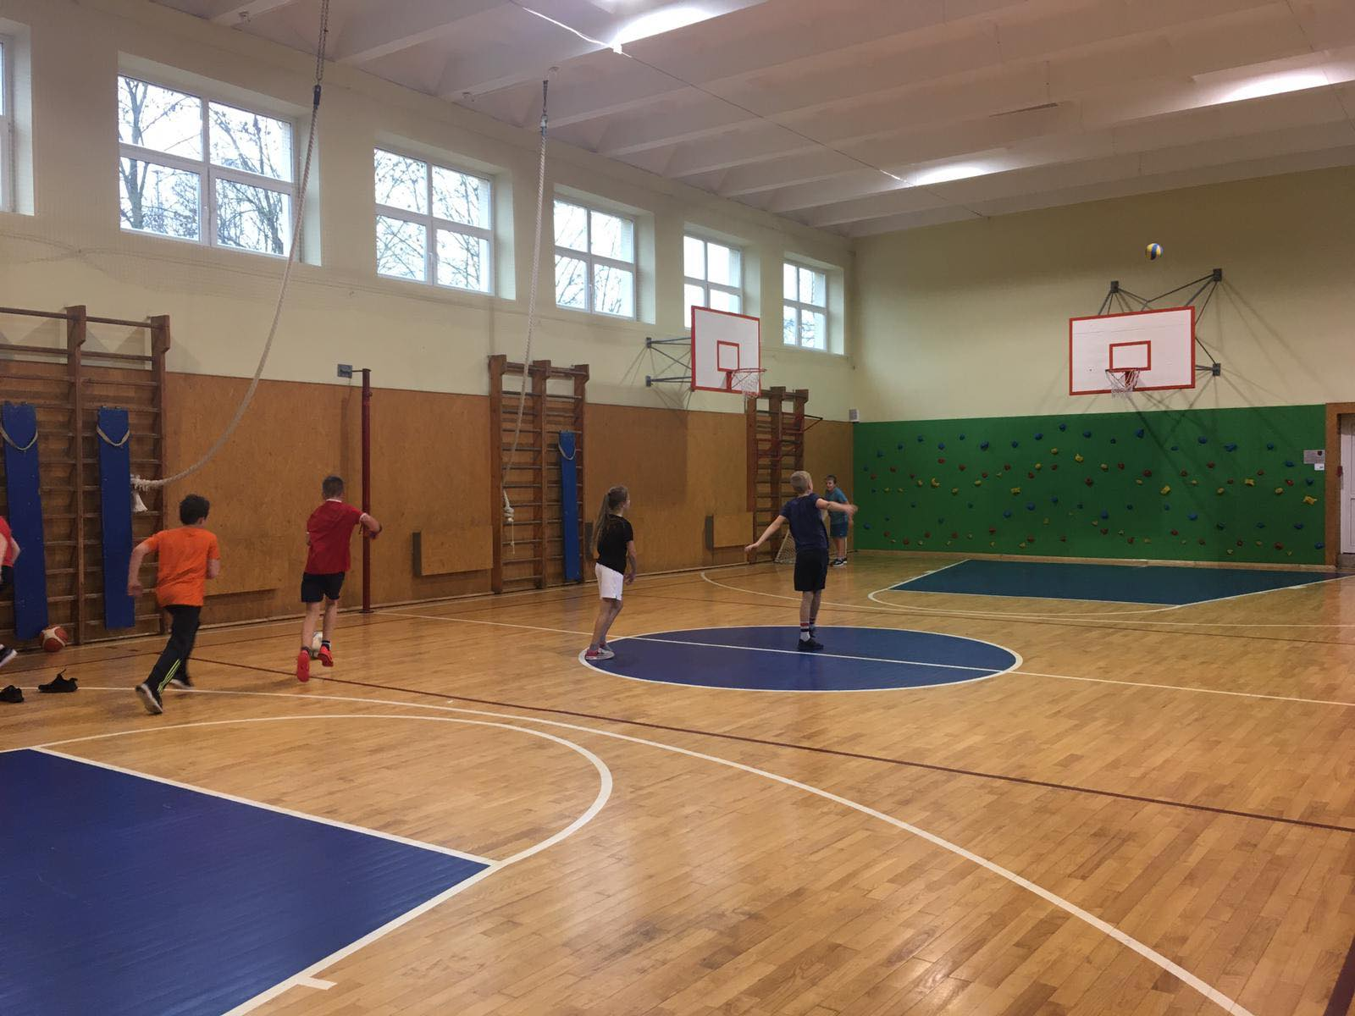
Gym
Our school has a big gym. In 2019 a climbing wall was built.
In our gym we can play every sports game.

Slide 13
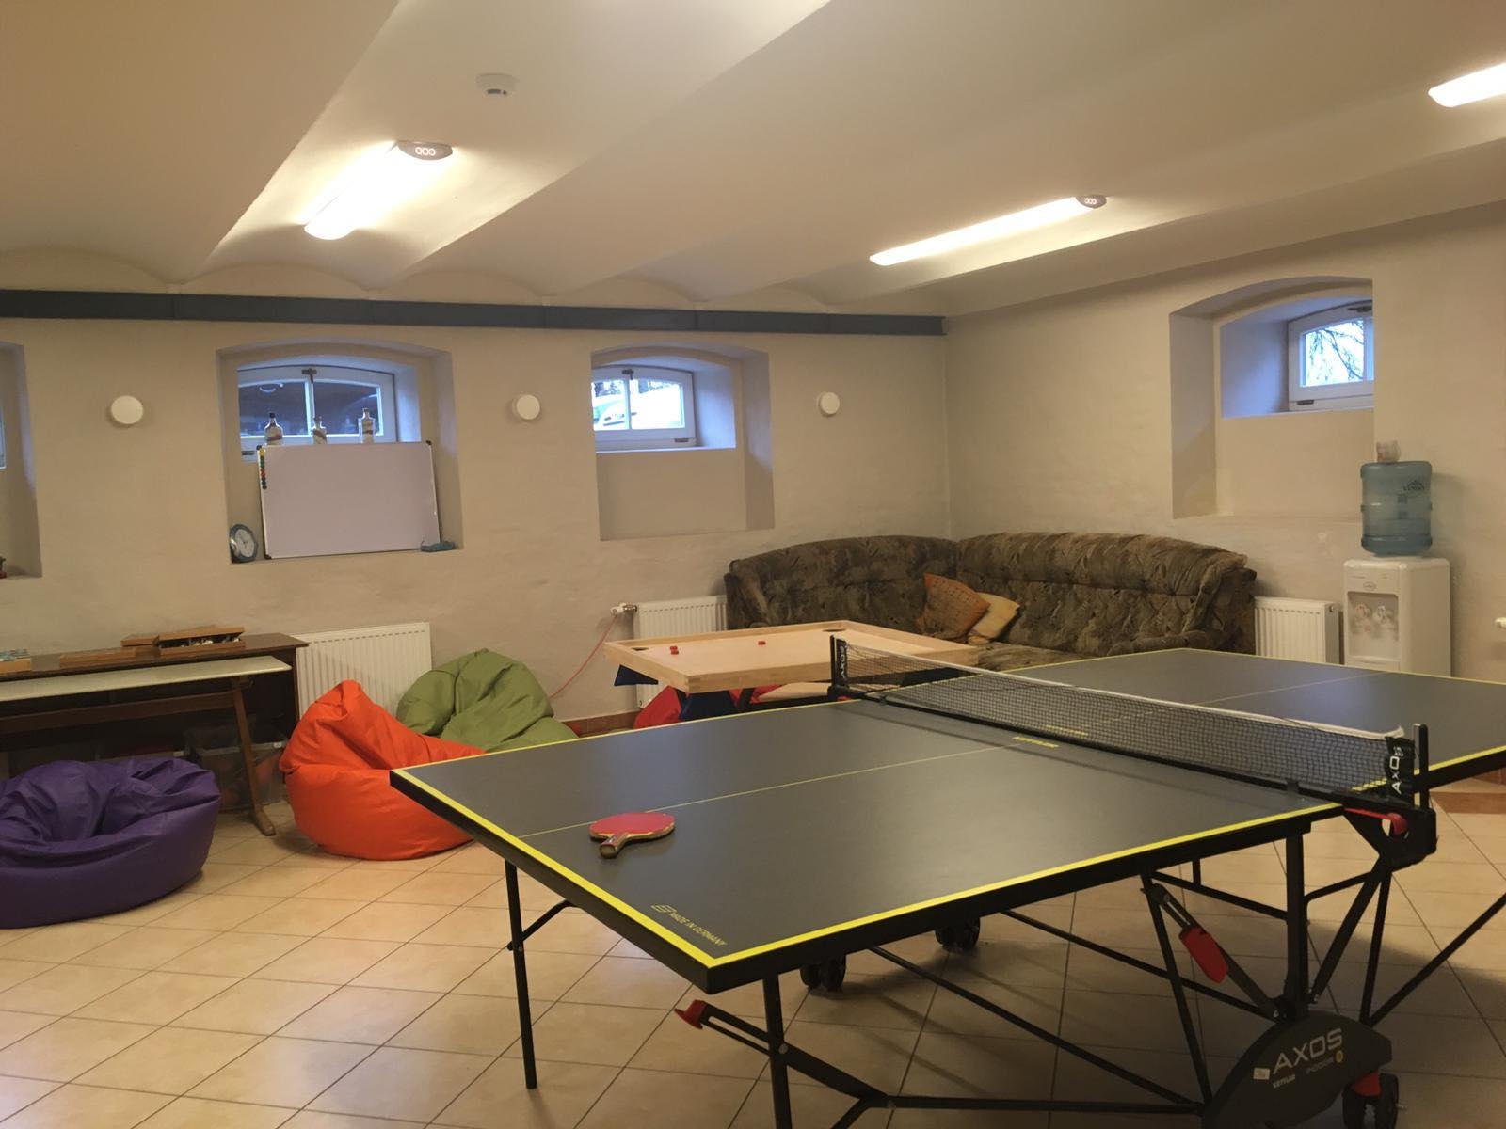
Game and relax room
We have a room where we can go and relax between lessons.
We can play all kinds of games, like board games, ping-pong, chess and others.
And we have a relax corner - a big sofa and bean bags, where we can sit and chat with our friends.

Slide 14
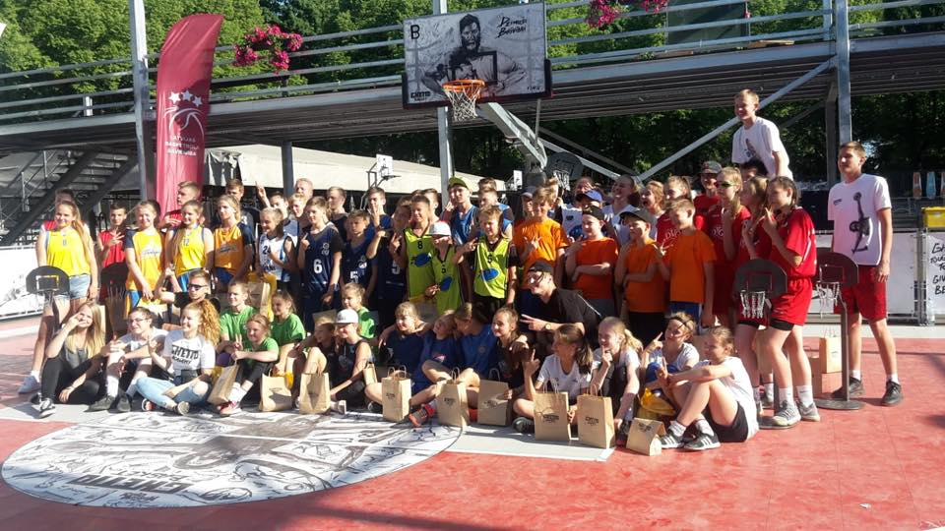
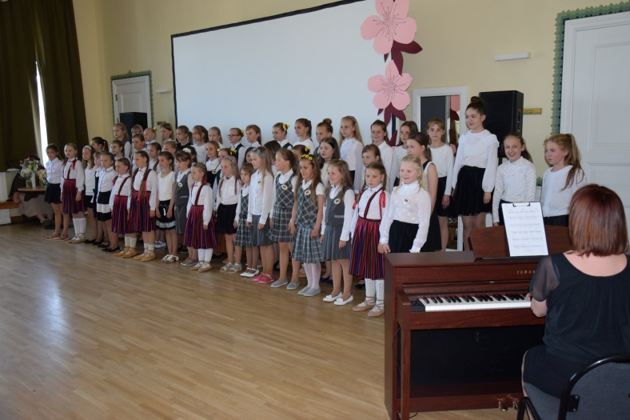
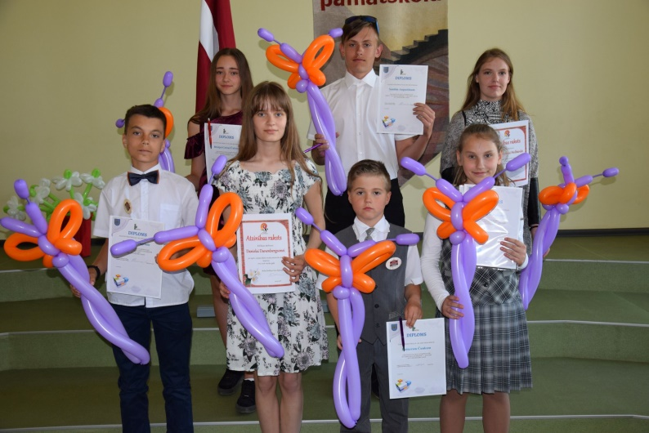
Students achievements
Our students love sports and art.
We have several sports teams and a choir with great results.

Slide 15
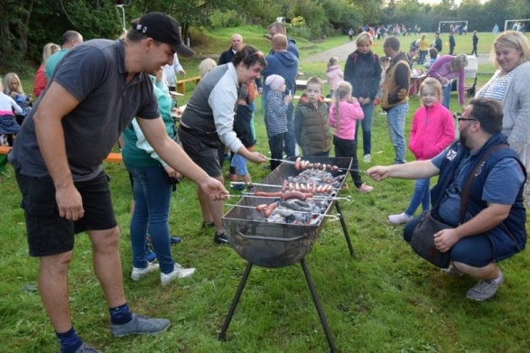
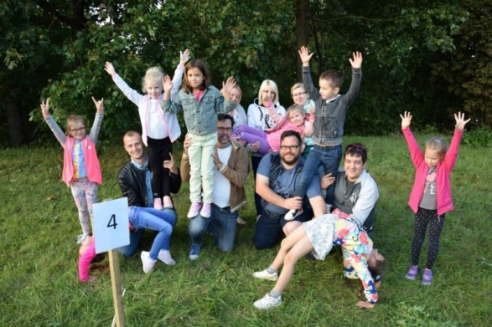
Schools activities and traditions
Our school has great traditions where everybody can join and have fun!
We have Fathers day activities:

Slide 16
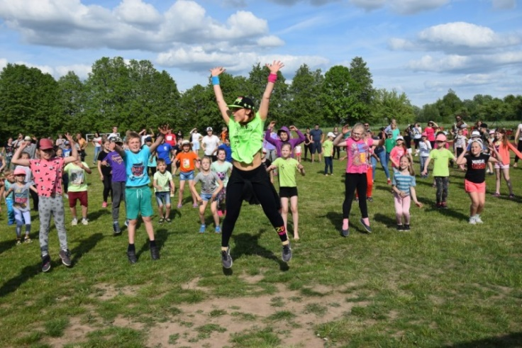
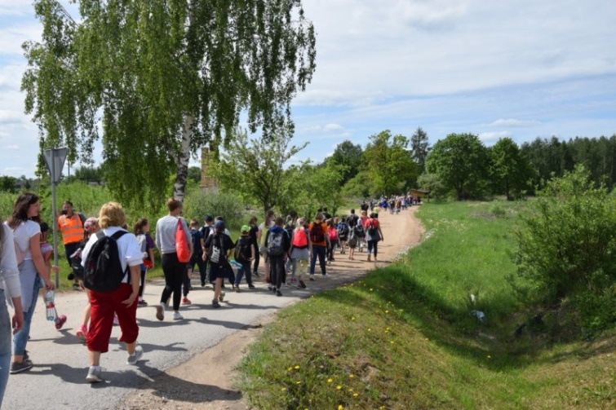
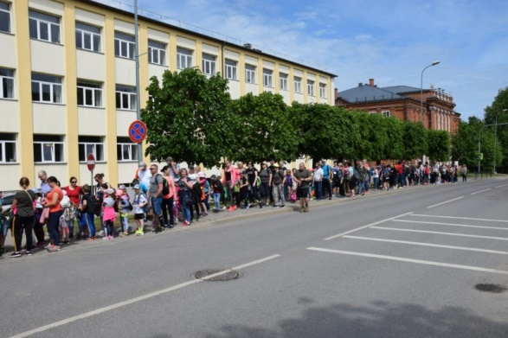
Schools activities and traditions
Spring hike from school to local sports field:

Slide 17
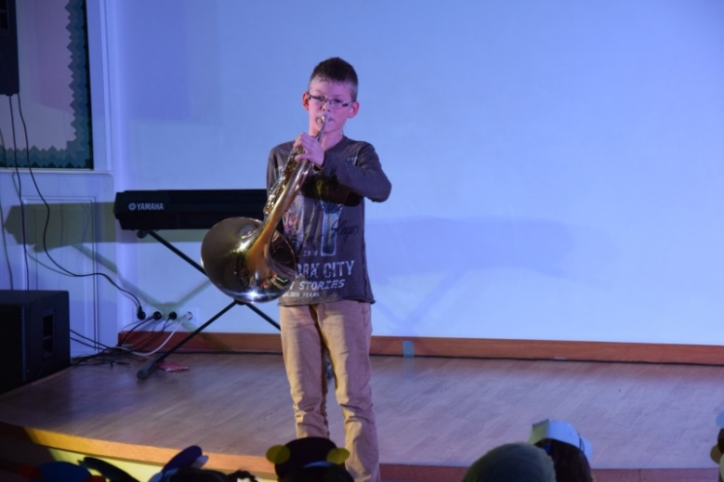
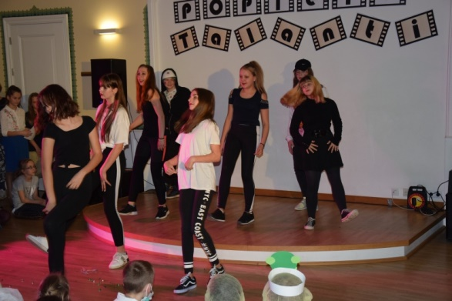
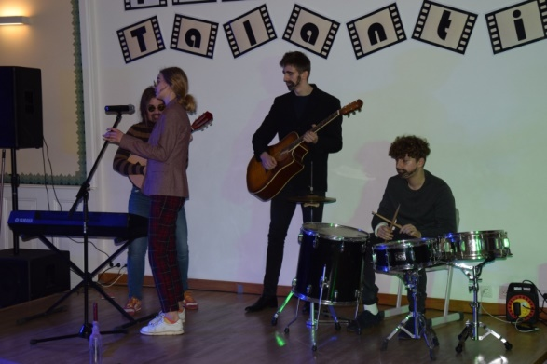
Schools activities and traditions
Talent show – the X factor:

Slide 18
THANK YOU FOR WATCHING!

