Slide 1
STUDENT MAIN AGENT
CURRICULUM
CONTENT
SIGNIFICANT LEARNING
MAKE OUR WORK PUBLIC
PBL
MAIN PRACTICAL TASK
CONFIDENCE
WELL BEING
BUILD NEW KNOWLEDGE FROM OWN EXPERIENCE
STUDENTS´
INTERACTION
THINKING SKILLS

Slide 2
GIVE REASONS
Interesting points
possible main tasks
STUDENT MAIN AGENT
1st step: agree on the project- DEBATE
CONVINCE CLASSMATES
THE SEA
STUDENTS´
INTERACTION
SIGNIFICANT LEARNING
2nd step: what we already know /what we want to know about
CONFIDENCE
WELL BEING

Slide 3
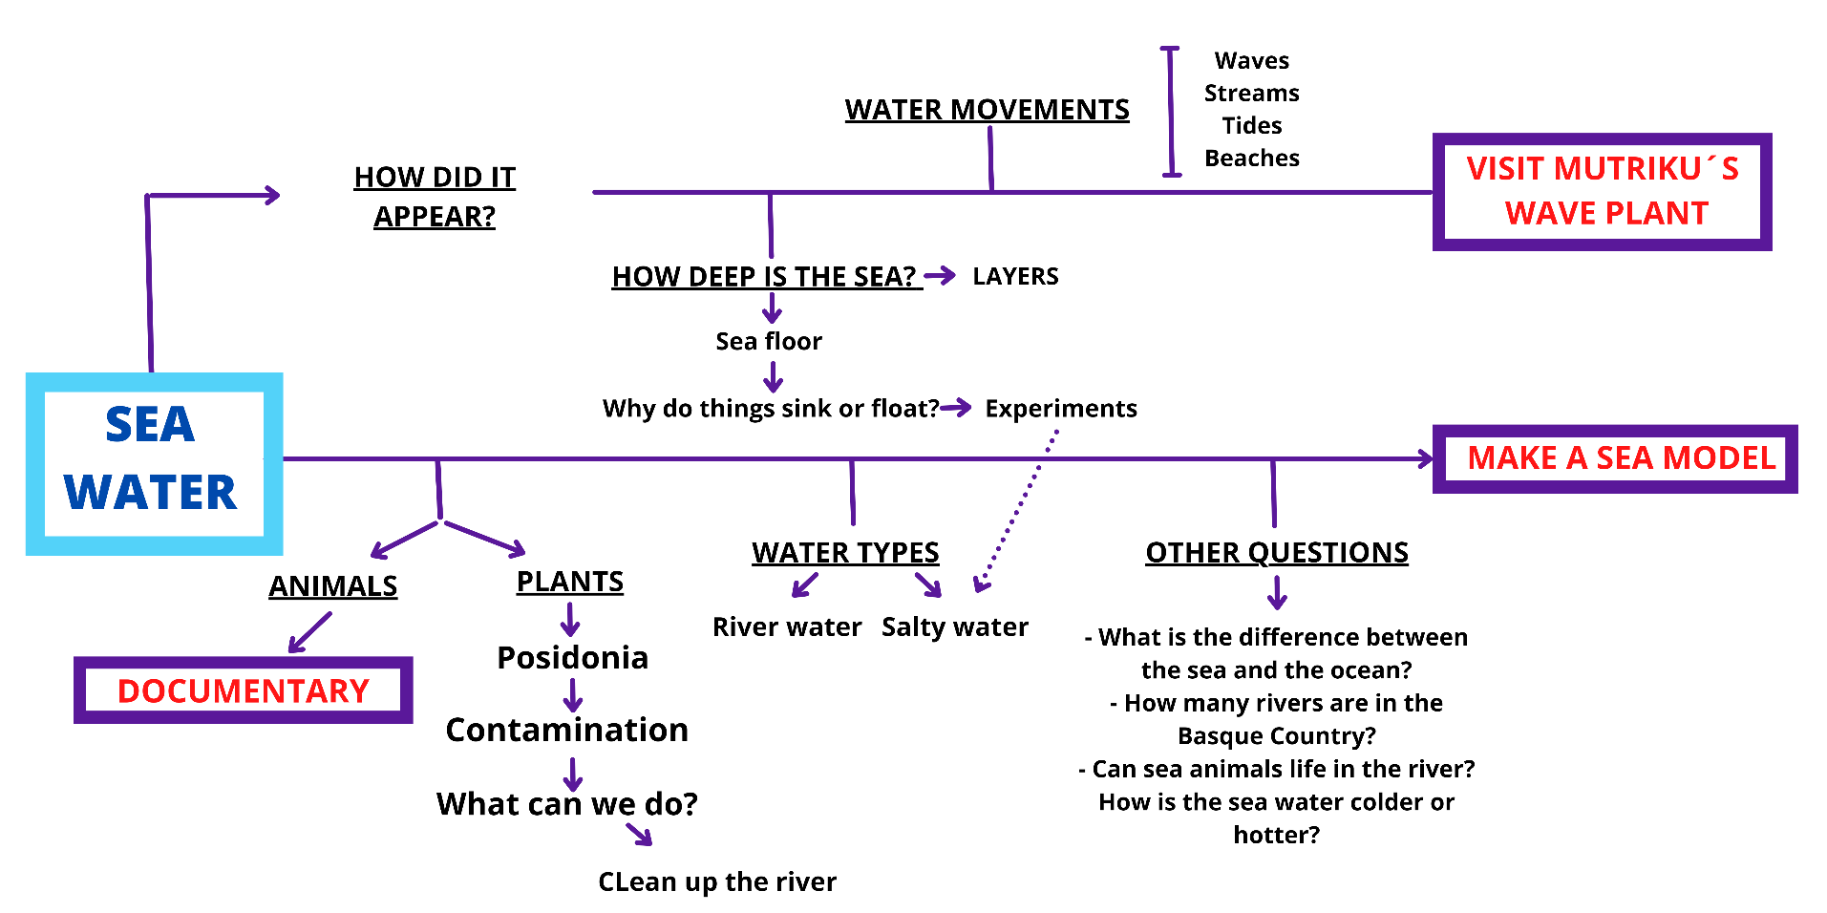
what we want to know about
Learn to satisfy our curiosity
PROJECT SCAFFOLDING
GUIDELINE

Slide 4
SHORTER
PROBLEM SOLVING SITUATIONS
BUILD NEW KNOWLEDGE FROM OWN EXPERIENCE
Sharing previous knowledge
Making hypothesis
Checking our previuos ideas and
hypothesis through
Reading
Videos
Experimenting
Listening to others´experiences..
THE SEA
Making use of thinking skills
CURRICULUM
CONTENT
Sharing strategies

Slide 5
THE SEA
CURRICULUM
CONTENT
HOW DEEP IS THE SEA?
POLLUTION
scale
MATHS
fractions
Scale poster of sea depth
percentage
Sea pollution
“2050. urterako itsasoan arrainak baino plastiko gehiago egongo dela uste da, pisuaren arabera. Baina nondik iristen dira hainbesteko zabor kantitateak gure itsasoetara? Zeintzuk dira hondakin horien iturri nagusiak? Itsas hondakinen %80 inguruk lehorreko jardueretan dauka jatorria: ingurune industrializatuak eta biztanle -dentsitate handiko tokiak dira iturburu nagusiak, eta lurretik itsasorako sarbidea erreketatik.”
The 80% of the sea wastes has its origin in land activities

Slide 6
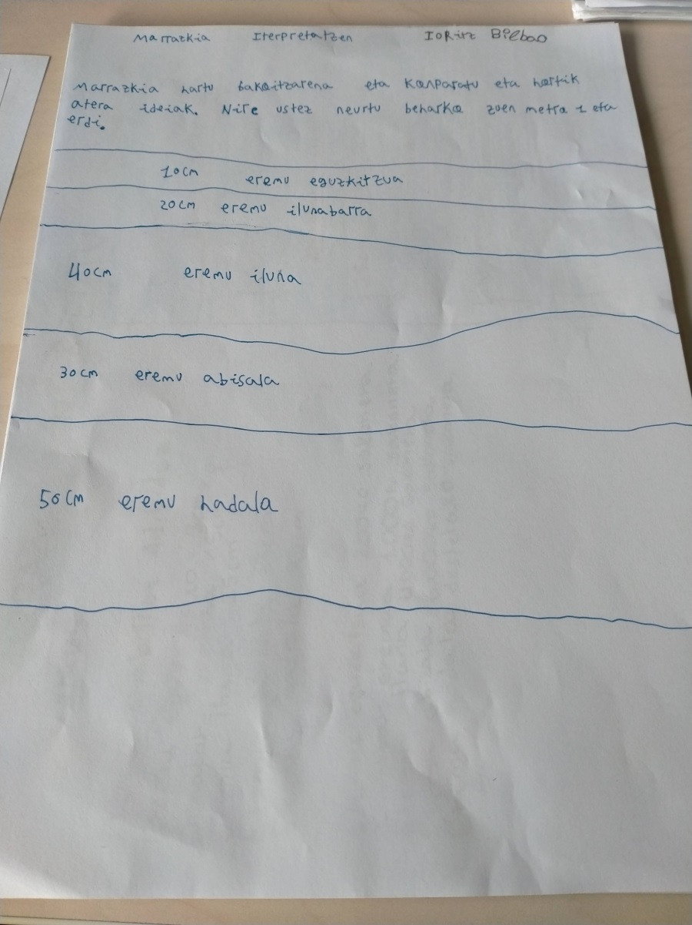
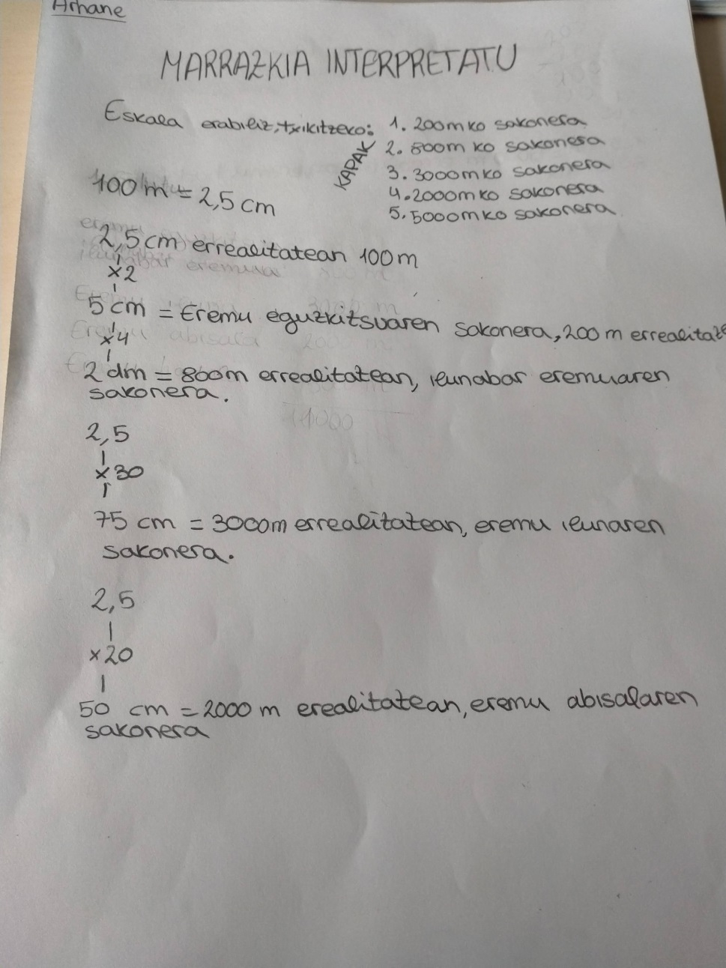
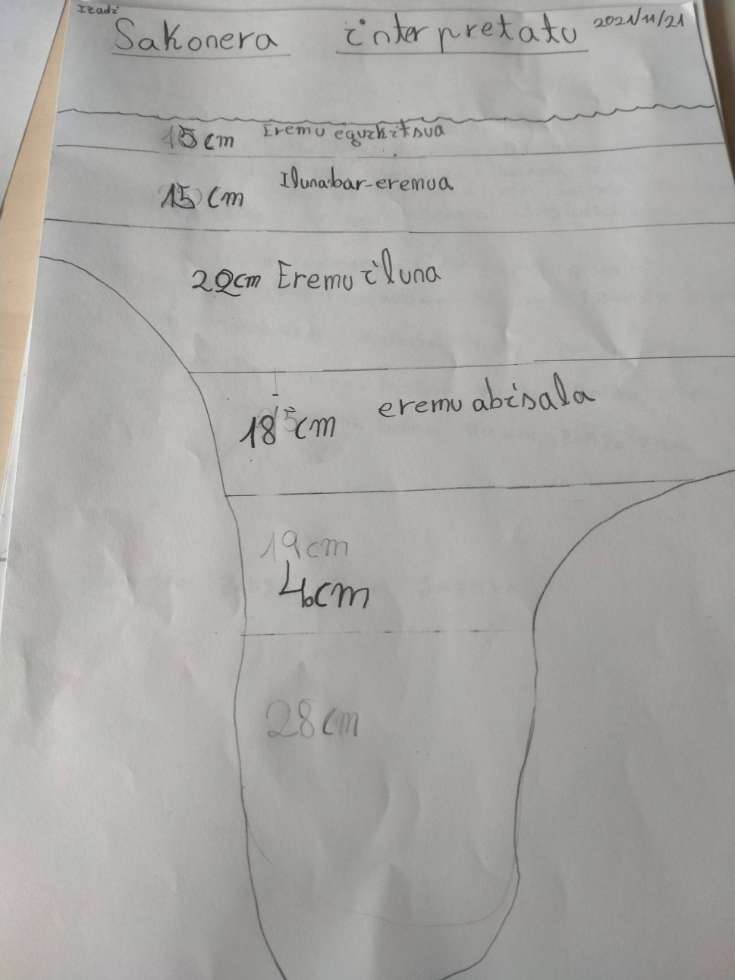
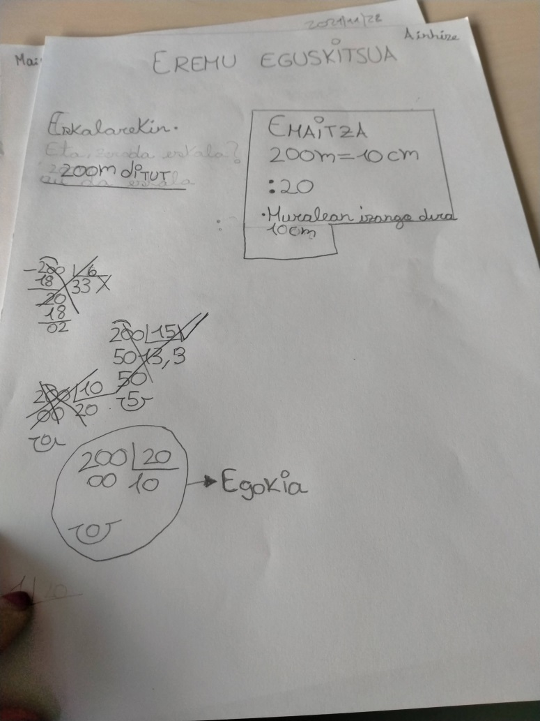

Slide 7
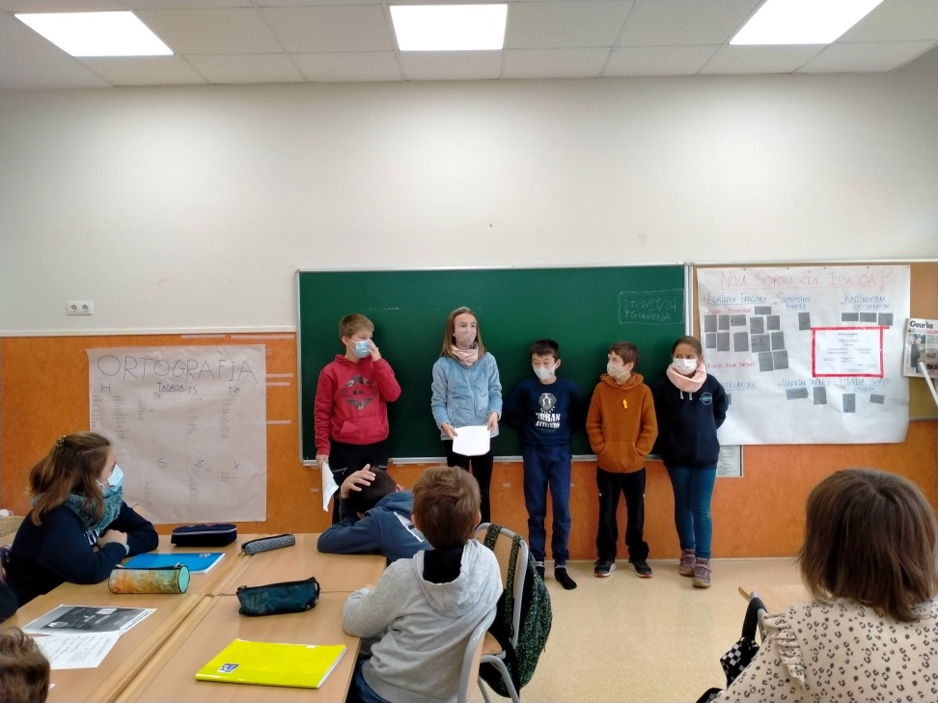
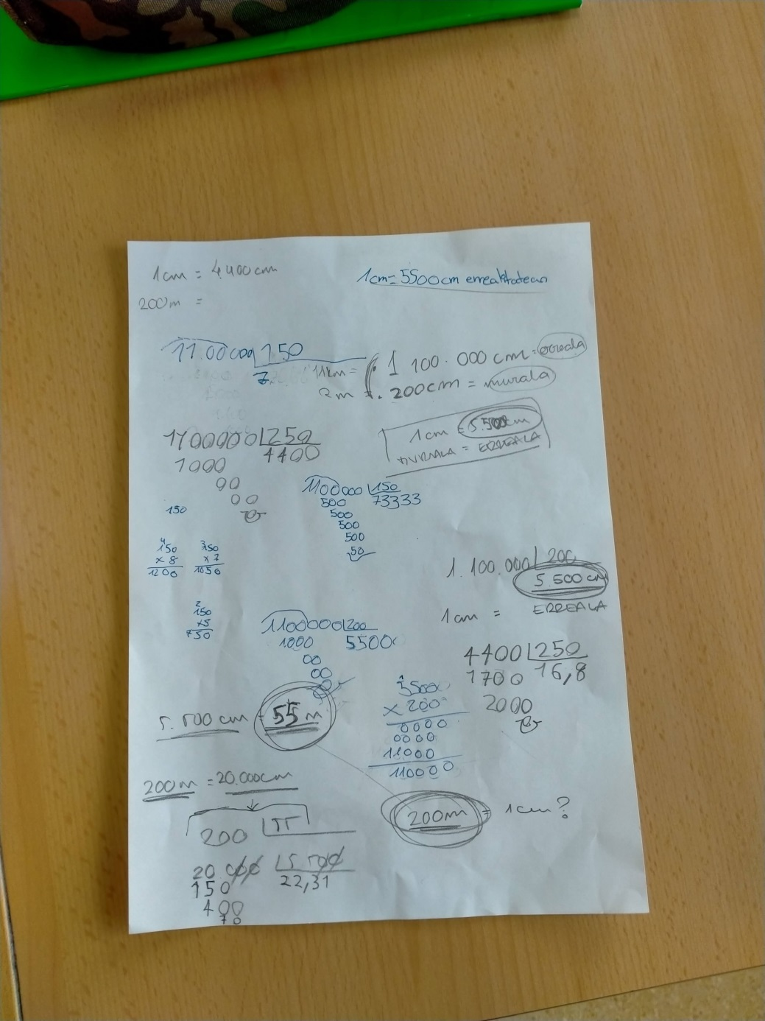
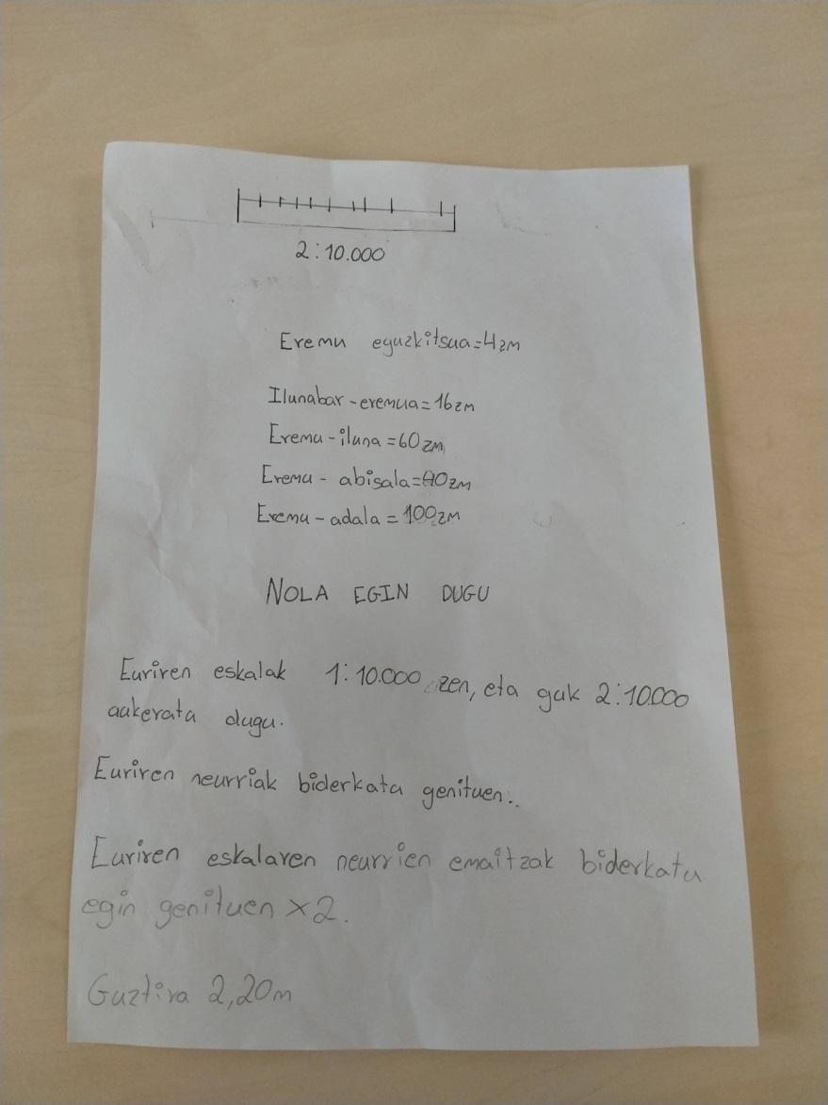
SHARE
STRATEGIES
AGREE ON THE MOST SUITABLE WAY

Slide 8
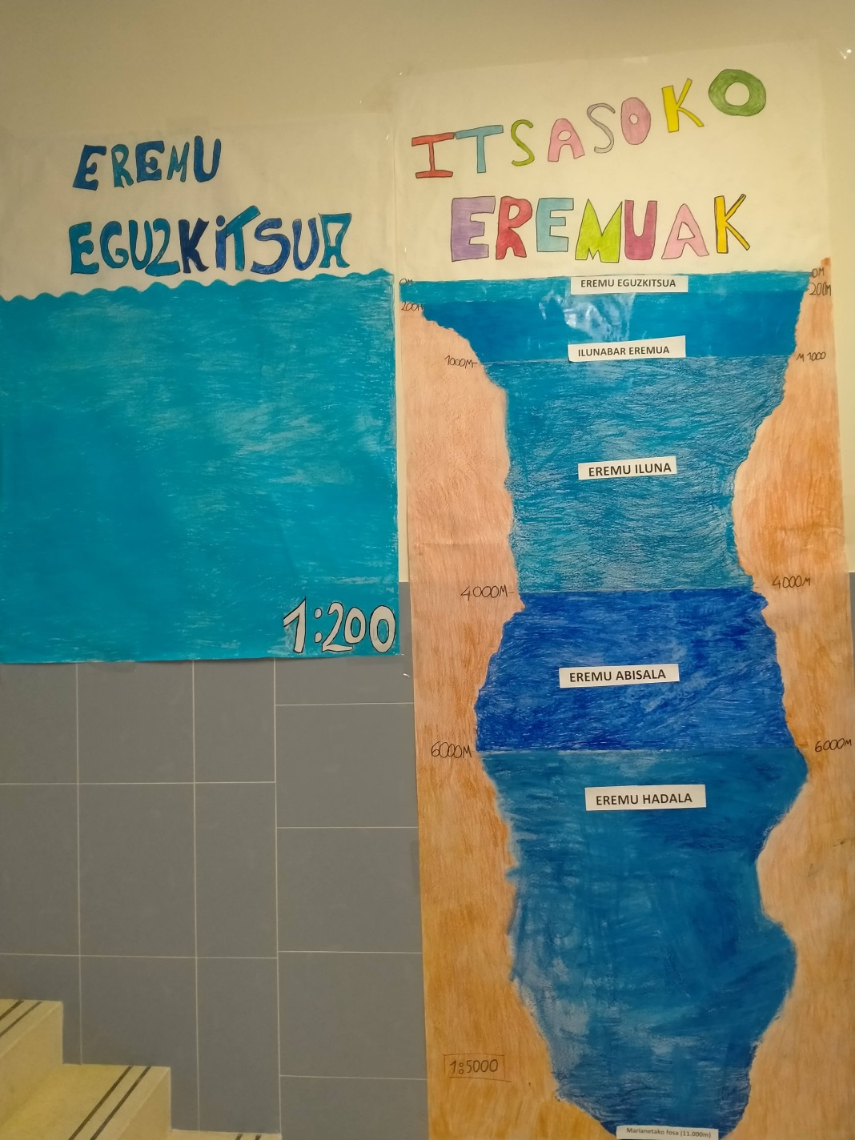
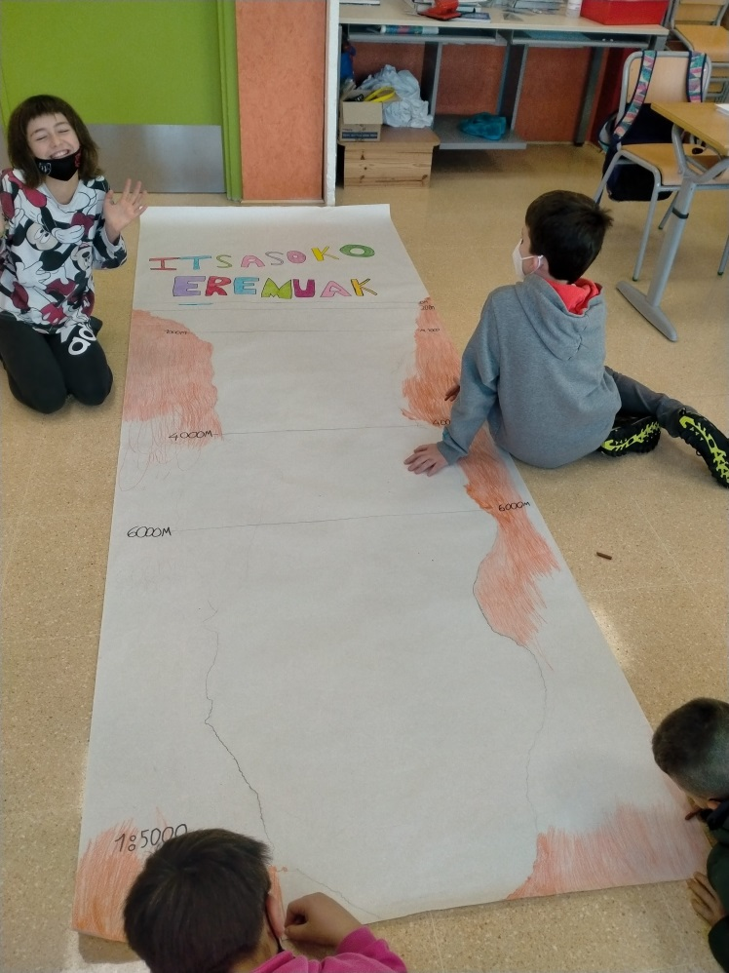

Slide 9
THE SEA
CURRICULUM
CONTENT
LANGUAGE
Reading
Making diagrams
Summarizing
Identifying main ideas
Writing different kinds of text in a real context:
Information text
Formal letter

Slide 10
THE SEA
CURRICULUM
CONTENT
GEAGRAPHY
SCIENCE
Seas & oceans
Basque rivers
Flotation
Water composition
Sea plants & animals
density
experiments

Slide 11
THE SEA
CURRICULUM
CONTENT
ENGLISH
Sea animals
Each student learns about one animal .
They share the information
Agree on what to do
DOCUMENTARY
Starting point:
What do we know about our animal? ( individual work)
How can we communicate that knowledge in English?

Slide 12
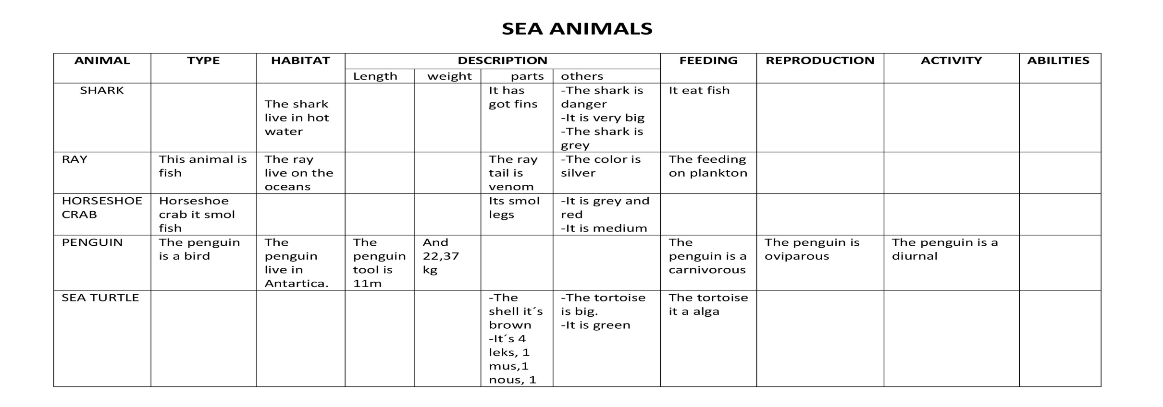
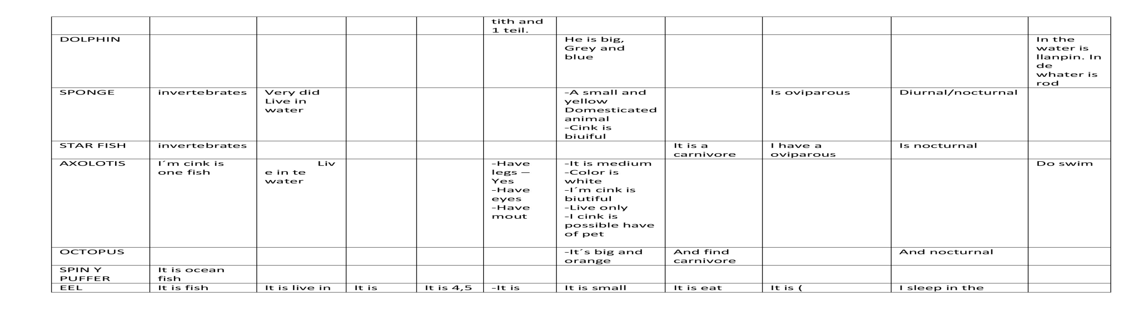
THE SEA
CURRICULUM
CONTENT
ENGLISH
Sea animals

Slide 13
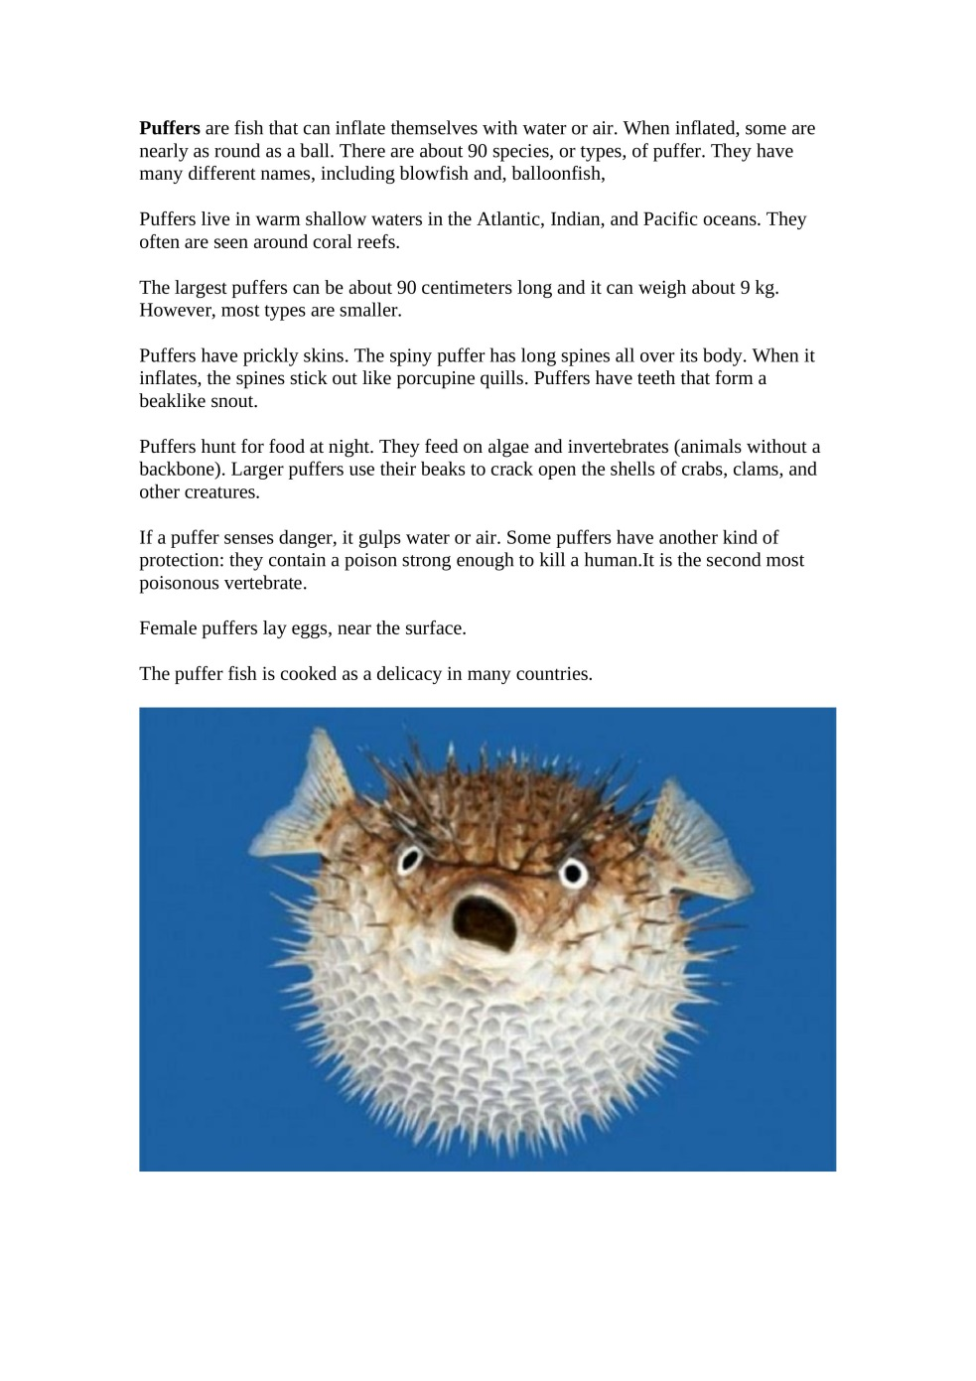
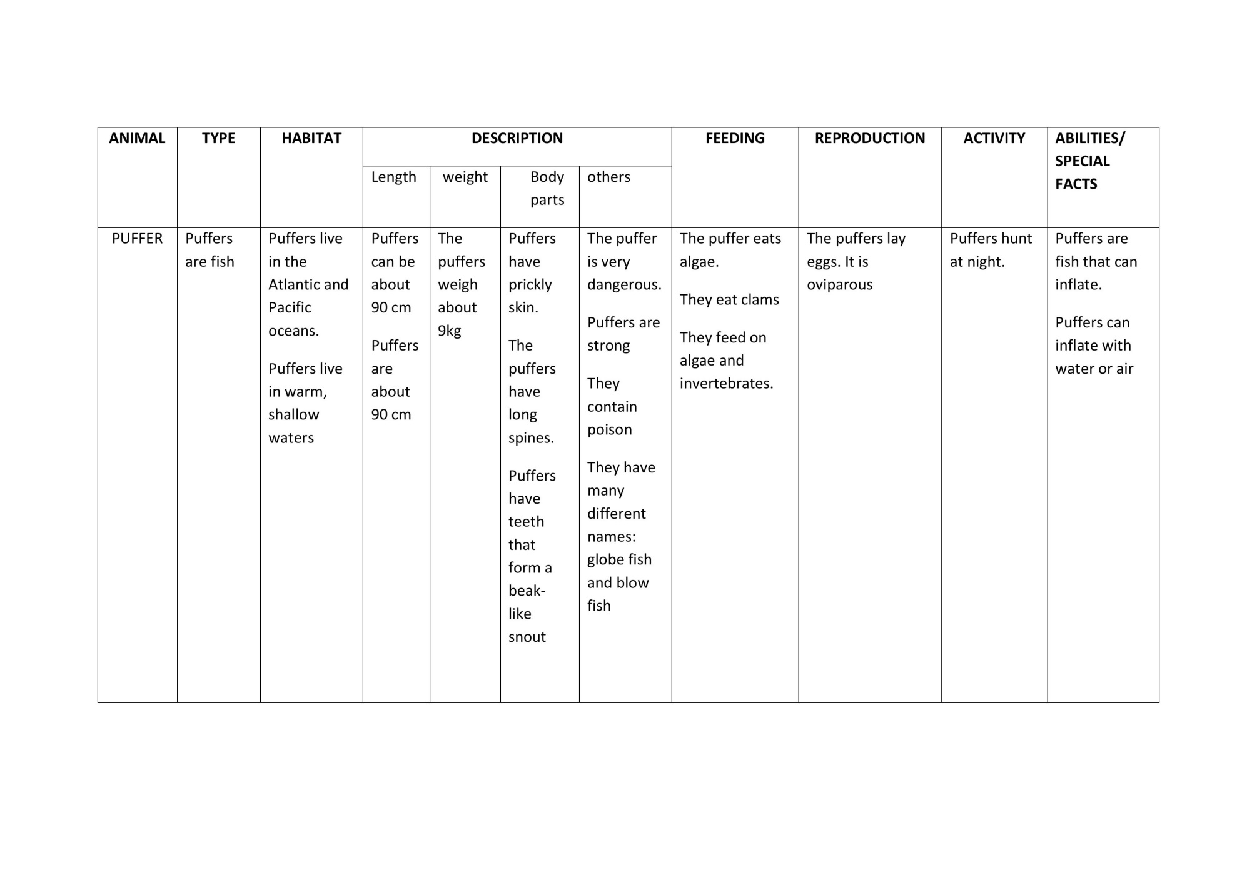

Slide 14
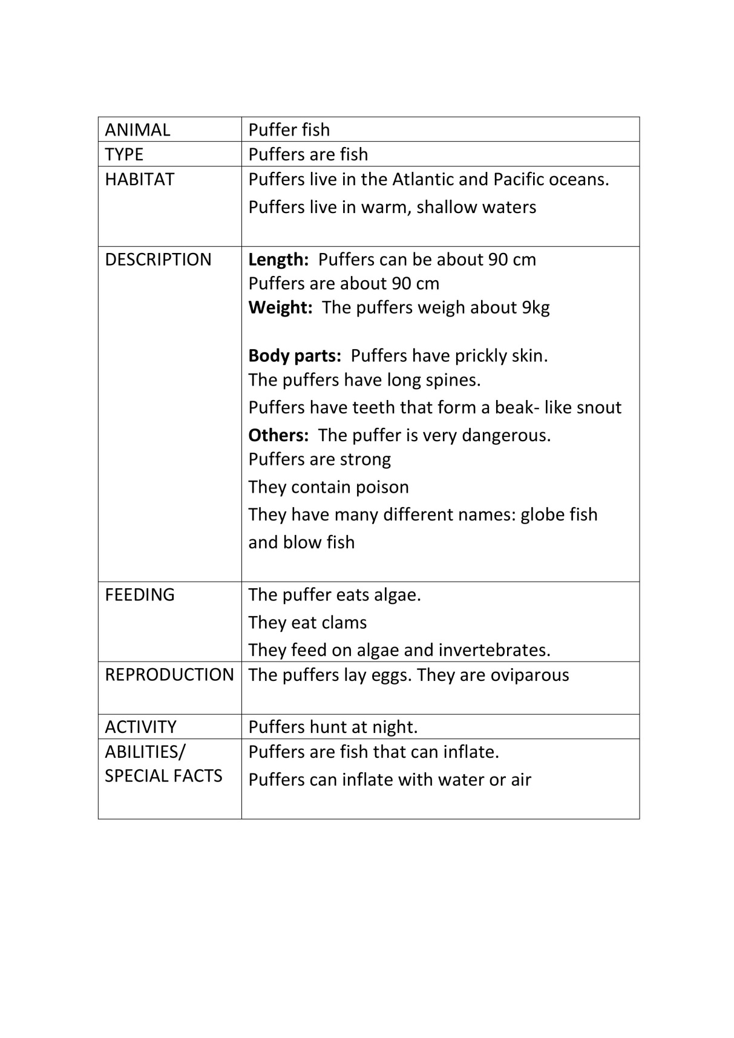

Slide 15
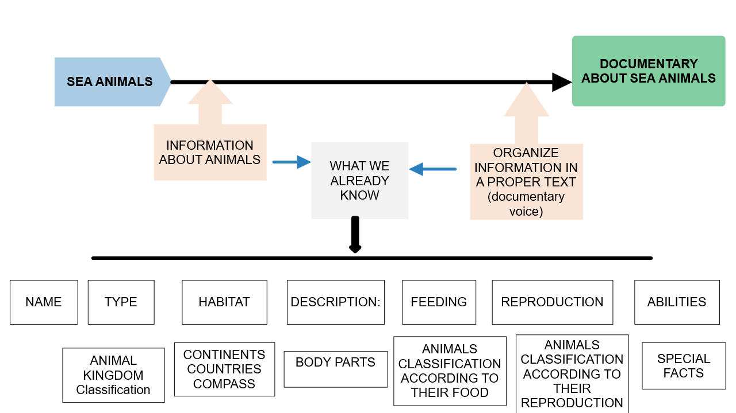
THE SEA
CURRICULUM
CONTENT
ENGLISH
Sea animals

Slide 16
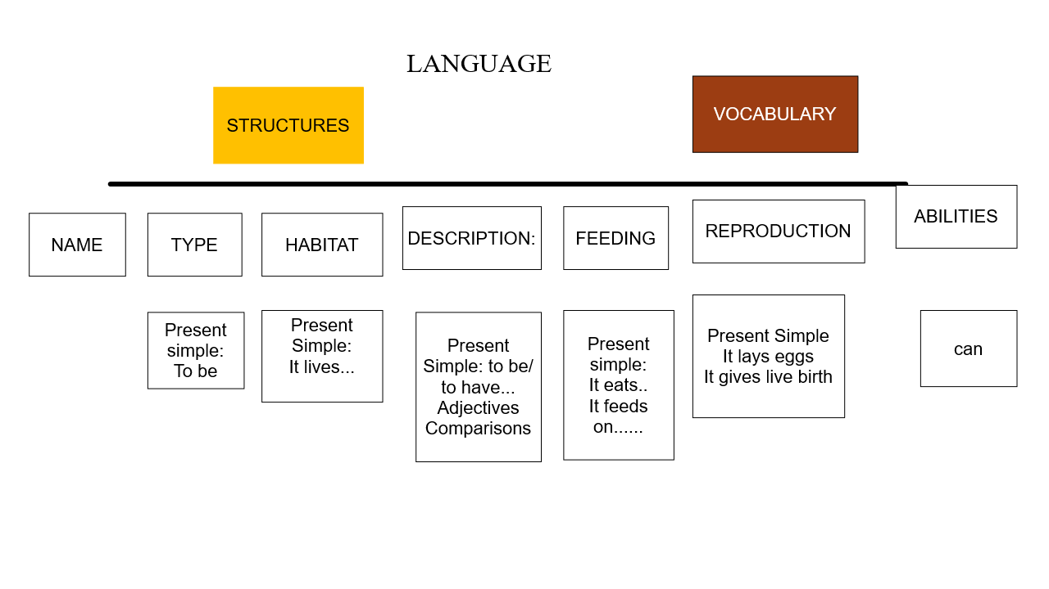
THE SEA
CURRICULUM
CONTENT
ENGLISH
Sea animals

Slide 17
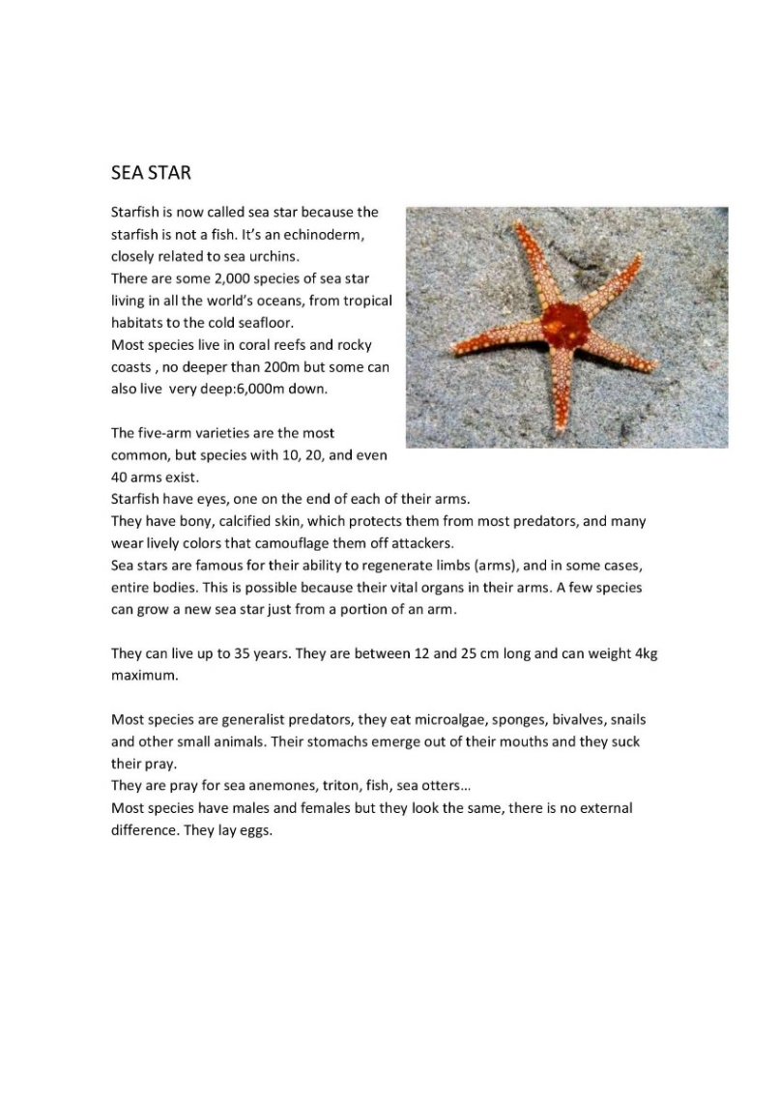
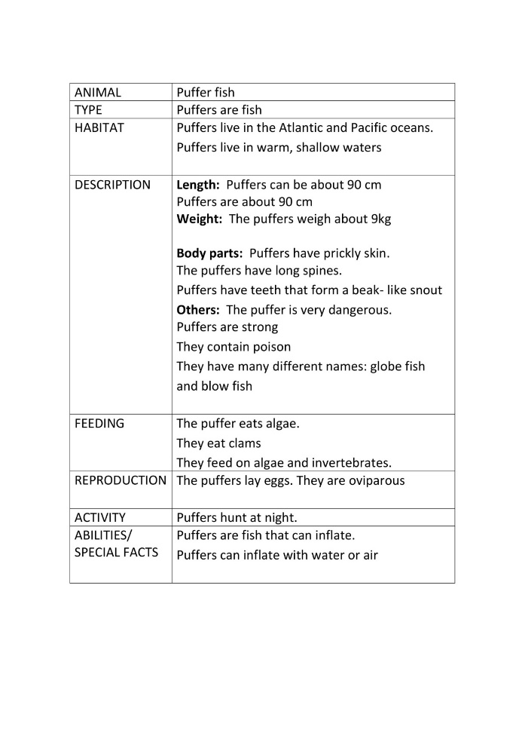
THE SEA
CURRICULUM
CONTENT
ENGLISH
Sea animals
Text for the
documentary
-Understand the language
-Understand the concepts

Slide 18

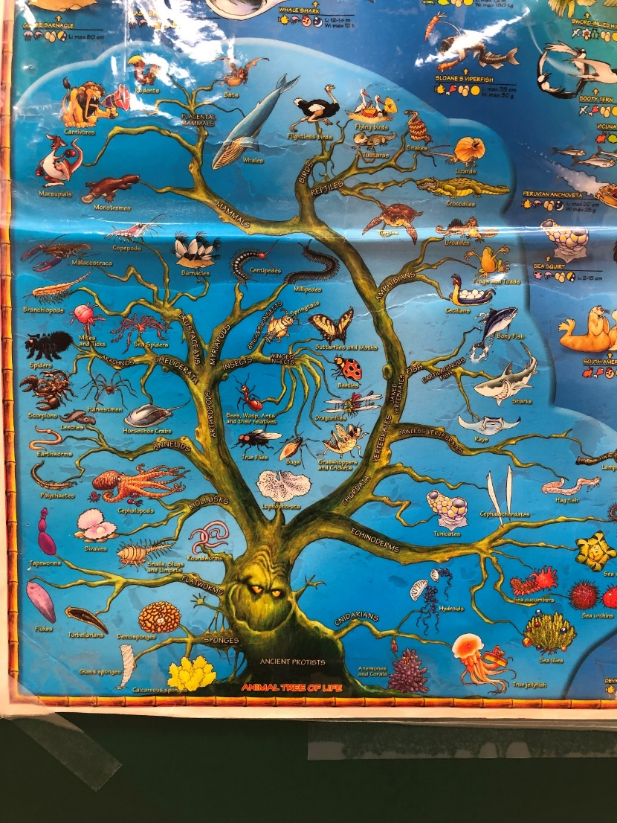
THE SEA
CURRICULUM
CONTENT
ENGLISH
Sea animals
concept
ANIMALS
CLASSIFICATION

Slide 19
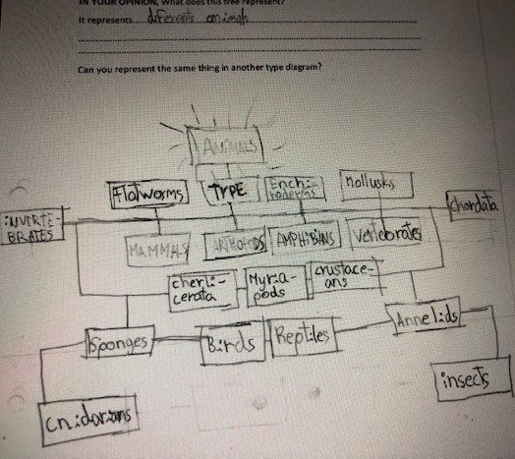
THE SEA
CURRICULUM
CONTENT
ENGLISH
Sea animals
- Manipulative model of a classification

Slide 20
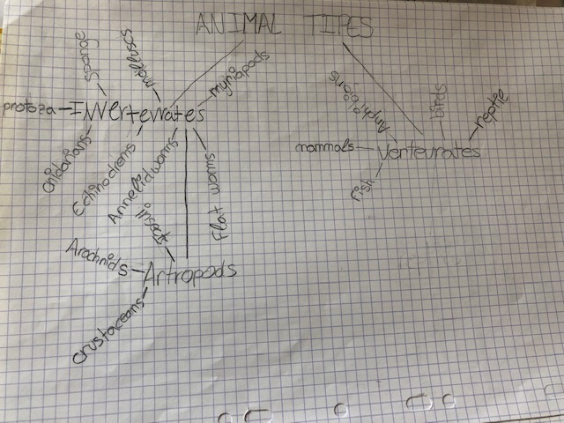
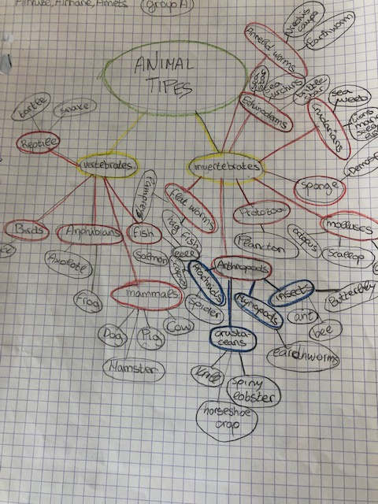
THE SEA
CURRICULUM
CONTENT
ENGLISH
Sea animals
-See a diagram of a classification from the scientifical point of view
- Watch a video

Slide 21
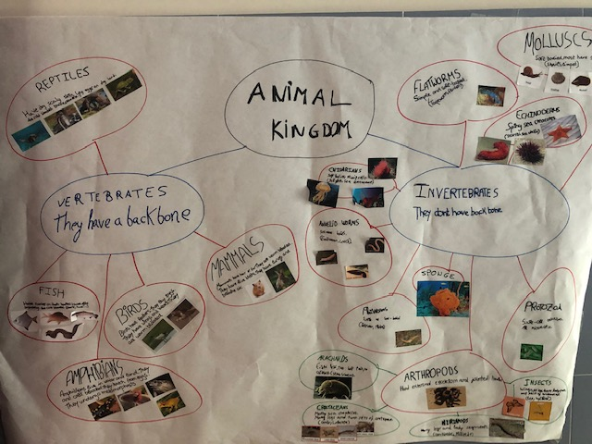
THE SEA
CURRICULUM
CONTENT
ENGLISH
Sea animals

Slide 22
THE SEA
CURRICULUM
CONTENT
ENGLISH
Sea animals
Language
Comparatives and superlatives.
Linkers: and, but, when, that….
Vocabulary…

Slide 23
THE SEA
CURRICULUM
CONTENT
ENGLISH
Sea animals
2nd
1st
Identify the different concepts in their texts
Make a list of situations that match those concepts to look for suitable photgraphs
Write the text
Improve it : peer work, teacher
3rd
4th
5th
Choose photographs
Learn how to use a video editor
Edit photographs as a video
Record their voices reading their text about the animal

Slide 24
