Slide 1
Jozef Stümpel

Slide 2
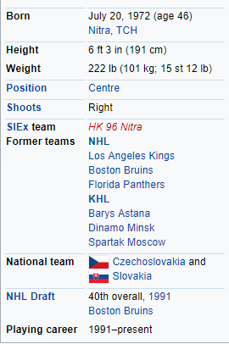
General information

Slide 3
Playing career
He started with hockey in his home town Nitra, hockey team HK Nitra.He started playing in the top Slovak league as a seventeen year old and helped the team to progress to the federal Czecho-Slovak league. He played in 49 matches where he scored 45 points for 23 goals, often partnering with Žigmund Pálffy. Wayne Gretzky and Mario Lemieux were Jozef’s top idols.

Slide 4
Jozef Stümpel was selected in the 2nd round, 40th overall, by the Boston Bruins in the 1991 NHL Entry draft, and immediately joined the Bruins organization. Prior to the 2004–05 NHL lockout season, Stümpel had played for only two clubs, the Bruins and the Los Angeles Kings. For the 2005–06 NHL season, Stümpel joined the Florida Panthers.
He was placed on unconditional waivers on June 27, 2008 and Florida decided to buy out his contract.
On May 4, 2011, Stümpel moved from KHL's Dinamo Minsk to Spartak Moscow.
A long-time friend of Žigmund Pálffy since the beginning of their professional careers, they were often line-mates on the Slovak national team.

Slide 5
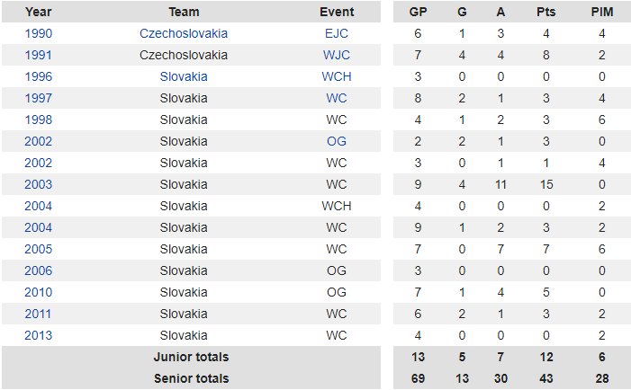
Most important stats from matches

Slide 6
3 questions
Who was Jozef Stümpel?
At what age did he play in the first national Slovak league for the first time?
How many goals did he score in 1991 at the world junior championship WJC (look at the stats)?

