Slide 1
JULIUS ZEYER

Slide 2
Basic information
he was born in 1841 in Prague
his family had French and Jewish origin
his native language was German
his Czech nanny told him old stories
he studied technology in Prague
he did not finish his studies

Slide 3
More about him
he travelled a lot
his most favourite place in Bohemia was town Vodňany
last years of his life he spent in Vodňany
Zeyer was one of the romance writers
he wrote epic verse or written prose, less lyrics

Slide 4
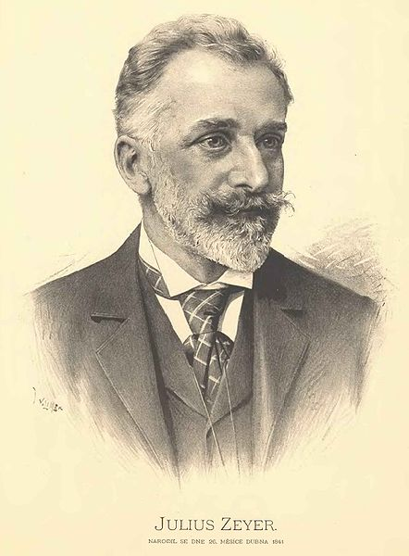
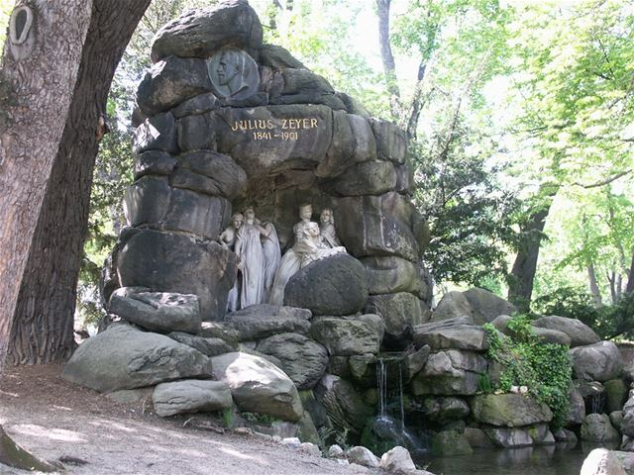
Memorial of Julius Zeyer

Slide 5
Sources
Julius Zeyer. In: TOPZINE [online]. Praha: CzechNetMedia, 2018 [cit. 2018-11-21]. Dostupné z: https://www.topzine.cz/wp-content/uploads/2010/09/442px-Jan_Vil%C3%ADmek_-_Julius_Zeyer.jpg
Julius Zeyer. In: NEVIDITELNÝ PES [online]. Praha: O.Neff, 1996 [cit. 2018-11-21]. Dostupné z: http://neviditelnypes.lidovky.cz/foto.aspx?r=p_architekt&c=A131020_202635_p_architekt_wag&foto=WAG4eae41_Julius_Zeyer.JPG
Julius Zeyer. In: Wikipedia: the free encyclopedia [online]. San Francisco (CA): Wikimedia Foundation, 2001- [cit. 2018-11-21]. Dostupné z: https://cs.wikipedia.org/wiki/Julius_Zeyer
Julius Zeyer. In: Osobnosti.cz [online]. Praha: Tiscali Media, 1996 [cit. 2018-11-21]. Dostupné z: https://www.spisovatele.cz/julius-zeyer#cv

