Slide 1
Adam Ďurica
by Adam Tóth

Slide 2
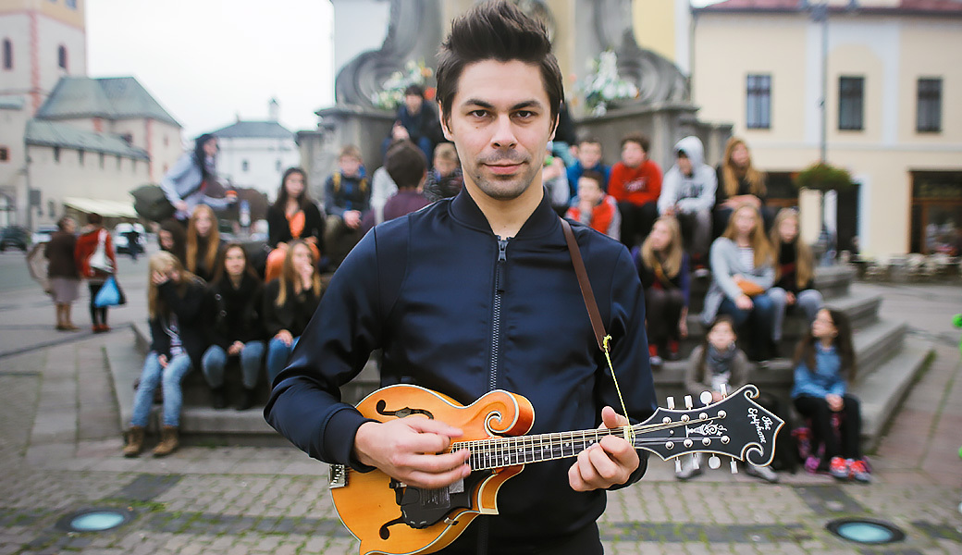
Adam Ďurica was born on 1st November 1987 in Nitra.
He is a slovak singer, musician, songwriter, and music producent.
He plays the bass, electric and acoustic guitar and mandolin.
He released four albums under Universal Music
He plays pop, folk and country

Slide 3
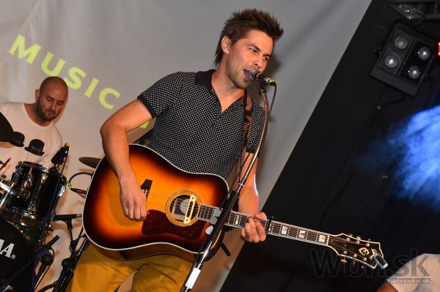
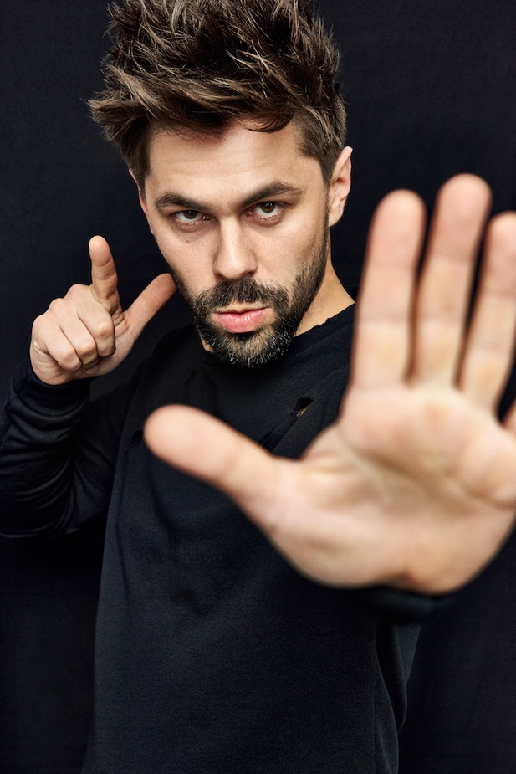
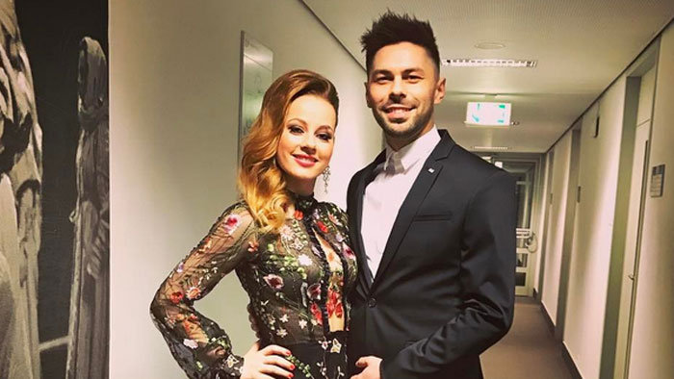
He played shows for 10,000 people
He won "singer of the year" three times
He became an engineer of BOZP
His mother is an artist and his father is also an engineer
His brother Michal played the piano with Adam in the same band
He first public appearance was in the first season of "Slovensko Hľadá Superstar” where he got to Top50

Slide 4
1. Wich of these instuments Adam doesn't play?
A) bass
B) piano
C) mandolin
2. How many times did Adam win "The singer of the year" ?
A) once
B) three times
C) five times
3. Under what label did Adam release his four albums?
A) Universal Music
B) Sony Music
C) Warner Music Group

Slide 5
Thank you for your attention

