Slide 1
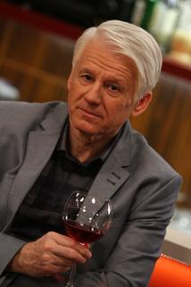
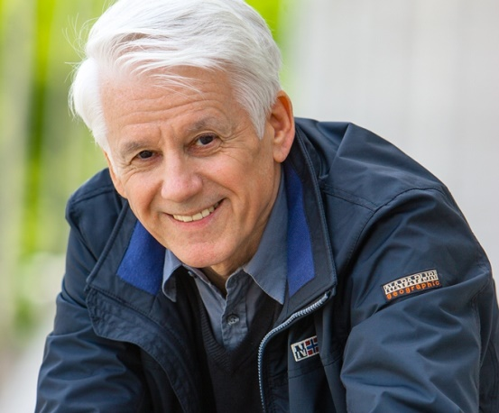
Emil Hotváth
Created by Ivan Dobrotka

Slide 2
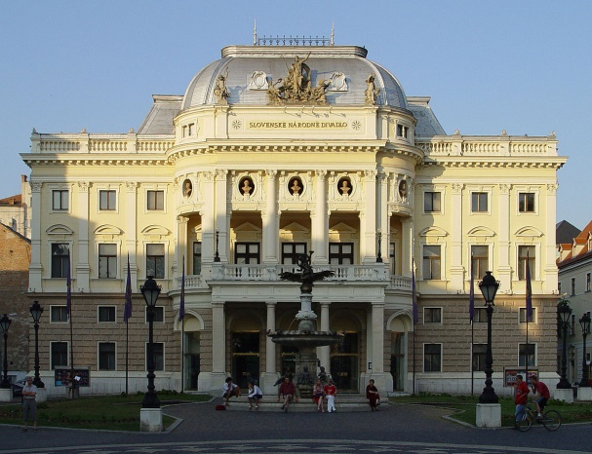
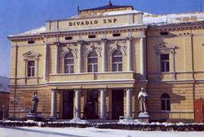
He was born on November 12, 1945 in Nitra, Czechoslovakia. He is an actor, director and theater pedagogue.
He graduated at The Academy of Performing Arts in Bratislava in 1968.
Slovak National Theater
He was a member of SNP Theater in Martin until 1976 and later in New Scene in Bratislava until 1983. Since then he is a member of The Slovak National Theater where he portrayed a lot of characters.
SNP Theater

Slide 3
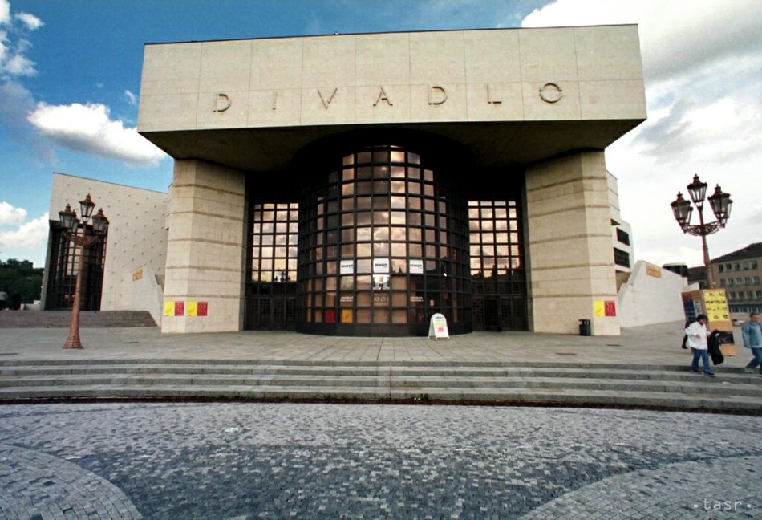
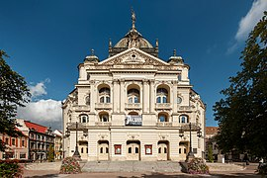
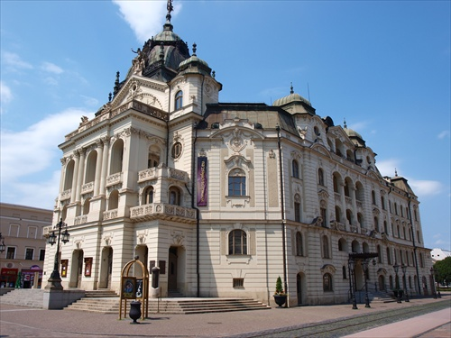
State Theater Košice
Andrej Bagar Theater
In recent years he has been directing himself. As director he also guest-performs in Bratislava theater West, in Andrej Bagar Theater in Nitra and State Theater Košice. He has played in many movies, TV productions and serials.

Slide 4
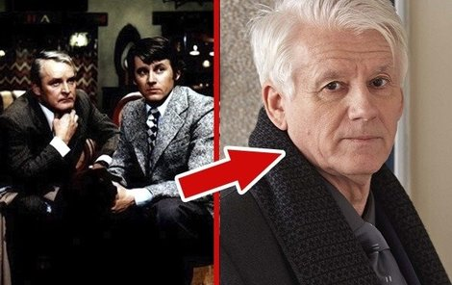
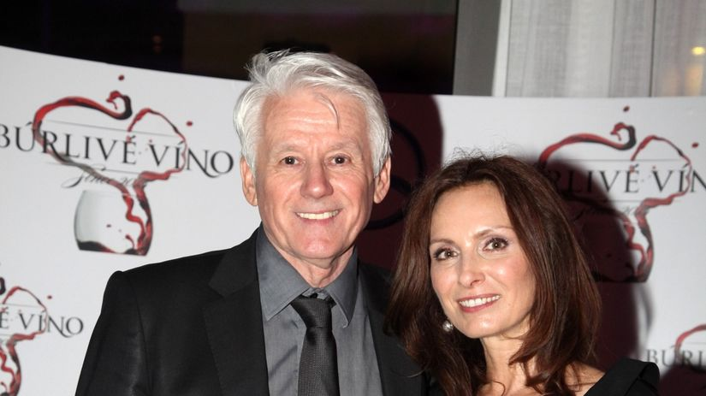
Some of the most popular shows are Thirty Cases of Major Zeman, Stormy Wine and Ordination in pink garden

Slide 5
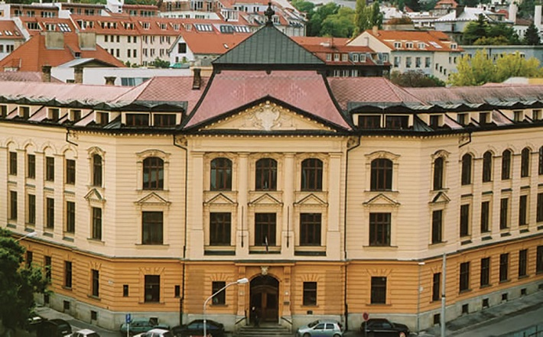
In 2005, the President of the Slovak Republic honoured him with Ľudovít Štúr II. Class award for significant credit in the field of cultural development.
He is a lecturer at The Academy of Performing Arts in Bratislava, where he received the title of Professor in 2005.

Slide 6
THE END
Thanks for your attention

Slide 7
Question time!!!
1.Who is Emil Horváth? a.) Actor, Director b.) Bricklayer c.) Accountant
2. When was he born? a.)1943 b.)1945 c.)1949
3. What title did he receive in 2005? a.) PhD. b.) Ing. c.) prof.

