Slide 1
MATEJ TÓTH
Slovak race walker
Samuel Varga III. MEPG

Slide 2
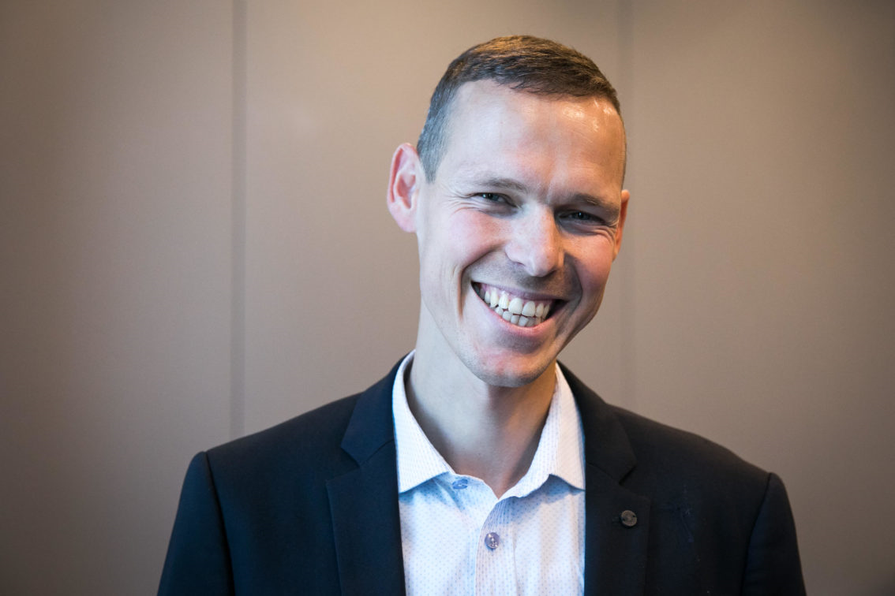
Matej Tóth
Slovak race walker
Born in Nitra, Slovakia in 1983
35 years old
Married

Slide 3
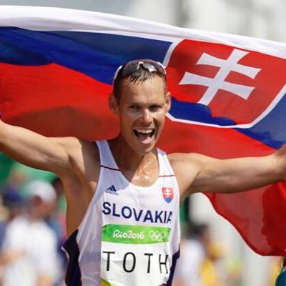
Matej Tóth
Won the gold medal in the 50 km walk at the 2010 IAAF World Race Walking Cup followed by gold at the 2015 World Championships, taking Slovakia´s first gold at the championships ever.
Finished first at the 2016 Olympic games in 50 km walk, winning the first Slovak Olympics medal in athletics.
Current olympic champion
in the 50 km walk.

Slide 4
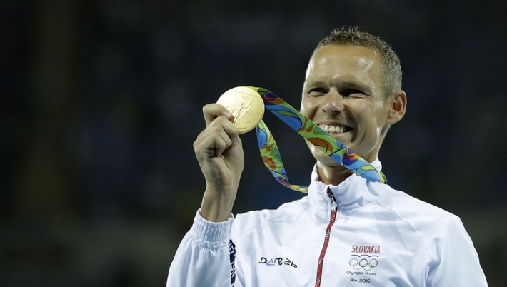
Matej Tóth and his records
He was named the 2006 Slovak Athlete of the Year.
Medals:
Olympics: 1 gold medal (2016)
World Championships: 1 gold medal (2015)
European Championships: 2 silver medals (2014, 2018)
World Race Walking Cup: 1 gold medal (2010)

Slide 5
Matej Tóth, his family and education
His wife´s name is Lenka. He has two children.
His daughter´s name is Emma, she is 11 years old.
His second daughter is Nina, she is 9 years old.
He studied at the UKF in Nitra, he graduated in 2006. His sports carrer began in 1996.

Slide 6
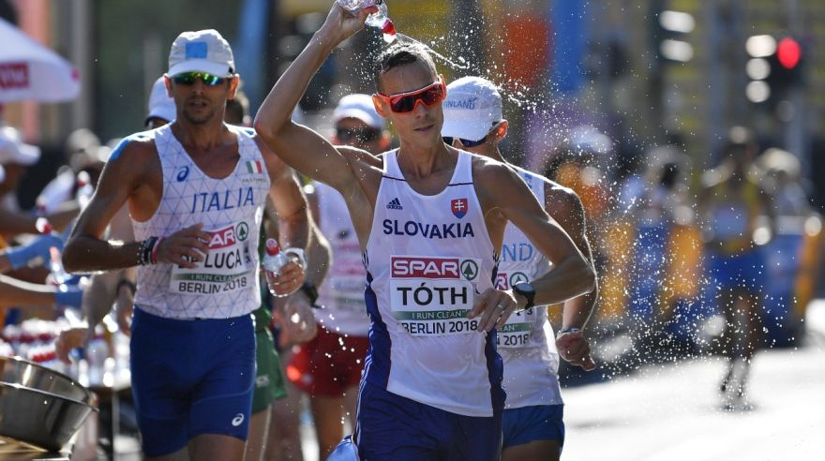
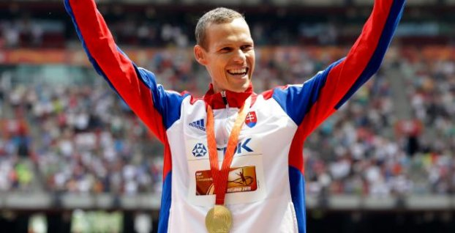

Slide 7
Questions:
1. In which city was he born?
Bratislava
Košice
Nitra
2. How many children does he have? ____________
3. What is his wife´s name?
Lenka
Adriana
Eva
4. When was he born? ____________
5. Where did he study? ____________

Slide 8
Thank you for your attention...

