Slide 1
Jan bauer
made by Karolína Lálová 2.VG

Slide 2
Jan Bauer is a Czech writer, journalist and amateur painter. He was born 11th of April 1945 in Jihlava. He is interested in fact literature and historical novels, but he is originally an agricultural engineer. In his early years he wrote under the pseudonym "Felix Krumlovský" and "Vojtěch Fišer". Now he is a profesional writer and journalist.

Slide 3
He was born in Jihlava, but later his family moved to Český Krumlov, where he finished the secondary school (SVVŠ). He studied Agricultural High School in České Budějovice. In years 1968-1998 he worked as journalist (redactor of Agricultury news´s diary. Later he became a profesional writer. He lives in a solitary house at Vodňany.

Slide 4
He has written fact literature since 2000.
- Towns, which disappeared
- Hussitain wars - betrayed legend
- Jesus - the secret man from Bethlehem
- Dissapeared towns´s tales

Slide 5
He wrote crime stories for nine years.
- The killer am I
- Death to death
- The death is coming with a grin
- Spy´s daughter

Slide 6
He has written historical novels since 2006.
- Save the king
- King doesn´t know a brother
- King rises the sword
- The bloody summer

Slide 7
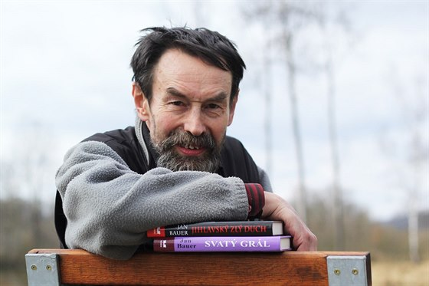

Slide 8
Used sources
https://www.google.cz/search?hl=cs&tbm=isch&source=hp&biw=1680&bih=908&ei=PX76W-qHA6StrgScvYSwBA&q=jan+bauer+vodnany&oq=jan+bauer+vodnany&gs_l=img.3...919.3959..4184...0.0..1.150.1779.11j6......1....1..gws-wiz-img.....0..0j35i39j0i30j0i5i30j0i8i30j0i19j0i30i19j0i8i30i19j0i5i30i19j0i24.VyIQ-EYmLAY#imgrc=RP3Am7eFJeEXAM:
https://cs.wikipedia.org/wiki/Jan_Bauer_(spisovatel)
https://www.spisovatele.cz/jan-bauer-spisovatel

