Slide 1
Jozef Stümpel
Martin Chovanec

Slide 2
Jozef Stümpel (born July 20, 1972) is a Slovak professional ice hockey centre currently playing for HK Nitra of the Slovak Extraliga.
Jozef Stümpel was selected in the 2nd round, 40th overall, by the Boston Bruins in the 1991 NHL Entry draft, and immediately joined the Bruins organization.

Slide 3
Prior to the 2004–05 NHL lockout season, Stümpel had played for only two clubs, the Bruins and the Los Angeles Kings.

Slide 4
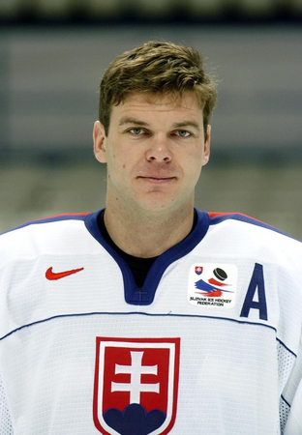
He was placed on unconditional waivers on June 27, 2008 and Florida decided to buy out his contract.
On May 4, 2011, Stümpel moved from KHL's Dinamo Minsk to Spartak Moscow.

Slide 5
Questions:
* When was Jozef Stümpel born?
* For what club is he playing right now?
* For which clubs did he play prior to the 2004–05 NHL lockout season?

