Slide 1
František Herites Karolína Šarešová

Slide 2
Byography
František Herites was born on the 27 of february in 1851 in Vodňany.
He was Czech pharmacist , writer , poet and reditor.
He wrote short stories and feuilletons.
He died in 1929 in Prague.

Slide 3
Information
He studied a grammar school in Písek and then he studied in Prague.
He started to work as pharmacist in Štýrském Hradci.
He traveled to Tatry , Italy and America.
In 1883 he worked as pharmacist after his father.
In 1896 he sold the hous because he didn‘t have a money.
He was Lumírovec.

Slide 4
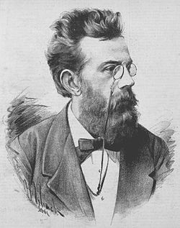
Literary work
Arabesky and fresky
Tajemství strýce Josefa
Za dědictvím

