Slide 1
JULIUS ZEYER
Kulířová Anna

Slide 2
Julius Zeyer
- Zeyer was born in Prague on 26. April 1841
- He was a Czech prose witer, poet and playwright
- His mother's name was Eleonora and his father's name was Jan Zeyer
His father came from French nobility and his mother was from a Jewish family
- He had seven siblings

Slide 3
Julius Zeyer
His family spoke German
He learned the Czech language from his nanny
His dad expected that Julius will take over the family's factory, but he decided to learn carpentering (truhlářství) instead
His attempts to sudy high school and university were unsuccessful

Slide 4
Julius Zeyer
During his life he often travelled in Europe and to Orient
After 1877 he moved to Voďnany, where he had a lot of friends and where he spent over a decade with literary work
He was Lumírovec (a group of writers)
Apparently he was a homosexual
Afrerwards, he returned to Prague
He died in Prague in 1901 (he was 59 years old)

Slide 5
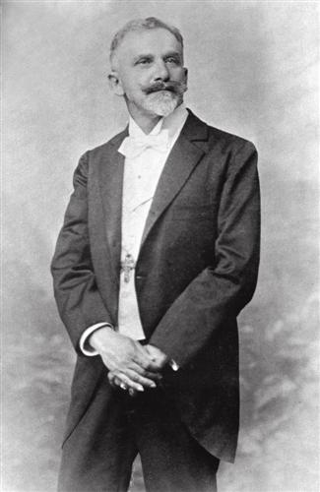
Julius Zeyer
His works:
- Radús a Mahulena
- Zpěv o pomstě za Igora
- Gompači a Komurasaki

Slide 6
Questions
In what century was he born and where?
Who was J. Zeyer?
What kind of family did his mother come from?
How many siblings did he have?
How did he learn Czech?

