Slide 1
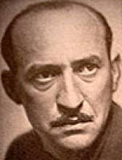
Andrej Bagar
Slovak actor director pedagogue
Born in 29.10.1900, Trenčianske Teplice
† 31. júl 1966, Bratislava

Slide 2
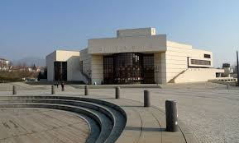
He is not from Nitra, but everybody from Nitra knows him.
A town square and theatre are named after him.

Slide 3
When he was 12 years old so in 1914, he went to study decorating in Vienna but at the same time he studied on artistic industrial school. From 1922 he studied acting in Prague. Garden was his frst bigger role, which changed his life.

Slide 4
He played in theatres in Košice, Pardubice and in SND. He played in films too.
Andrej founded and led the Front Theatre.
In 1939-40 he was inprisoned for his antifascist activities. After he worked as a director of Bratislava radio under name Ján Minárik.

Slide 5
He was a minister od Slovak republic for a number of years. He was rewarded a number of prizes for his work, e.g. Czechoslovak War Cross

