Slide 1
ICT SKILLS
RESULTS OF THE SPANISH TEAM

Slide 2
1. Defining information needs.
September 2018 January 2021
Gained experience in defining information needs.

Slide 3
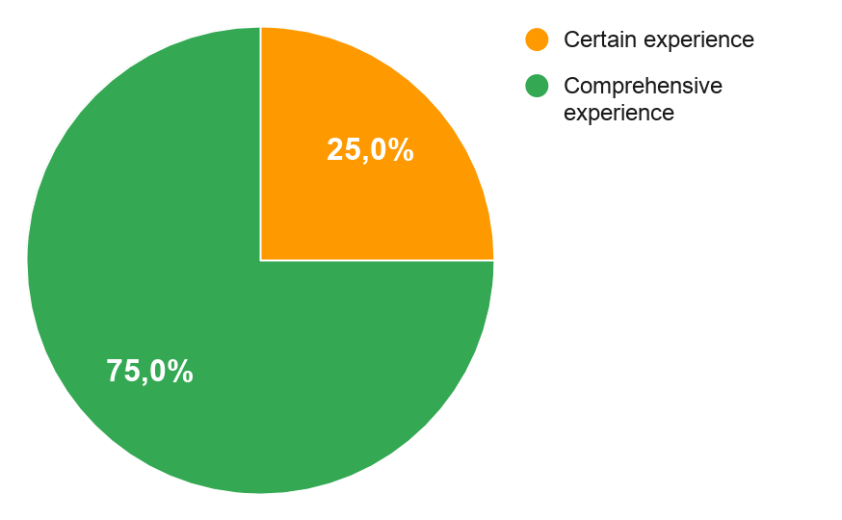
2. Access to information
2.1. Using search engines on the internet (e.g. Google, Yahoo, etc.)
September 2018 January 2021
Added new students, younger ones.

Slide 4
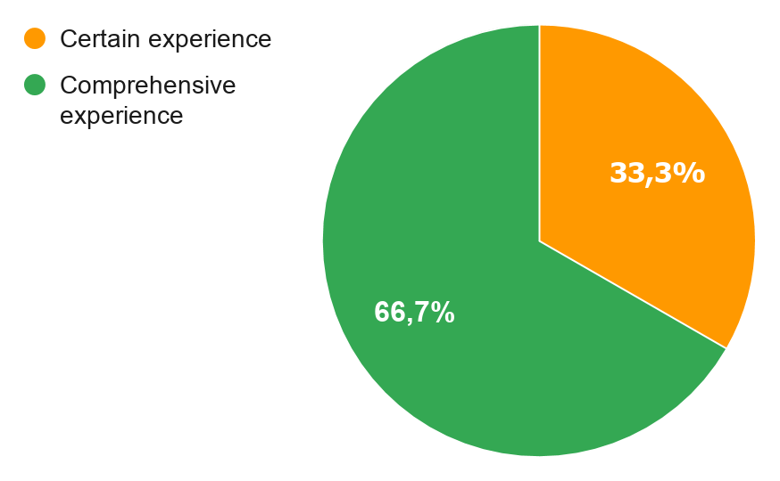
2. Access to information
2.2. Locating websites that contain the information you need.
September 2018 January 2021
Better skills in locating information.

Slide 5
2. Access to information
2.3. Obtaining an overview and navigating on a website.
September 2018 January 2021
Gained experience

Slide 6
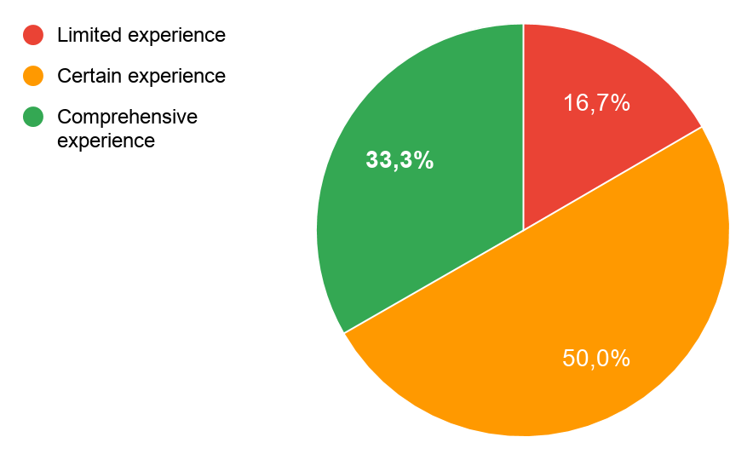
2. Access to information
2. 4. Finding specific information on websites of government agencies.
September 2018 January 2021
More experience in finding information on websites of government.

Slide 7
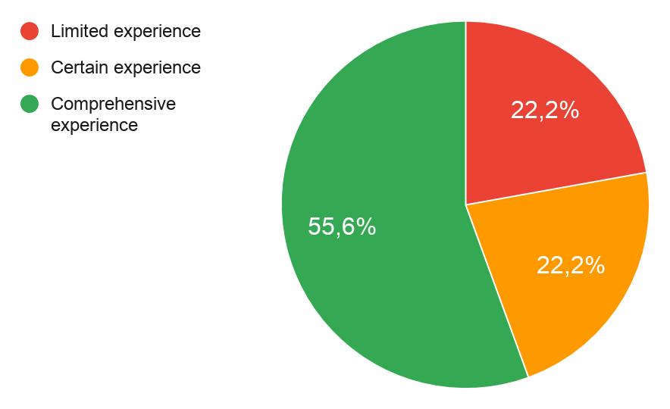
2. Access to information
2.5. Finding websites in a language other than Spanish.
September 2018 January 2021
Language Skill increases remarkably.

Slide 8
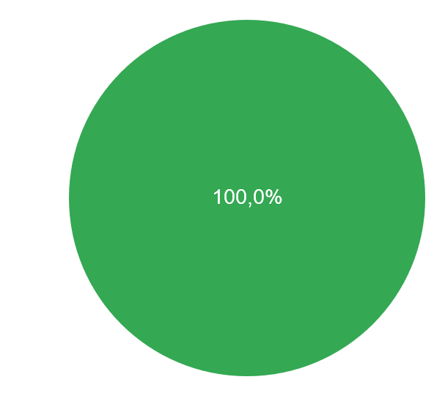
3. Technological self-reliance.
3.1. Creating an email address independently.
September 2018 January 2021
All students are able now to create an email by themselves.

Slide 9
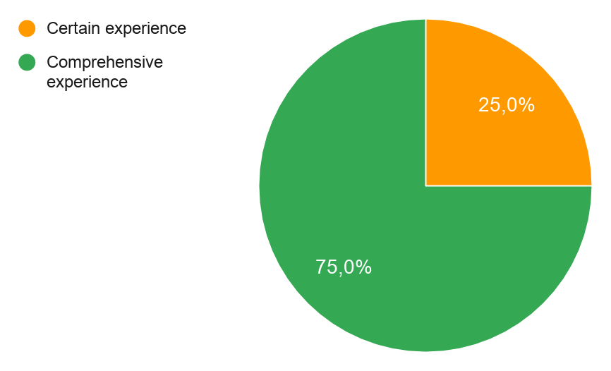
3. Technological self-reliance.
3.2. Being able to install programs on the computer independently.
September 2018 January 2021
Bigger autonomy

Slide 10
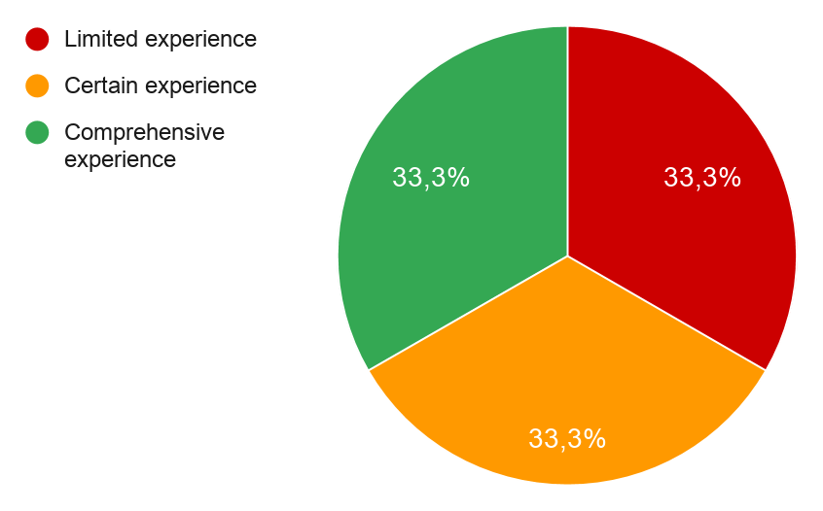
3. Technological self-reliance.
3.3. Using a program from a CD-ROM
September 2018 January 2021
Every student has now more experience.

Slide 11
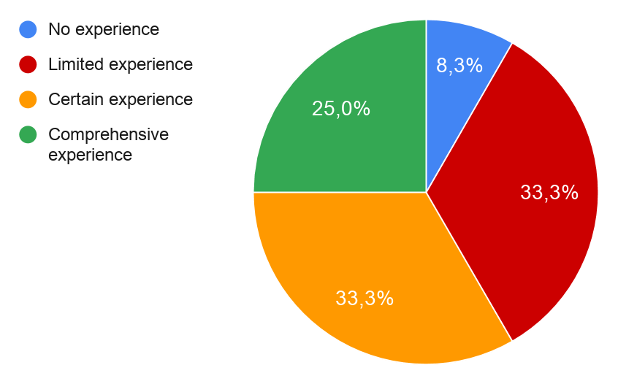
3. Technological self-reliance.
3.4. Using anti-virus software.
September 2018 January 2021
Anti- virus usage increases.
More conscious on the dangers of the internet.

Slide 12
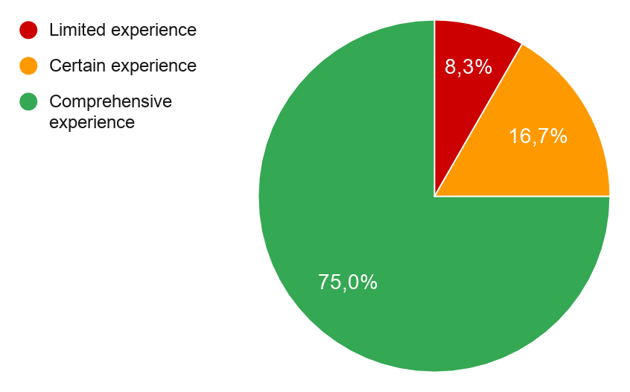
3. Technological self-reliance.
3.5. Opening computer programs independently.
September 2018 January 2021

Slide 13
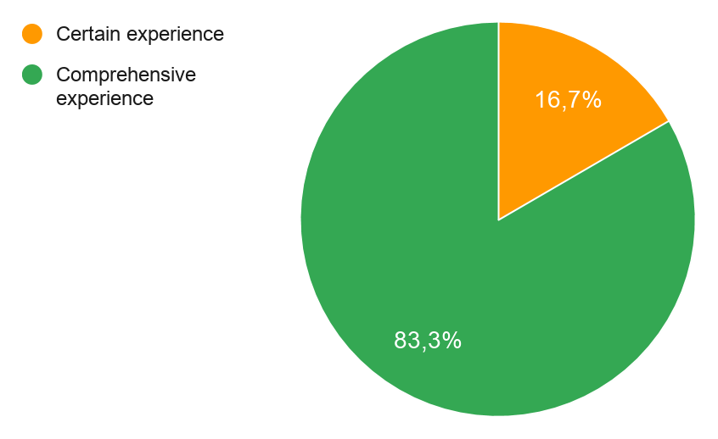
3. Technological self-reliance.
3.6. Being able to transfer photos from a digital camera to a computer.
September 2018 January 2021
Gained autonomy

Slide 14
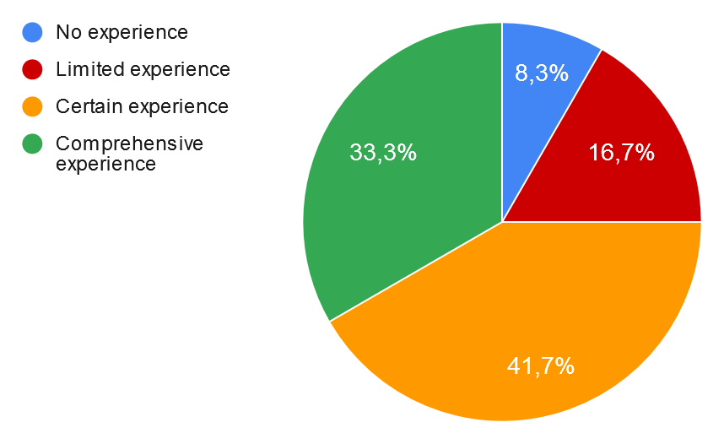
3. Technological self-reliance.
3.7. Creating a digital signature
September 2018 January 2021
Digital signature increases significantly.

Slide 15
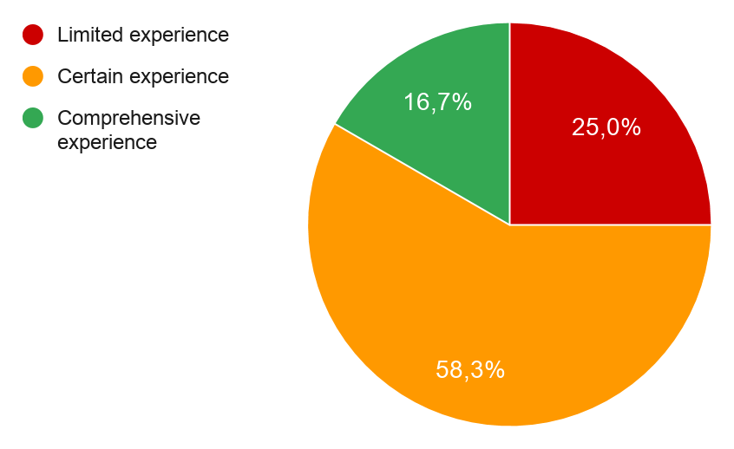
3. Technological self-reliance.
3.8. Creating a homepage
September 2018 January 2021
In two years we’ve changed, creating a blog and webpage are common tasks.

Slide 16
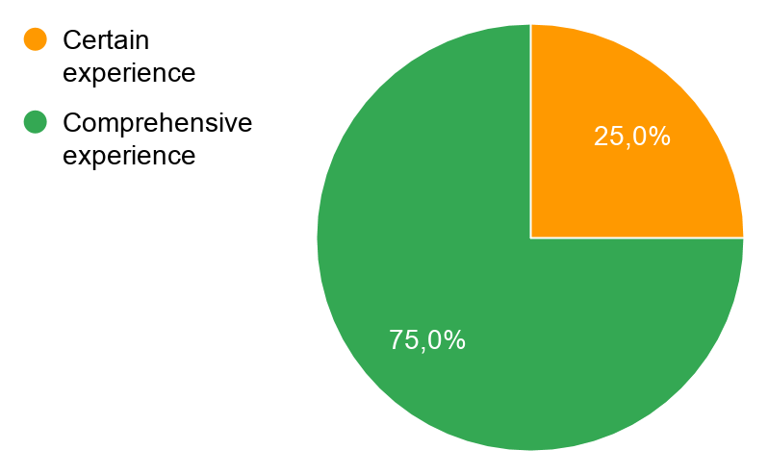
4. Information management.
4.1. Select information one needs from the internet
September 2018 January 2021
Progress in selecting information

Slide 17
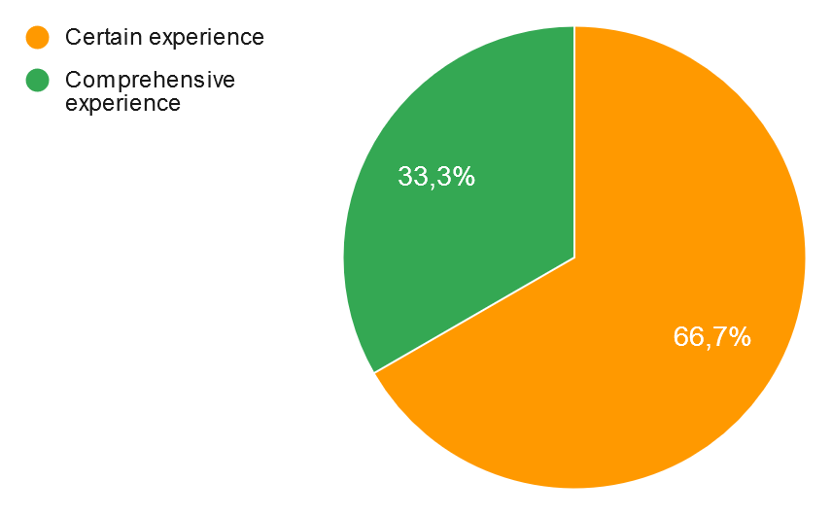
4. Information management.
4.2. Organizing and storing files in one’s computer, so that they can be easily retrieved.
September 2018 January 2021
File organization improvements.

Slide 18
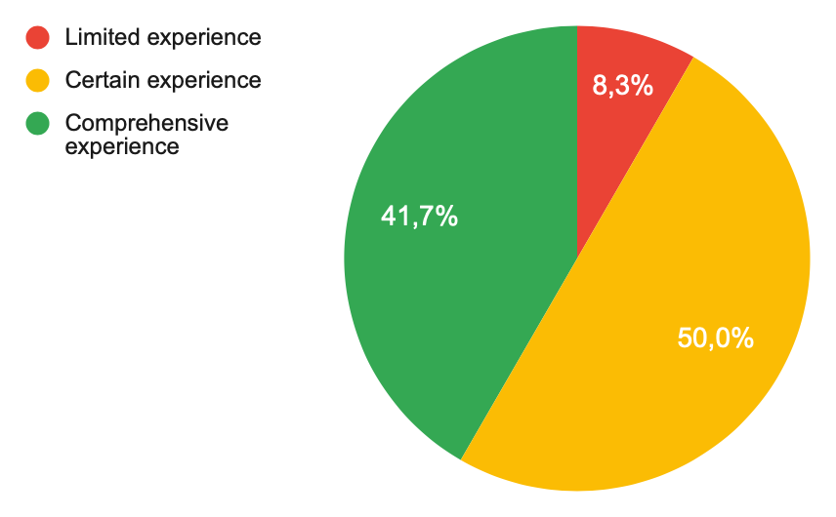
4. Information management.
4.3. Being able to organize the information found, for example by arranging it into lists or tables.
September 2018 January 2021
Better skills in organizing information

Slide 19
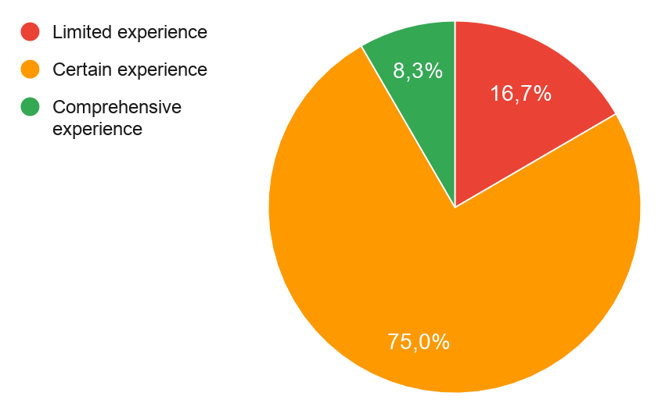
4. Information management.
4.4. Being able to transfer figures from a spreadsheet to a different program and vice versa.
September 2018 January 2021
All students have reached some experience.

Slide 20
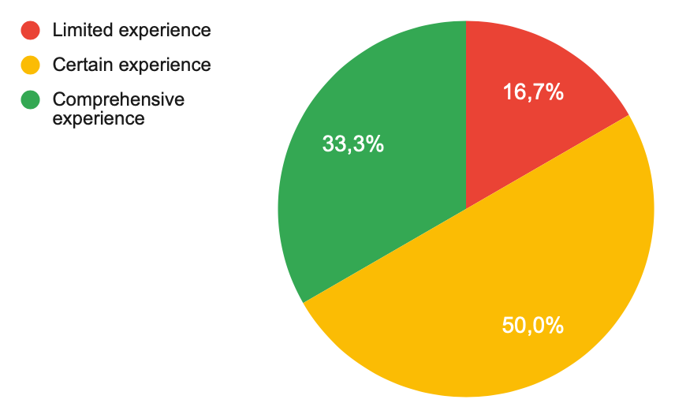
5. Information assessment
5.1 Assessing the quality of the information that you find on the internet, for example whether it is old, biased or untrustworthy.
September 2018 January 2021
Assessing the quality of information has become much more difficult nowadays, because of the big amounth of fake news and pseudo science in the net. All students have gained experience on this field.

Slide 21
5. Information assessment.
5.2 Assessing the safety of publishing information on the internet, for example on Facebook, in chat rooms, etc.
September 2018 January 2021

Slide 22
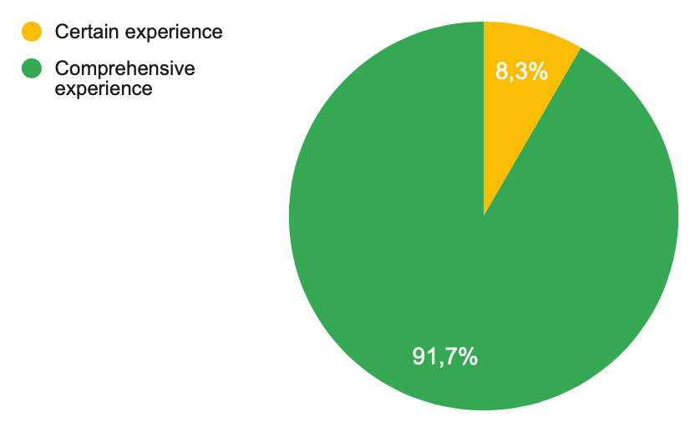
6. Integration of information
6.1 Writing, editing and transferring text in word processors.
September 2018 January 2021
Mastering ofimatic tools has become a must these days. The experience gained is very important in all of them.

Slide 23
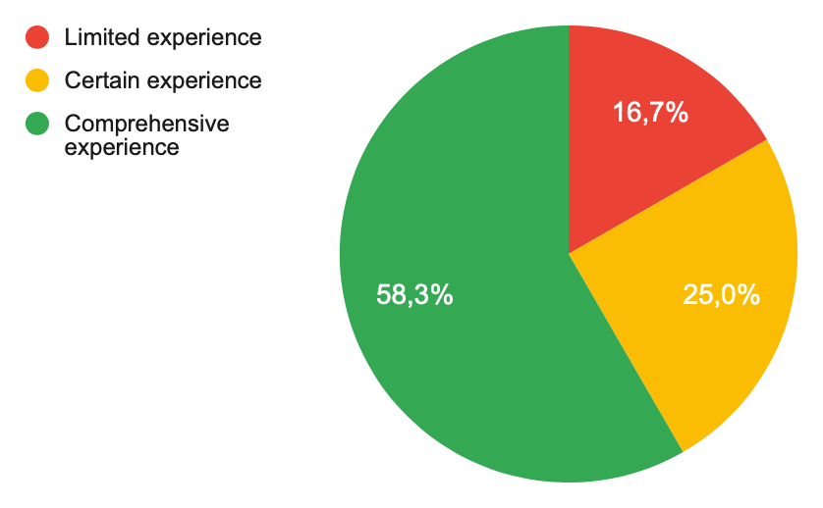
6. Integration of information
6.2 Using spell checkers/ dictionaries.
September 2018 January 2021

Slide 24
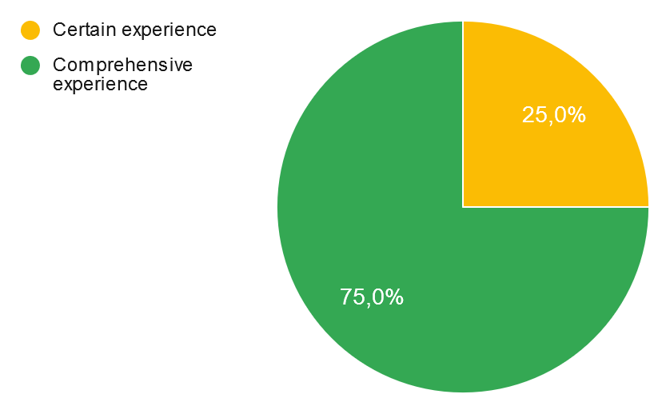
6. Integration of information
6.3 Inserting images/symbols in word processors.
September 2018 January 2021

Slide 25
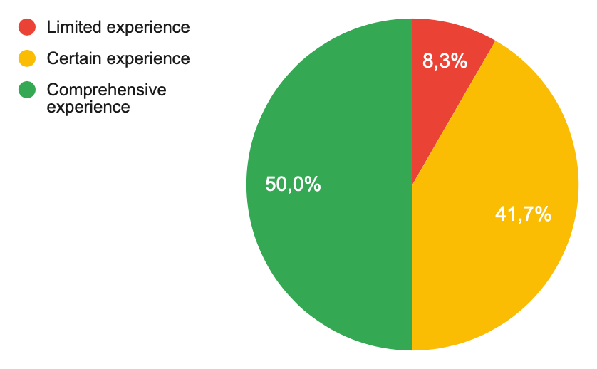
6. Integration of information
6.4 Inserting and editing tables in word processors.
September 2018 January 2021

Slide 26
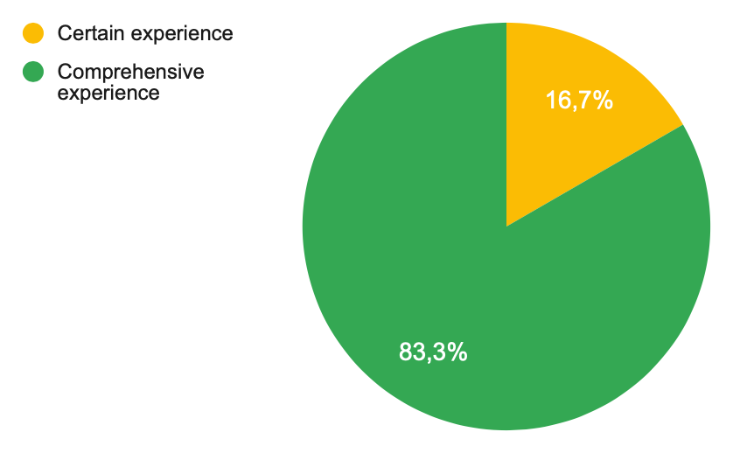
6. Integration of information.
6.5 Using drawing/graphics applications, for example Powerpoint.
September 2018 January 2021

Slide 27
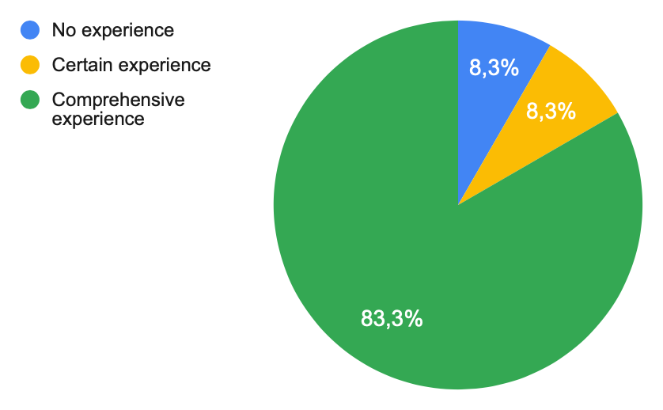
7. Communication and information sharing.
7.1 Sending/receiving SMS/MMS messages from a mobile phone.
September 2018 January 2021
In this section, we can see an important growth on experience.
Many of the tools were already well known in 2018, but are much better mastered now.

Slide 28
7. Communication and information sharing
7.2 Connecting to the internet using a mobile phone.
September 2018 January 2021
Those skills related to online teaching and communication have of course improved a lot, due to the lockdown months, but also thanks to the project activities.

Slide 29
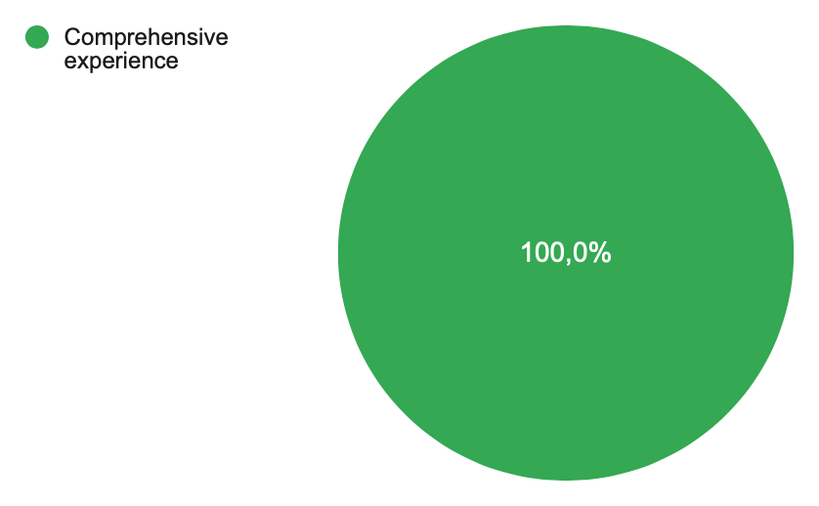
7. Communication and information sharing
7.3 Sending/receiving email
September 2018 January 2021

Slide 30
7. Communication and information sharing
7.4 Sending attachments (files) with emails.
September 2018 January 2021

Slide 31
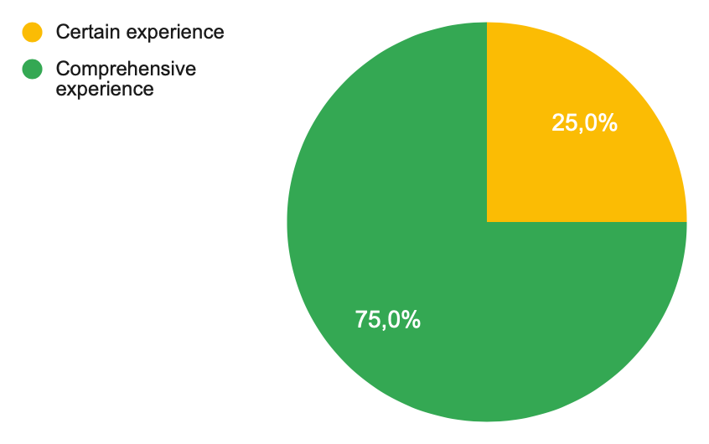
7. Communication and information sharing
7.5 Using email/calendar systems to organize/arrange meetings.
September 2018 January 2021
Remarkable improvement.

Slide 32
7. Communication and information sharing
7.6 Ordering/purchasing tickets over the internet.
September 2018 January 2021
Online market has spread a lot in the last year.

Slide 33
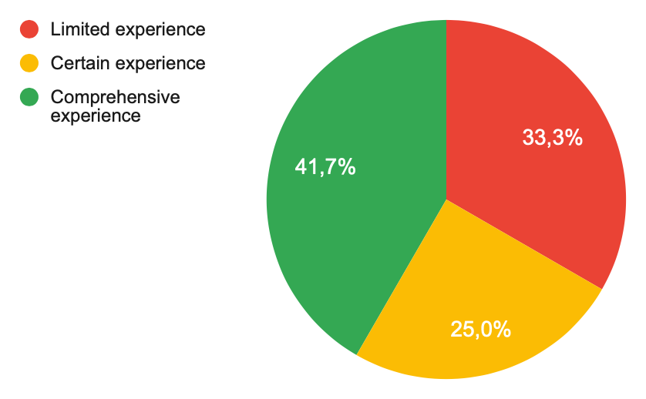
7. Communication and information sharing
7.7 Entering information by using a net-based template, for example electricity meter reading, etc.
September 2018 January 2021

Slide 34
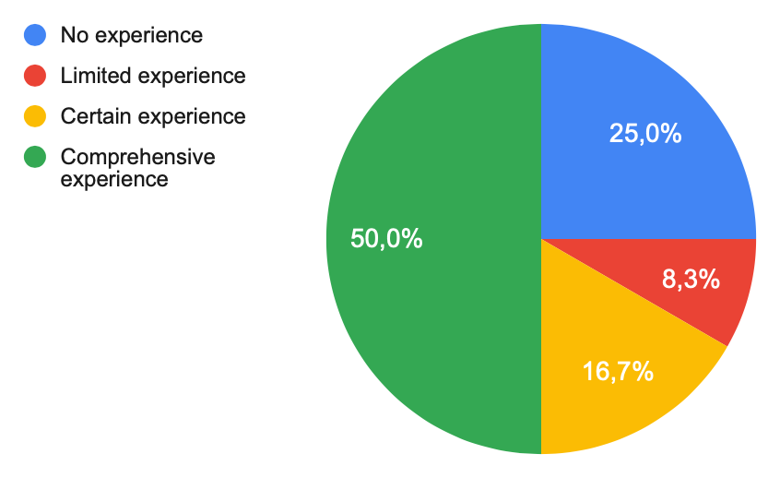
7. Communication and information sharing
7.8 Buying and selling goods through Spanish websites
September 2018 January 2021

Slide 35
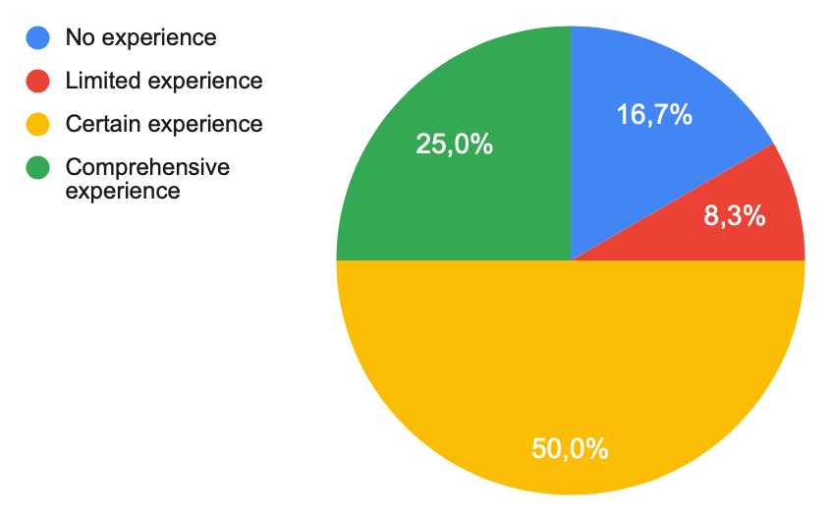
7. Communication and information sharing.
7.9 Buying and selling goods through websites in other languages than Spanish.
September 2018 January 2021

Slide 36
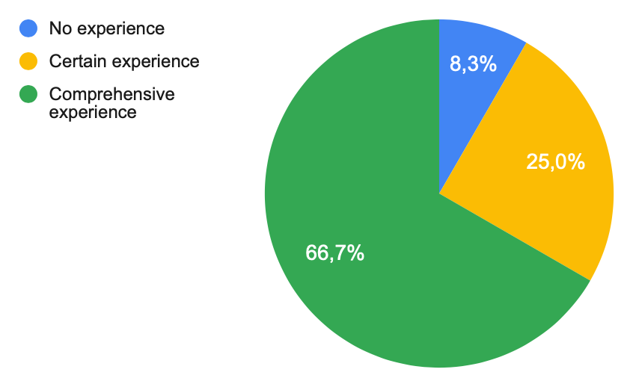
7. Communication and information sharing
7.10 Using IP telephony or Skype
September 2018 January 2021

Slide 37
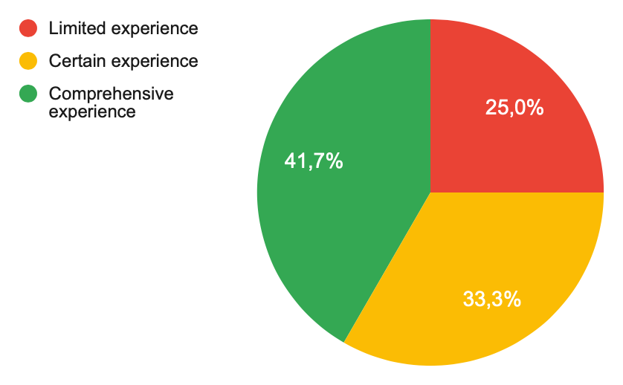
7. Communication and information sharing
7.11 Using a digital signature
September 2018 January 2021

Slide 38
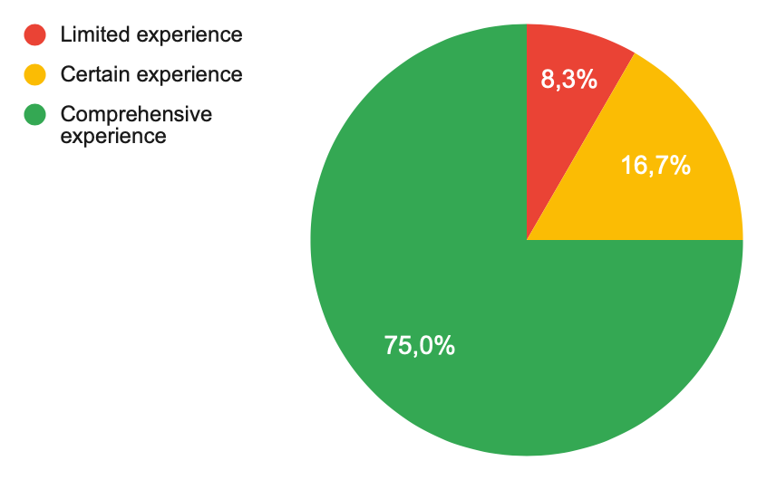
7. Communication and information sharing
7.12 Participating in network societies, for example Facebook or Twitter.
September 2018 January 2021

Slide 39
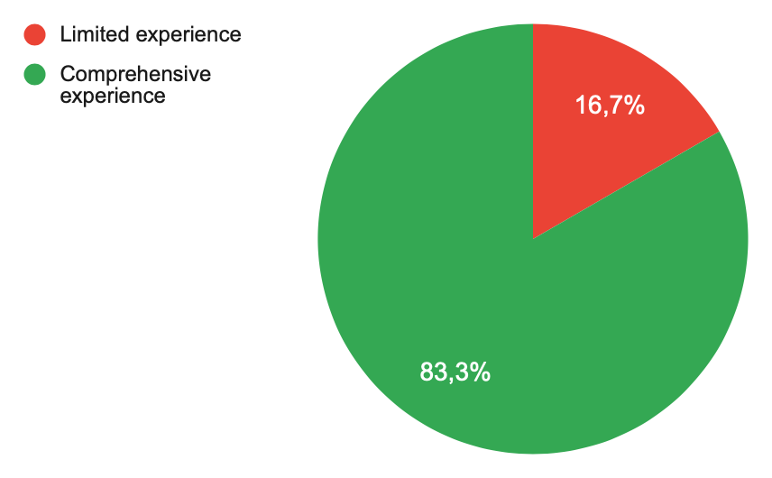
7. Communication and information sharing
7.13 Reading and/or commenting on a blog.
September 2018 January 2021
Remarkable improvement in the skills related to online communication.

Slide 40
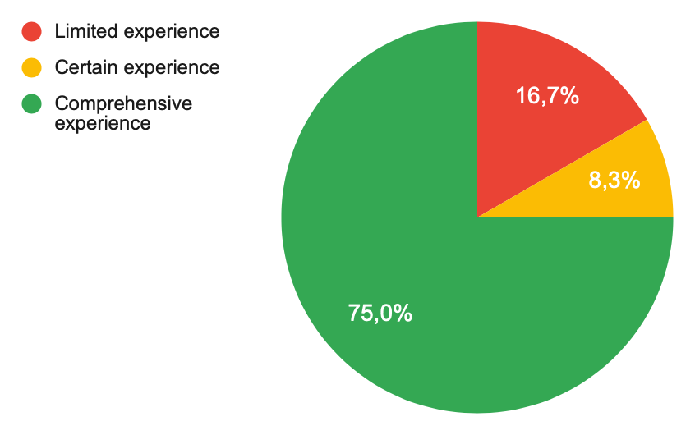
7. Communication and information sharing
7.14 Participating in cooperation and project groups over the internet.
September 2018 January 2021
Robots’R Us means a big opportunity to cooperate with mate students through the internet.

Slide 41
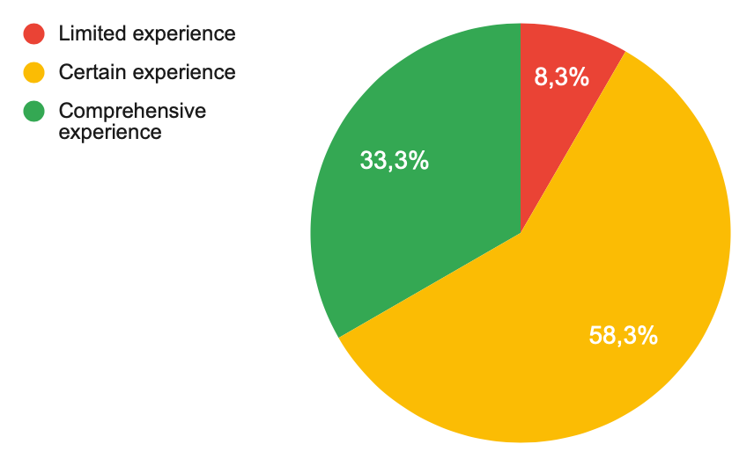
8. Creating new information
8.1 Composing information that you have found, being able to present it to others electronically.
September 2018 January 2021
All students have gained experience in presenting self composed information.

Slide 42
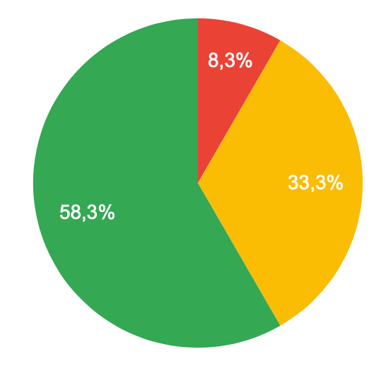
9. Exchange of information.
9.2 Using Skype for international information exchange
9.1 Sharing documents on a team platform.
Project activities, as well as our situation during last year have lead students to use these tools intensively.

Slide 43
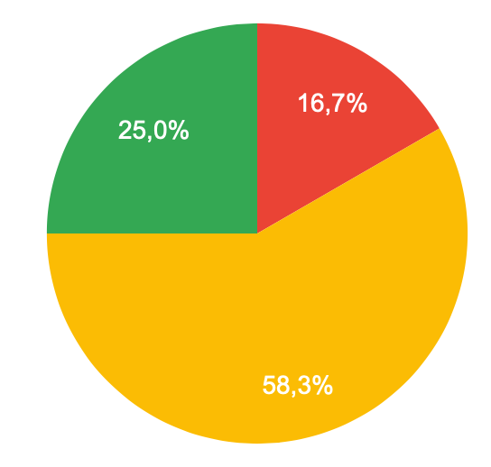
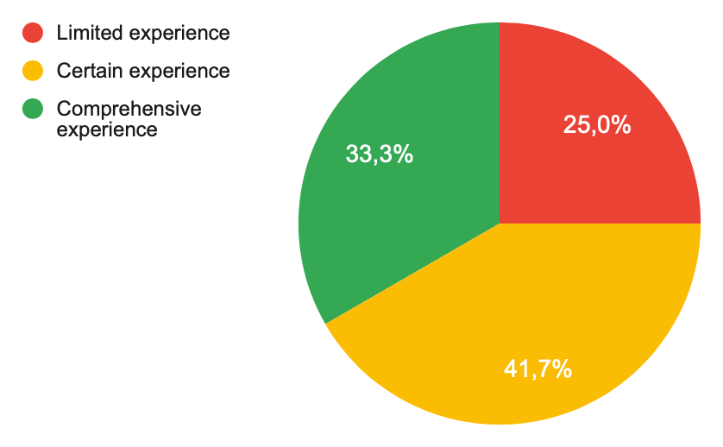
9. Exchange of information.
9.3 Creating a homepage for publishing a project.
9.4 Searching for specific information on automation.
All students have gained experience in these fields

Slide 44
9. Exchange of information.
9.5 Searching for specific information on materials.

Slide 45
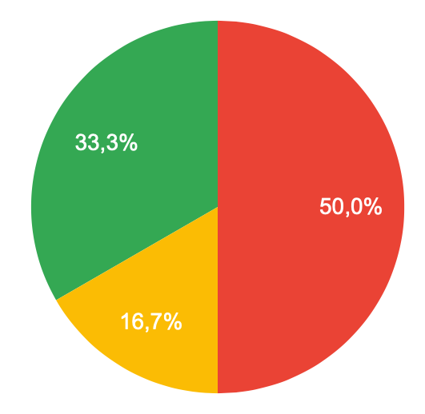
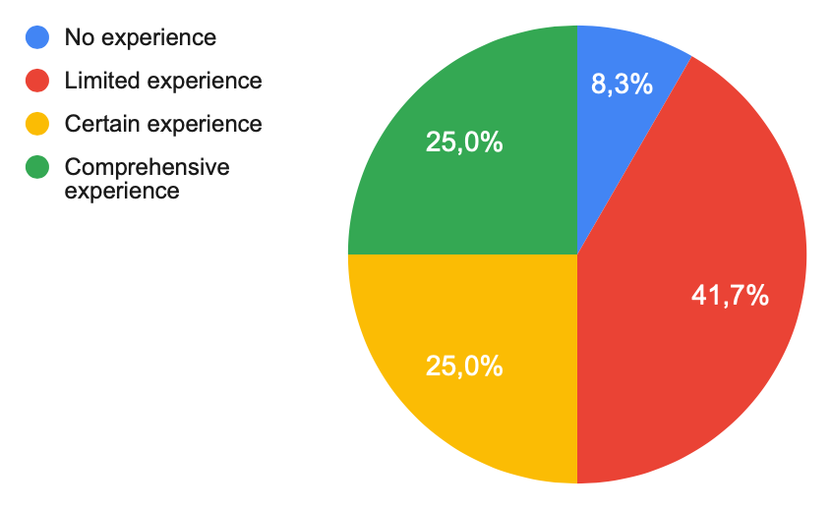
10. Programming robots
10.2 Working with different programmes for coding.
10.1 Coding (Lego or Arduino)
Spanish students were organized in different teams. Those who worked directly with coding have gained a lot of experience. Other students took care of other aspects.

Slide 46
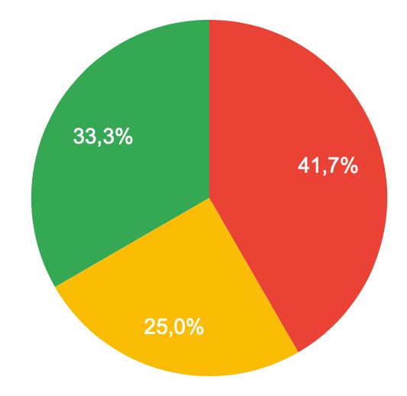
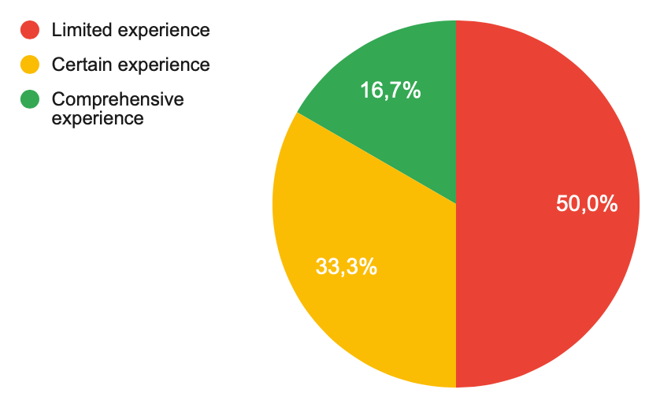
10. Programming robots
10.3 Using an Open-code platform (MAKER)
10.4 Programming sensors (function, application)
All students are now familiar with open-code platforms and sensors to some point.

Slide 47
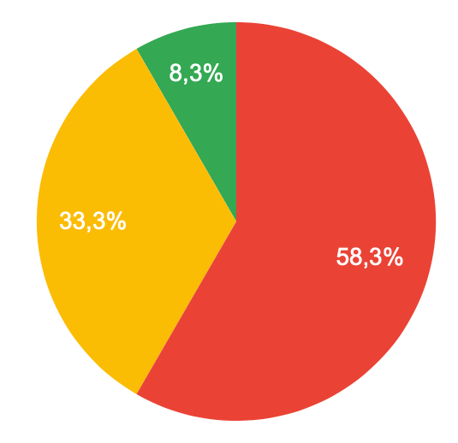
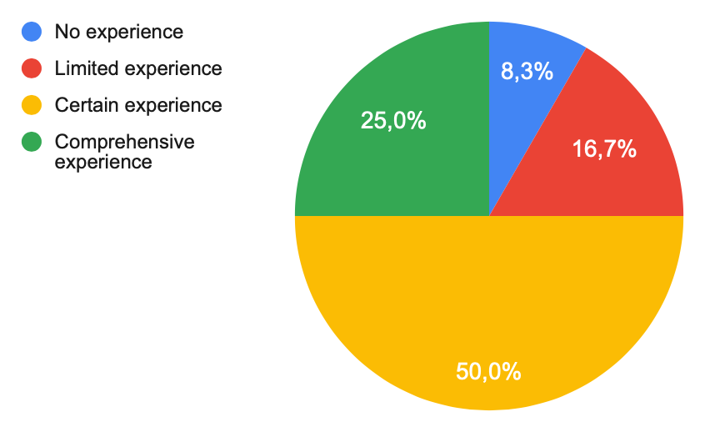
11. CAD/CAM
11.1 Designing a robot with the help of CAD
11.2 Using a 3D printer
Members of CAD/Printer Team are now real experts. All students have gained some experience with the software.

Slide 48
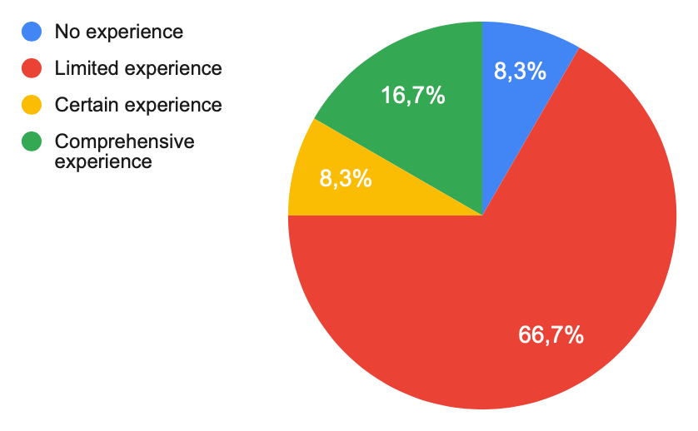
11. CAD/CAM
11.3 Programming CAM systems
We have very little experience in Computer Aided Manufacturing systems.

Slide 49
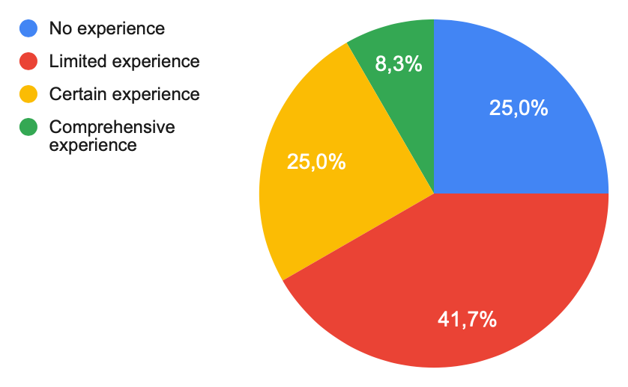
12. ICT in industry.
12.1 Using ICT for mechanical engineering.
Our students are not in contact with mechanical engineering yet. However, More than half of them have gained experience, while working directly on the robots.

