Slide 1
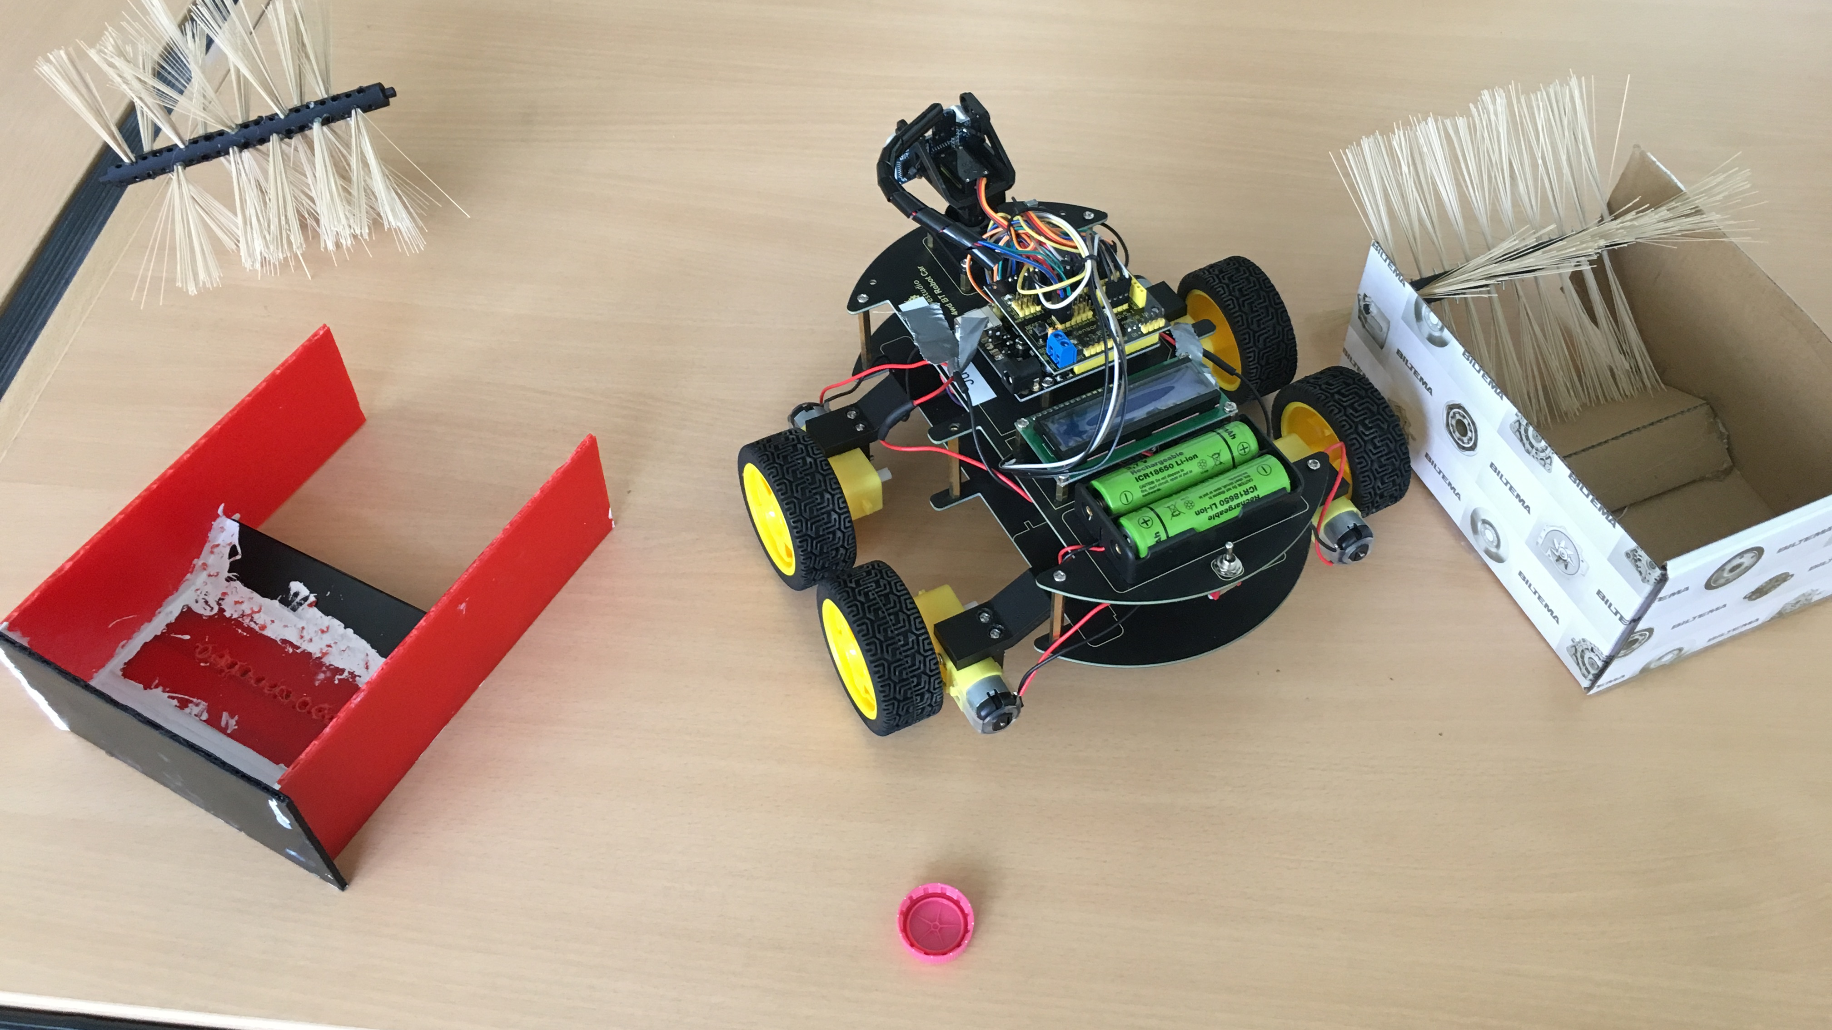
Work process
ERASMUS Robot`r us, Norway

Slide 2
Starting point

Slide 3
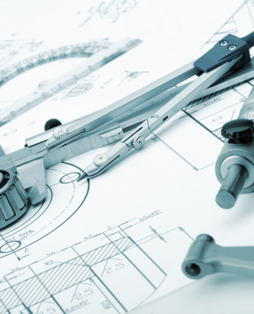
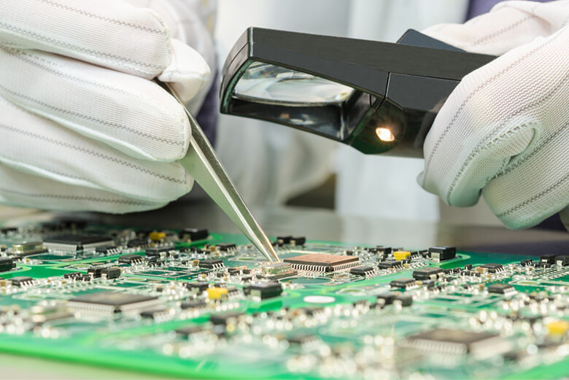
Work phases
Coding
Mechanical Design
Assembly and testing

Slide 4
Timeline
Oct 2020Pre planning
6 nov 2020 Coding start
18 dec 2020 Coding end
6 jan 2021 Mechanical design
20 jan 2021 Assembly and testing
29 jan 2021 final testing

Slide 5
1) PROJECT CODING
Basic training
Learning Arduino IDE
Coding and testing for simple functionalities
Fixing steering by trial and error.

Slide 6
2) Project Mechanical design
Form and function
Structural strength, time to print
Ramp and sidewalls
Brush and motor
Box for electronics, spoiler
Camera mount

Slide 7
3) Assembly and testing
Assemble and test belt drive
Assemble pickup brush
Fix all cables
Final testing

