Slide 1
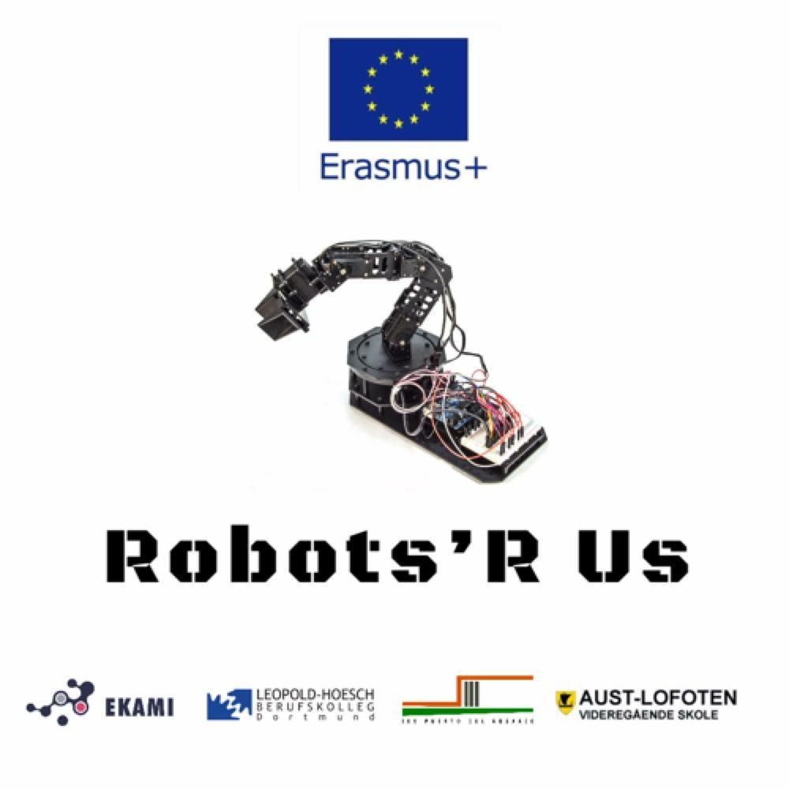
What have you learned in this project?
Norwegian students reflect on skills and experiences gained in the Robot project

Slide 2
Digital learning outputs
Have you learned anything more (than in other subjects) in the fields of digital skills, automation and/or programming by being part of the project?
"I have learned much about Arduino and how the software and hardware work and how it can be utilized in vehicles for example. I have also learned how to 3D print." Ottar
"Yes, I have learned how to make drawings for 3D printing" Amir
“I have learned much about Arduino and how the software and hardware work and how it can be utilized in vehicles for example. I have also learned how to 3D print.”

Slide 3
Digital learning output, cont.
«I have learned how Arduino works and something about coding in Arduino, for example the architecture of the code.» Kasper
“I have learned that making a product that works is very hard. And after this project I am much better at 3d printing.” Simon
“ I have learned that you can programme a robot from a computer” Jawad
“I have learnt programmes for modelling”
“Drawing in Solid Edge and Fusion 360”

Slide 4
Other learning outputs
Have you learned or experienced anything else by being part of this project?
"I have learned how to interact and communicate through teams, even if its international." Ottar
"I have learned about communication with people from other countries and to talk a little bit of English." Amir
“I have learned how to interact and communicate through teams, even if its international.” Filip
“I have used English in real life. The specific language for the subjects we are working with is different in different countries, but we found out that it works well to communicate across borders even if we have different English skills and experience”
“I have learned more English”

Slide 5
Other learning outputs, cont.
«I have gained some more experience in working in teams, learned about prototyping, and problemsolving. When we were unsure whether the speed of the brush was sufficient, we needed to make two solutions – one with two gears and one where the motor was directly attached to the brush. We also made a prototype for the robot itself, that the other students had started.» Kasper
“I have learned that it’s not only the Norwegian teachers that have problems with Teams.” Simon
“It was difficult working on Teams in home school”
“During the visits to Dortmund, Fuerteventura and Finland, we learned about other cultures in Europe.”

Slide 6
Other learning outputs, cont. 2
«In Spain they don’t eat breakfast, but they have cake for lunch!»
«The equipment at the different schools are very different»
«The German students were excellent in programming!»
Yes, and the Finns were really good at electronics and connectors»

Slide 7
Other learning outputs, cont. 2
«The Spanish excelled in 3D-printing and programming»
«We (the Norwegian team in Dortmund) had the best idea and design»
«It was difficult that the groups of students changed from workshop to workshop, because then we didn’t know the people that we were supposed to work with in the international teams»

Slide 8
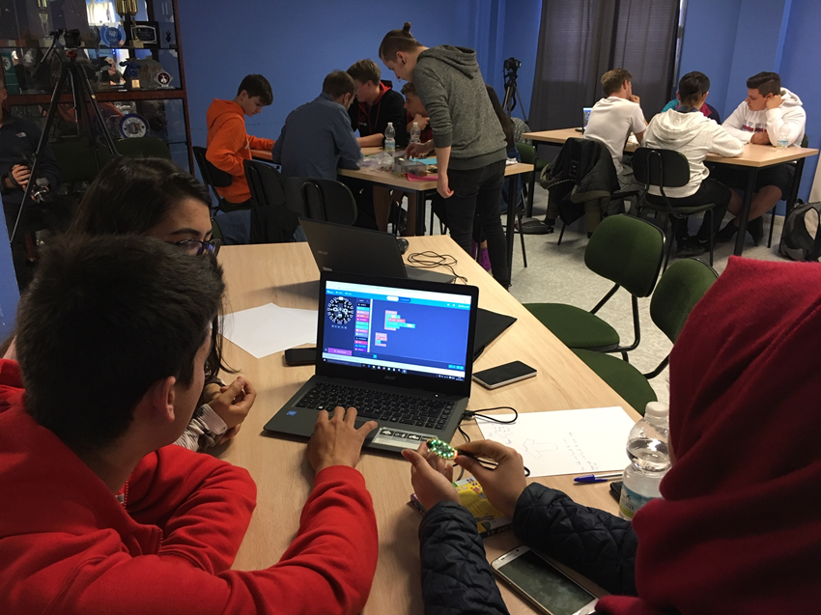
Erasmus+ project experience
Would you recommend to others to participate in an international project/Erasmus project?
"Yes, I would recommend joining an international project/Erasmus to anyone that has some interest in technology or for a person who wants to work in a company in the future." Ottar
"Yes, I would suggest to other people to take part in an international project to learn new things, particularly to get connected to people from other countries and to practice English and learn more in school." Amir
«Oh yes, we had lots of new experiences, it was different than normal school – something to look forward to: travel, visit a new country»

Slide 9
Erasmus+ project experience, cont.
“I would have recommended the Erasmus project to other people because it’s a great way to see how it is to work with people form other countries.” Simon
«Yes, I would recommend others to join a project like this, because you get to be with other people and try new and exciting things.» Kasper
«I learned about other countries»
«Taking part in an Erasmus-project is a lot of fun, new experiences, you learn a lot, get more knowledge and new skills within ICT and technology, you get new friends in other countries – and even in your own school!»

Slide 10
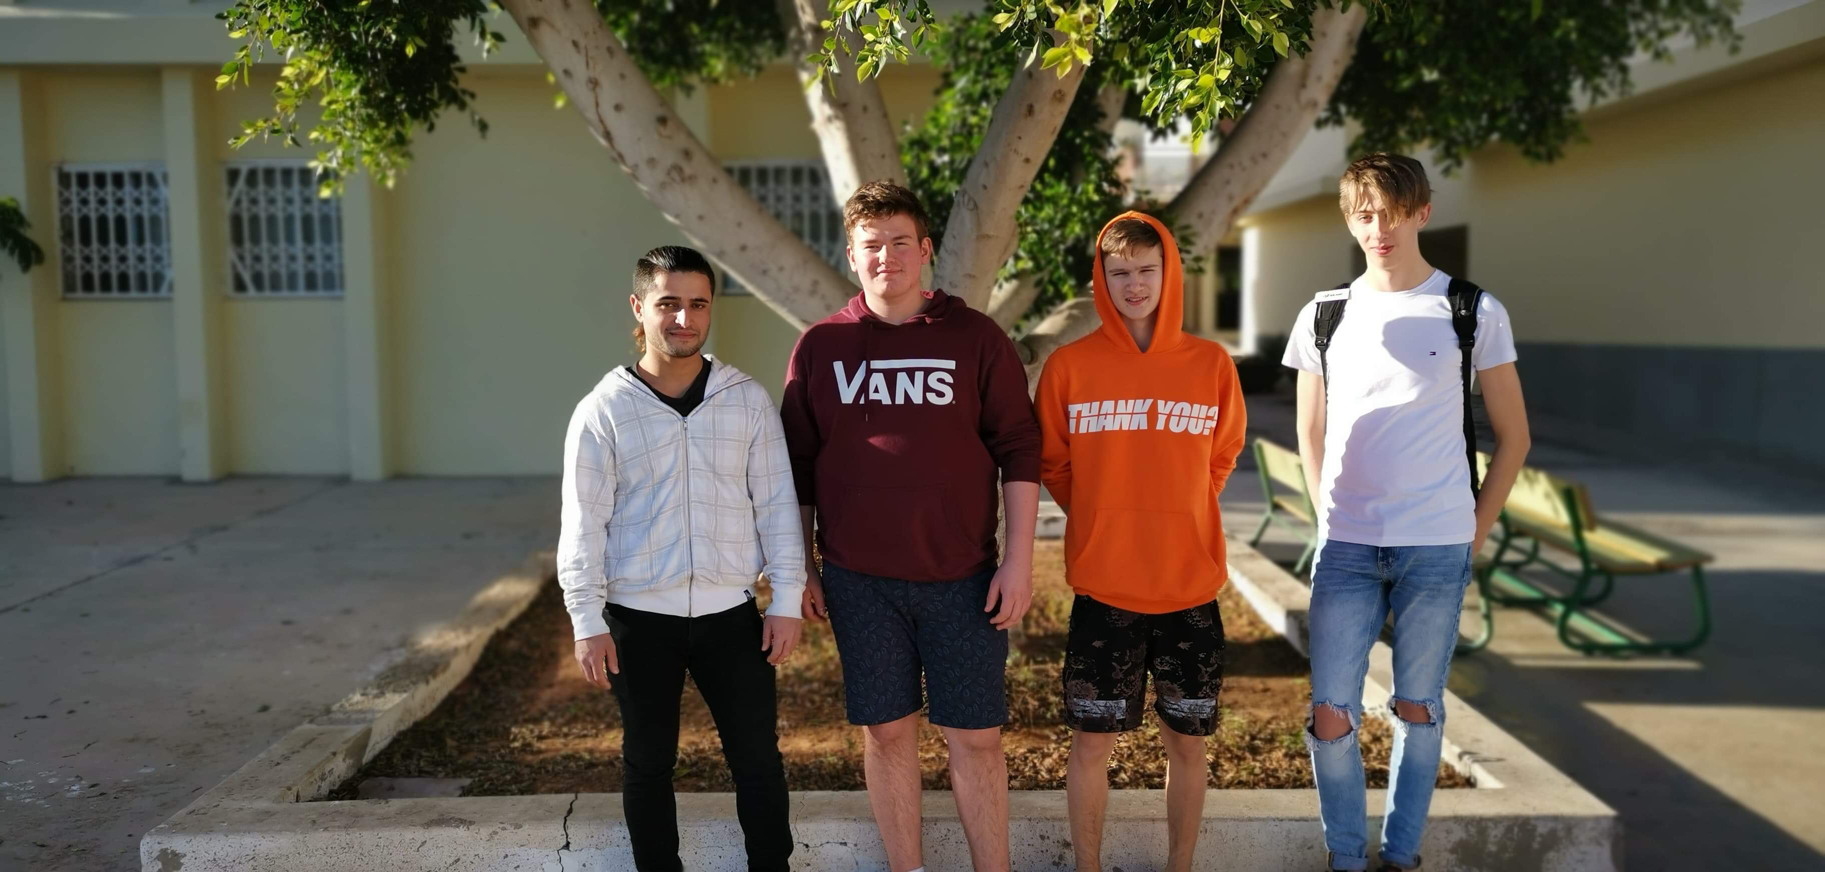
An experience for life?
In what way do you think you will benefit from this experience later in school, study, work or in life in general?
"I believe I benefited from this project in many ways, one of them being; “t is a different school experience. It´s more of an active learning experience based on trial and error. In my humble opinion. This the best and most effective way to learn. We should utilize this way of learning much more!” Ottar
«It will be useful in the future to have communicated with people from other countries, and to know how to make a product from idea via prototype to final robot.» Kasper
“I think this will help me later in life when I need to work with people and talk English.” Simon

Slide 11
An experience for life? Cont.
«I have put this Erasmus project on my CV, and it will be valuable for getting a job» Patryck
«When I told about this project at the workplace where I am doing my apprenticeship, they thought it was so interesting that I got these three days off to take part in the final Robot conference here»
«This project made my two years at Aust-Lofoten Upper Secondary School much more fun and rewarding!»
«Through this project and the travels abroad and the project work, we got a very good relation to our teachers at Aust-Lofoten Upper Secondary School, and this made the school years som much better»
«I want to become project leader in engeneering and I think my experience in this Erasmus project will help me get there» Patryck

