Slide 1
Food products in my area
Maja Mišević & Sara Šušnjar
Zmijavci, Croatia

Slide 2
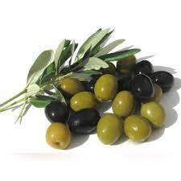
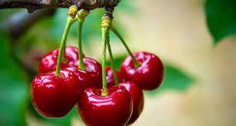
Olives – Olives are small in shape, they can be green or black. They have a slightly bitter taste but are very tasty.
Cherry - The cherries are red in color, have a sweet taste and are small.

Slide 3
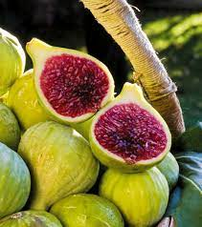
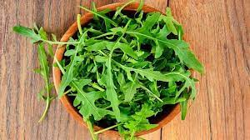
Figs – The figs are green on the outside and red on the inside. They are very tasty and sticky.
Arugula - Arugula is green in color, used in salads.

Slide 4
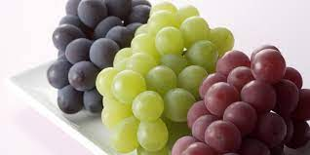
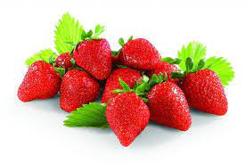
Grapes – The grapes are small and round in shape, they can be green, reddish or blue. Wine is made from it.
Strawberry - The strawberries are red, sweet-tasting and pyramid-shaped.

Slide 5
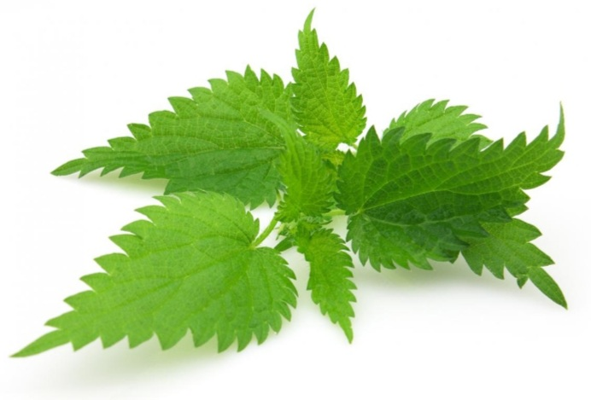
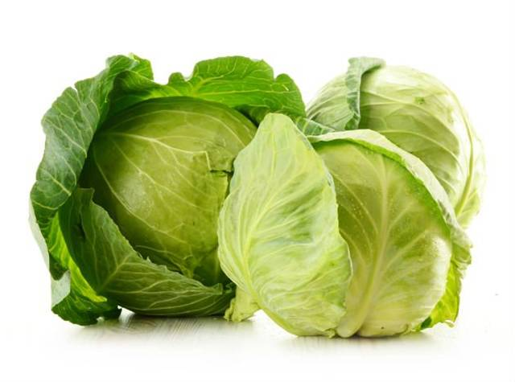
Nettle- The leaves and stems are covered with fibers, and that is why it is very uncomfortable to touch them, because they pour sharp juice on the skin. Nettle has healing properties.
Cabbage- cabbage is a plant species that is mainly used for food. It is green in color and helps reduce swelling. It is grown in the garden.

Slide 6
Thank you for attention
Maja Mišević & Sara Šušnjar

