Slide 1
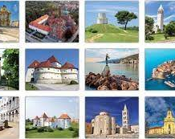
Sights of Croatia
Marija M.
Anđela P.
7.a

Slide 2
Plitvice Lakes
Plitivce lakes is the first National Park in Croatia.
To visitors hiking, cycling and sledding in the winter months are offered.
The best times to visit are late spring and early fall.

Slide 3
Zadar
Greetings to the Sun
Five Wells Square
Church of St. Donatus
Sea organ
Zadar Archaeological Museum

Slide 4
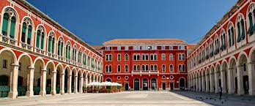
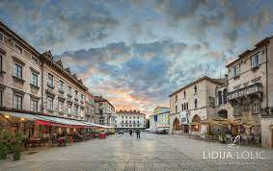
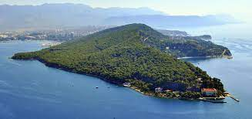
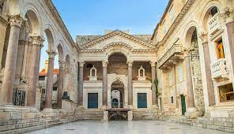
Split
Diocletian's Palace
Republic Square
Pjaca Square
Marjan

Slide 5
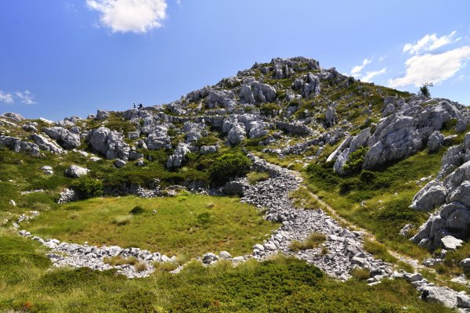
Biokovo
-The highest peak near the sea
-More then 40 endems
-There were so many chamois it became their symbol
-A lot of caves and pits, and the biggest one is Krjava 2

Slide 6
Dubrovnik
-Main and most popular street is Stradun
-City walls with fortresses- people can walk on city walls
-Dubrovnik Summer Festival- actors performing on stages

Slide 7
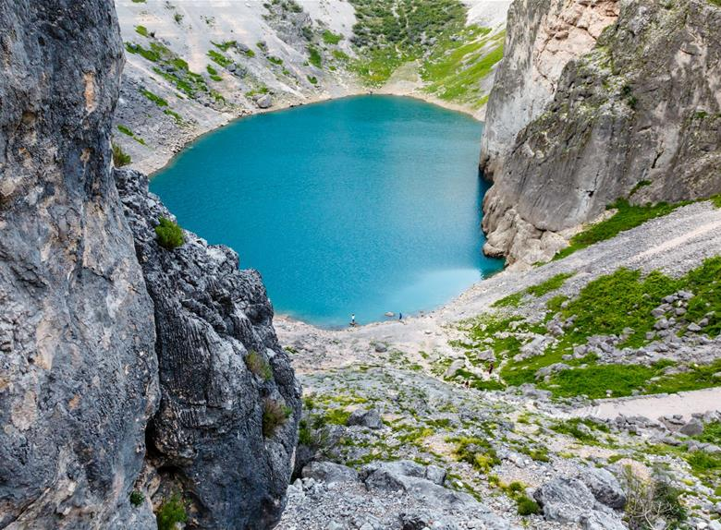
Blue Lake
- Karst lake in Imotski
-It's 300 ft. deep
-The lake is located below the gorge where the Topana fortress is located
-There is a famous legend about Gavan's castle

Slide 8
Krapina
-Prehistoric site and Museum of Krapina Neanderthals
-Church of st. Catherine- over 350 years old

Slide 9
Thank you for attention!

