Slide 1
Polish Food Products
see what we like eating

Slide 2
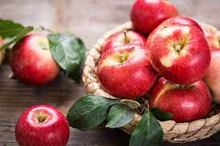
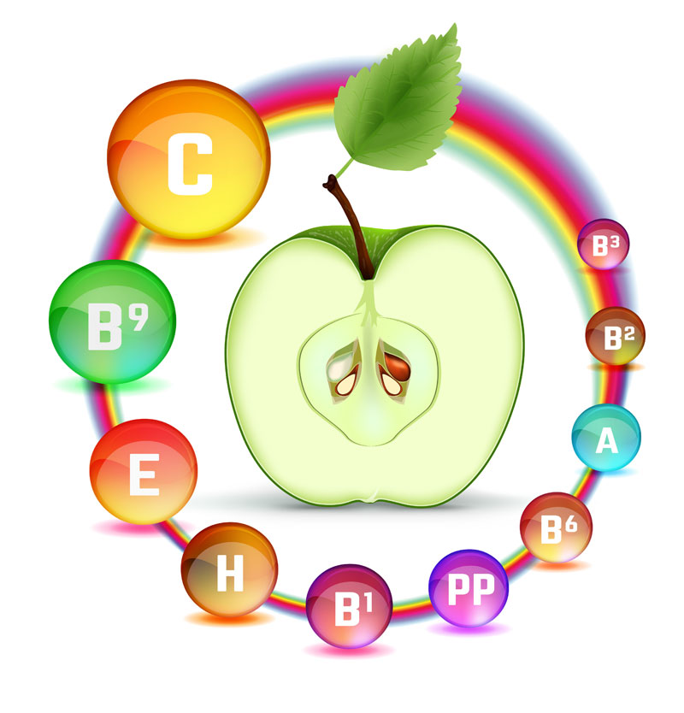
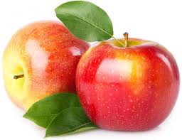
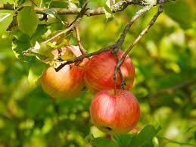
Apples
In Poland we produce a large number of apples.
There are 250 kinds of apples grown in our country.
Poland is the largest apple producers in Europe.
Apples have a lot of vitamins.
They have vitamin C, E, K and B vitamins.
“One apple a day keeps a doctor away”

Slide 3
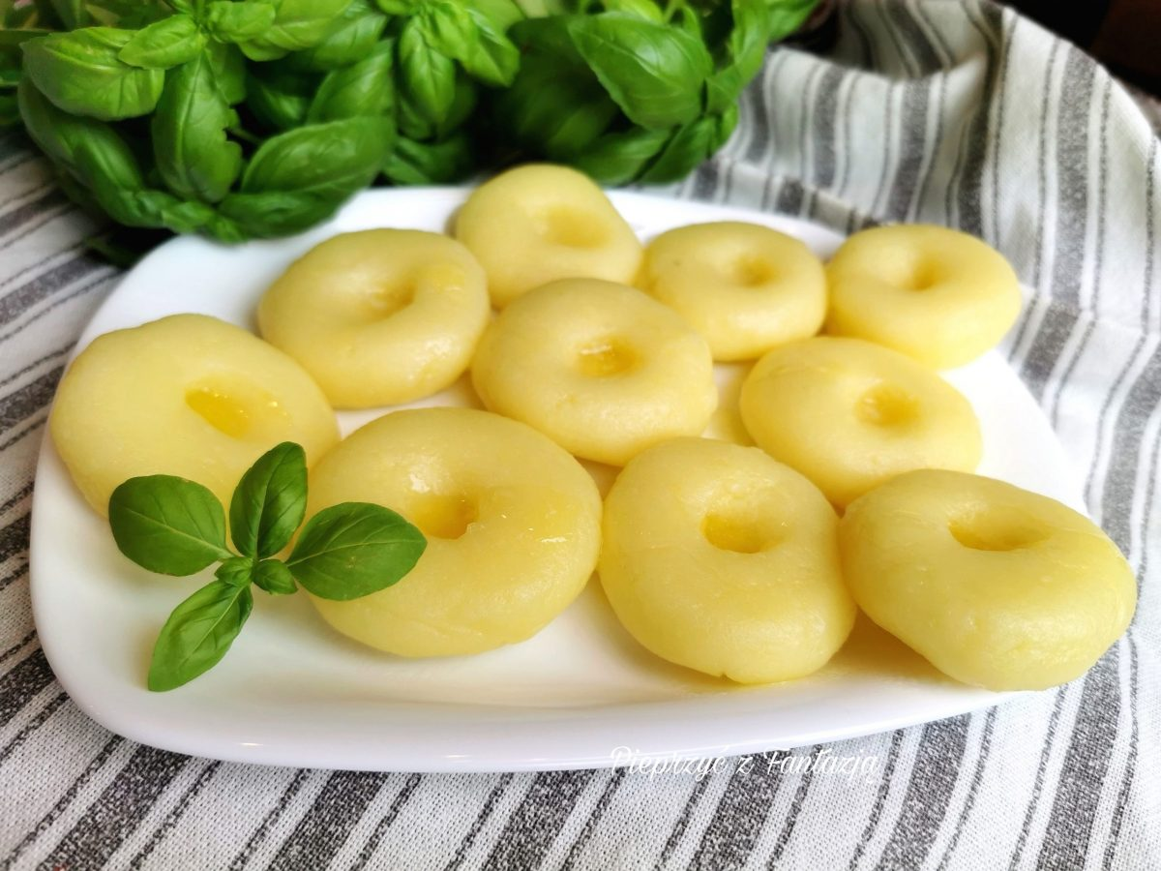
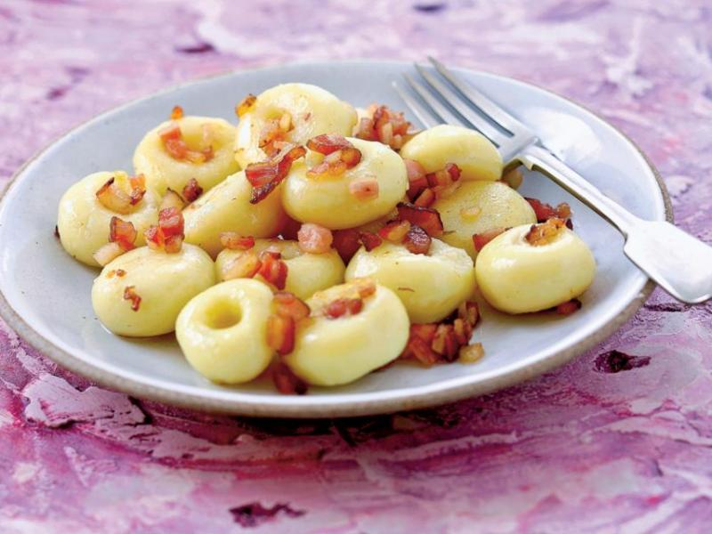
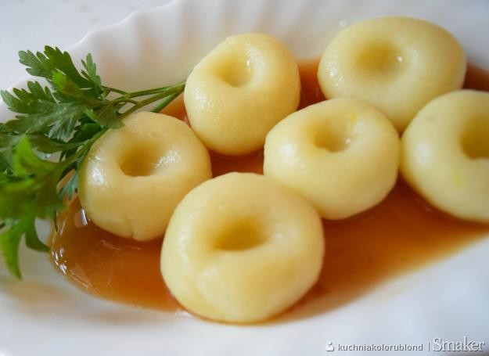
Silesian Dumplings
Silesian dumplings are on the List of traditional products of the Lower and Upper Silesia (South West Poland). They can be prepared in many different ways and with many additions. You can make them sweet, but you can also, serve them for dinner with some sauce. Silesian dumplings are prepared from boiled potatoes combined with potato flour and salt. Then they are cooked for two to three minutes.

Slide 4
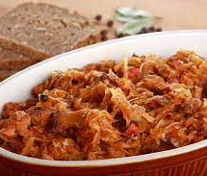
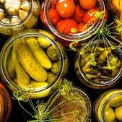
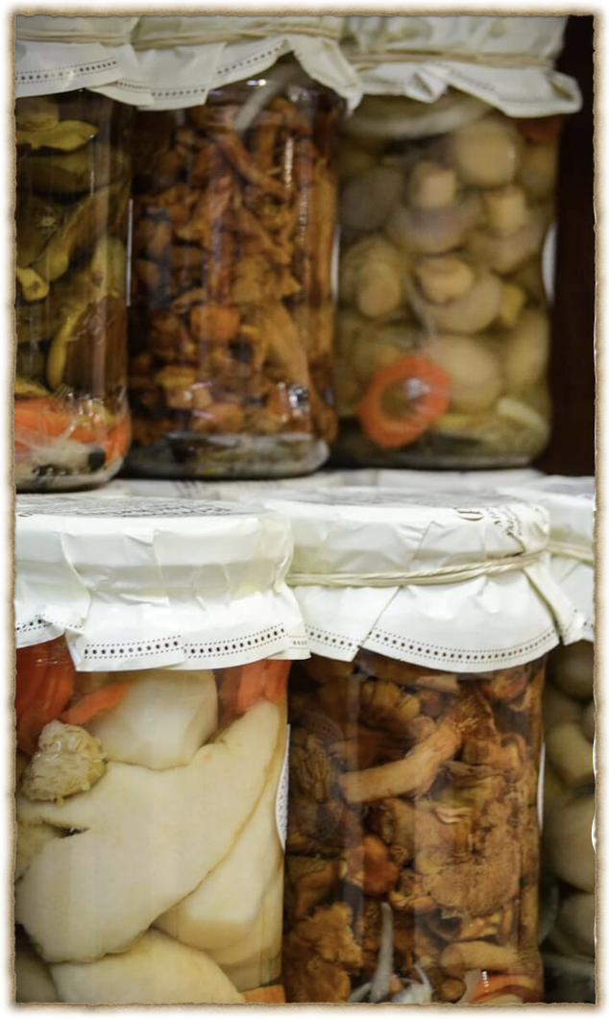
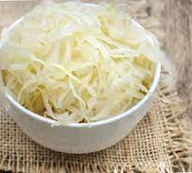
Pickles
In Poland many traditional dishes
have a sour taste (żurek, kapuśniak, bigos)
as we often use pickles to prepare them.
Pickling is a method of preserving vegetables, fruit or mushrooms based on lactic fermentation.
You can prepare pickles from basically anything: fruit, vegetables, etc.
If the pickles after pasteurization is placed in smaller jars, it can be tasty for up to a year.
How to make them: prepare the things you want to preserve
eg. cabbage and carrot, cut them into pieces.
Put them into a jar together with some spices:
balls of black pepper, clove of garlic.
Pour it with hot salty water
Keep it in room temperature and after a week you can enjoy your pickles.

Slide 5
Sausages
Sausages are very popular in Polish cuisine.
There are dozen of varieties:
smoked or fresh, made of pork,
beef, turkey, lamb, chicken or veal.
Every region of Poland has its own speciality.

Slide 6
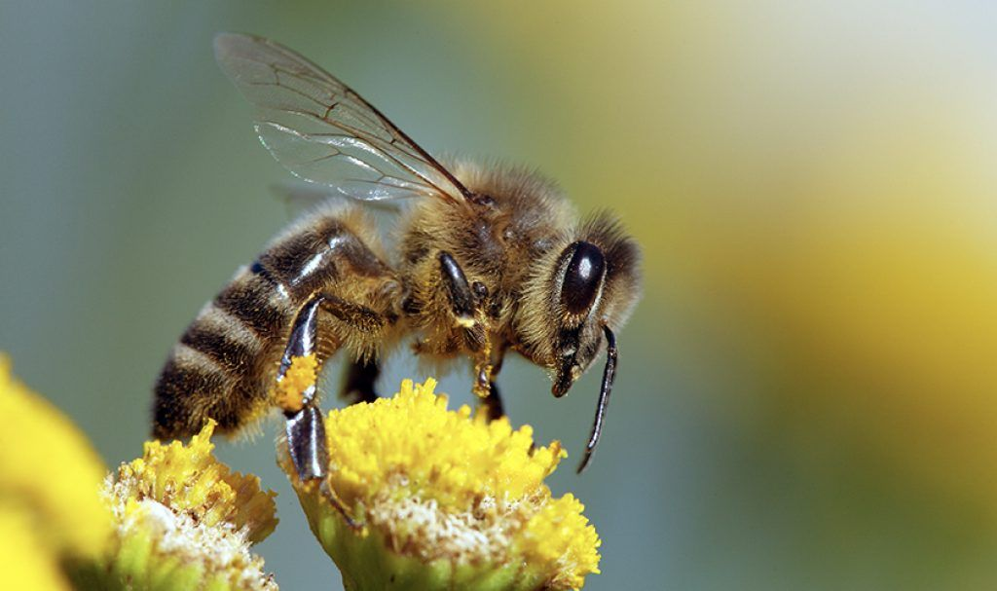
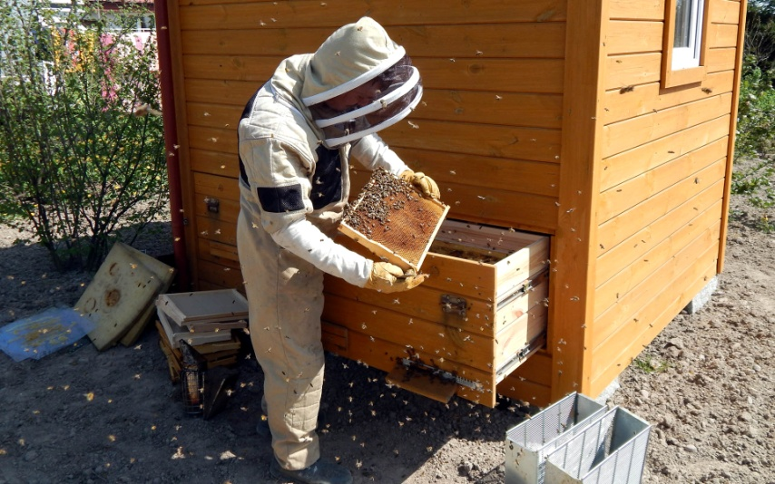
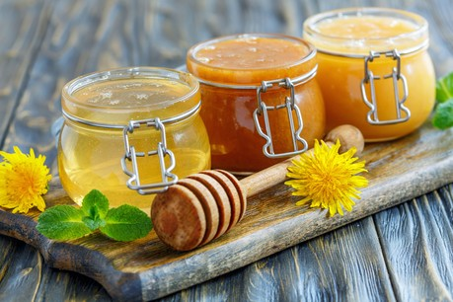
Honey
Honey is added to cosmetics.
It is a good remedium for
heart, nerves, brain or wounds.
It prevents some illnesses.
Contains micro-elements and vitamins.
It lowers the blood pressure.
And it is tasty!
Honey is very popular in Poland.
People in many regions have hives and produce honey.
There are many different types of honey
eg. honeydew, linden, acacia or multiflorous.

Slide 7
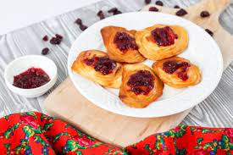
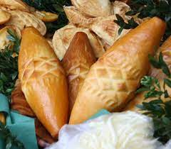
Oscypek cheese
Oscypek is hand-made, hard,
smoked cheese which is made
mainly from sheep’s milk and salt.
It is characteristic of the Polish mountains
particularly for Podhale region.
Oscypek can be grilled, fried or served with preserves.
They are suitable as an addition to salads
and hot dishes or as one of the ingredients the cheese board.

Slide 8
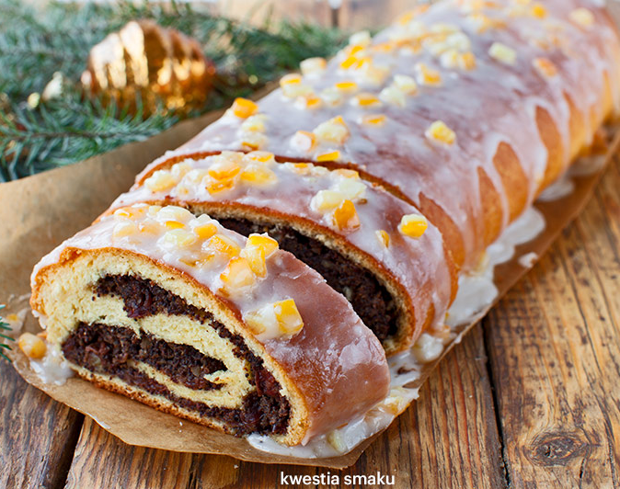
Poppy Seed
Poppy seeds are small black balls that are seeds of the field poppy - beautiful red flower.
With poppy seeds and dough you can create many desserts eg. Makowiec. This is a delicious cake. In Poland this is a traditional Christmas cake.

Slide 9
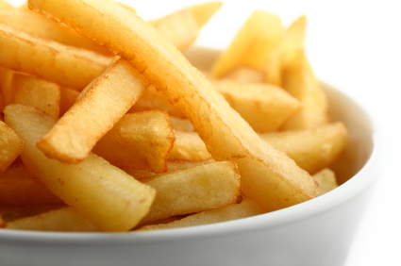
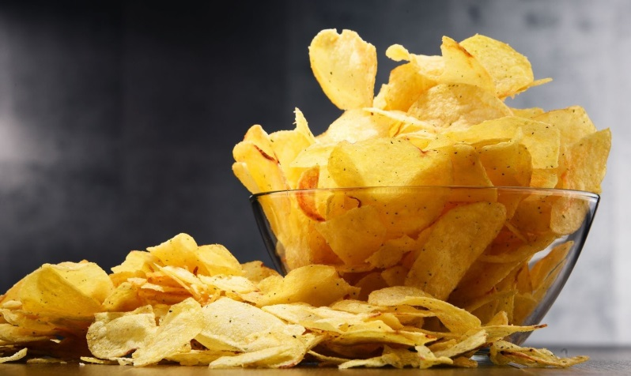
Potatoes
Potatoes are one of the most popular vegetables in Poland. They are used to make chips, crisps, starch and fodder. They are also parts of many salads typical in our country. Potatoes are not demanding plants, so they are grown in all parts of Poland. Poles eat them almost every day.

