Slide 1
Finland - part-time jobs

Slide 2
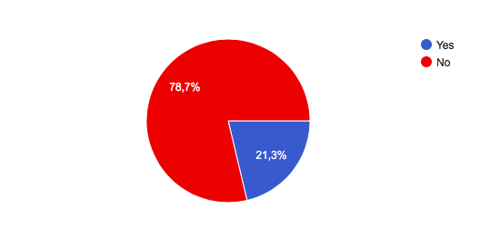
Do students in our school have part-time jobs?

Slide 3
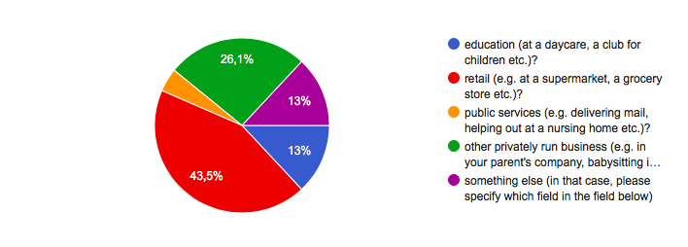
What kind of jobs do they have?

Slide 4
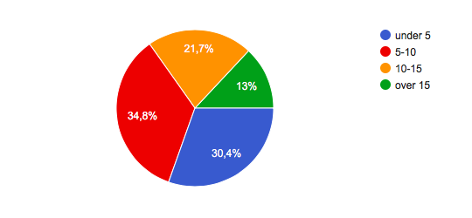
What kind of hours do they work weekly?

Slide 5
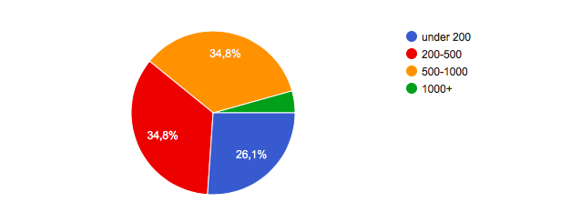
What kind of pay do they get per month?

Slide 6
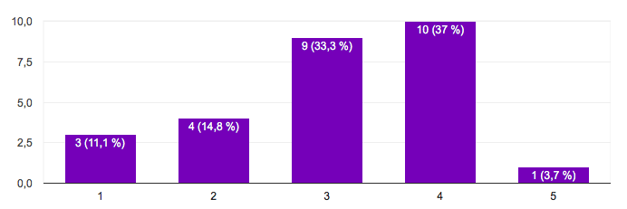
How easy is it to get a part-time job in Vammala?
From 1 (very easy) to 5 (very difficult)

