Slide 1
Immigration and concepts of integration
in Estonia
Lähte Gymnasium 2019
Pille Pihlapuu, Sandra Pomjalov,
Maria-Elizabeth Helmik, Joosep Lamp

Slide 2
Our School
Experience with Immigration and Intergration from the past
No refugees or immigrants in our school
Some Russian- speaking students who speak Estonian well (integrated families)
Huge wave of immigration after World War 2
Integration attempts
Integration is not easy
Estonian language
Introductory welcoming programme
Communication

Slide 3
What has changed in the migration flows in your country in the last ten years?
Biggest immigration flow in 2015
4 types of immigrants to Estonia:
people returning to Estonia (52%)
people from former Soviet Union (Russia and Ukraine)( 30% )
from EU member states (10%) and 4) from the rest of the world (10%)
in 2015 - 15 413 immigrants
in 2018 - 13 030
immigration quata for third-country citizens - 0.1 % of the country’ s permanent population annually (1,315)
exclusions

Slide 4
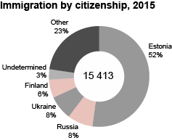

Slide 5
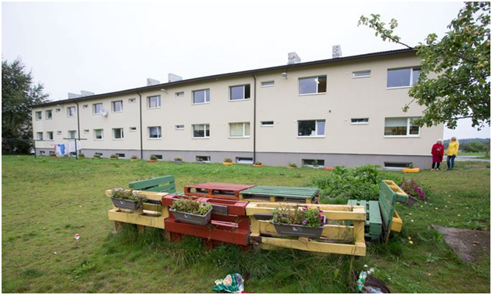
Asylum seekers and refugees
206 quota refugees accepted
98 adults, 108 children
88 have left Estonia
2019 - 40 more refugees
refugee centres - 2
learning and
entertainment centres
Vao asylum seekers and refugee centre

Slide 6
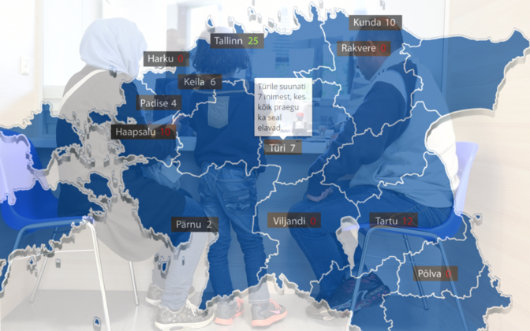

Slide 7
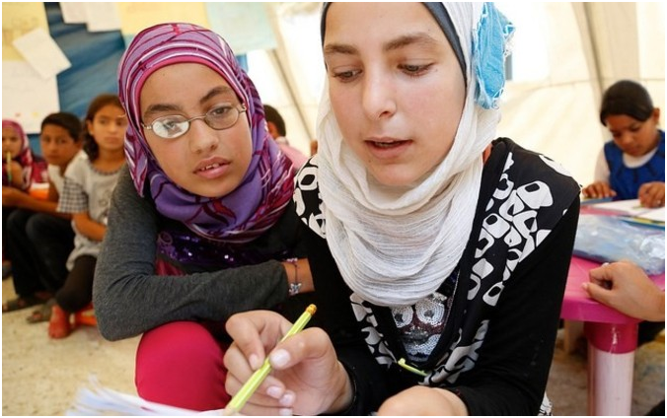
Tallinn learning
and
support centre -
one can come
to the center
to receive advice
and information
as well as
for recreation."

Slide 8
Examples of integration in Estonia
Positive
Education
Working
Different activities and events
Opportunity to learn language
Study culture
Compensates the negative population growth
highly educated immigrants - very successful
set up their own business - restaurants etc

Slide 9
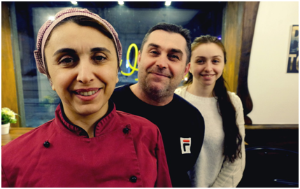
Day in the Life: The Muradyan family (from Armenia), cafe owners

Slide 10
Negative
Local people do not feel safe
Estonian language is quite hard
Immigrants and refugees do not like our culture and religion
Cold weather
Low wages

Slide 11
Conclusion
Refugees and immigrants should live in town
Better opportunities
Learning language
Educating their children
Finding work
Most important - communication with the locals

