Slide 1
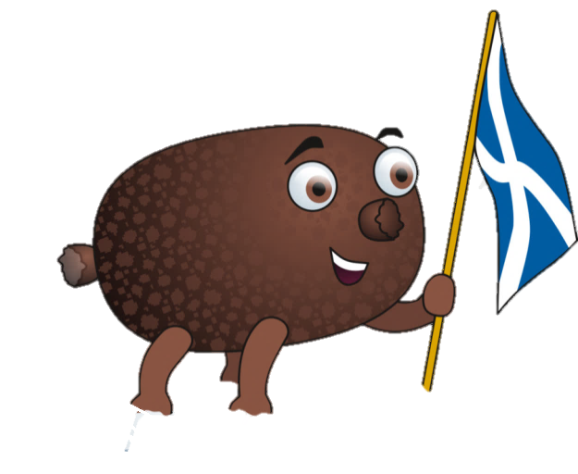
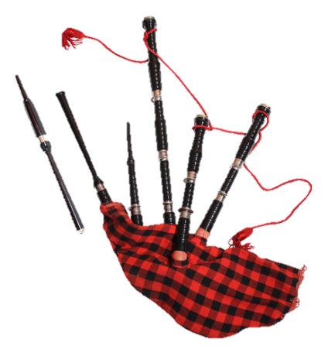
The World Of Work Pathways & Support

Slide 2
How does Peebles High School support students to get into the World of Work?
Bulletin-The school advertises jobs which are on offer in the local area through the daily bulletin, which reaches all students.
Assemblies- Speakers talk about job opportunities and apprenticeships during assemblies.
Placements-Peebles High School works closely with businesses in the community and sometimes students may get opportunities to volunteer in these businesses a few hours a week.
Notice Board- Displays job vacancies, apprenticeship information and web links to sites which advertise jobs.

Slide 3
At Peebles High School what support do students get from Teachers/Careers advisors on getting into the World of Work and how is this structured?
During Personal and Social Education (PSE), the school helps us by using many different techniques. One being Planit Plus. On Planit Plus, there is lots of different work-related and exam help e.g. apprentice opportunities, university courses, careers and much more.
We also have been to UCAS events. At these, we get the chance to talk to different universities, receive prospectuses and get the chance to speak to about our options for the future and get help with our applications.

Slide 4
Part Time work and how Peebles High School prepares junior and senior students to get into the World of Work?
There are lots of opportunities for part time jobs. There are many small businesses in the local area in which students work.
In the last 2 years PHS has helped S3 pupils (roughly aged 14) organise a week of work experience in a field that they would like to work in, in the future.
There is also a careers advisor which you can request an interview with who will help you decide on the career path which is best for you.

Slide 5
What General Soft and Hard Skills/Qualities are required for different jobs?
Hard Skills- skills which can be learned
Basic Numeracy (Jobs involving money e.g. finance)
Foreign Languages (Interpreting and Translating)
Computer Skills (Need for most jobs now)
Writing (Roles in Journalism)
Soft Skills- people skills and the way you interact with others
Communication Motivation
Leadership Organisation
Flexibility Creativity
Work well under pressure/ in groups
Attention to detail

Slide 6
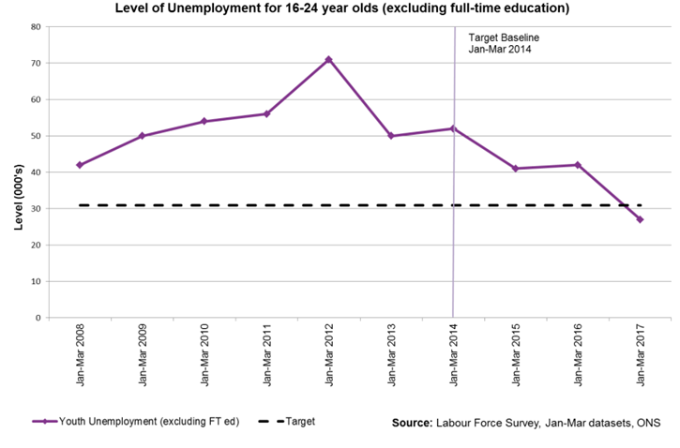
Youth Unemployment Statistics
The level of youth unemployment has reduced from 52,000 in Jan-Mar 2014 to 27,000 in Jan-Mar 2017, a decrease of 25,000 (48.3 per cent) since the Jan-Mar 2014.
The highest rates of youth unemployment are in parts of Glasgow, the west of Scotland, Kirkcaldy and parts of the Central Belt. Lowest
rates are in Aberdeen,
parts of Edinburgh,
parts of Glasgow,
North East Fife and
the Shetland Islands.

Slide 7
Reasons For Youth Unemployment Statistics
Lack of qualifications. Young people without any skills are much more likely to be unemployed (structural unemployment.)
Geographical Unemployment. Youth unemployment is often focused in certain areas – often inner cities where there is a cycle of low achievement and low expectations.
Lack of graduate jobs. Many young people leave college with a degree but then find graduate jobs are in short-supply.
Family Background. Youth unemployment is often higher among people who have a
history of broken families,
drug use or criminal records.

