Slide 1
Immigration and concepts of integration
Arlinda.K & Dominika.W

Slide 2
Give an overview of the nationalities of the immigrants in your school

Slide 3
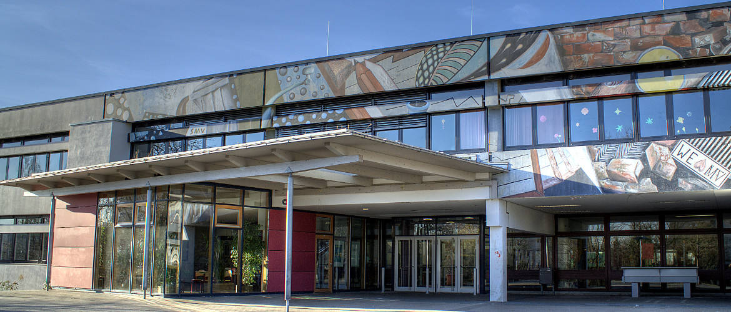
What types of activities are planned towards foreign students in your school?
Otto-Hahn-Gymnasium Ostfildern

Slide 4
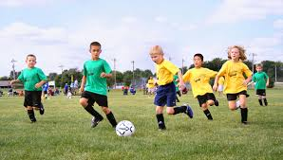

Slide 5
Explain your point of view about the actual level of integration achieved by foreign students in your school

Slide 6
How could foreign students be best integrated into your school, and into society?
equality
projects and activities

Slide 7
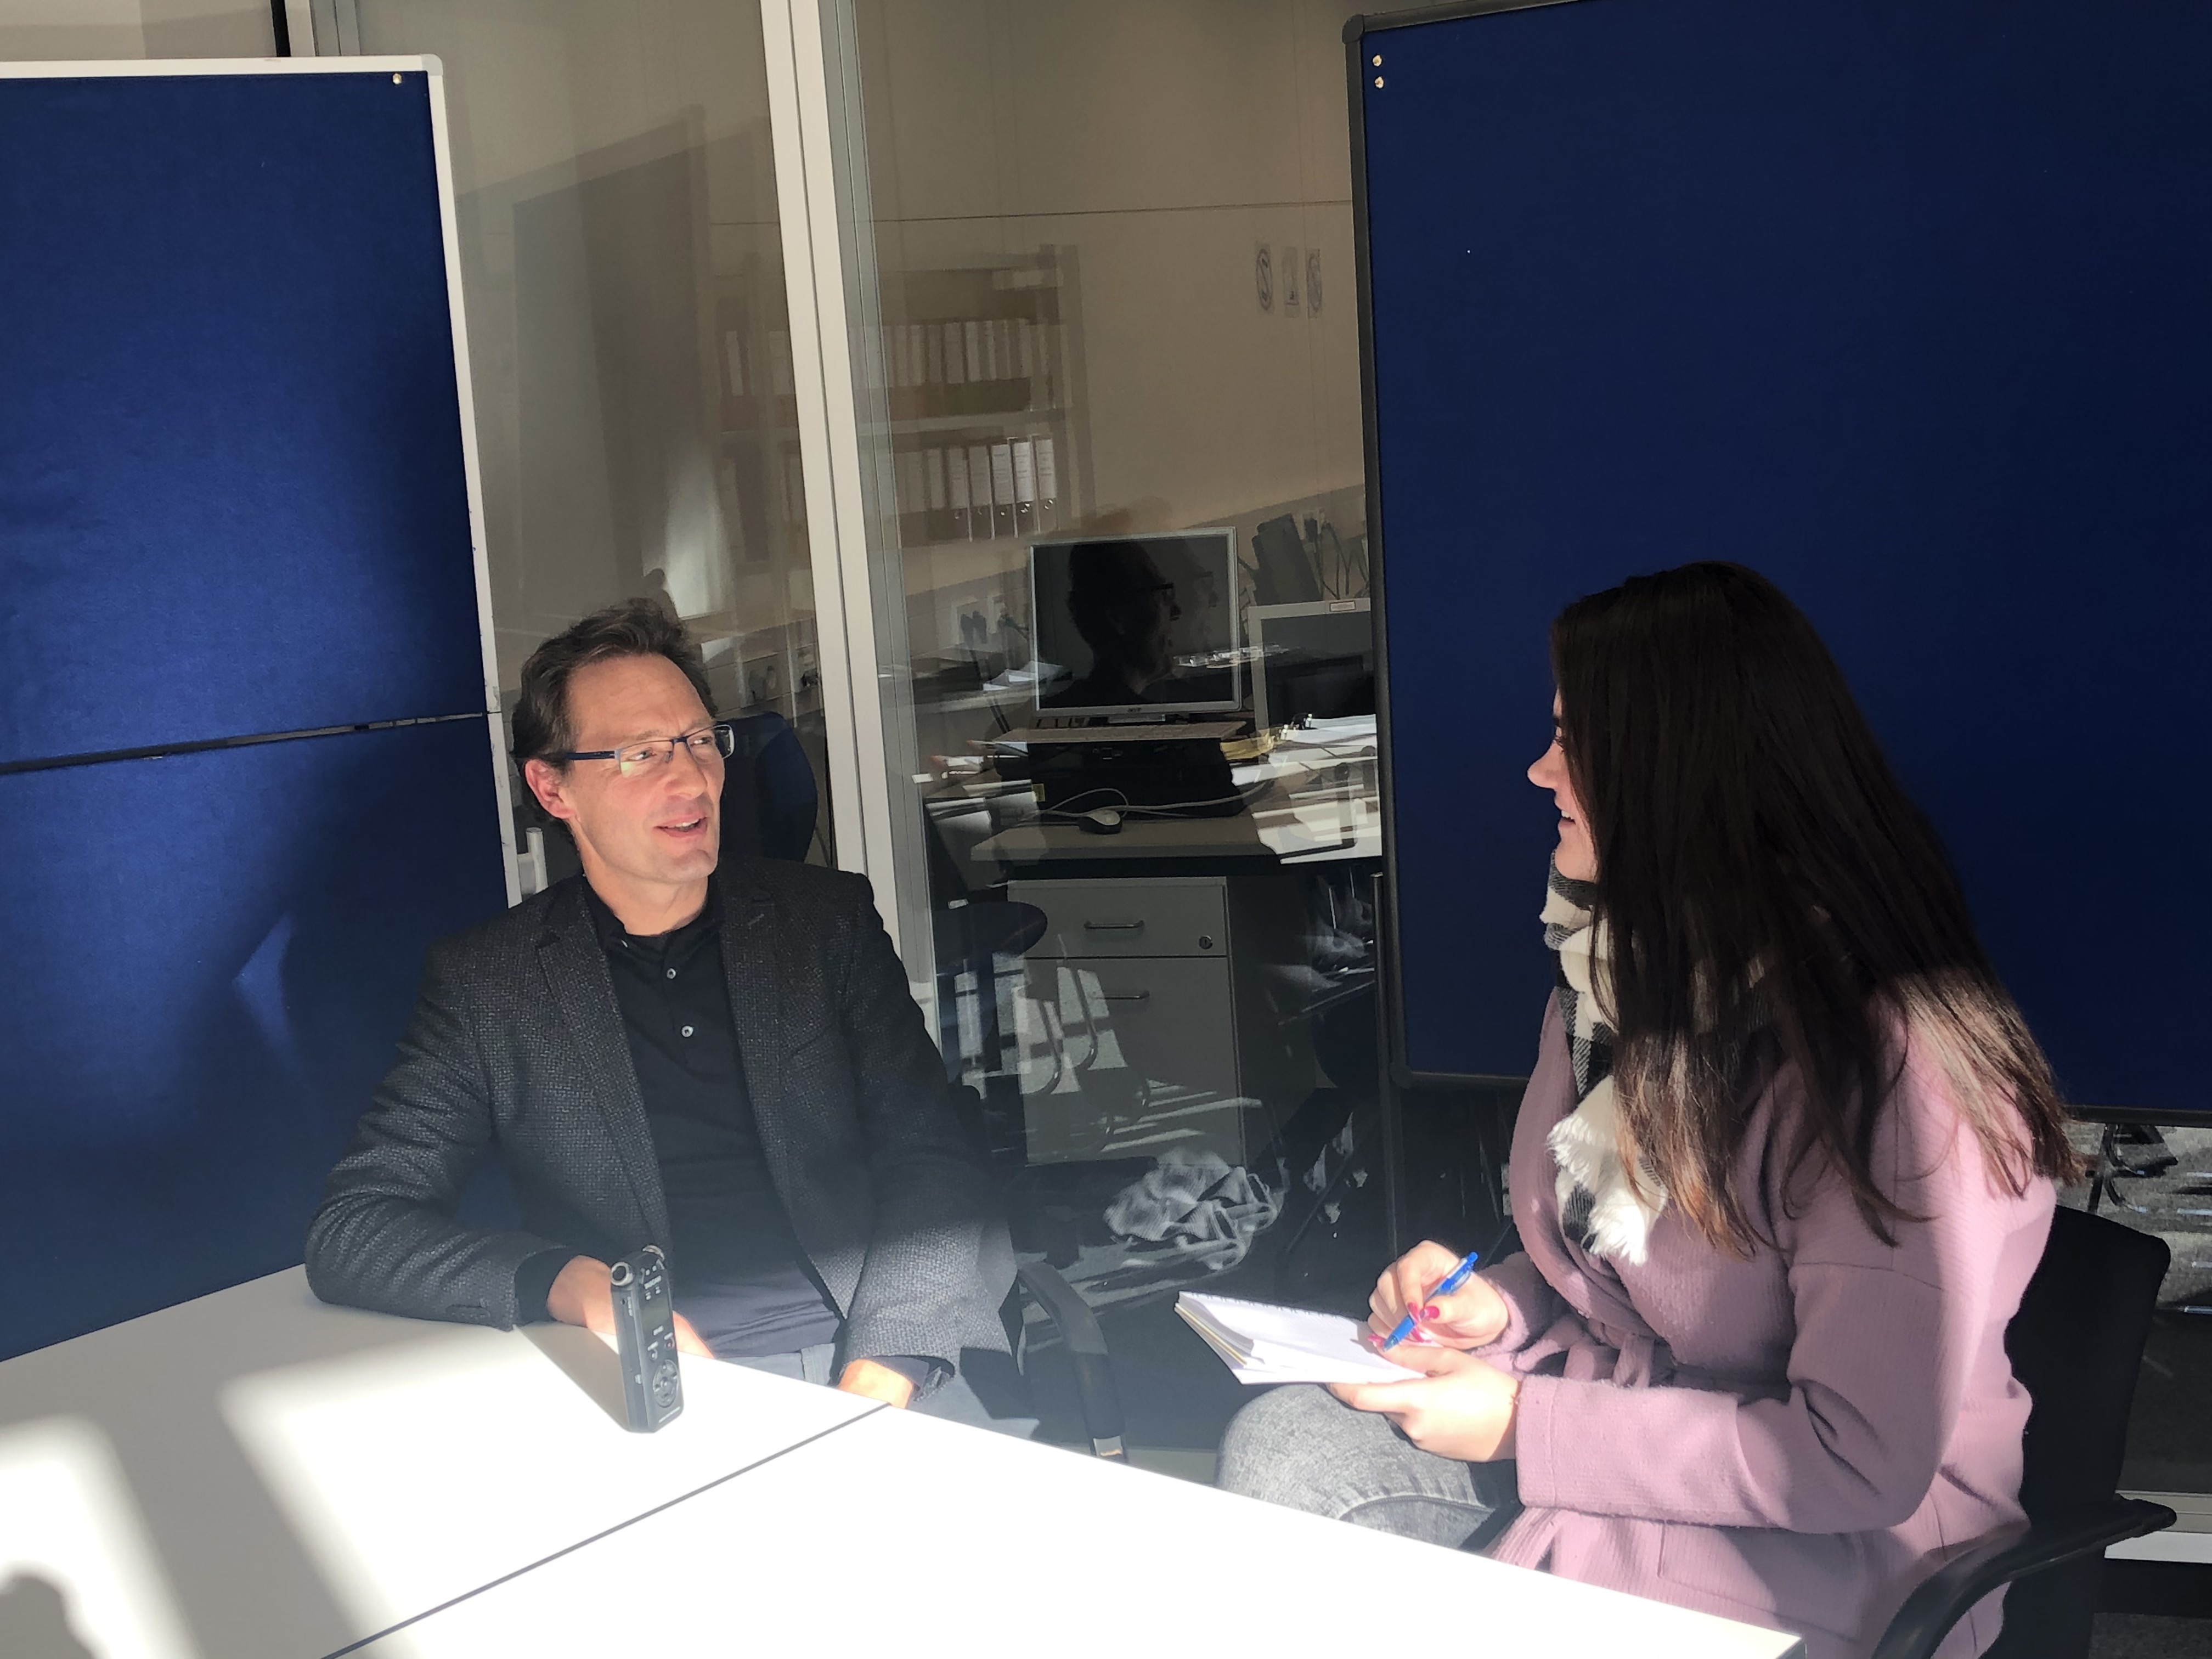
Mr. Lietzau -
principal of Otto-Hahn-Gymnasium

Slide 8
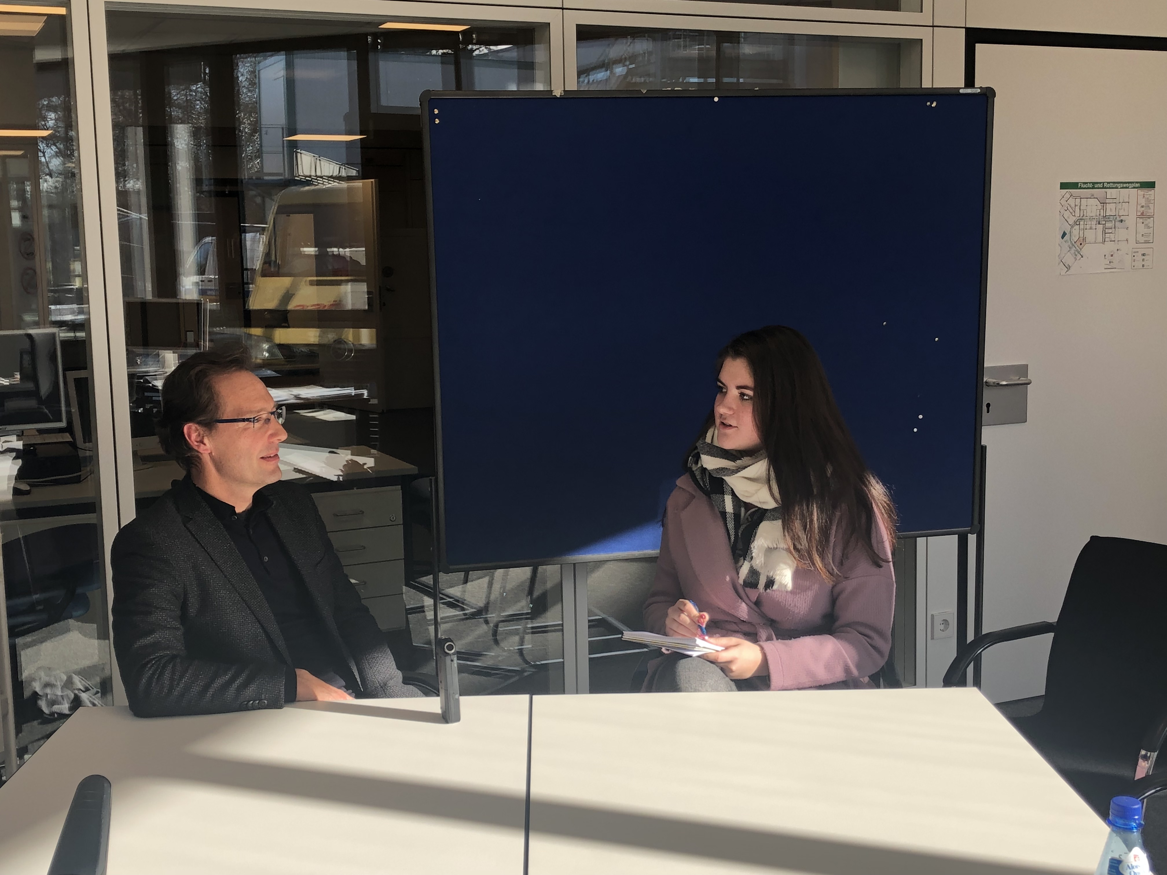

Slide 9
https://goo.gl/images/qxfKy2
https://goo.gl/images/8XaRf5
https://goo.gl/images/TYYBKV
https://goo.gl/images/6Ha5sy
https://goo.gl/images/xbToHw
https://goo.gl/images/VjhGAu
https://goo.gl/images/Pr7Bpi
https://goo.gl/images/QmeYnZ
https://goo.gl/images/n9owoa
https://goo.gl/images/CKABam
https://goo.gl/images/KDoqLY
https://goo.gl/images/d6Tvao
https://goo.gl/images/yovQqk
https://goo.gl/images/fAh3g6
https://goo.gl/images/HML4o1
http://www.bpb.de/lernen/grafstat/projekt-integration/
https://www.wir-zusammen.de
https://goo.gl/images/Xqy9wx
Sources

