Slide 1

Debating in schools
according to the rules and regulations of the Debating Society Germany e.V. (DSG)
www.schoolsdebate.de

Slide 2
Ladies and gentlemen, the proposition believes that debating is the best way of developing the students‘ speaking, listening, presentational, social and intercultural skills !

Slide 3
The World Schools Debate Format
What to debate about: the motions
The given topic, which is known as the motion, usually starts with „This house believes that …“ (THBT), „ This house would …“ (THW), „This house …“ (TH).

Slide 4
Motion examples
  THBT there is too much advertising in sports
  THBT all pupils should wear school uniforms
  THB in patchwork families
  THBT are computers better than books for learning.
  THW negotiate with terrorists
  THW punish sports teams whose fans misbehave

Slide 5
Prepared and impromptu debates
Prepared debates
The motions are announced to tournament participants in advance. Teams have time to prepare their speeches.
Impromptu debates
The teams receive the motion one hour ahead of the debate.

Slide 6
Course of the debate and timing
Proposition and Opposition
The Proposition defends the motion whereas the Opposition tries to rebut and refute the arguments given by the Proposition, i.e. to destroy the Proposition‘s case.
The side teams debate on is determined by the tournament draw.

Slide 7
Duration of speeches
Every team presents 3 speeches of 6 minutes and 1 reply speech of 3 minutes, given by the either the 1st or the 2nd speaker.

Slide 8
Succession of speeches
Proposition | Opposition
1st speaker Definition of the motion Presentation of team line 1 – 2 arguments (4-5‘) | 1st speaker Definition (accepts or redefines it) Rebuttal Presentation of team line 1 – 2 arguments
2nd speaker Rebuttal (2’) At least one more argument (2’) (from team line) | 2nd speaker Rebuttal (2-3‘) At least one more argument (2-3‘) (from team line)
3rd speaker Rebuttal (4-5’) 1 minor argument (only if announced in team line) Link to case | 3rd speaker Rebuttal (4-5‘) Link to case
Reply speaker (1st or 2nd speaker) Summary of debate: points out clashes | Reply speaker (1st or 2nd speaker) Summary of the debate: points our clashes

Slide 9
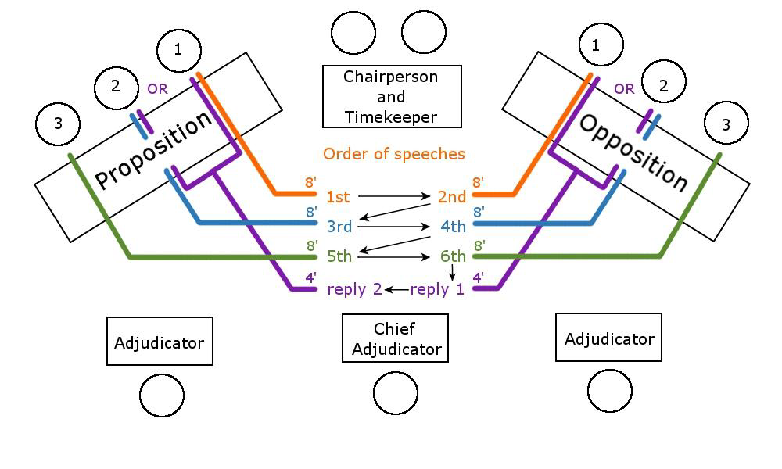
From: Christopher Sanchez, A Quick Introduction to Debating in Schools, 2012, www.schoolsdebate.de

Slide 10
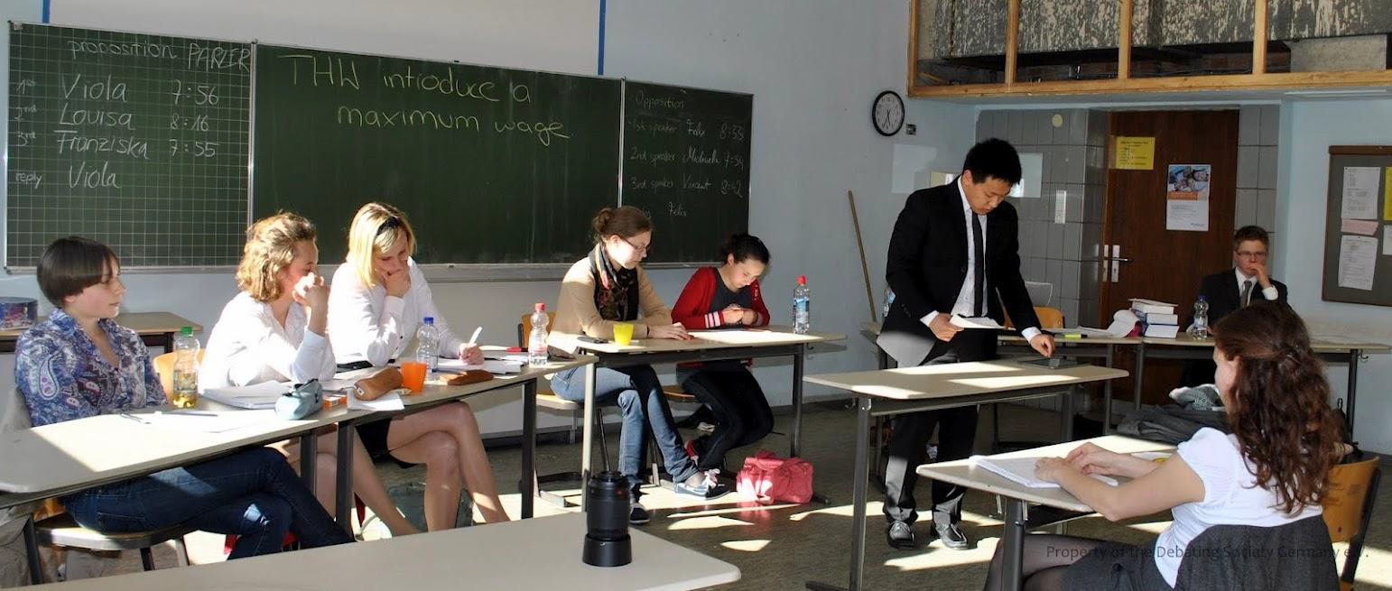
From: Christopher Sanchez, A Quick Introduction to Debating in Schools, 2014, www.schoolsdebate.de, p.9

Slide 11
Points of information
During the substantive speeches (not during the reply speeches!), and only between minutes 2 and 4 does the team not speaking have the opportunity to ask short questions or make short points.
The speaker can either
accept or decline a POI.
Every debater is expected
to accept at least
one POIs per speech.
From: Christopher Sanchez, A Quick Introduction to Debating in Schools, 2014, www.schoolsdebate.de, p-9

Slide 12
The cast involved in debating
debaters
a chairperson and a timekeeper
judges (a minimum of 3 judges)
the audience

Slide 13
Speaker roles
Proposition | Opposition
1st speaker Definition of the motion Presentation of team line 1 – 2 arguments (6-7‘) | 1st speaker Definition (accepts or redefines it) Rebuttal Presentation of team line 1 – 2 arguments
2nd speaker Rebuttal (4’) At least one more argument (4’) (from team line) | 2nd speaker Rebuttal (4-5‘) At least one more argument (3-4‘) (from team line)
3rd speaker Rebuttal (6-7’) 1 minor argument (only if announced in team line) Link to case | 3rd speaker Rebuttal (6-7‘) Link to case
Reply speaker (1st or 2nd speaker) Summary of debate: points out clashes | Reply speaker (1st or 2nd speaker) Summary of the debate: points out clashes

Slide 14
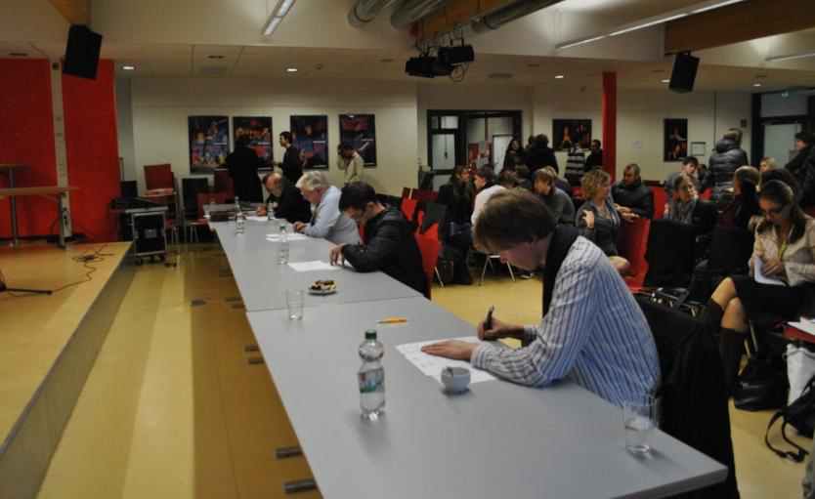
Judging
Debaters are judged as to
style
content
strategy
From: Christopher Sanchez, A Quick Introduction to Debating in Schools, 2014, www.schoolsdebate.de, p.18

Slide 15
Style
The way the speaker speaks (rhetorical competence)
  free, skillful use of palmcards
  comprehensible, correct, suitable language
  fluency
  eloquence
  ability to use rhetorical means
The appropriate manner and bearing of the speaker
  body language
  positive relationship with audience
  courtesy towards the opposing team

Slide 16
Content
Weight, consistency and quality of the arguments
  balance: logical order
  strength: relevance, significance
  validity: appropriate support and convincing examples

Slide 17
SPERM
S: Social issues
P: Politics
E: Economy
E: Environment
E: Ethics
R: Religion
M: Moral issues
ARE
A: Argument
R: Reason
E: Example

