Slide 1
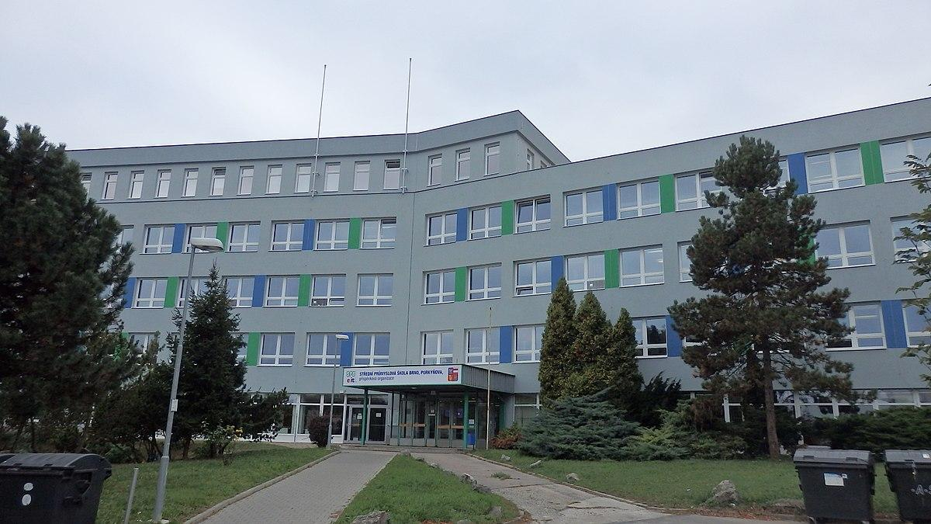
OUR SCHOOL
SSP Purkyňova
SSP Purkyňova

Slide 2
The past of our school
The history of our school goes back to 1949 when it was created as a school for apprentices for the company Tesla Brno.
The current building in the first picture was built in 1984 . And it has been the main building ever since.
In 2013 we merged with another big technical school

Slide 3
The present times
Our school has over 1300 students
We have many study progammes ranging from IT to economics, those two being the main programmes.
For IT we have four main specializations:
- Programming
- Graphics and Web design
- Automation
- Networking

Slide 4
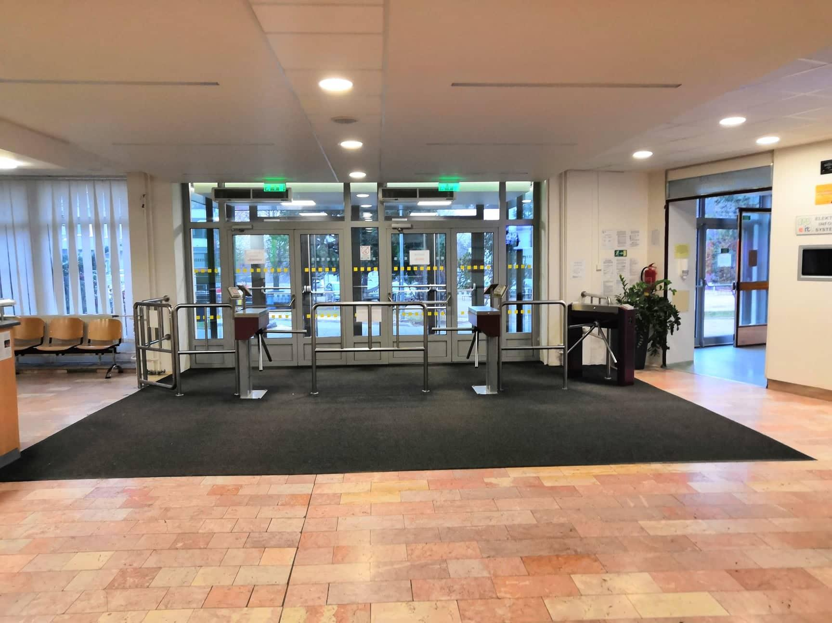
How our school looks inside
Main entrance

Slide 5
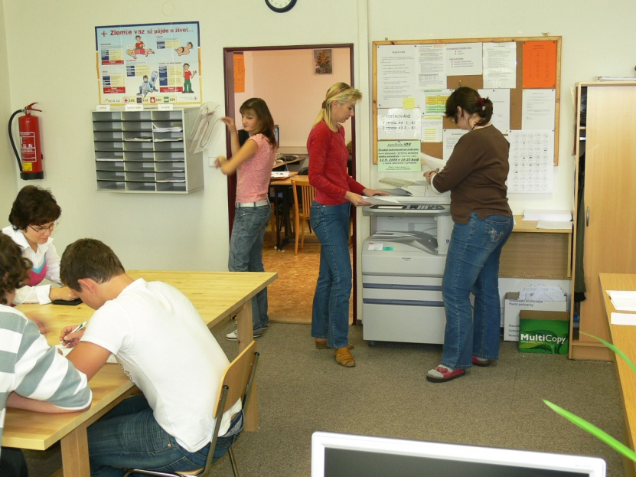
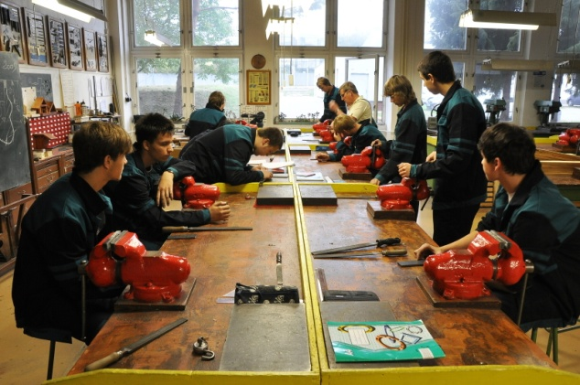
Ground floor
Gatehouse
Canteen
Cafeteria
Study
Our cabinet (boxes)
Specialist classrooms for training - electrical and mechanical
Gym

Slide 6
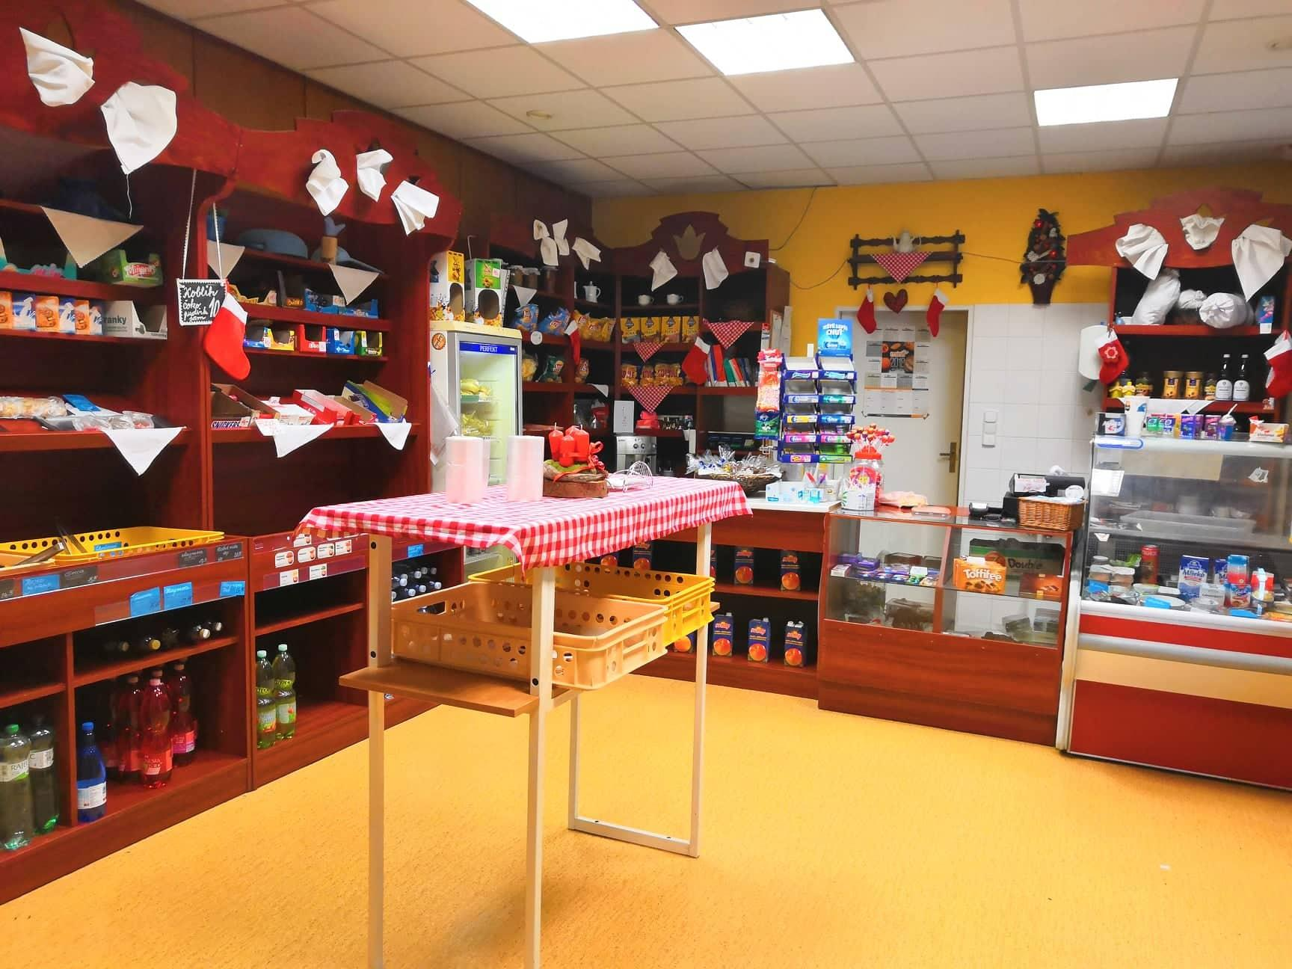
Most important – Our cafeteria

Slide 7
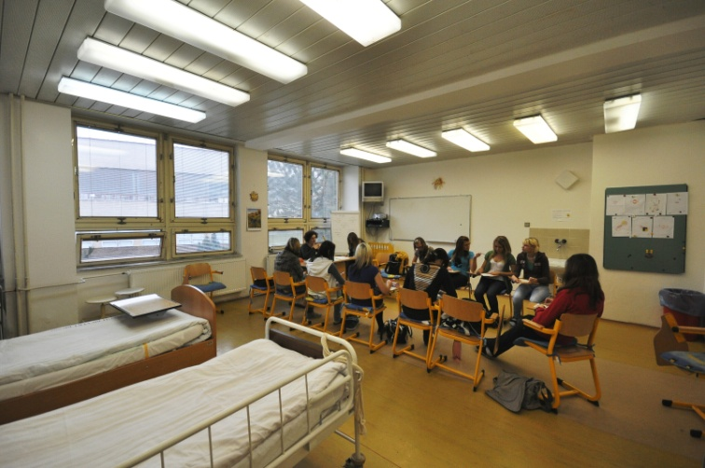
First floor
Music classroom
Art classroom
Classrooms for teaching business correspondence and typing
Special classrooms social care
Staff rooms
Librery
Table football

Slide 8
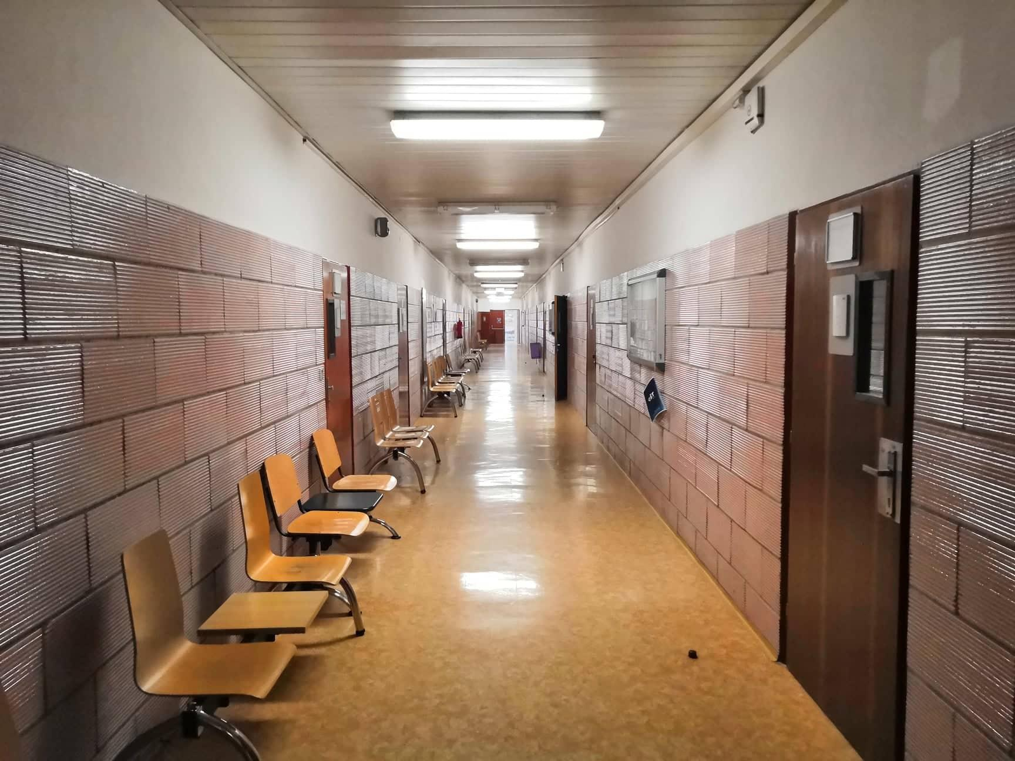
Hallway

Slide 9
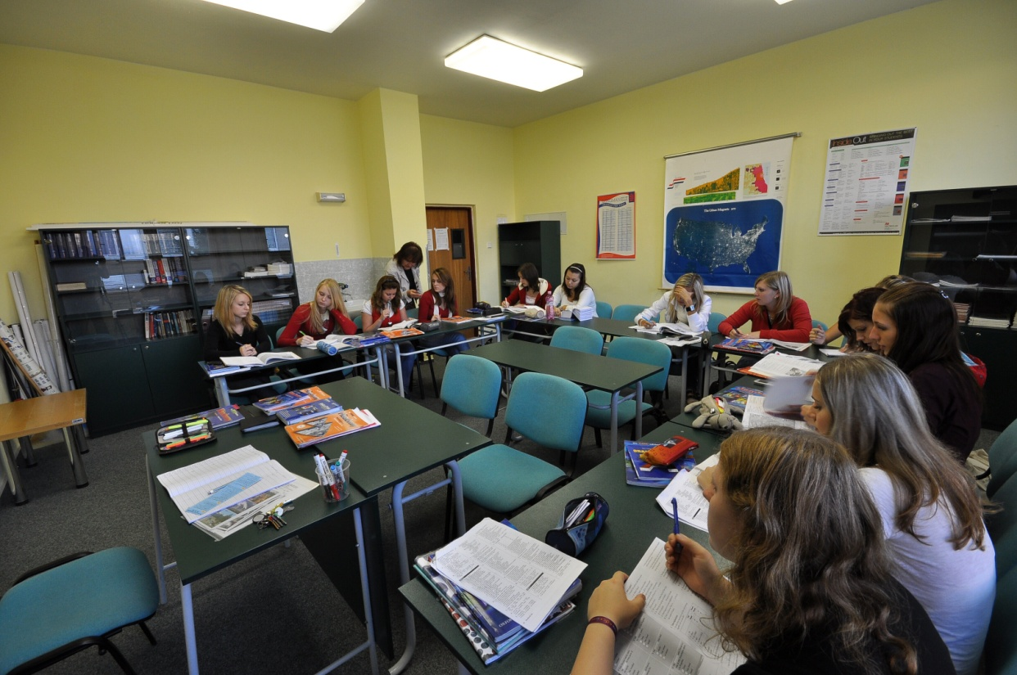
Second floor
Language classrooms
Staff rooms
School management and school administration
Place to sit

Slide 10
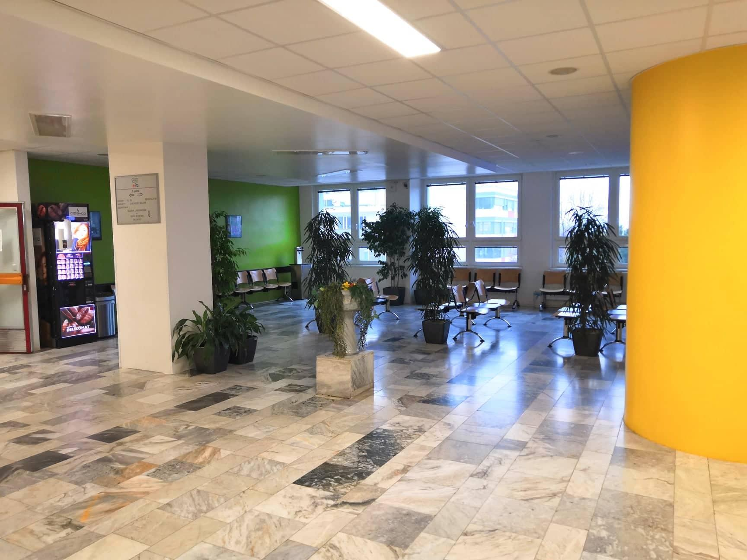
Lobby area

Slide 11
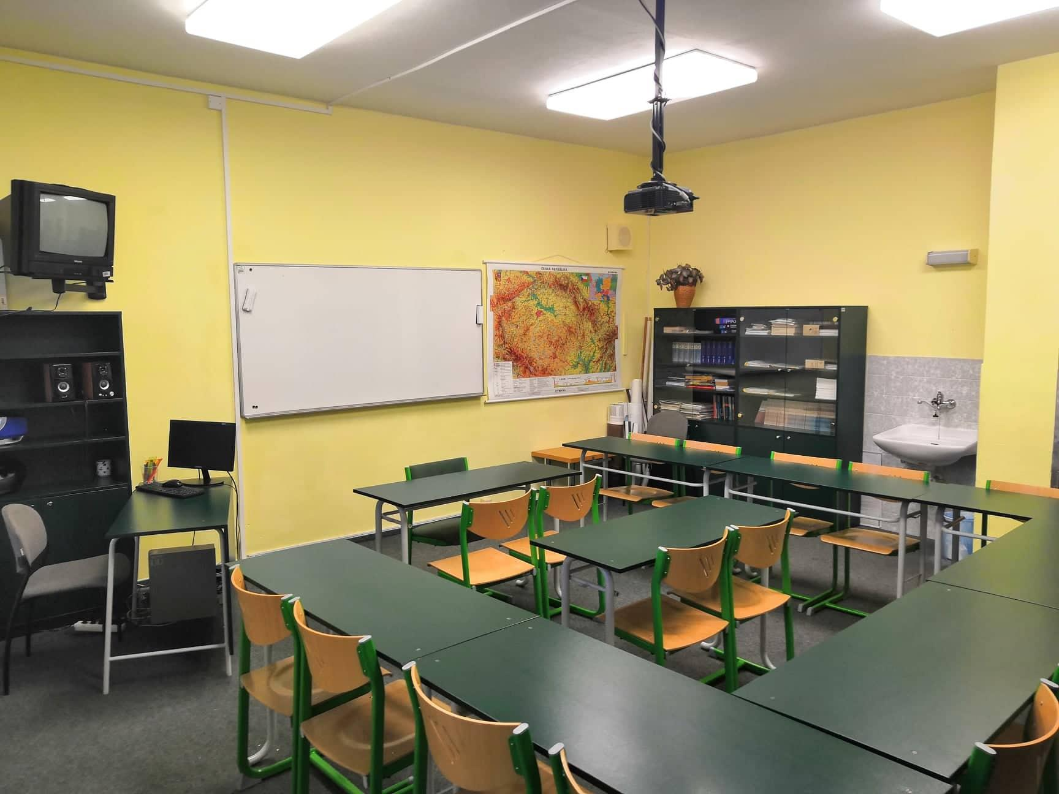
Language class

Slide 12
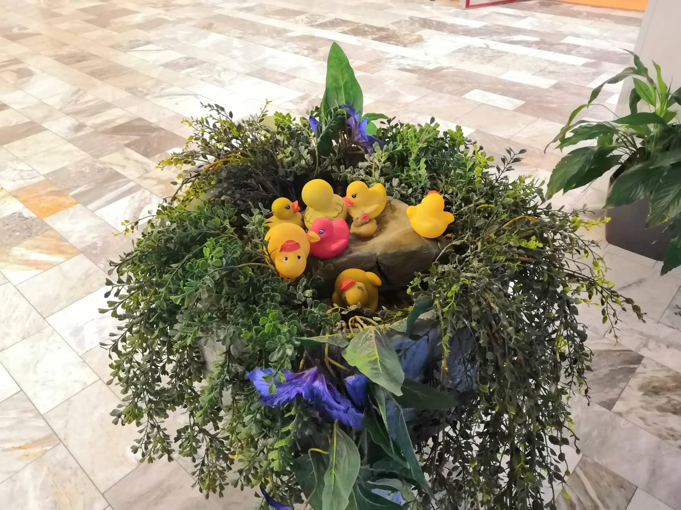
Our unofficial mascot
Rubber ducks

Slide 13
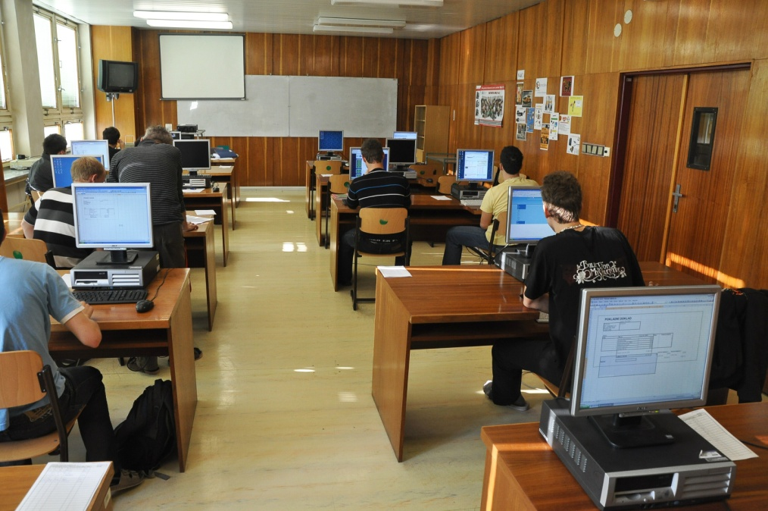
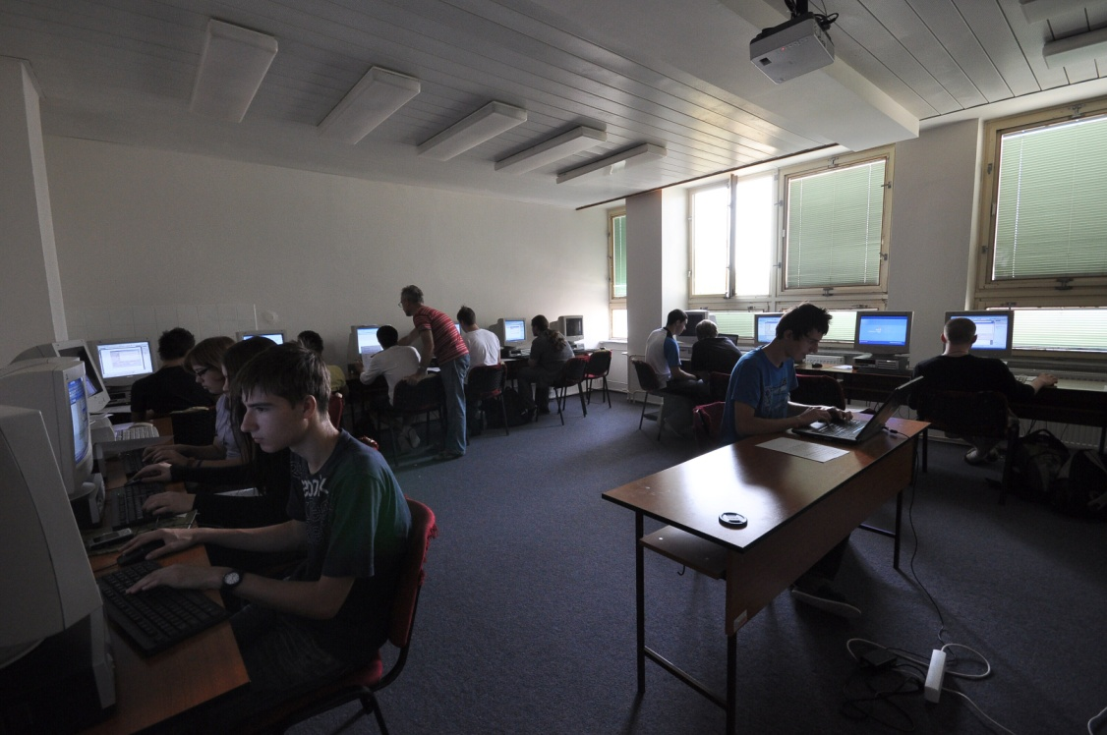
Third floor
Staff rooms
Mostly computer classrooms

Slide 14
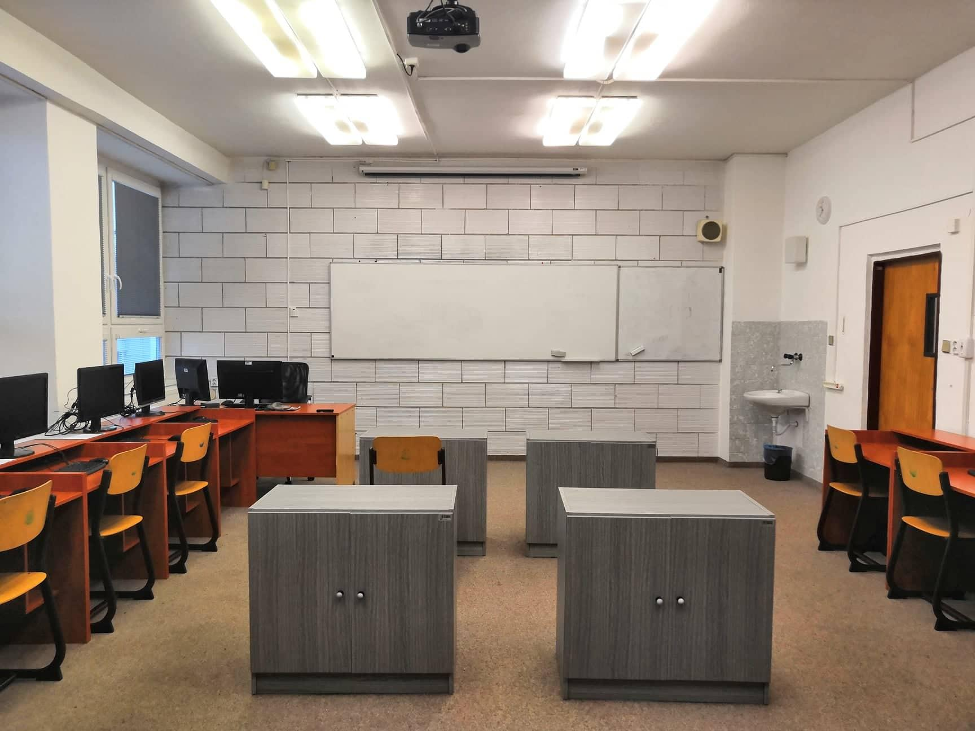
Computer class

Slide 15
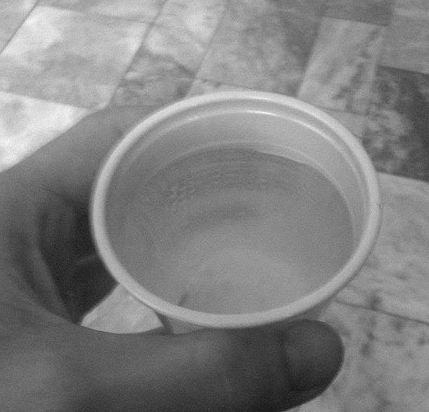
Basic information
We‘re a state school
We have more than 1200 students
Many study programmes
Our school has a great soda water for free ☺

Slide 16
Study programmes in our school
Střední průmyslová škola Brno, Purkyňova, příspěvková organizace

Slide 17
Study programmes
IT
Electrotechnics
Social administration
Economics & business
Ecology

Slide 18
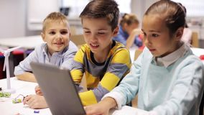
Information technologies
Installation, repair and maintenance of the PC
Design and management of computer networks and IT resources
Creation of websites, work with graphical material, advertising, company presentation, presentation of data, programming
Automation, control and regulation of the production process

Slide 19
Economics
knowledge of basic economic concepts and principles business activities
making business correspondence
accounting and tax records
teaching world languages
basic orientation in legal standards

Slide 20
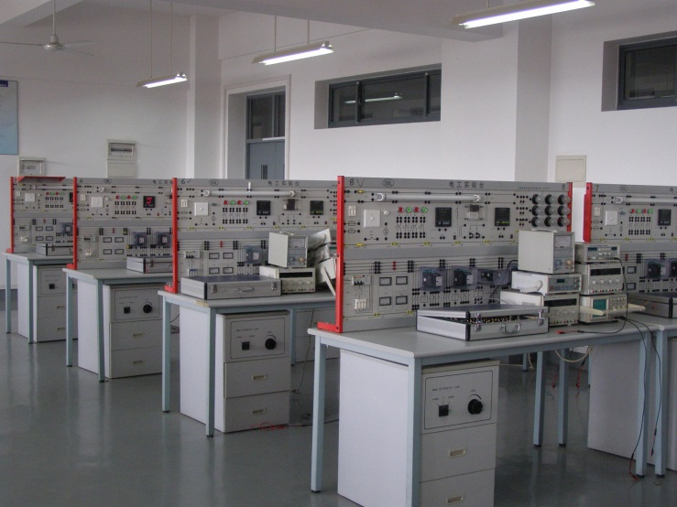
Electrotechnics
network traffic analysis
securing network elements against unauthorized access input
Installation, repair and maintenance of the PC
Design and management of computer networks and IT resources
creating websites, working with graphs material, advertising, company presentation, presentation data processing, programming

Slide 21
Thank you for your attention
Look at this video☺

