Slide 1
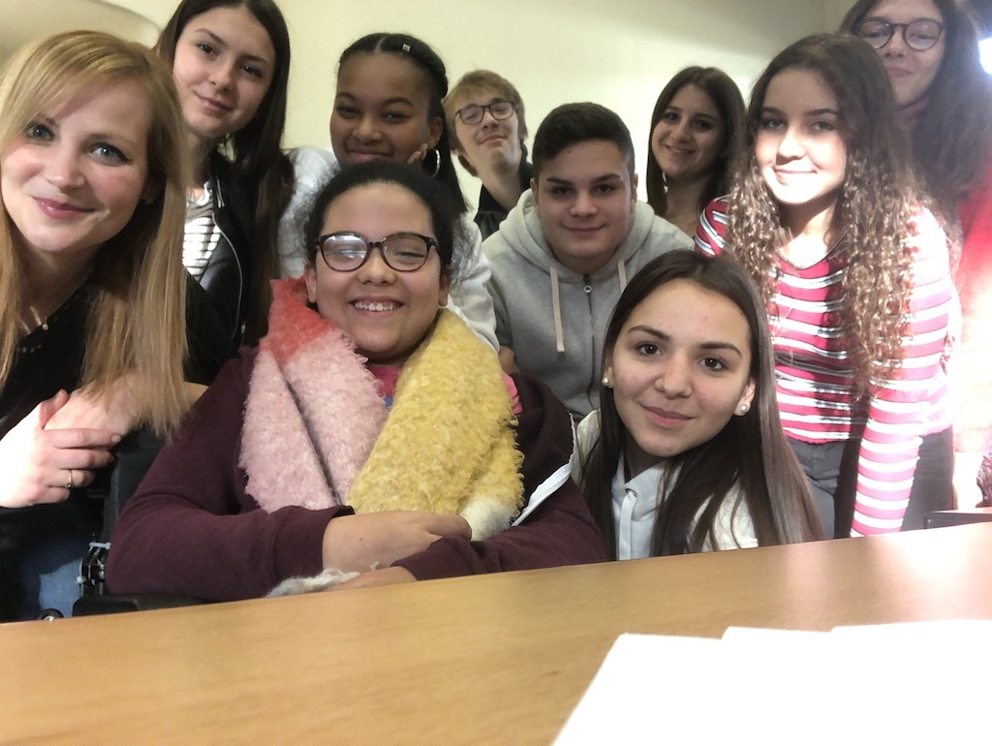
Institut provincial d’enseignement secondaire de Seraing
All the students from 3rd and 4th grade in business and tourism speciliazation are happy to present their school to you dear partners!

Slide 2
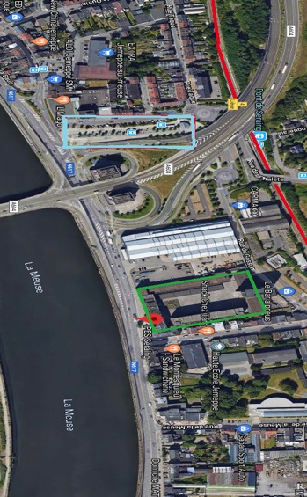
Look at the map ! Our school is situated in Jemeppe.
Jemeppe is a small city near Liège.
We are here !
red: railway
green: our school
blue: bus station

Slide 3
What can we do at IPES Jemeppe?
Well, there are many subjects or specializations such as :
Arts
pupils learn composition and creation, drawing techniques, scientific drawing, arts education etc. Arts specialization is perfect for people who want to be architect, graphic designer or artist.
Physical education:
Students learn anatomy and physiology, basketball, rugby, cycling
This specialization is great for people who want to be P.E teacher, doctor, educator or sportsman.
Economics and Business administration:
Pupils learn ICT, civil law or accounting
If you want to work as a secretary, a lawyer, an accountant, this is for you!
Biology and Science:
Students learn Biology, Chemistry and physics. These specializations are perfect for people who want to become scientist, laboratory assistant or even beautician (with the “beauty” specialization)

Slide 4
On a side note, our school was at first a school for electricians and dressmakers.
This blacboard was removed 3 years ago at school !
Now, of course, people aren’t allowed to smoke at school anymore or anywhere in public places (since 1990 in Belgium)
Here is a class picture from 1967! Nice ties guys ☺

Slide 5
Here are a few more information about our specialization : Business Adminstration and Tourism
We learn :
Dutch (it’s the other offical language in Belgium! It sounds like German but it isn’t!)
ICT (how to use computers and technologies)
Typing (we need to type faster than our teacher but Mrs Ambroise is still the best!)
Law and marketing
Geography (it’s better to know the world if you study tourism, doesn’t it?)
And of course all other normal subjects as :
French, Maths, Science, P.E and Philosophy.
In the future we can become :
Secretary
Hotel manager
Travel agent Steward/stewardess
Tour guide
Receptionist
Resort representative etc.
Click here to hear us saying hello in Dutch!

Slide 6
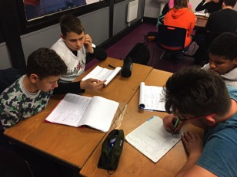
Schedule and information
School starts at 8:10 am and we have a 15-minute- break at 10:00.
Lunch time is at 12:35 and it lasts 1 hour.
Homework club starts at 5:10 (in that club, we can do our homework or we can get help from teachers in Maths, French, English or Dutch.
And you? Are you also going to the homework club?

Slide 7
Schedule
 | Monday | Tuesday | Wednesday | Thursday | Friday
1 (8.10-9.00) | Dutch | Maths | PE | Dutch | Typing
2 (9.00-9.50) | French | History | PE | Dutch | Typing
3 (10.05-10.55) | Maths | Science | / | Typing | Typing
4 (10.55-11.45) | Maths | Science | English | Arts | English
5 (11.45-12.35 | Geography | Maths | Philosophy | Arts | English
6 (12.35-13.35) | Break | Break |  | Break | Break
7 (13.35-14.25) | Economics | Economics |  | French | Typing
8 (14.25-15.15) | French | Typing |  | French | English
9 (15.15-16.05) | Dutch | Marketing |  | Philosophy
10 (16.10-17.00) |  | Marketing

Slide 8
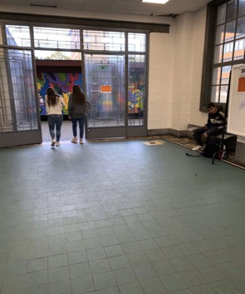
Now take your umbrella (it always rains in here) and come with us visiting our school!
This is the main entrance :
Sarah, Laura and Adriana say Hi!

Slide 9
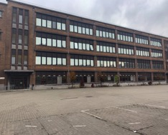
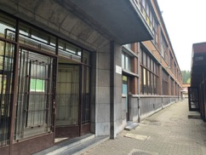
Now, let’s see our buildings !
These are the cottages. They were built after the old buildings because there were too many students and not enough places! Now we have got 8 more classrooms!
This is the East building.
There are 26 classrooms with a laboratory and 2 beauty spaces for the beautician specialization.
This is the West building .
There are 10 classrooms with a large corridor with 3 vending machines.

Slide 10
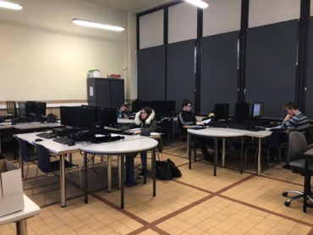
Our favourite classrooms :
This is the Geography class!
There are 5 Geography maps.
There are tables and chairs.
This is the computers class.
There are a lot of computers.
This class is perfect for our specialization (Tourism)

Slide 11
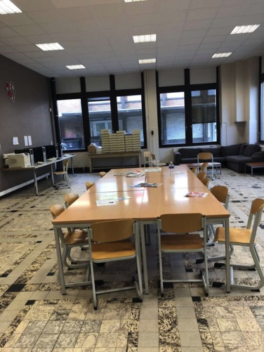
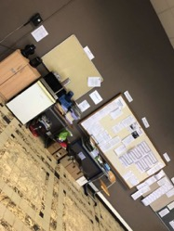
The teachers’ room
This is the teachers’ room.
Teachers meetings take place there.
There is a coffee machine, a sofa,…
There are computers, tables and teacher’s box.
It is said that sometimes, when the coffee machine is out of order, teachers fall asleep on the couch ^^

Slide 12
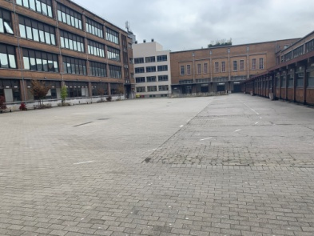
The playground
The playground is very big ! We have enough places to run, to walk and we’ve got benches to sit on.
Once a week, students are in charge of music during lunch time. It means that we can choose songs we like to put on the school radio. It’s great !

Slide 13
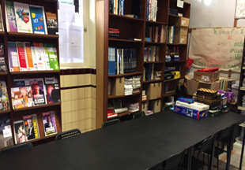
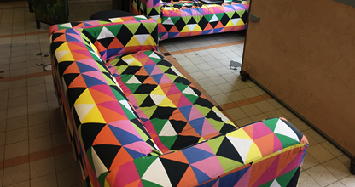
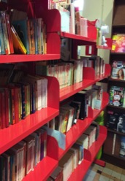
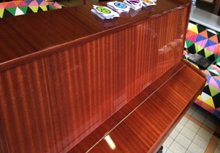
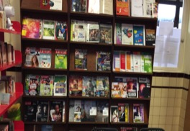
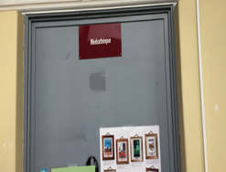
The students’library ! Our best room!
Here we can play the piano, sing, read or just relax on the sofa!

Slide 14
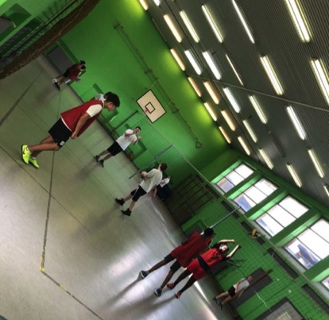
Sports Hall
This is the gymnasium!
We have a lot of sports equipment! This is great because some famous sportsman are from our school!
Have you ever heard about « Standard de Liège »? Well, some boys from the team studied here because we are a sports science school !

Slide 15
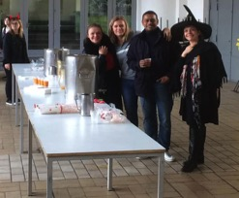
This is where we eat, our cafeteria :
We have a wide variety of choices for lunch :
Sandwiches (ham and cheese, chicken, tuna or vegetarian)
Pasta (with different sauces)
Hot meal (vegetarian or not).
Vegetables soup
This was Halloween at school ! Each student had a pumpkin soup and could come to school dressed up in vampires, witches or anything scary.

Slide 16
Why did I choose this school ?
Sara: because I always wanted to be a secretary and I knew this school had that specialization!
Justine: It was my mother who enrolled me because it’s a nice school and there was the specialization that I liked.
Tamara: because I wanted to be a medical secretary and this school is near to my house.
Lucie: I love languages and I want to work in a retail company.
Ines : I chose this specialization because I’d like to become a stewardess and also because I like to learn new languages.
Noah : In the future i want to be a Business Man
Dilara : I would like to be a policewoman . So I have to learn different languages this is why I took this option.
Lara : I want to work abroad in a zoo so I have to speak different languages.

Slide 17
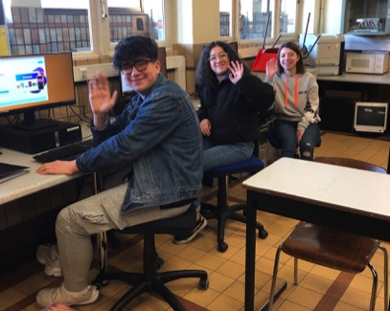
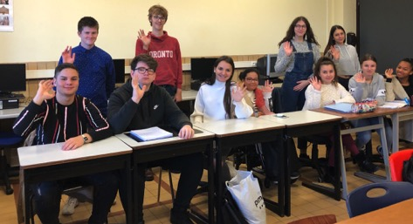
That’s all about our school!
I hope someday you’ll come to visit us ! See you!

