Slide 1
The Legend of the Golden Duck
decorations and costumes

Slide 2
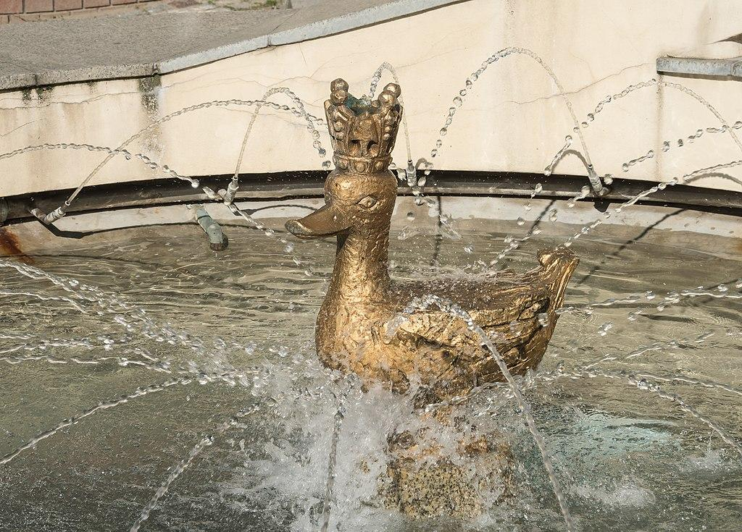
The legend by Artur Oppman
https://wolnelektury.pl/media/book/pdf/legendy-warszawskie-zlota-kaczka.pdf
Polish version: https://www.youtube.com/watch?v=WFOCPSWVVvE
English version with Polish translation: https://www.youtube.com/watch?v=WFOCPSWVVvE
(source: https://warsawtour.pl)

Slide 3
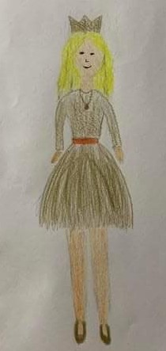
Costume by Pola

Slide 4
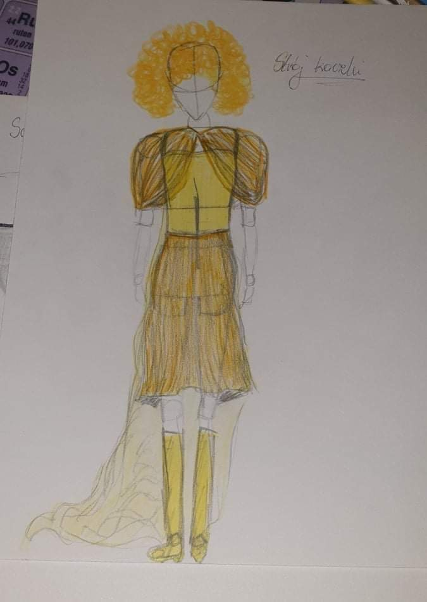
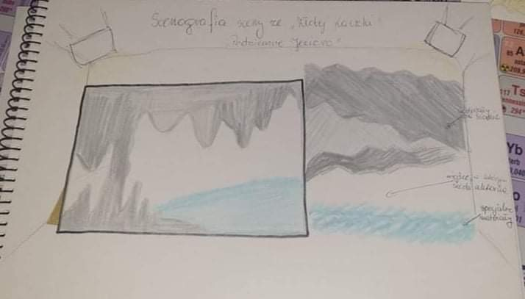
Costume and scenography by Iga

Slide 5
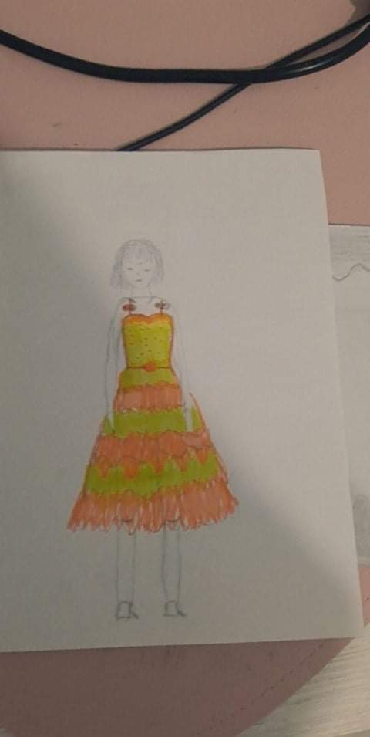
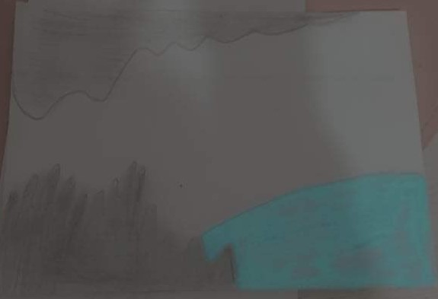
Julia’s costume and scenography

Slide 6
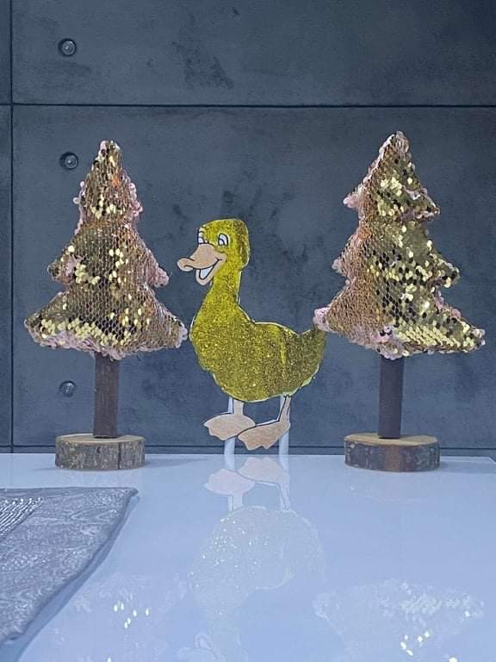
Marcel’s scenography

Slide 7
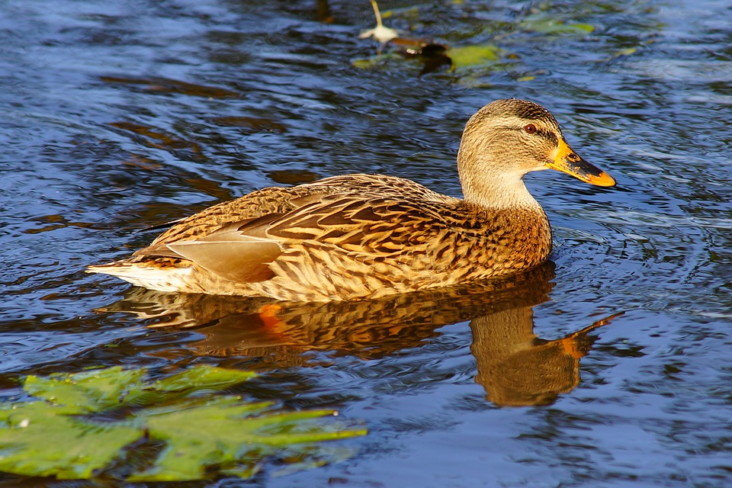
And finally…
A song
Danuta Stankiewicz, Legenda o złotej kaczce
https://www.youtube.com/watch?v=-IACBOB7Es8

