Slide 1
Polish Legends
from Warmia and Masuria region

Slide 2
'The legend of the Tatar stone' by Julia P.
As evening fell, Georg threw a few galleys into the fire and starts thinking about the burned villages and murdered people. That night, Georg was given the task of the starost to guard the city whether the barbazhians called Tatars were coming. After a minute he fell asleep.. .He was awakened by running horses, after a moment of wondering what to do Georg ran to inform the staroste. Around noon, from the north side of the walls, screams were heard and the fields were overgrown with the gray silhouettes of the Tatars. At ahead was the leader of the Tatars dressed in silver armor. Near one of the cannons there was a young man named Janek Nowak. Suddenly, somewhere on the left side, a cannon roared, the bullet flew into the air and hit straight into the chest of the leader of the Tatars who fell to the ground under the hooves of rushing horses. Janek hid in a dark and fell asleep. He was found in the morning and the staroste gave a pot of silver for Him. Janek hid this pot somewhere in the castle, no one managed to find it. Centuries have passed, oaks decayed, but the city remained and the castle on the hill. In the fields to this day there is a huge stone called the Tatar Stone, and next to it there is a beautiful village called "Tatary".

Slide 3
I

Slide 4
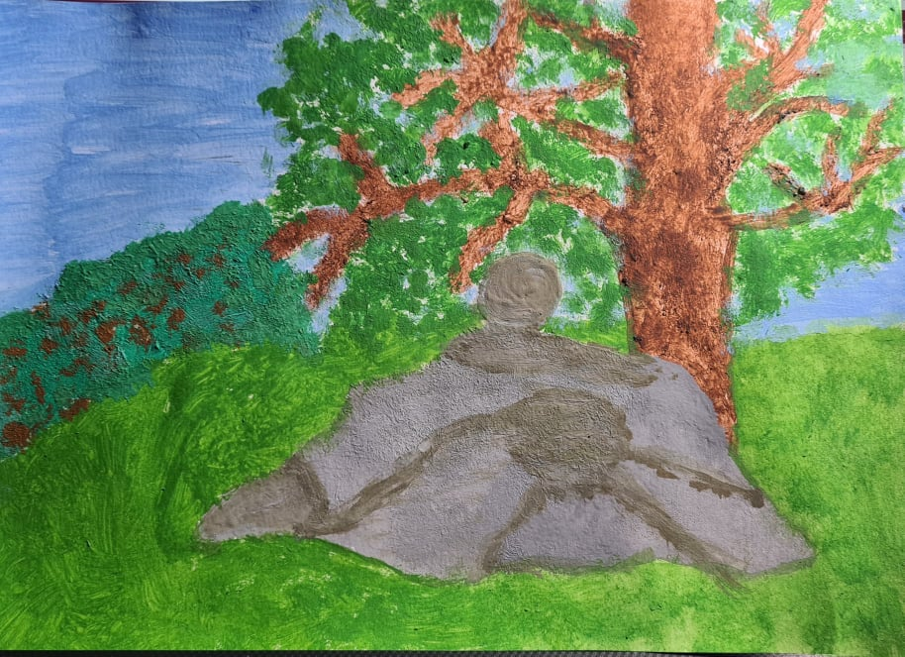
'The legend of the Tatar stone' by Ola D.

Slide 5
'The legend of the Tatar stone' by Ola O.

Slide 6
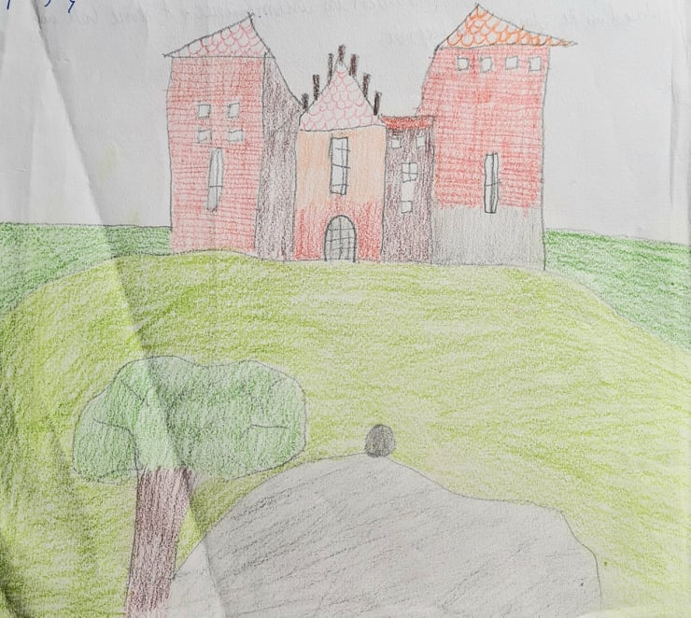
'The legend of the Tatar stone'
by Marcel K.

Slide 7
'The legend of the Tatar stone' by Pola K.

Slide 8
'The legend of the Tatar stone' by Alan S.

Slide 9
'Mysterious springs in Napiwoda' by Iga P.

Slide 10
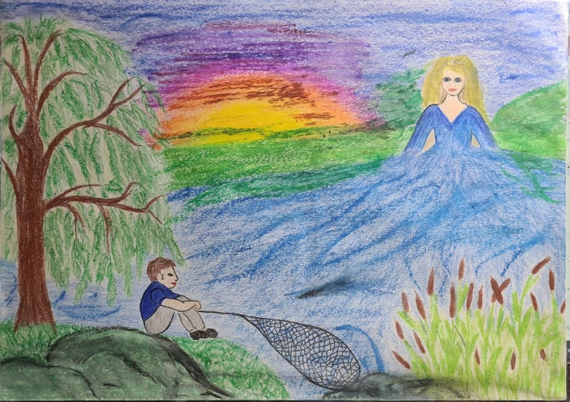
'The Legend of Łyna river' by Kacper O.

Slide 11
'The Legend of Łyna river' by Ola P.

