Slide 1
LEGENDS OF WARMIA AND MASURIA REGION
Authors and their works

Slide 2
Warmia and Masuria
A region with many stories, legends and fairy tales born of folk beliefs. They are relics of the past, an element of folklore, cultural heritage, as well as a testimony of spiritual culture, a reflection of views and an image of the social life of these lands in the old days.
Source: https://mazury.travel.pl

Slide 3
Max P. Toeppen
Author: Toeppen Max (Töppen Max Pollux)
Original title: Aberglauben aus Masuren mit einem Anhange, enthaltend: Masurische Sagen und Mährchen
Original language: German
Translator: Piltzówna Eugenia
Category: Scientific and popular science literature
Genre: Social Sciences (Psychology, Sociology, etc.)
Form: fairy tales
First published: 1867
Year of the first Polish edition: 1894

Slide 4
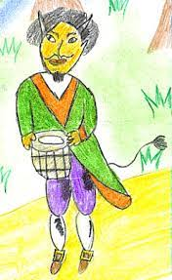
Kłobuk / Kołbuk - a demon looking after property and a fire in the house

Slide 5
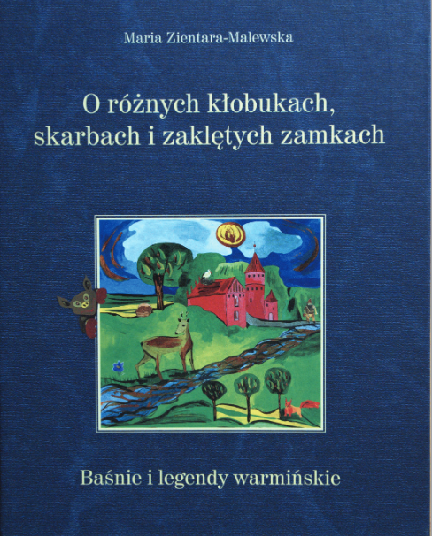
https://www.youtube.com/watch?v=ynjBWYfmB04
 | - A fairy tale about robbers at Lake Skanda - How the springs of the Łyna river were created - The legend of Święta Lipka - The legend of Saint James, the patron of Olsztyn - The enchanted army in Lake Wadąskie - The enchanted castle in the Olsztyn forest
Contents:

Slide 6
LEGEND OF ŁYNA: HTTPS://WWW.YOUTUBE.COM/WATCH?V=ATKSX8AEYCY THE VICTIM OF SMĘTEK. WARMIA LEGEND: HTTPS://WWW.YOUTUBE.COM/WATCH?V=CZJPMKGWZXW LEGEND ABOUT JACOB: HTTPS://WWW.YOUTUBE.COM/WATCH?V=RLAJ5YPXRNY
LEGENDS in Polish

Slide 7
https://www.youtube.com/watch?v=3kS3__5_gNY
Legends of
of the Land of a Thousand Lakes

Slide 8
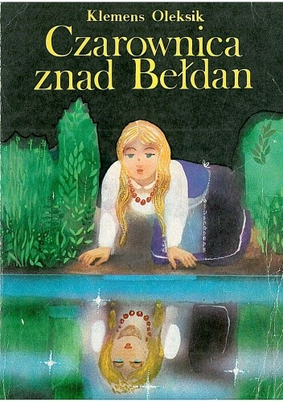
The witch
of Bełdan
The witch of Bełdan - a theatrical spectacle
https://www.youtube.com/watch?v=zAKBG4bGFDQ
https://www.youtube.com/watch?v=s33l3F5GiR4

Slide 9
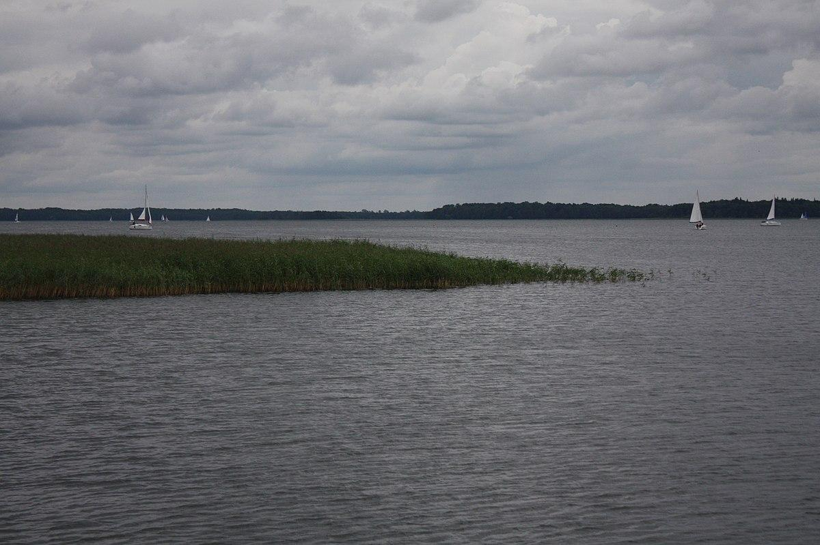
New Fairy Tale Fair
To zdjęcie, autor: Nieznany autor, licencja: CC BY-ND
To zdjęcie, autor: Nieznany autor, licencja: CC BY-SA

Slide 10
The Warmia Anthology is to serve (...) forgetting Warmia, it is to introduce into the consciousness of both small and large inhabitants of the micro- and macroregion, but also the whole country, the memory of the past and traditions of Warmia. It is supposed to remind and bring closer not only its history, but also its geography. It is supposed to be a kind of a fairy-tale description of Warmia, its peculiar, fairy-tale-like geography. " Teresa Brzeska -Smerek
The Warmia Anthology
Wedding of the Birds

Slide 11
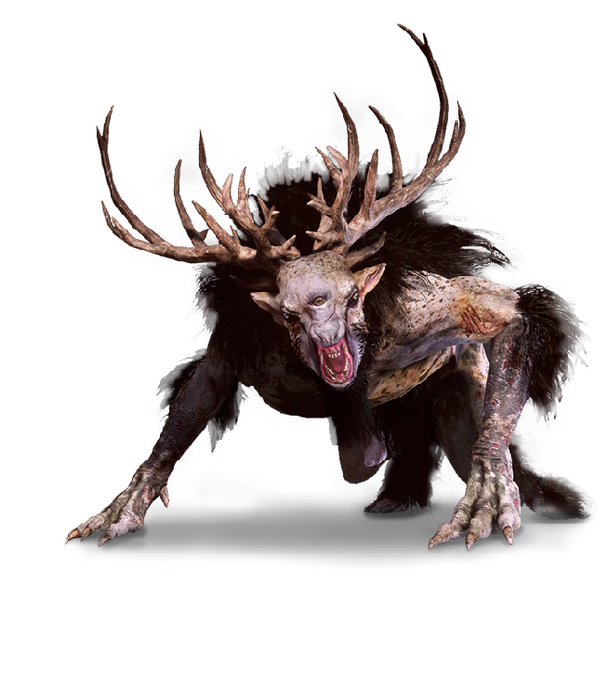
The legend of Kłobuk
https://www.youtube.com/watch?v=Z--06lJ6yrA
To zdjęcie, autor: Nieznany autor, licencja: CC BY-SA

