Slide 1
St. John’s Day
Presented by: Deimantė Tviragaitė, Gabija Graužinytė

Slide 2
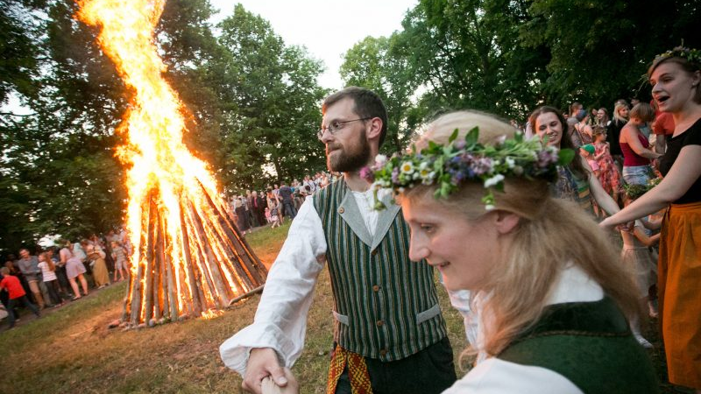
St. John‘s Day – June 24th

Slide 3
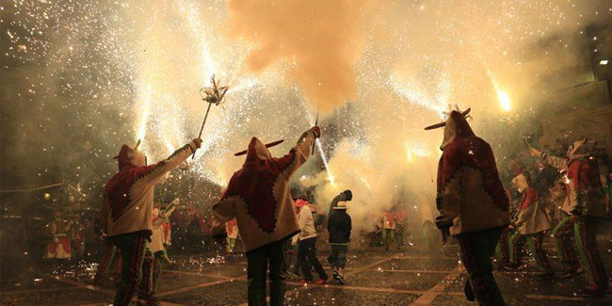
Short history

Slide 4
The longest day and the shortest night

Slide 5
Blossoming and greenery

Slide 6
Wreaths

Slide 7
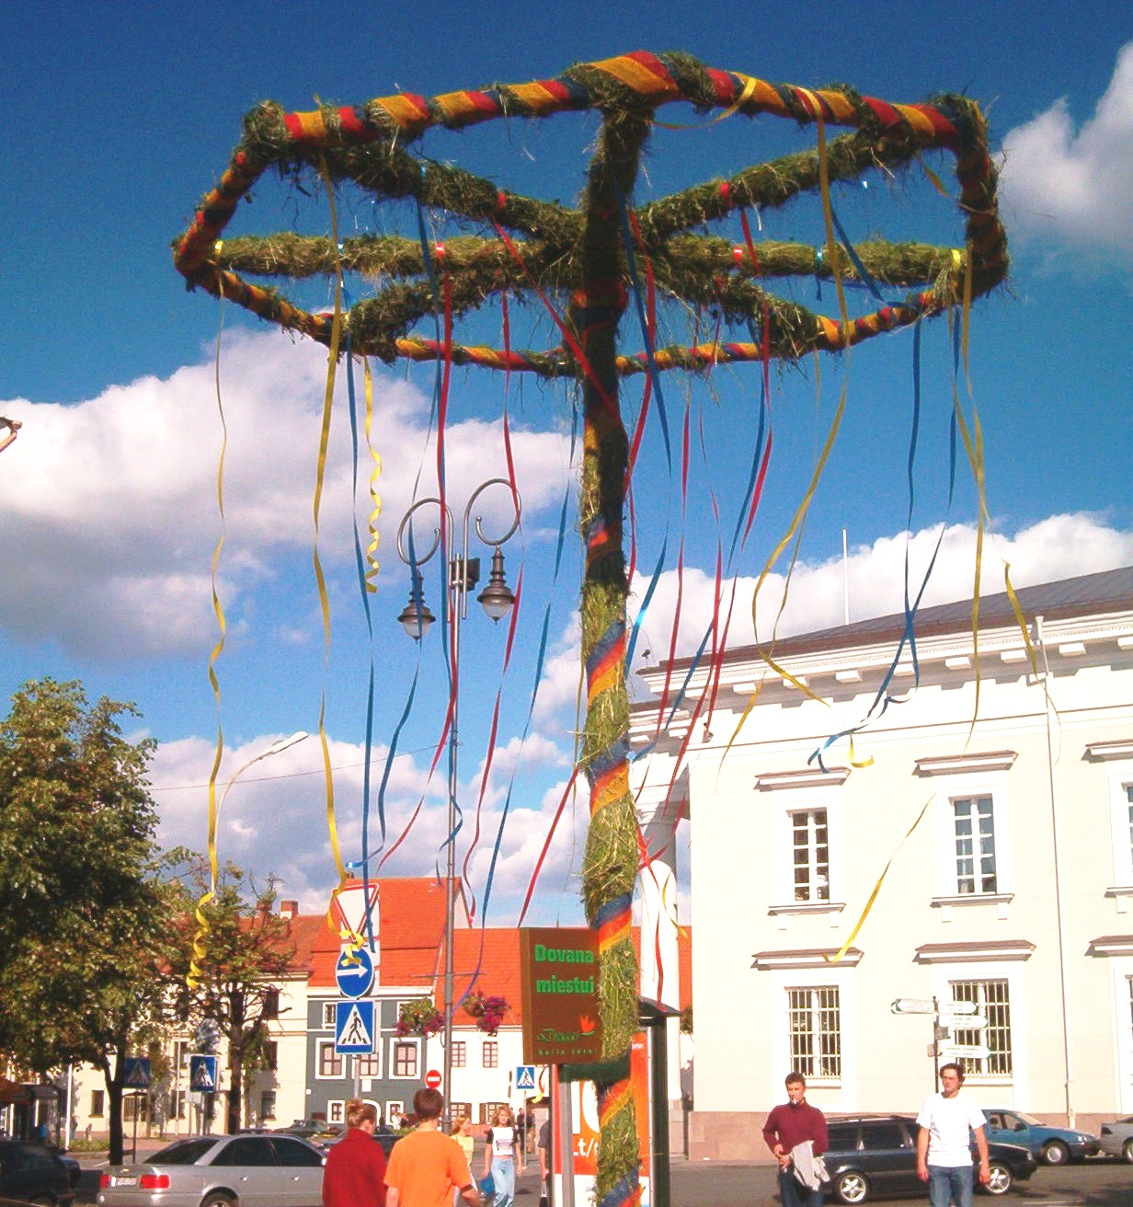
“ Kupolė“

Slide 8
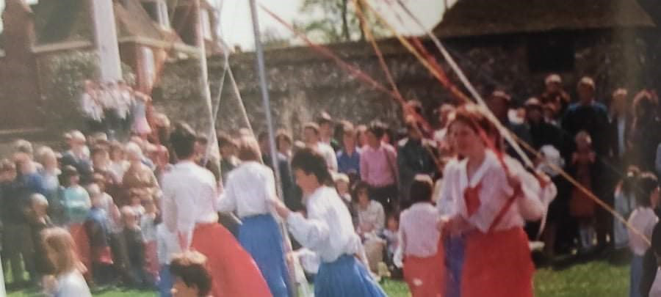
Dancing around “Kupolė“

Slide 9
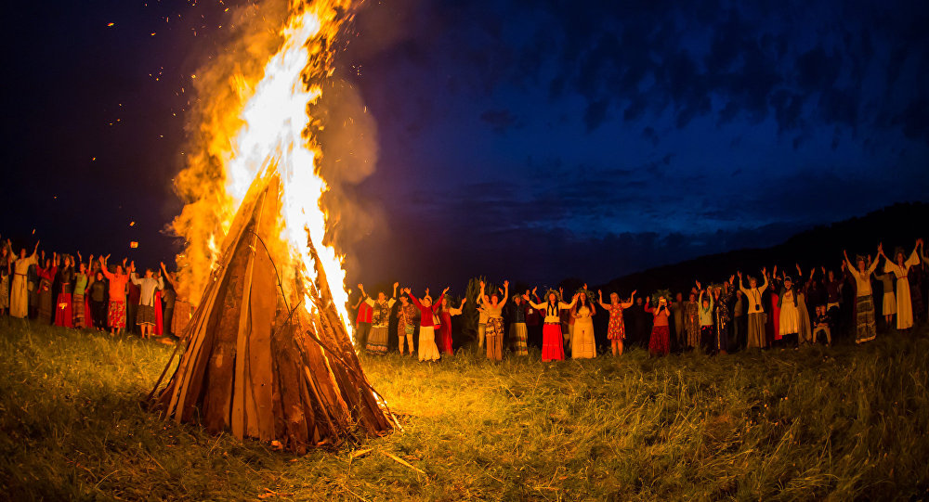
Bonfires

Slide 10
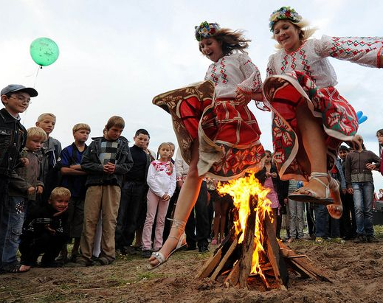
Jumping over bonfires

Slide 11
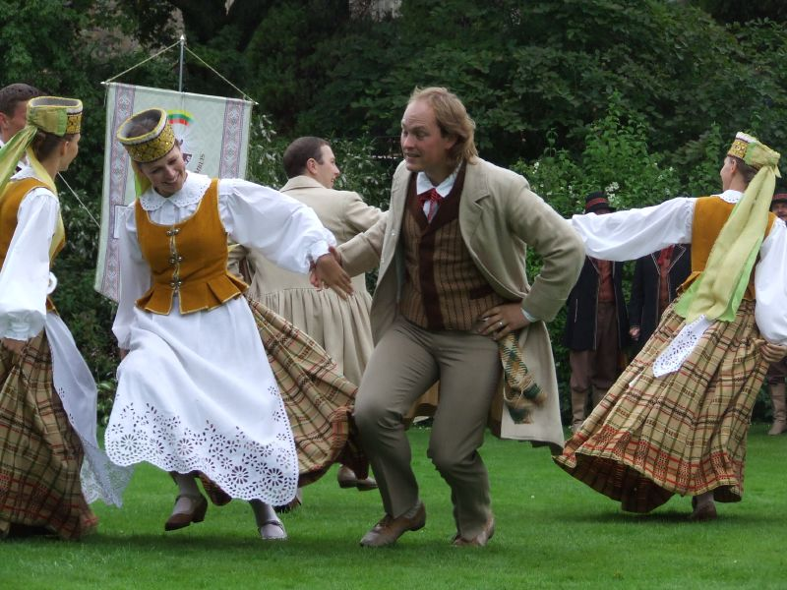
Singing and dancing

Slide 12
https://www.youtube.com/watch?v=m1CeFRJoZto&list=PLrLh0Vet5pcIAJmWhA_eSx-sS7C-Rx_eU

Slide 13
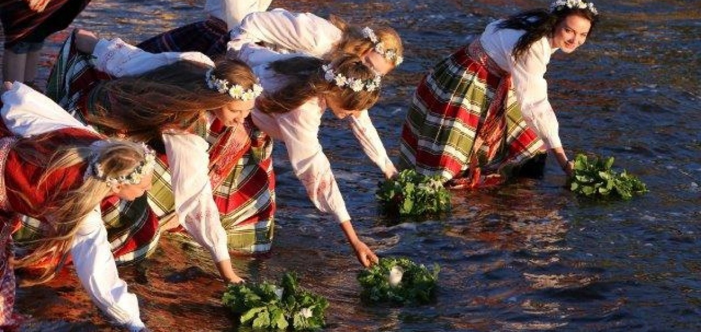
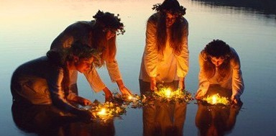
Wreathing

Slide 14
Washing with the morning dew

Slide 15
Searching for a Fern Flower

Slide 16
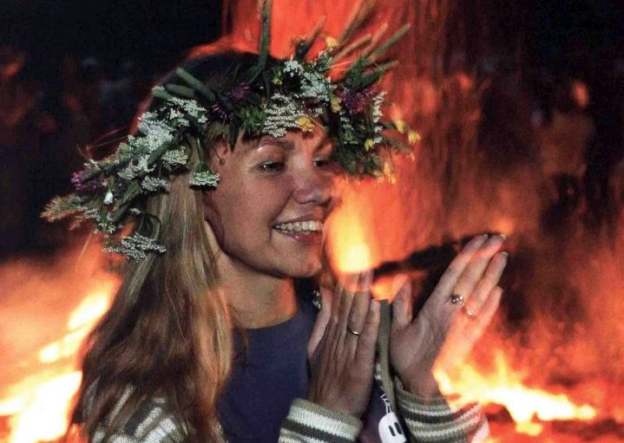
Thank you for your attention!

