Slide 1
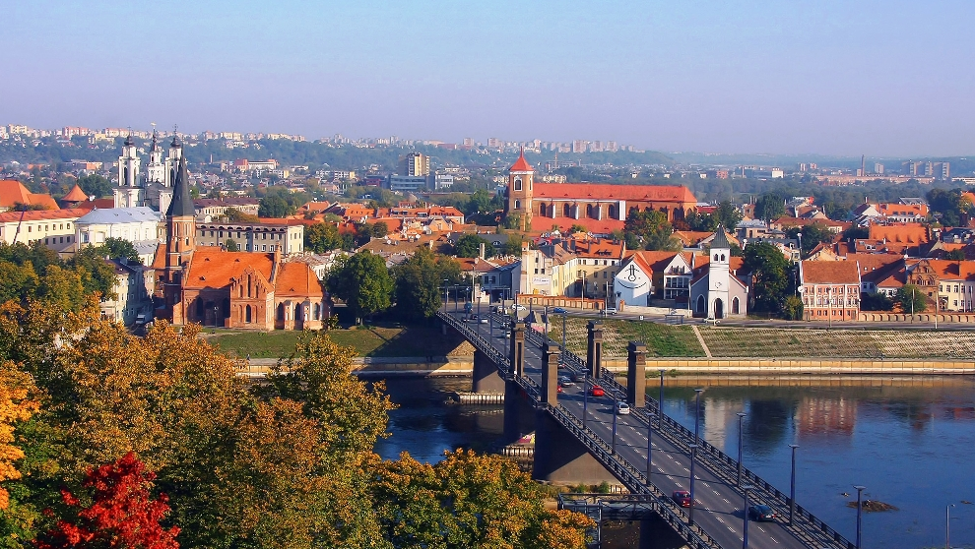
LITHUANIA
CITY - KAUNAS

Slide 4
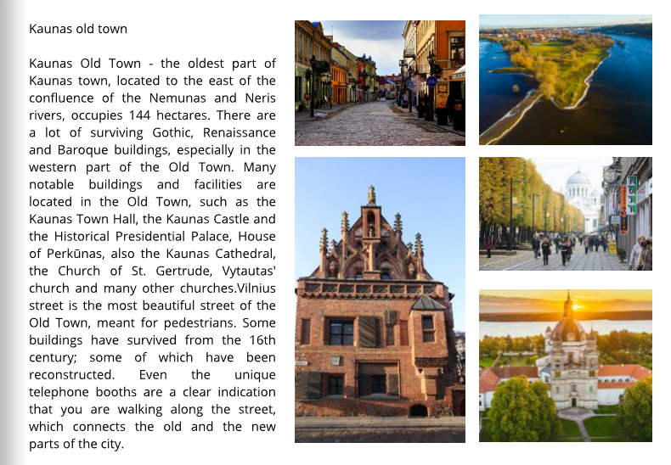

Slide 8
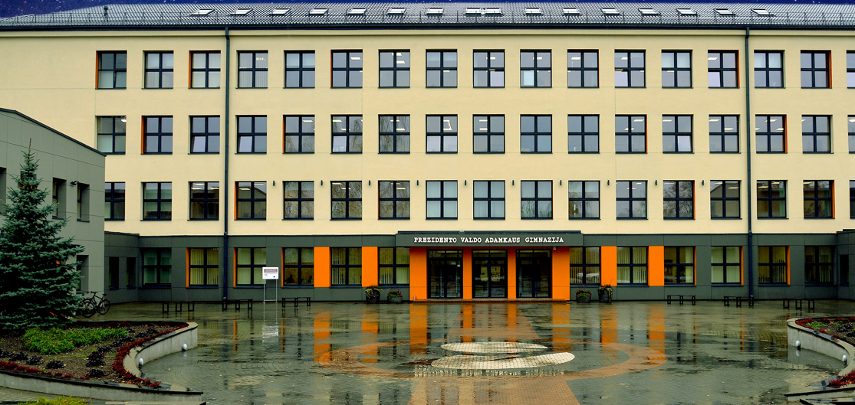

Slide 9
Thank you for your attention

