Slide 1
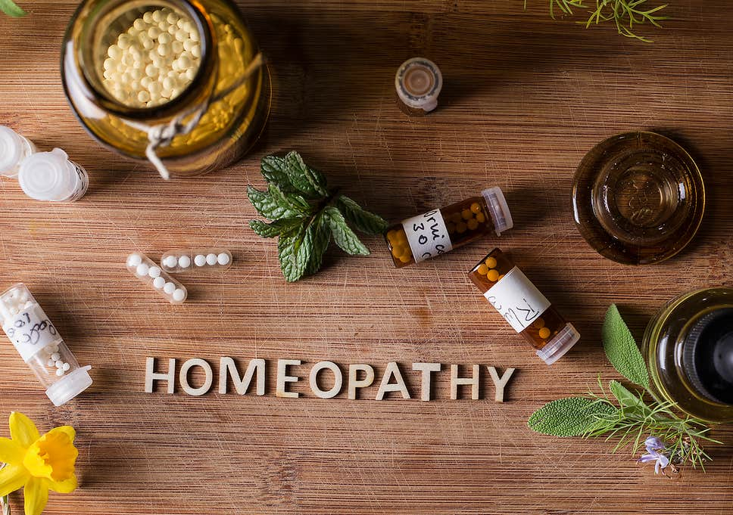
Smilte Ališauskaite

Slide 2
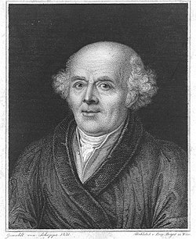
What is it?
Homeopathy is a system of alternative medicine.
It is created in 1796 by Samuel Hahnemann.
Samuel Hahnemann
Born | 10 April 1755 Meissen, Electorate of Saxony
Died | 2 July 1843 (aged 88) Paris, France
Nationality | German
Scientific career
Fields | Homeopathy

Slide 3
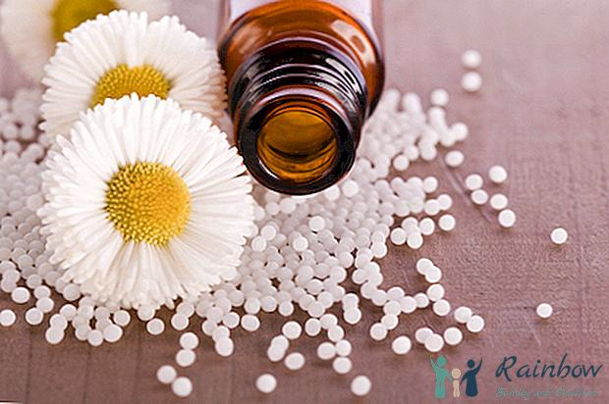
History
Haneman developed the theory that every disease can be cured with substances that, at higher doses, cause symptoms similar to the disease.
He concluded from studies that the lower the dose, the greater the effect.

Slide 4
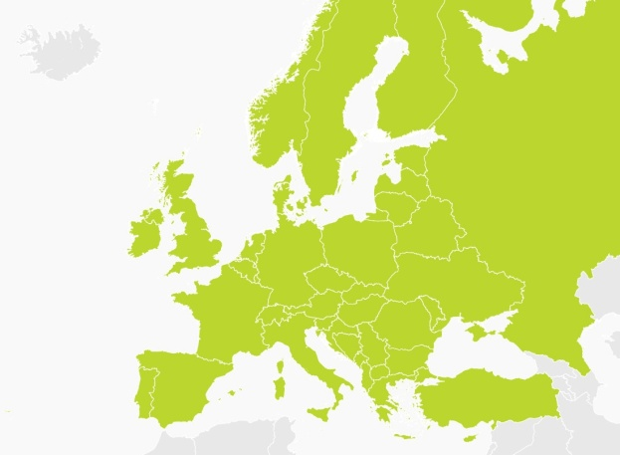
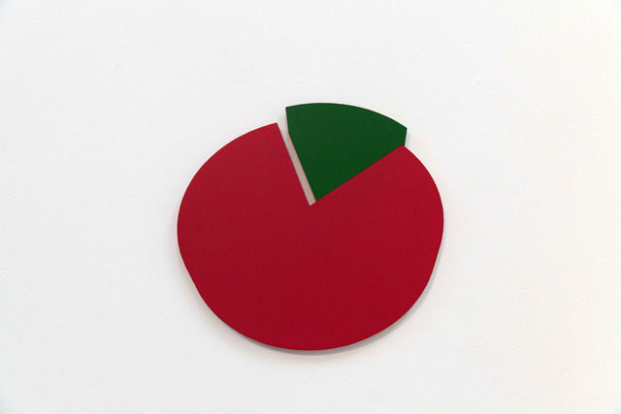
Prevalence
Homeopathy has been used in Lithuania since ancient times.
25% doctors in Lithuania sometimes use haemeopathic preparations and 7% - constantly.

Slide 5
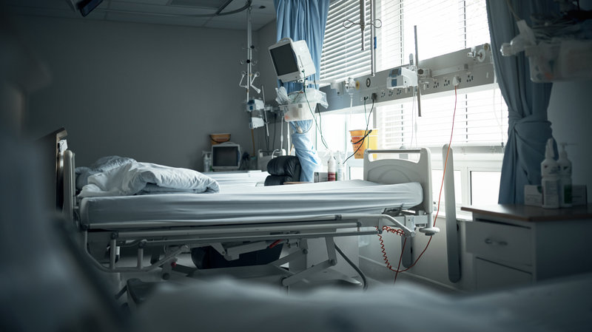
Some of the illnesses that respond best to homeopathic treatment are as highlighted below:
ENT and bronchial problems;
Digestive problems;
Cardiovascular problems;
Osteoarticular complaints;
Traumas;
Urological disorders;
Gynaecological problems;
Dermatological problems;
Neurological disorders;
Behavioural and psychiatric disorders;
Endocrine disorders;
Palliative care;

Slide 6
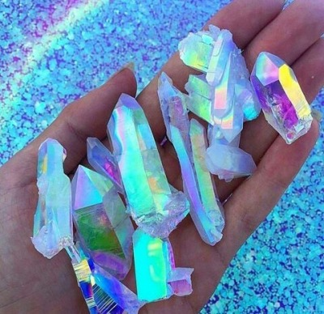
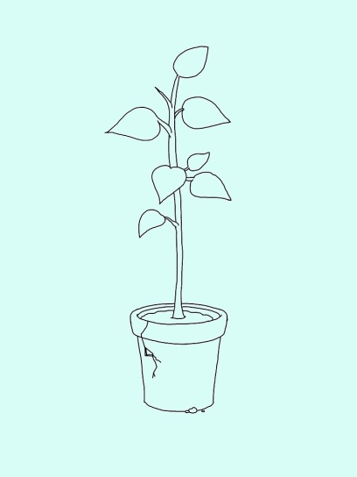
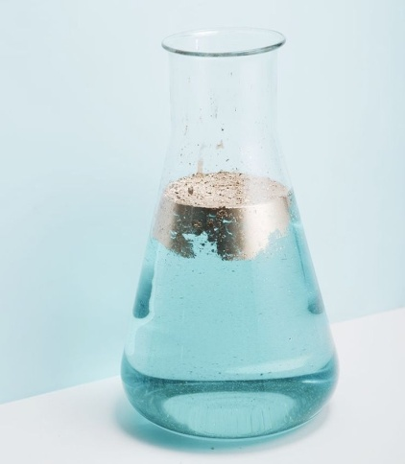
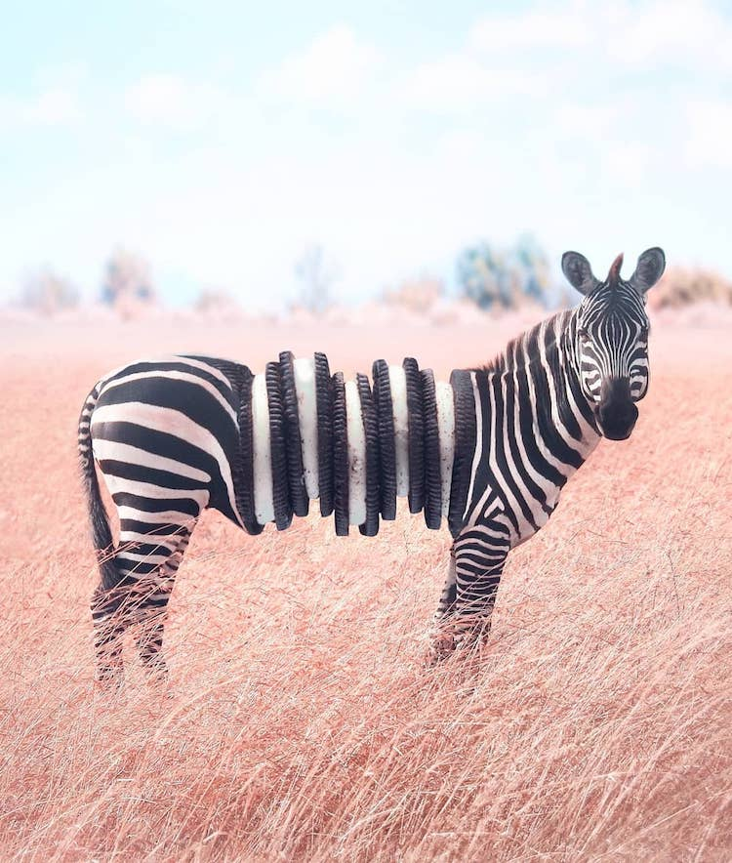
What is homeopathic medicine made of?
Plant;
Chemical;
Mineral;
Animal sources.

Slide 7
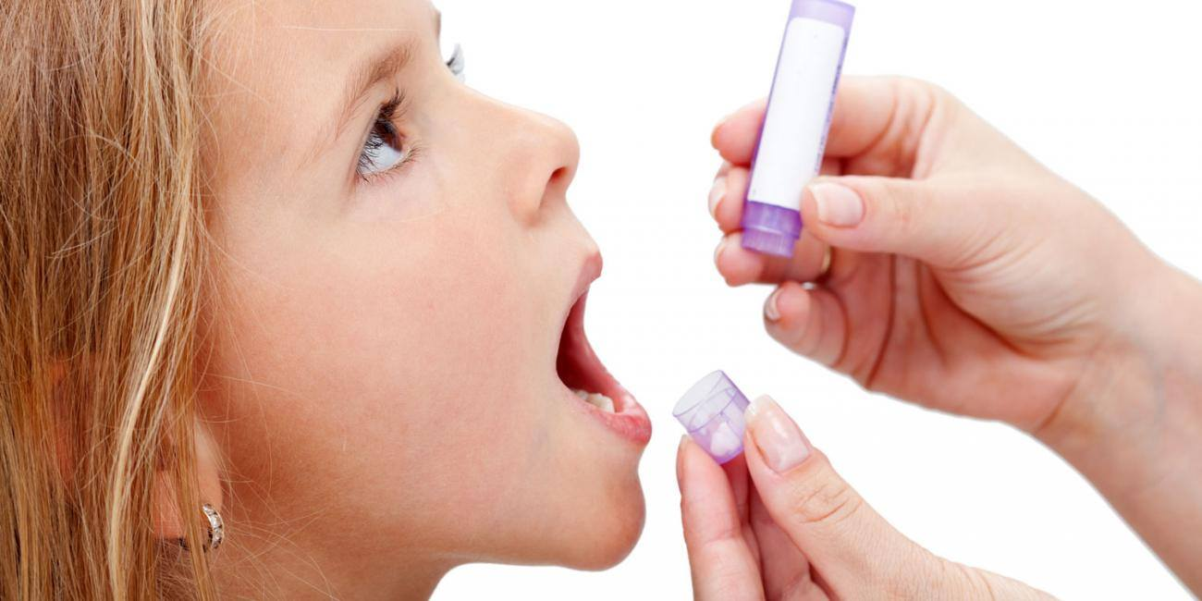
How to use
They should be taken on an empty stomach,
Rinsing of the mouth with boiled water is recommended.
Do not eat, drink or brush your teeth within 30 minutes before and after use.

Slide 8
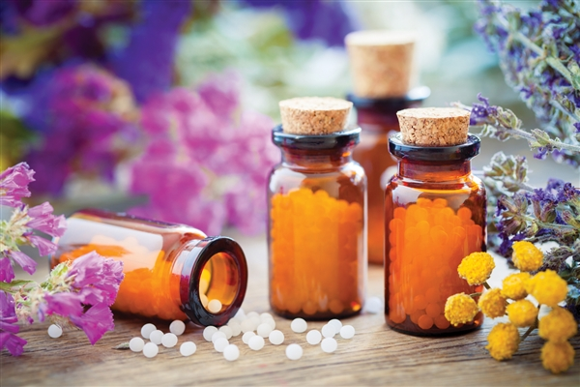
Thank you for your attention

