Slide 1
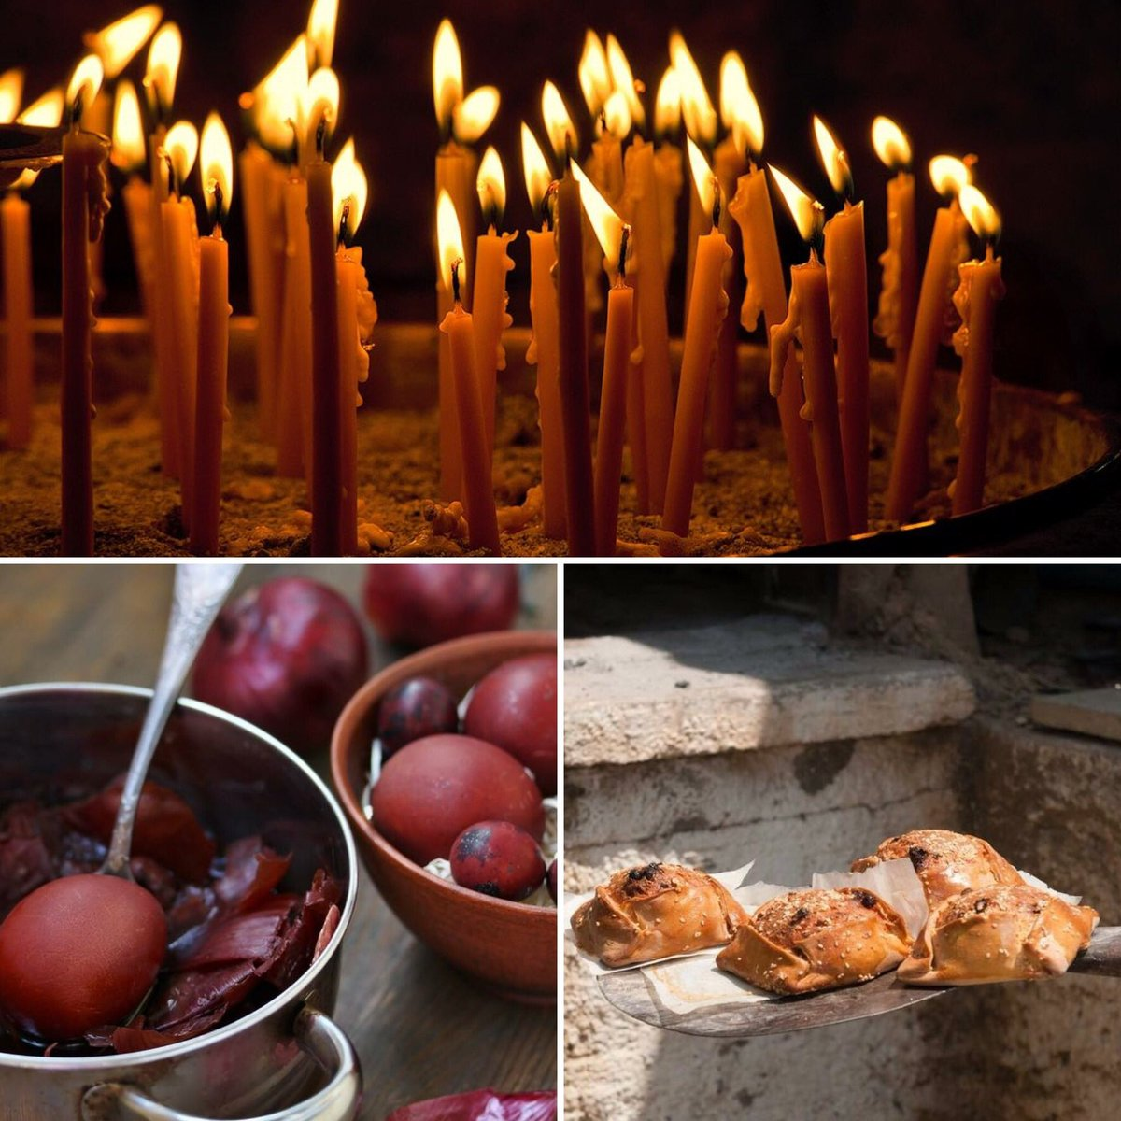
EASTER CUSTOMS OF CYPRUS

Slide 2
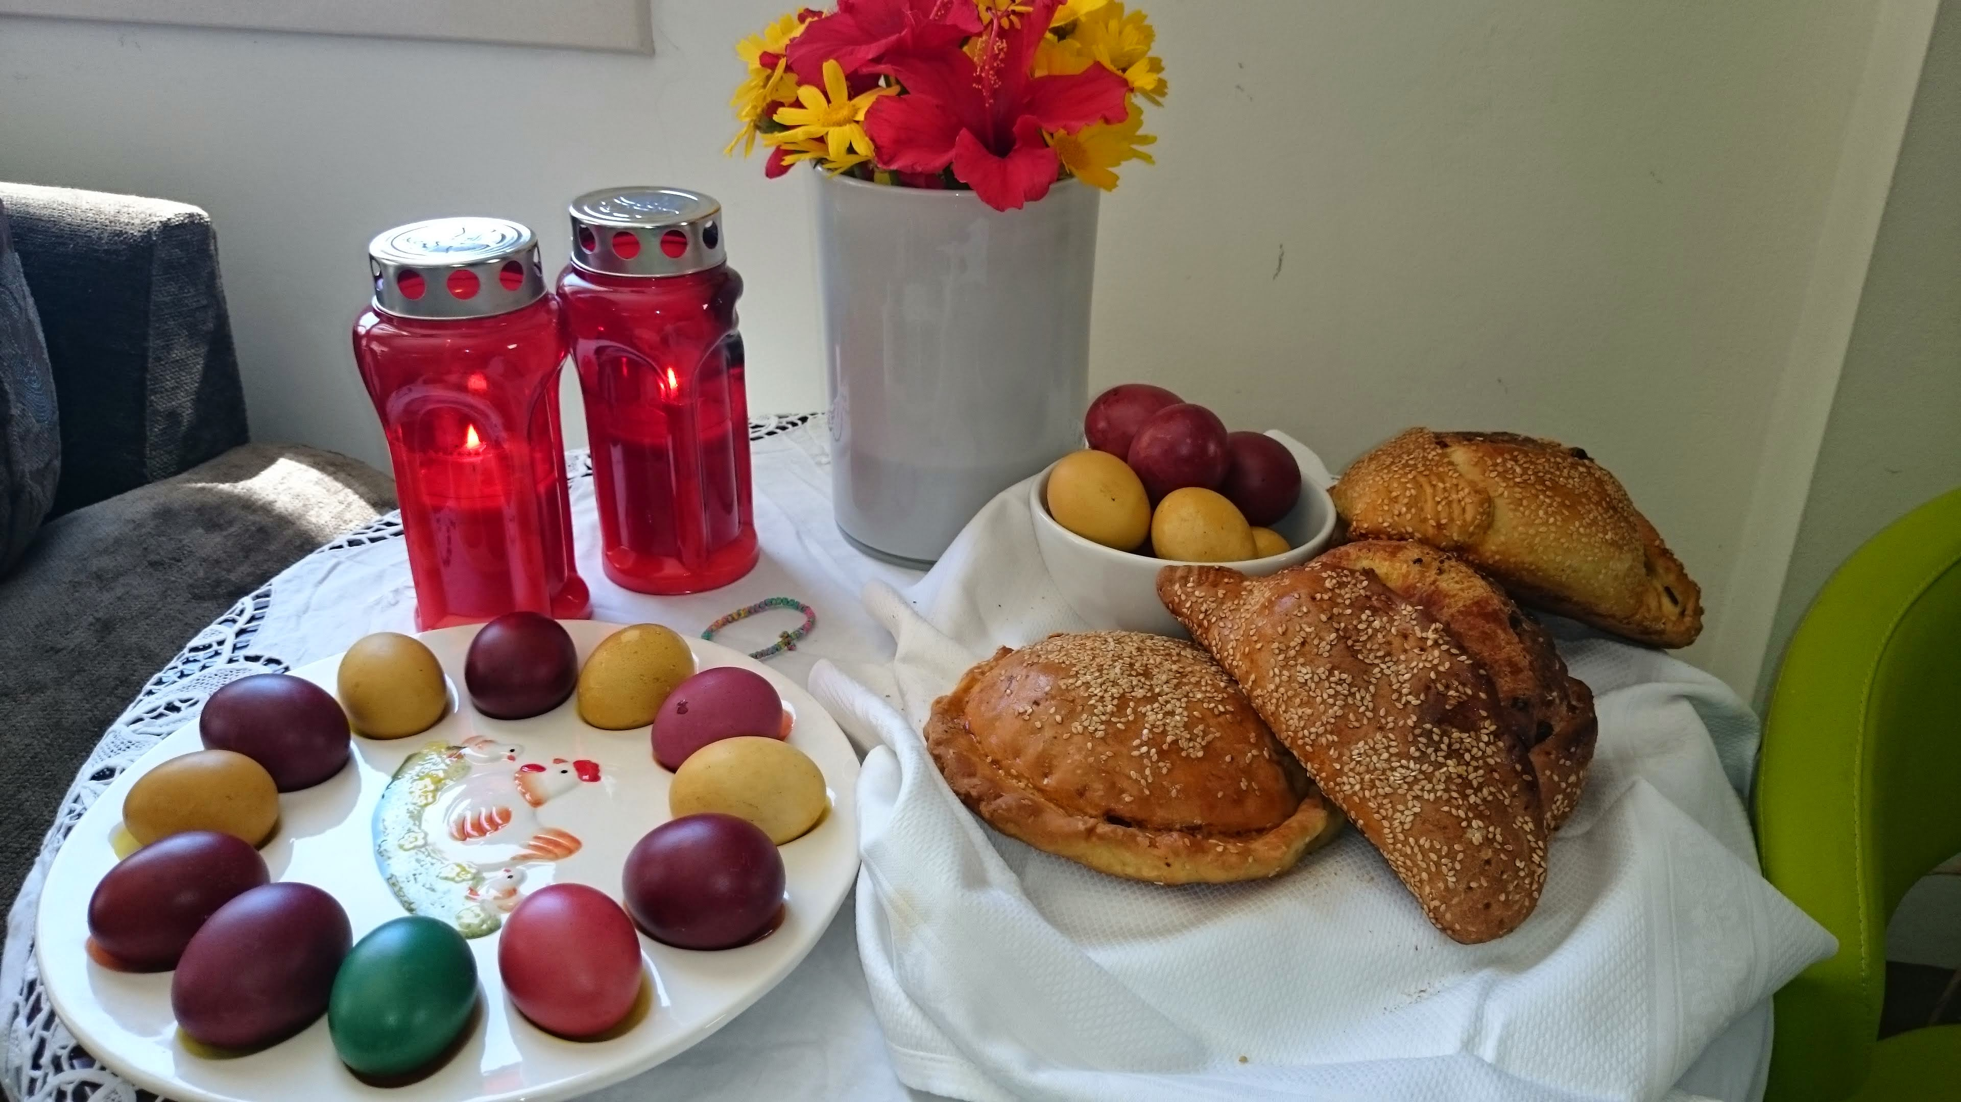
EASTER TRADITIONS & CUSTOMS OF CYPRUS
Pascha (Easter), the most luminous feast of Christianity and the greatest feast of Hellenism and the people of Cyprus, who call it, “Lambri”, “the Bright One” since it shines with the light of.
Thursday of Holy Week is when the wonderful aromas begin to waft out onto the streets as this is traditionally the day when housewives start preparing the flaounes (small loaves made of flour, eggs, cheese, mint and sometimes raisins). These are shaped into triangles, sprinkled with sesame seeds then baked in the oven. Tiropites (small cheese pies in puff pastry), paskies (small meat pies) and koulouria (biscuits made of milk, flour, spices and sugar) are also prepared. Eggs are hard boiled and dyed red in preparation for games on Sunday. Everywhere is a hive of activity.

Slide 3
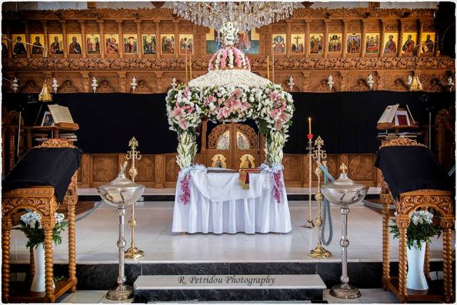
“Megali paraskevi” – great or good friday
On the Friday morning before Easter (Megali Paraskevi - Good Friday or “Great Friday” as it is called in Greek) families, carrying flowers, gather in the churches. The flowers are collected and used by young girls to decorate the Epitafios (Holy Sepulchre) during the service.
The Epitafios is a four-post litter with a canopy in which the icon of Christ is placed.

Slide 4
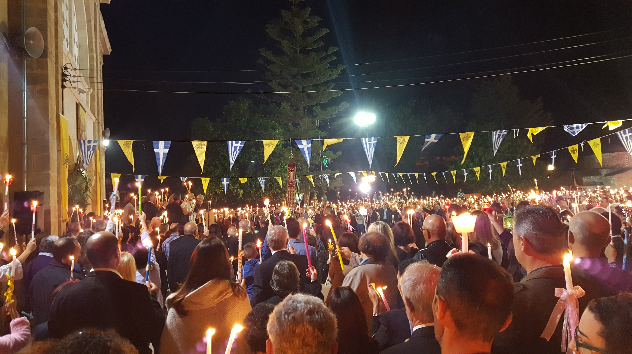
Megalo savvato – holy saturday
On Holy Saturday morning, during the “first Resurrection” ,The black veils covering the icons during the Holy Week drop, the priests throw laurel leaves and myrtle to the floor, the faithful bang their pews, the bells toll merrily and the general mood is triumphant.
In the evening of Saturday, at midnight, the Holy liturgy of Resurrection (KALOLOGOS- the “Good Word”) is held in the courtyard of churches.

Slide 5
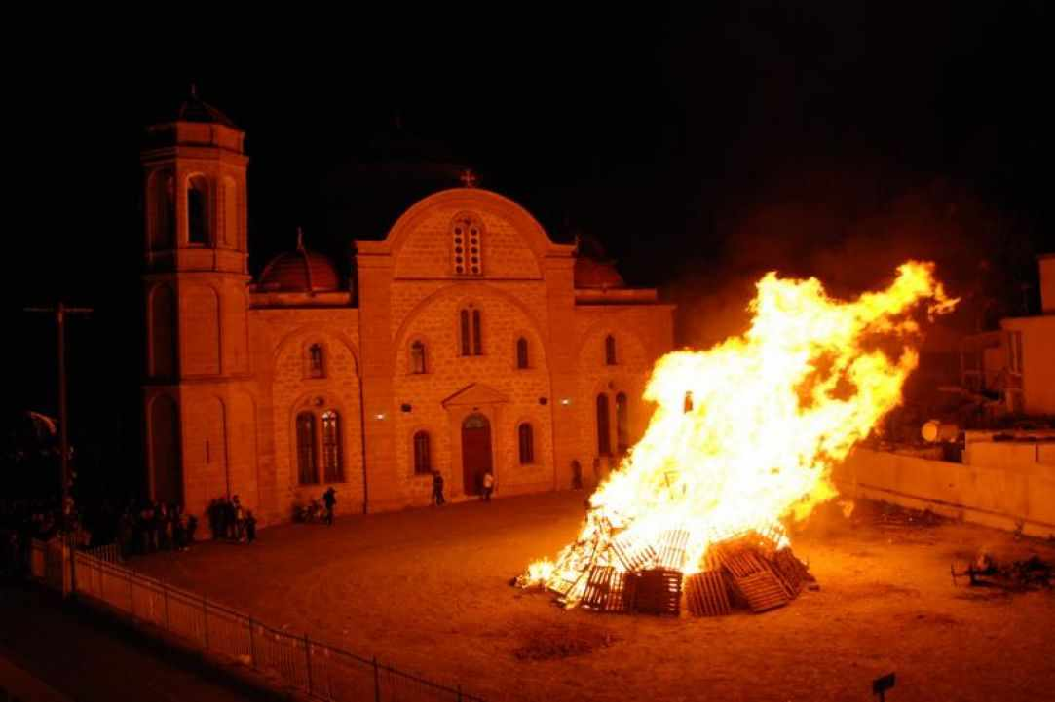
“LAMPRATZIA”- bonfire
At nightfall Cyprus lights up. Literally. Driving around cities and villages on Good Saturday night you will encounter plenty of bonfires, which are meant to symbolise the punishment of Judas who betrayed Jesus. Crowds gather around them every year to admire the days – even weeks – of work that went into assembling the bonfires (teenagers trying to find anything flammable – such as furniture, mattresses and tree branches from fields, neighbourhood, and old storage– that will add to the height of their bonfire) and contribute to the ambience of the night by setting off mini fireworks and rockets.

Slide 6
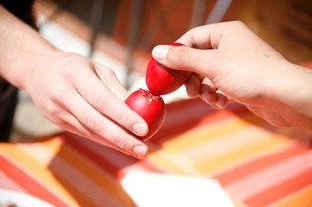
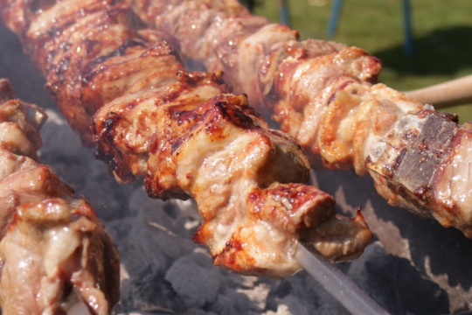
EASTER SUNDAY
Easter Sunday is all about food, friends and family. Lambs get roasted on spits on people’s back yards(Souvla or ovelias), kisses and hugs are exchanged all day long (along with the wish “Christos Anesti!” – translates to “Christ is Risen!” – and its response “Alithos Anesti” – Truly He is Risen!”).
The eggs which were hardboiled and dyed on Thursday are now used in a game where they are tapped against each other and whoever is left with an uncracked egg wins

Slide 7
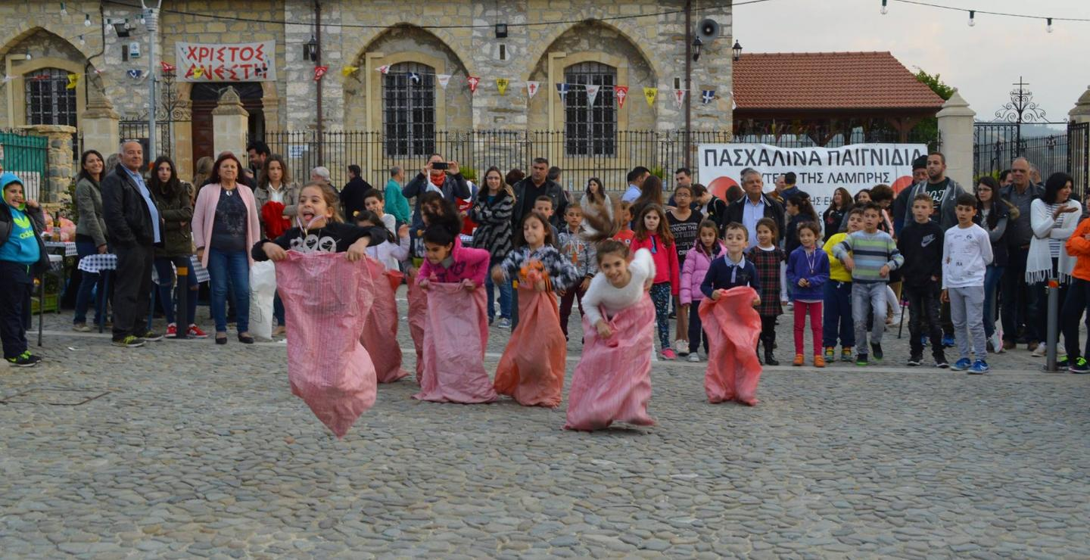
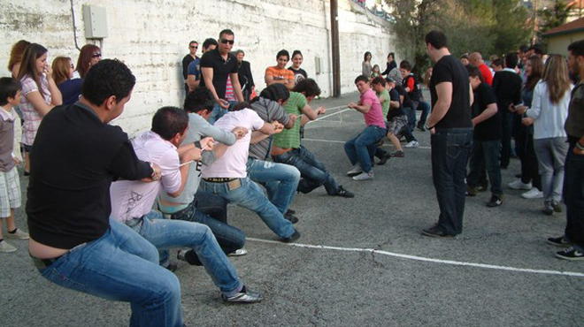
Traditional games are also played throughout the day, particularly in villages. School yards, church yards or village squares are usually the chosen place for Easter Sunday festivities, which in Cyprus include avgoulodromies – “egg races” (racing to the finish line whilst attempting to not drop an egg balanced on a spoon, which is held by people’s mouths), sakoulodromies (racing to the finish line whilst inside an empty sack of potatoes – involves a lot of jumping!), pulling rope as well as performances of traditional dances.

Slide 8
LOUKAS MICHAEL

