Slide 1
FOLK MEDICINE Lithuania

Slide 2
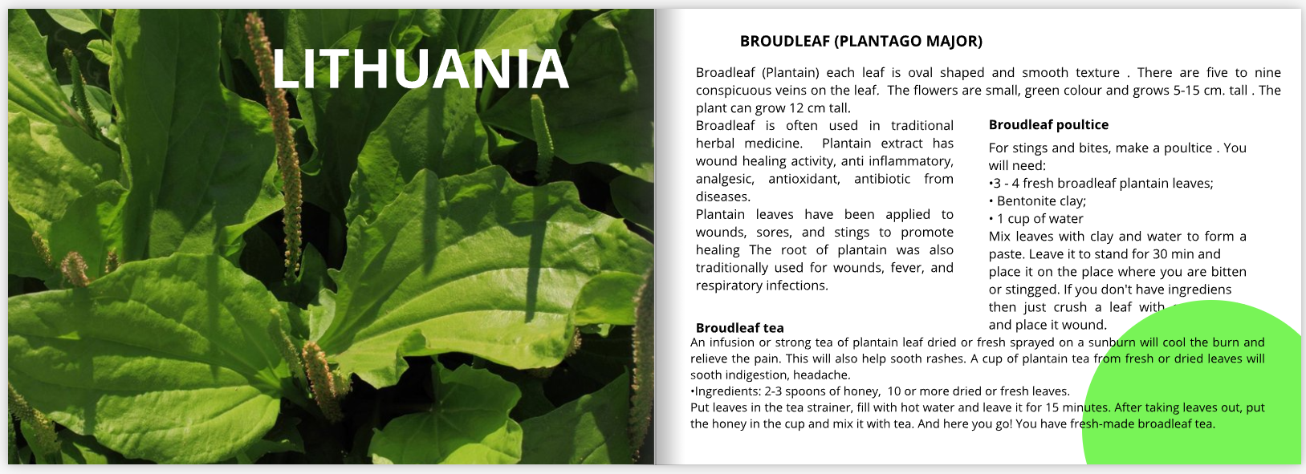

Slide 3
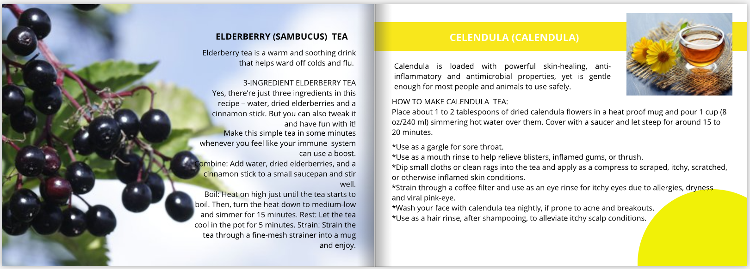

Slide 4
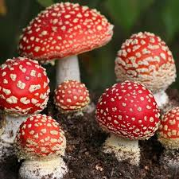
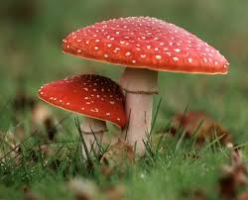
Death cap

Slide 5
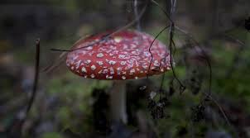
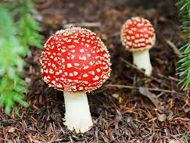
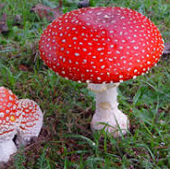
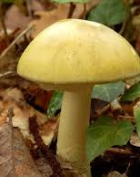
Death cap
Death cap is a deadly poisonous fungus.
Death cap is widely distributed across Europe.
It appear in summer and autumn

Slide 6
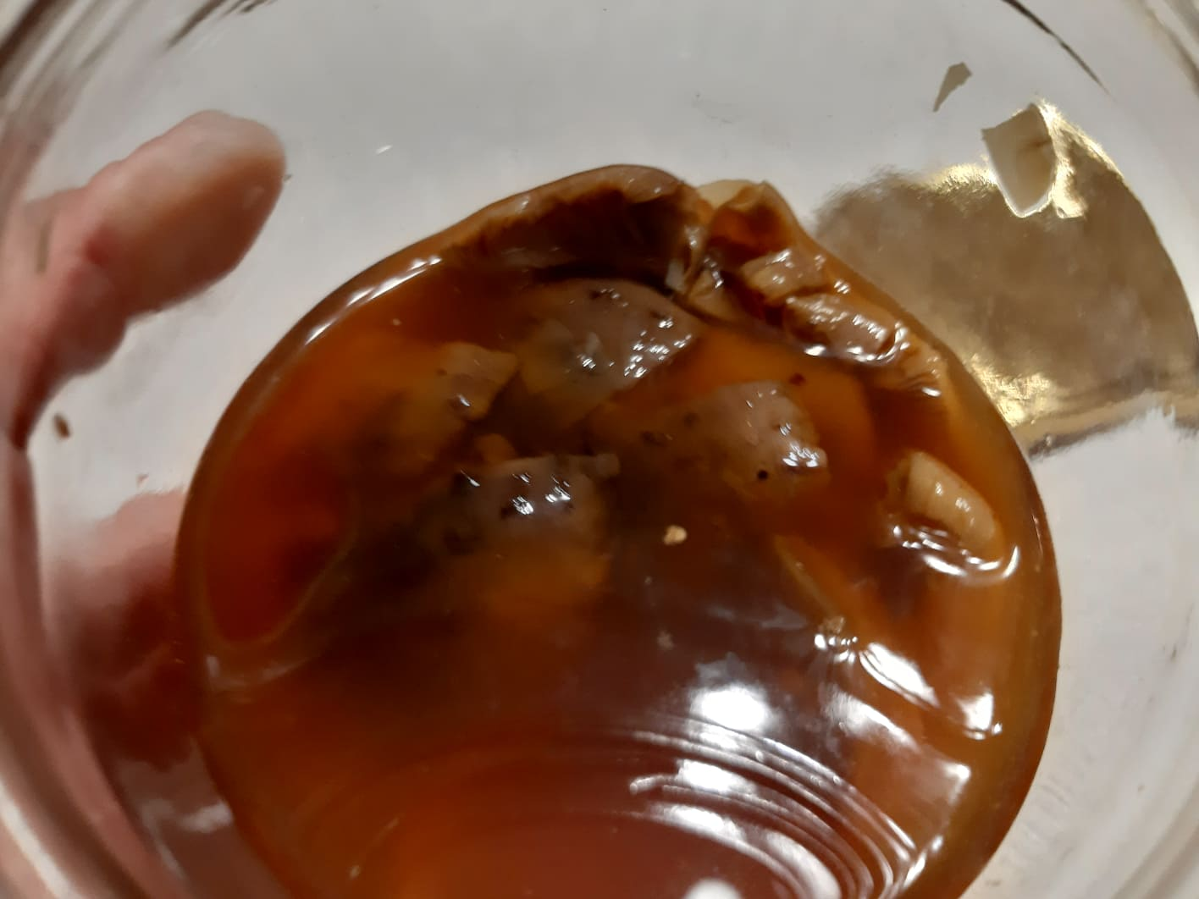
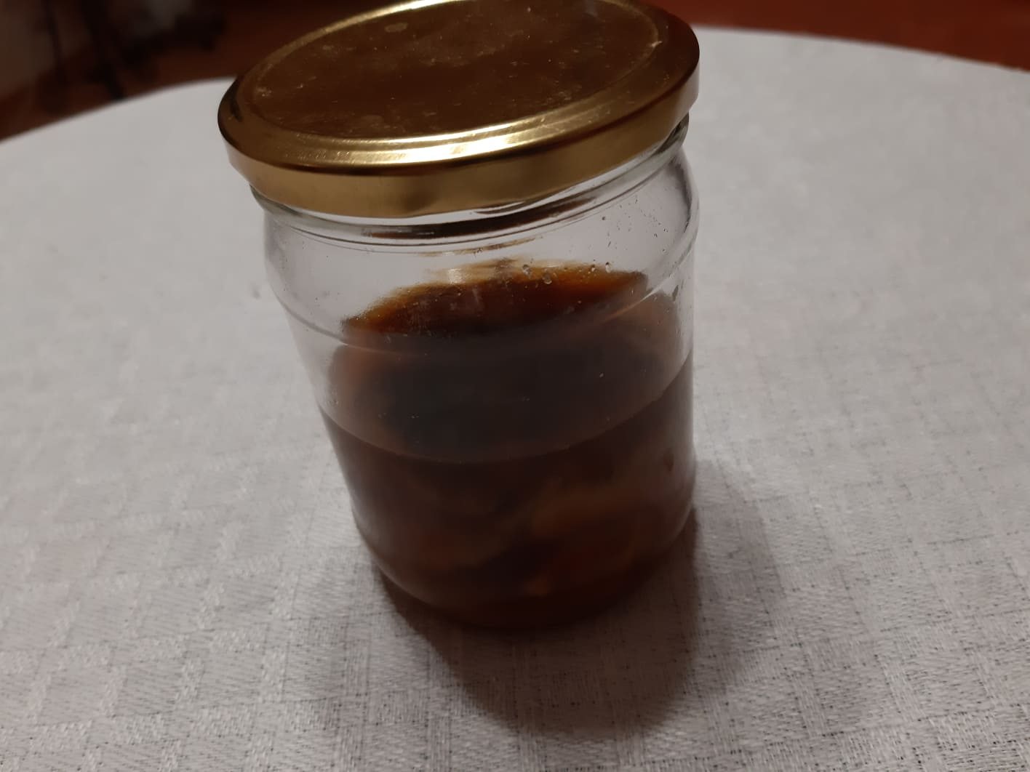
The recipe of death cap medications
3 hats (upper parts) of a death cap
Vodka
You have to put the hats in a jar and pour
enough vodka, until the hats will be submerged.
Then you have to leave it for 3 months in a dark place.

Slide 7
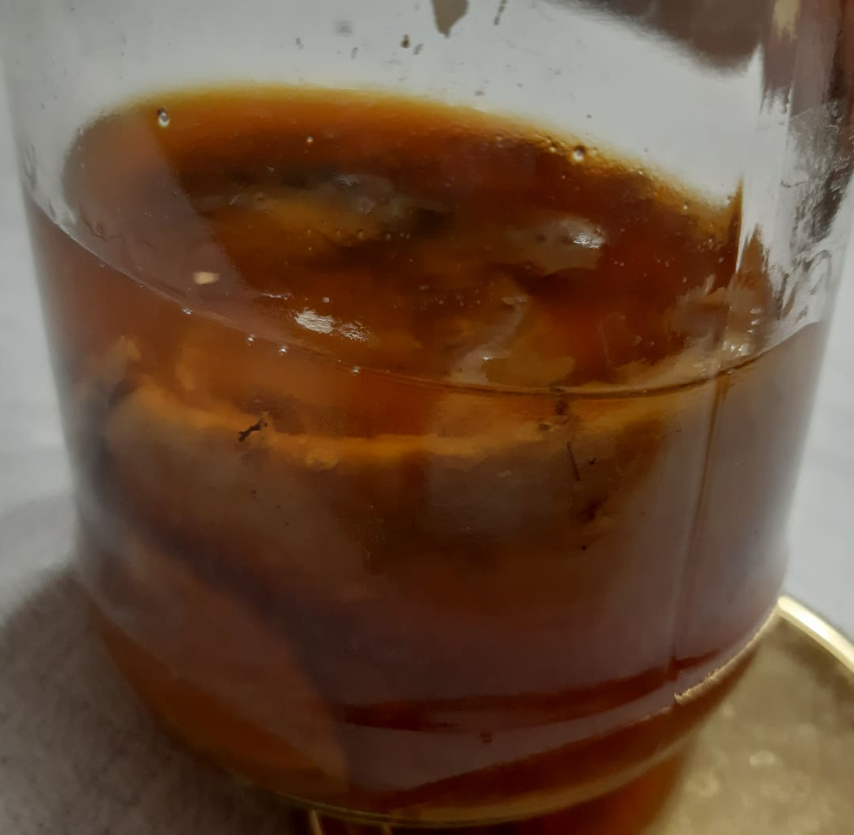
The recipe of death cap medications
You have to eat one teaspoon on an empty
stomach for 10 days, then have a 10 day break.
People can do it just one time a year.
This recipe keeps our immune system safe from tumers.

Slide 8
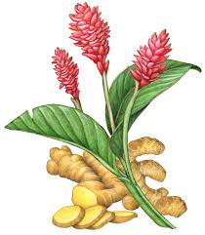
GINGER What is ginger?
Ginger – is a flowering plant which root is widely used as a spice and a folk medicine. Ginger is among the healthiest (and most delicious) spices on the planet. Although ginger originated in South Asia, it is widely used in Lithuania. Some people are even growing it indoors.

Slide 9
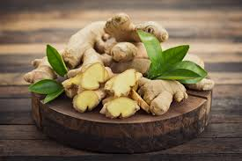
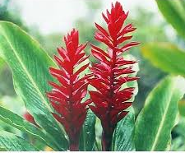
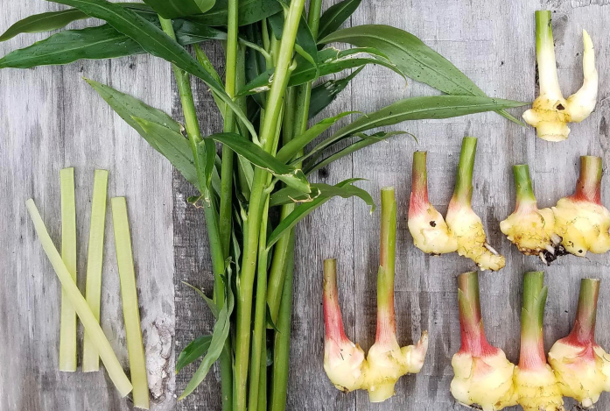

Slide 10
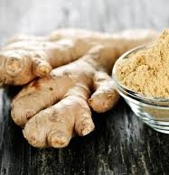
Ginger in Traditional medicine
Ginger is used in various forms of traditional/alternative medicine.
Ginger can:
Treat many forms of nausea, especially morning sickness.
Help reduce muscle pain and soreness
Drastically lower blood sugars
Help treat indigestion
Lower cholesterol levels
Help prevent Cancer
Help fight infections

Slide 11
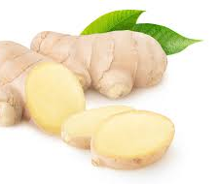
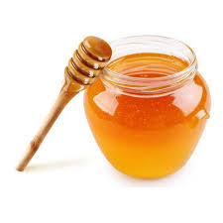
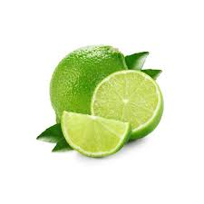
Ginger root tea
Ingredients:
1 tablespoon of ginger root (fresh, raw, about 4 centimetres of ginger root)
1 cup of water
1 to 2 tablespoons honey
1 slice of lime (or 1 tablespoon fresh lime juice)

Slide 12
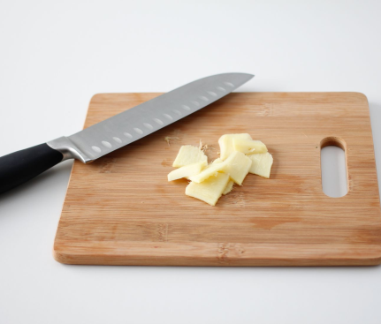
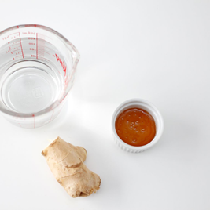
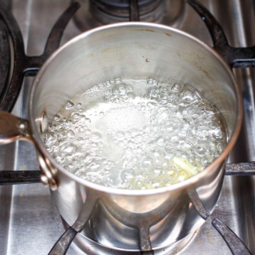
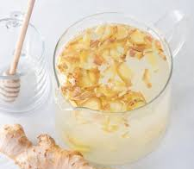
Ginger root tea
Directions:
First, prepare the fresh ginger by peeling it and slicing it thinly to maximize the surface area. This will help you make a very flavorful ginger tea.
Boil the ginger in water for at least 10 minutes.
Remove it from the heat and add the lime juice and honey to taste and enjoy your ginger tea!

Slide 13
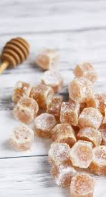
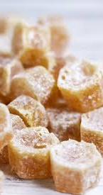
Ginger candies
Ingredients:
Ginger
Sugar
3 cups of water
Directions:
Peel the ginger root and slice into 1/2-cm thick slices
Place into a saucepan with the water and sugar and set over medium-high heat. Cover and cook for 35 minutes
Transfer the ginger to a colander to drain and toss the ginger slices in a bowl of sugar
Place the ginger slices on the cooling rack to sit overnight.

