Slide 1
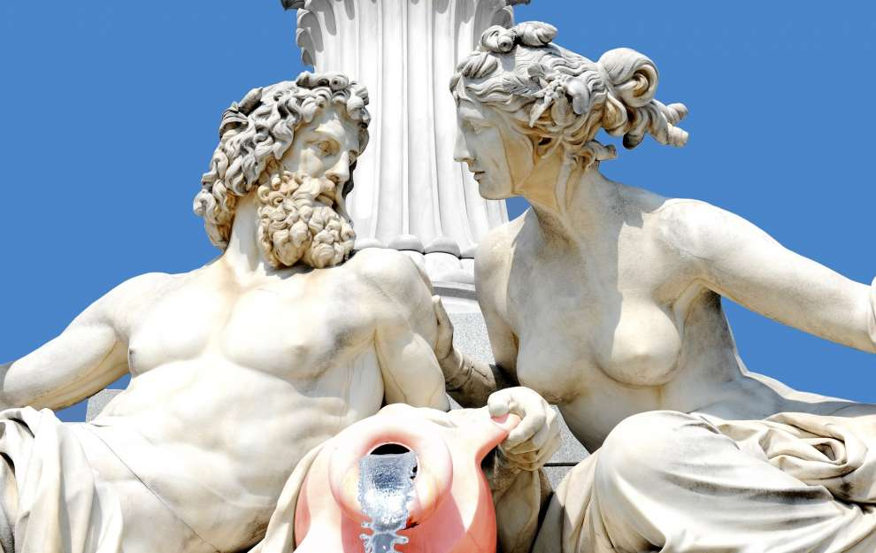
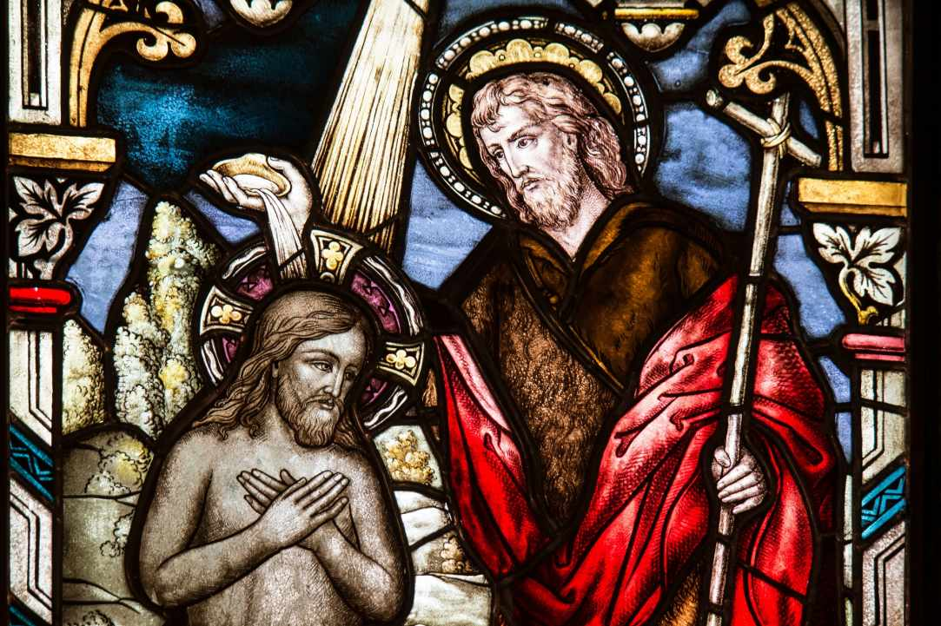
The custom of Kataklysmos, or the Flood Festival, takes place in Cyprus every year in June, 50 days after Orthodox Easter. The event takes place on the day that is known also as the day of the Holy Spirit, because it commemorates the descent of the Holy Spirit to the Apostles. In Cyprus, however, the celebrations are connected also to the ancient ceremonies organized in honor of Aphrodite and Adonis.
Flood Festival (Kataklysmos ): The Cypriot customs and the water war

Slide 2
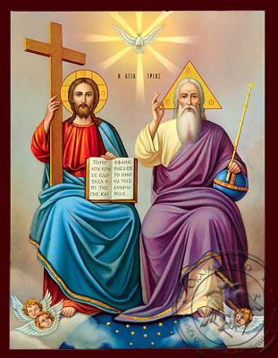
The Christian tradition (pentikosti)
According to the Christian tradition, when Christ was crucified, he descended to Hades, to bring His redemptive message to the dead of the ungrateful and dark underworld. Christ took pity on the imprisoned man and with His Resurrection freed the souls from the spidery and unsmiling world of decay, allowing them to move in the upper world, among the living, in the sunny creatures of God. For fifty days the souls are free, but on the fiftieth day after the Resurrection of Christ the souls return to their prison, to the black and dark world of the dead.

Slide 3
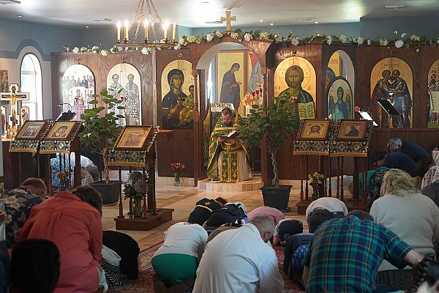
The Feast of the Holy Spirit
On the Sunday of Pentecost, "of the Kneeling" as we call it, the kneeling priests return prayers for the souls of the dead to the Father and the Son, through the Holy Spirit, to lead the souls to the light of truth, repentance, salvation. People, priests and congregations, fall to their knees, praying for their own dead to walk on the way downhill to the dark world, guided by the Holy Spirit, who enlightens and sanctifies everyone and everything.
The candles that are lit in the church are the symbol of the Holy Spirit, on which the safe path of man is left. The last day of the trilogy is the feast of the Holy Spirit, the Gathering of the Holy Spirit, which is called the Flood.

Slide 4
What is the symbolism of the identification of the feast of the Flood with the feast of the Holy Spirit?
In coastal cities, towns and villages, residents gather to the beaches playing, diving in the sea or throwing sea water, which cleans the pollutants, both physical and mental.

Slide 5
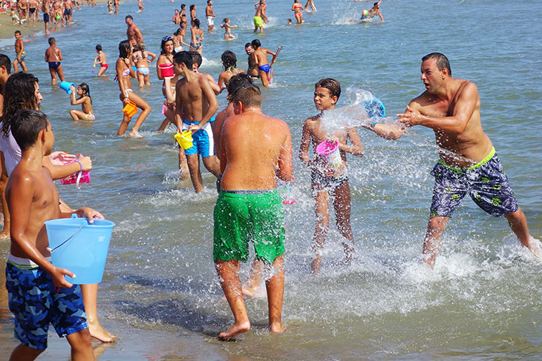
Celebrations for the Festival of Flood (KATAKLYSMOS)
Water is the main focus of the festival. All coastal cities organize concerts, games and other events near the waterfront. Be ready to get wet at Kataklysmos!
Larnaka and Pafos organize the biggest Festivals of Flood in Cyprus and celebrate Kataklysmos for several days. On the sea front promenade you will find open-air fair with plenty of kiosks selling toys and traditional food. Popular Greek and Cypriot singers and dance troupes perform in Larnaka (finikoudes area) and in Kato Pafos by the harbour. There are competitions in the water as well as a contest for tsiatista, or rhyming songs in the Cypriot dialect.

Slide 6
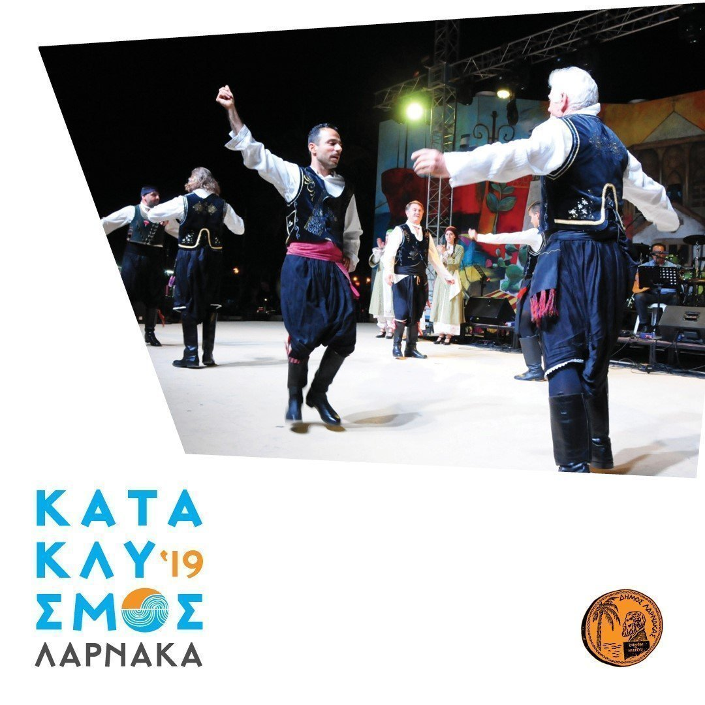
FESTIVAL PHOTOS
FOLK DANCES
TSIATISTA (rhyming songs in the Cypriot dialect)
OPEN AIR/FAIR SELLING KIOSKS

Slide 7
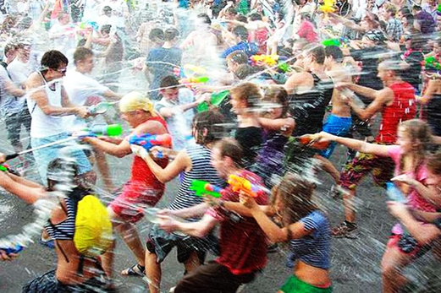
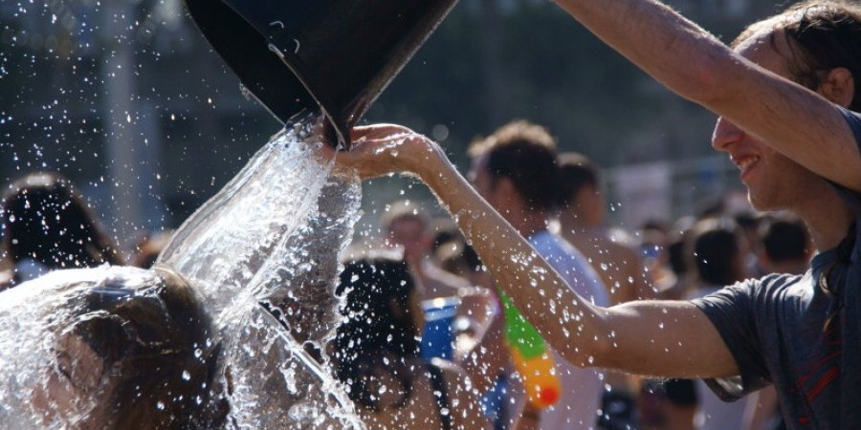
The Water war – “Pitsikliasma”
A custom that children especially like is the water war.
Children and adults gather in the neighborhoods for the custom of water war, having fun and playing to get rid of all evil.

Slide 8
Thank you for your attention

