Slide 1
Local herbs used for medicinal purposes – Polish folk medicine
Poland

Slide 2
Nettle
Species: Urtica dioica
Habitat: meadow/ Nidzica/Poland
used as a folk remedy for treating rheumatism
has a wider use in dermatology, involving dermatitis caused by various skin irritants and pathogens.
auxiliary substance in treating noninsulin-dependent diabetes mellitus
improve intestinal peristalsis

Slide 3
Wild thyme
Species: Thymus serpyllum
Habitat: garden/ Nidzica/Poland
used as:
disinfectant,
anti-inflammatory drug,
used for gargle,
helps with insect stings

Slide 4
Rowan
Species: Sorbus aucuparia
Habitat: roadside/ Nidzica/Poland
Used in folk medicine as a:
laxative,
against rheumatism and kidney disease,
gargled juice against hoarseness
Treatment of disorders of the respiratory tract, fever, infections, colds, flu, and gout

Slide 5
Field horsetail
Species: Equisetum arvense
Habitat: roadside/Działdowo/Poland
Diuretic effect,
Anti-inflammatory effect,
Used for psilosis
Fresh juice steam bleeding
used for gargle

Slide 6
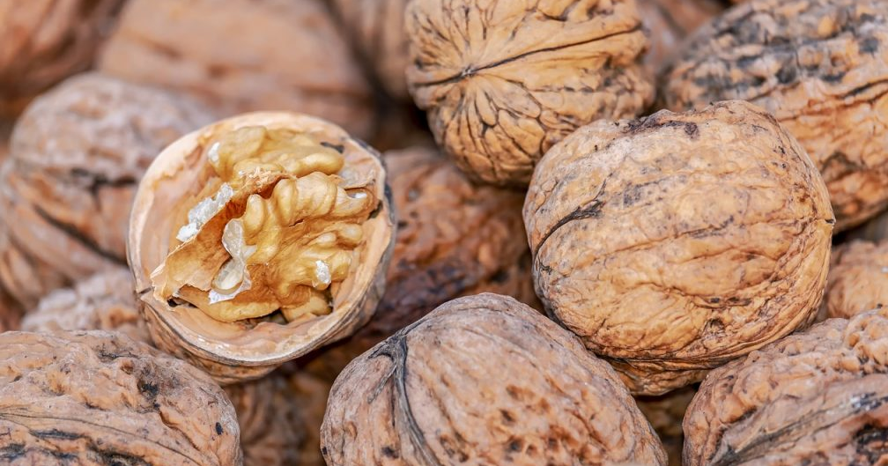
Walnut
Species: Juglans regia
Habitat: garden/ Nidzica/ Poland
Leafes and green shells have :
antibacterial and anti-inflammatory attribute,
helps with diarrhoea
They kill parasites of digestive system
Used as gently laxative
https://www.landini.it/things-to-know-about-walnut-production-around-the-world/

Slide 7
Silver birch
Species: Betula pendula
Habitat: forrest/Nidzica/ Poland
Used in folk medicine as bleach for skin and against freckles,
Has diuretic effect,
Used for :
psoriasis,
nephrolithiasis,
growth of hear

