Slide 1
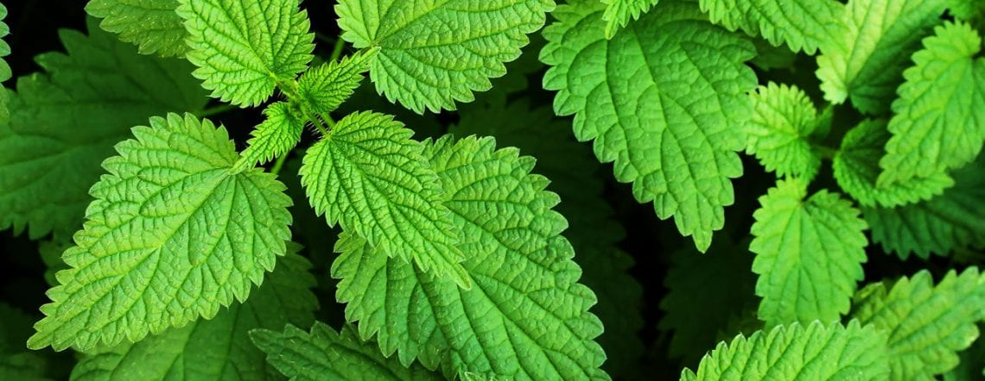
NETTLE
.

Slide 2
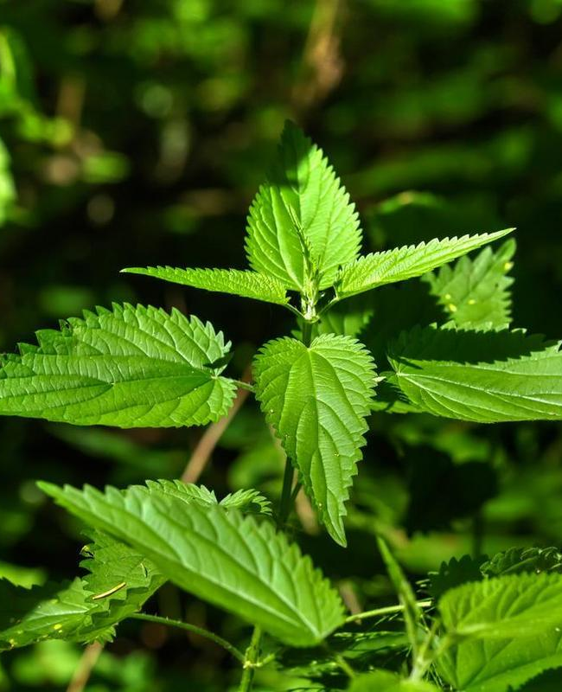
Description of a plant
This plant has been used in the countryside for many years. It was the people of rural areas who were the first to recognize the beneficial properties of nettle. Nettle contains many valuable vitamins and minerals that help in the fight against, among others, with kidney stones.

Slide 3
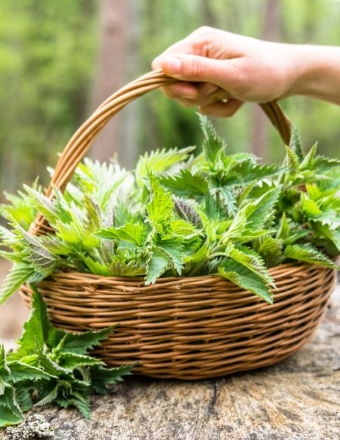
What is the purpose to use it?
Nettle is used in particular in home medicine. Our grandmothers used to cook nettle soup
It has a beneficial effect on: - reduction of allergy symptoms, - lowering cholesterol, - reducing the amount of urea and sodium chloride, - reduces inflammation, - relieves pain, - inhibits hair loss, - dilates blood vessels, - lowers blood pressure, - supports the wound healing process.

Slide 4
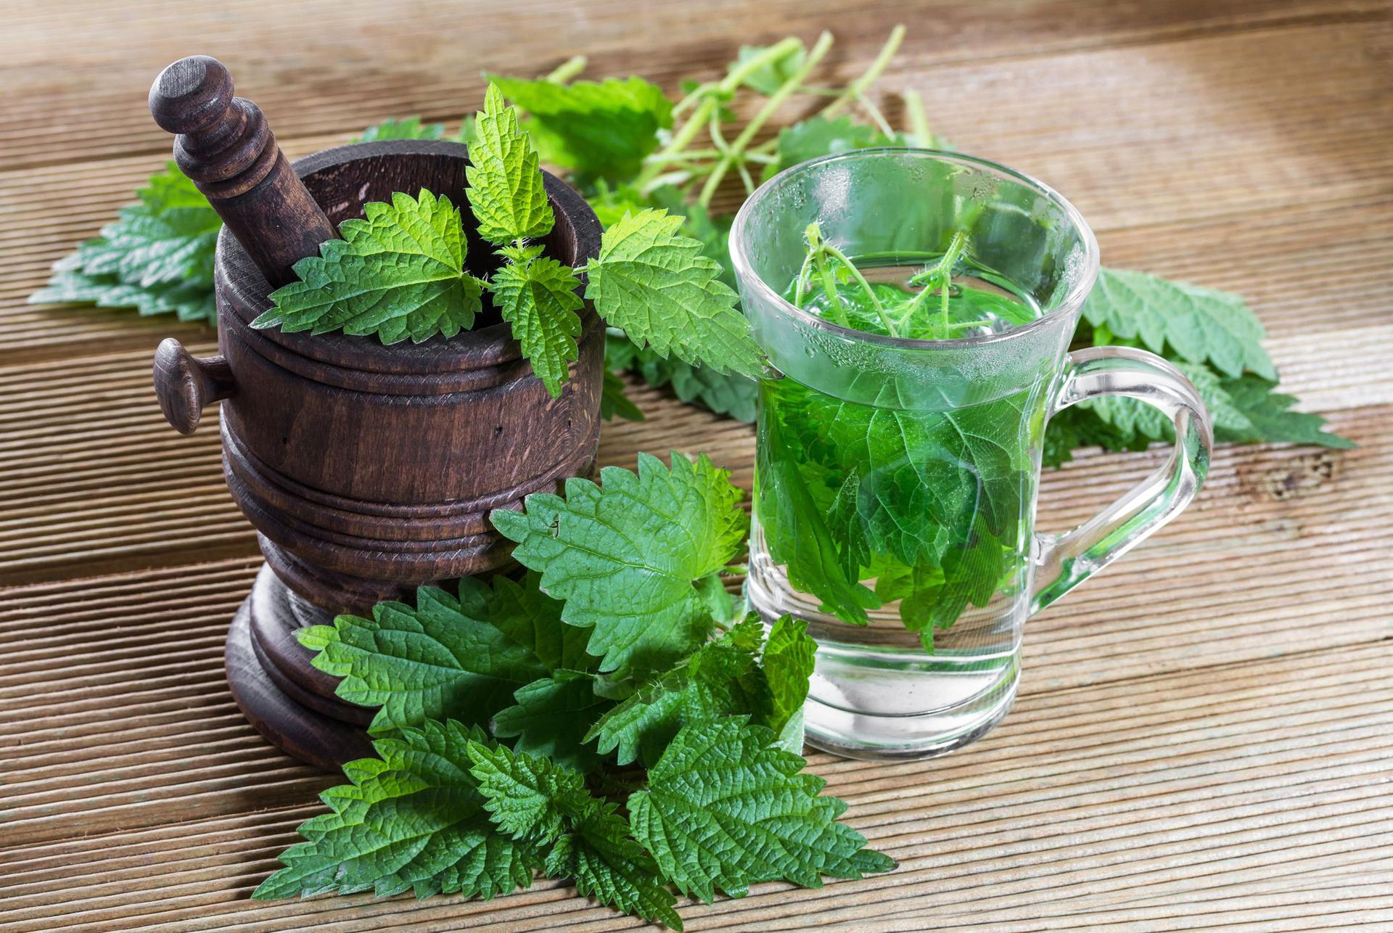
How to use it?
In medicine, both fresh nettle leaves are used (they should be collected before the plant blooms) and the root (it should be dug up in the fall or early spring). More importantly, the entire plant and its juice can also be used. It is recommended to drink the juice from fresh shoots of the plant, especially in the period of increased spring fatigue. This juice strengthens the body.

