Slide 1
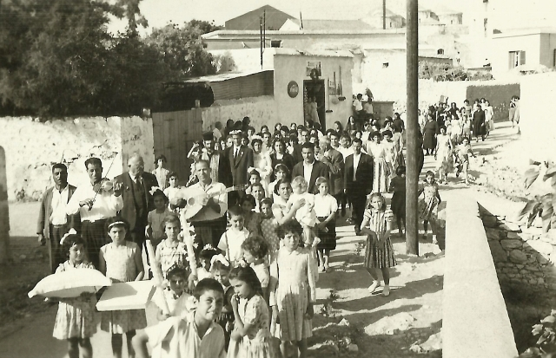
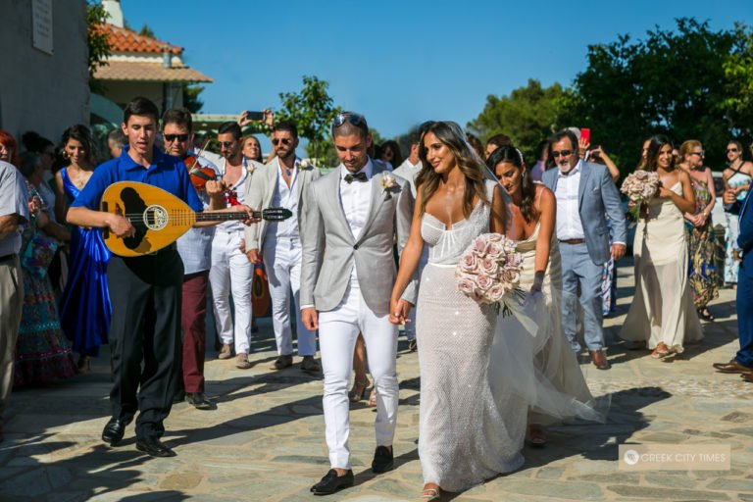
Traditional Cypriot wedding through the years

Slide 2
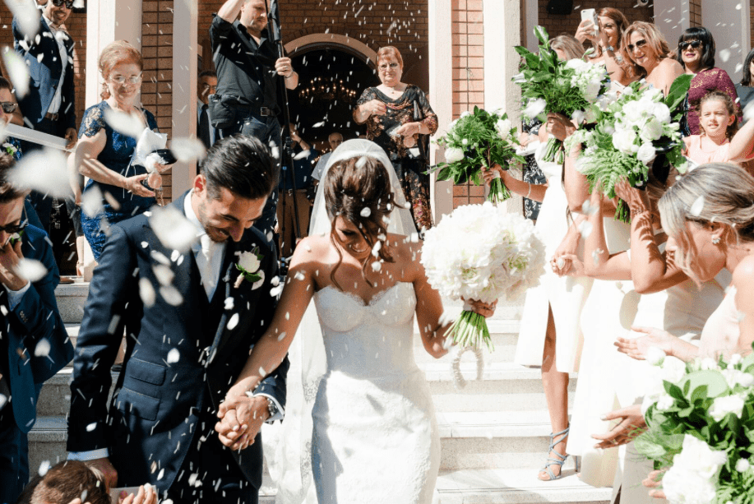
CYPRIOT WEDDING CUSTOMS
⇒ The customs of the traditional wedding are followed by people across Cyprus. Maintaining and transmitting these customs is mainly up to new couples, their families and friends, and whether they decide to incorporate wedding traditions and customs into their wedding day celebrations.
⇒ Some of the traditional activities include:
Wrapping red scarves around the couple (zosmata)
Shaving the groom
Crowning the bridal couple (stefana)
Exchaging the wedding rings
Tossing of the rice
Inscribing the soles of the bride’s shoes with the names of her friends
Pinning money during the newly-wed dance to the bride and groom’s clothing
Tossing of the bride’s bouquet and garter

Slide 3
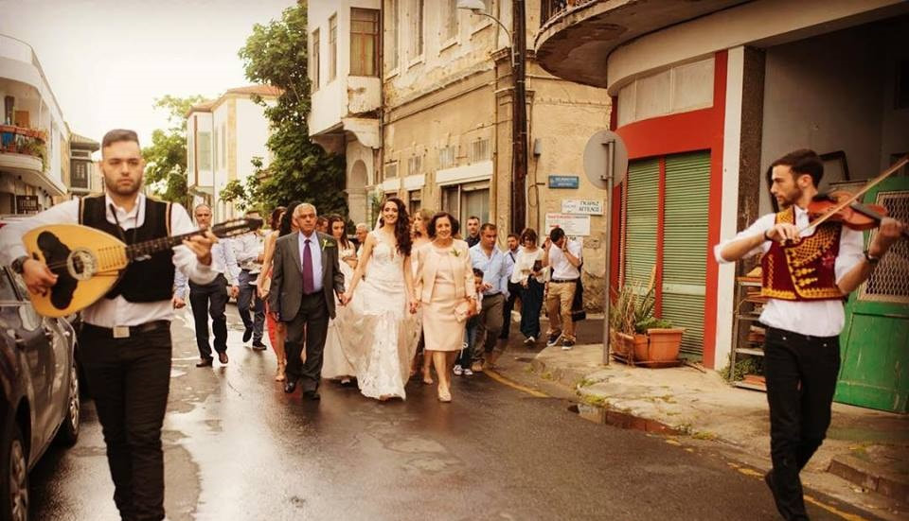
Red Scarves & Shaving of the Groom
On the wedding day, after the bride is all dressed up and ready to leave for the ceremony, her parents, chief attendant and close friends gather around her and wrap a red scarf around her waist in order to symbolize her virginity. All of this happens while musicians delight them with beautiful traditional wedding songs.
Naturally, a similar ceremony takes place for the groom as well, only this time, his best man (koumbaro) proceeds to offer him his last shave, under the loving gaze of his friends and family. After the shaving, the koumbaro dresses the groom in shirt, waistcoat, cravat and dark suit while the music is playing. Afterwards, a red scarf is wrapped around the groom’s waist in order to declare his fertility. The soon-to-be husband now makes his way, along his family and companions to the bride’s house, and then they all head to the church.
Depending on the location of the wedding, a proper change in clothing and traditions is in order. So, if we’re talking about local Cyprus weddings, they usually take place in a village. In this situation, the bride will wear a gown that will cover the top of her arms, and the bridal party will walk to the church. If the wedding takes place in a larger town, then the bride will wear a short or long evening dress. Also she and her father will arrive at the church by car, limousine or a horse-drawn carriage while the guests will eagerly await them outside the church entrance.

Slide 4
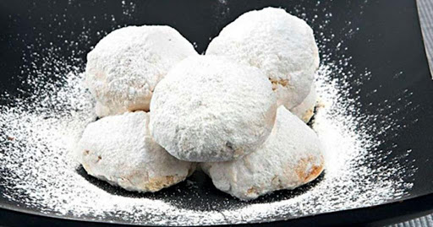
Like any traditional Cyprus wedding, food is an essential part. It contains:
Kourampiedes: a specialty sugared bun served at the reception.
Glistarkes: This is the ceremonial bread which is handed out as a wedding invitation by the bride’s family.
Prosfora: A special bread that is given to the bridal couple by the priest; the prosfora also accompanies the famous Cypriot red wine during the religious ceremony.
Koufetta or sugared almonds are given to the wedding guests by the bride and groom as they leave the church as man and woman.
Resi: is a traditional Cyprus wedding dish. It is made from coarsely ground wheat boiled in meat broth (made only in some villages of Cyprus).

Slide 5
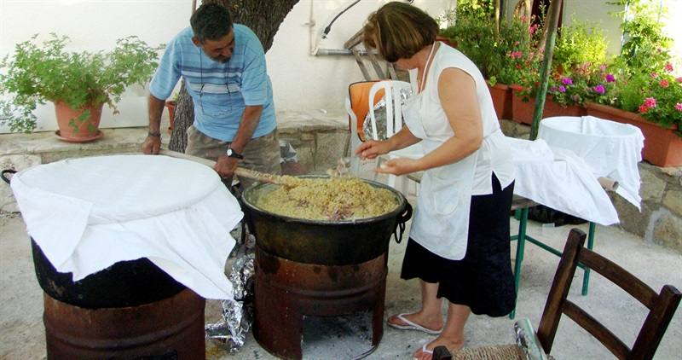
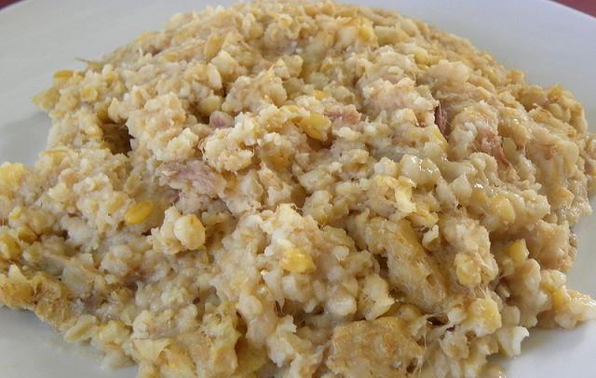
Preparation of the resi:
Resi is a traditional Cyprus wedding dish. It is made from coarsely ground wheat boiled in meat broth. As the preparation method is time-consuming, it is usually carried out as a ritual at weddings, with special attention to every detail. Fellow villagers would help with preparing the resi in the old days, and so they would be invited to gather and wash and beat the wheat.
At first they used to use faoutes (wooden flails) to beat the wheat before turning to grinding it either in a hand-made mill or the village’s olive mill. The wheat would then be left out in the sun to dry, before the bark was removed and it was taken to the village fountain to be washed. First they boil the meat thoroughly and mash it with their fingers to ensure there are no bones left in the broth. They then slowly pour in the wheat and cook over a low heat overnight, so it turns into porridge.
The resi is cooked in cauldrons and the procedure, which demands delicate handling, must always be carried out by someone experienced. Nowadays, this tradition is being kept alive by families mostly in the Paphos and Limassol districts. In fact, Letymbou village in Paphos has established an annual resi festival, aimed at safeguarding the tradition as a part of our cultural heritage.

Slide 6
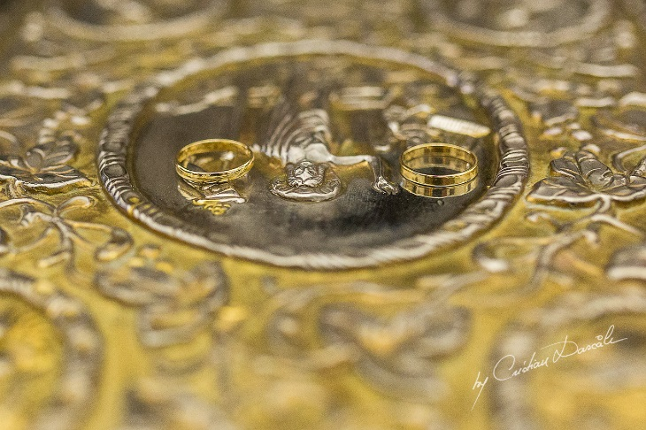
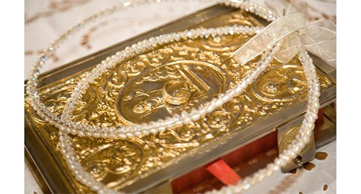
The Ceremony
During the ceremony the priest will serve the couple the ceremonial prosfora (bread) to eat and koumandaria (red Cypriot wine) to drink, symbolizing the wedding at Cana in Galilee. According to the Bible, that is where Christ blessed the marriage and turned water into wine.
After they exchanged their wedding rings, the couple performs the Dance of Isaiah, in which the priest is leading them three times around the table that holds the Gospel and the Cross. The best man and chief bridesmaid walk behind the couple, making sure that the stefana will remain in place.
Upon the completion of the dance, the priest blesses the couple one more time and removes the stefana asksing God to grant them a long and happy life together. Finally, he separates the couple’s joined hands, showing them that it is only God who can separate them.

Slide 7
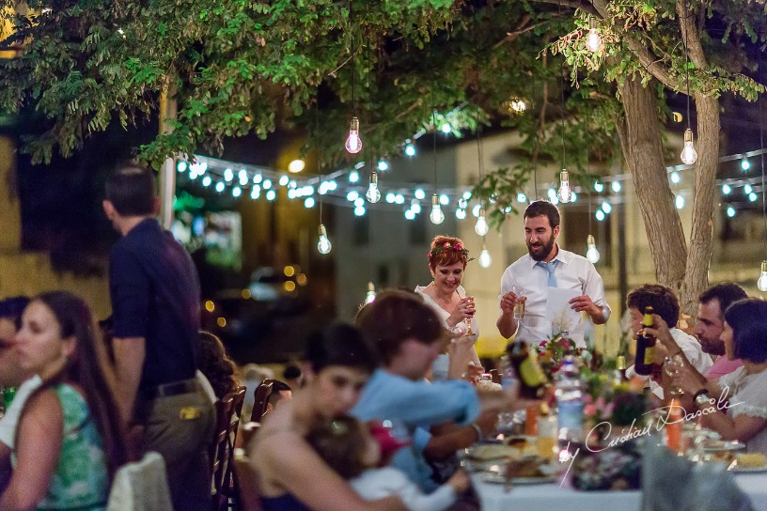
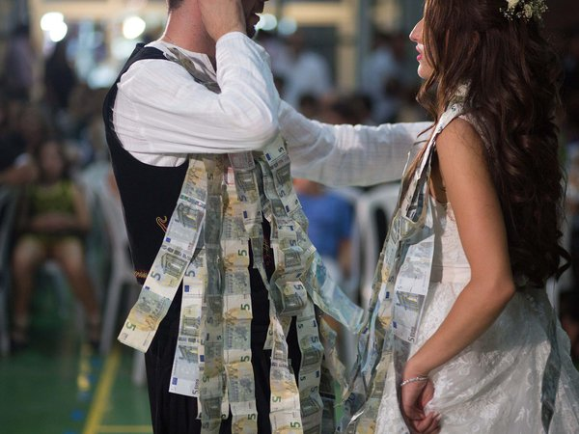
The Reception
If the wedding is successful, the reception may well last until the early morning hours, which is not something uncommon. Between dancing and having the time of their life, guests can enjoy another traditional Cypriot food, such as the koulouria – a ring-shaped cookie or biscuit sprinkled with delicious sesame seeds. Also, early in the festivities, the unmarried friends of the bride will write their names on the bottom of the bride’s shoes. At the end of the evening, when the bride takes off her shoes, only one name will remain written on the sole. That will be the next woman to marry!
Halfway through the reception, the couple walks up to the dance floor to perform their very first dance as husband and wife. In the past the parents and the guests had the chance to pin money to the couple’s clothes in order to help them pay the wedding expenses and start their marriage debt-free. Nowadays the parents and the guests give the money in an envelope as a present.

Slide 8
THANK YOU FOR YOUR ATTENTION Antria Kouta

